Slide 1
High Throughput
High-throughput design is concerned:
  More about the steady-state data rate
  Less about latency (i.e., the time an specific piece of data requires to propagate through the design)
High-throughput design employs the so-called pipeline architecture
  New data can begin processing before the prior data has finished → improving system throughput
Let us consider some examples to illustrate the beauty of pipeline architecture

Slide 2
Low latency
Low-latency design: passes data from the input to the output as quickly as possible
  To achieve the goal, minimizing intermediate processing delays
Often, a low-latency design requires:
  Parallelisms
  Removal of pipelining
  Logical short cuts
Observing the previous pipelined implementation, we can see the possibility of reducing latency:
  At each pipeline stage, the product of each multiply must wait for the next clock edge to propagate to the next stage
  Therefore, we expect that removing pipeline registers → reducing latency

Slide 3
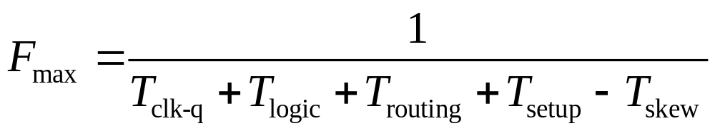
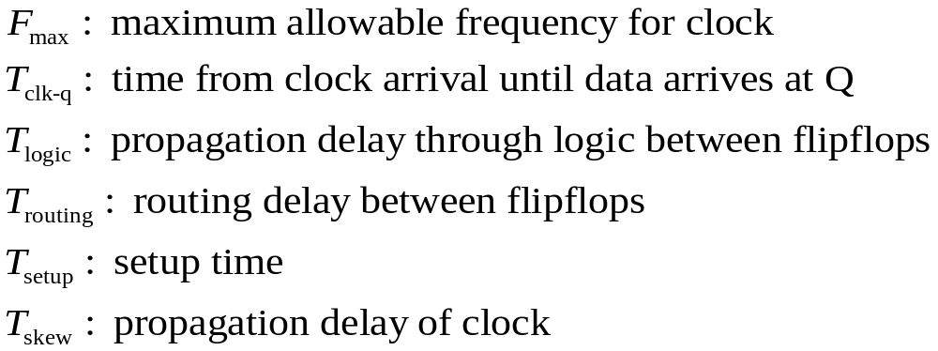
Timing
Timing refers to the clock speed of a design
Maximum delay between any two sequential elements in a design will determine the max clock speed.
Maximum speed, or maximum frequency, is defined as follows:
where

Slide 4
Timing – Add Register Layers
Adding intermediate layers of registers to the critical path is the first strategy for architectural timing improvement
This technique should be used in highly pipelined designs, where:
  An additional clock cycle latency does not violate the design specifications
  The overall functionality will not be affected by the further addition of registers
For example: assume the architecture for the following FIR implementation does not meet timing:

Slide 5
Timing – Parallel Structures
Reorganizing the critical path such that logic structures are implemented in parallel is the second strategy for architectural timing improvement
This technique should be used whenever:
  A function that currently evaluates through a serial string of logic
  But can be broken and evaluated in parallel
For instance, assume that the standard pipelined power-of-3 design discussed above does not meet timing
To create parallel structures:
  Break up the multipliers into independent operations
  Recombine them to get results

Slide 6
Timing – Flatten Logic Structures
Flattening logic structures is the third strategy for architectural timing improvement
This technique is closely related to the idea of parallel structures, but applies specifically to logic that is chained due to priority encoding.
Normally, synthesis and layout tools are not smart enough to break up logic structures coded in a serial fashion
They also do not have enough information relating to the priority requirements of the design
Therefore, it is possible that they are unable to give us a configuration with our desired timing

