Slide 1
What were the total Rental Counts Per Film-Category?
We can see here, depend on each film-category, there will be a column with exact number of its rental count
Notes:
SELECT DATE_TRUNC('month',rental_date) AS mon, staff_id,
COUNT(rental_id)
FROM rental
GROUP BY mon, staff_id
ORDER BY mon, staff_id
/* This query isn’t as complex as yours should be, as there isn’t a join - this is just an example template of what your ending slide should like */

Slide 2
The rental duration for each rent during n-quartile?
The chart doesn’t show the film name, film category. But we can see the rental duration and quartile separated in 2 lines. From the chart, from Q1 mostly the rental durations within 3h, but sightly increasing from Q3, Q4. With Q2 and Q3, there are the mixed from 4h and 5h duration
Notes:
SELECT DATE_TRUNC('month',rental_date) AS mon, staff_id,
COUNT(rental_id)
FROM rental
GROUP BY mon, staff_id
ORDER BY mon, staff_id
/* This query isn’t as complex as yours should be, as there isn’t a join - this is just an example template of what your ending slide should like */

Slide 3
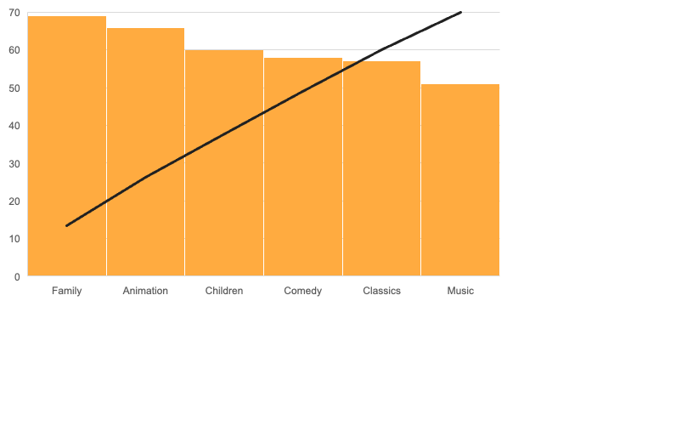
What is the chart for the family-friendly film category, each of the quartiles, and the corresponding count of movies?
From the chart, we can see that, the yellow-pillar depend for film category.
The line is n-quartile, which sightly increasing from 1-4
Left hand columns is the total sum of each film-category
Notes:
SELECT DATE_TRUNC('month',rental_date) AS mon, staff_id,
COUNT(rental_id)
FROM rental
GROUP BY mon, staff_id
ORDER BY mon, staff_id
/* This query isn’t as complex as yours should be, as there isn’t a join - this is just an example template of what your ending slide should like */

Slide 4
We want to find out how the two stores compare in their count of rental orders during every month for all the years we have data for.
The chart showing that both store 1 and store 2 have very close rentals count based on monthly
Notes:
SELECT DATE_TRUNC('month',rental_date) AS mon, staff_id,
COUNT(rental_id)
FROM rental
GROUP BY mon, staff_id
ORDER BY mon, staff_id
/* This query isn’t as complex as yours should be, as there isn’t a join - this is just an example template of what your ending slide should like */

