Slide 1


Emotional
Intelligence in
the Workplace
Presenter:
Vice President, Client Services ESI Employee Assistance Group

Slide 2

Role Play
Five employees have been assigned to work on a project and they are having difficulty working together and completing tasks.
Notes:
Five employees have been assigned to work on a project together. Michelle is the project leader and has assigned the various tasks.
Maureen is sitting at her desk and is very frustrated because she just cannot understand her assignment. She’s flustered, is sighing and slamming her pen down. She asks Michelle for an explanation of the task. Michelle comes over and says she can’t understand why Maureen is not getting this, especially since Michelle has explained it to her 3 times.
Phil is sitting next to Maureen and says to both Maureen and Michelle that he’s told them he’d prefer to work on the spreadsheet that Maureen is doing because he is a detail person and that is his background and why they hired him. Michelle remains inflexible and tells Phil that’s not the way the tasks were assigned and they can’t be changed halfway through. Phil just shakes his head and continues looking down at his laptop.
Meanwhile, Susan and Patty are chatting away while they are supposed to be working on their pieces of the project. Susan is having a conversation with Patty about who they will invite out for dinner from the office.
Susan and Patty begin talking about Maureen saying she doesn’t understand anything and they can’t believe she just sits at her desk for hours but doesn’t get the project done. Patty says Maureen is so disruptive with her sighing and slamming things around.

Slide 3


Role Play Questions
Can you see this scenario happening in the workplace?
What could Maureen have done differently?
Did Michelle and Phil express themselves in a professional manner? What would you say or do that would be more effective?
What can be done about Susan and Patty’s behavior?

Slide 4
Training Overview
Definition of Emotional Intelligence
Why it’s Important
Misconceptions
The Five Competencies: Self Awareness, Empathy, Social Skills, Self-Regulation and Motivation
Case Studies
Strategies to Increase Skills

Slide 5


How Would You Define
Emotional Intelligence?

Slide 6
Definition of Emotional Intelligence
The capacity for recognizing our own feelings and those of others, for motivating ourselves and for managing emotions well in ourselves and in our relationships.
Includes five emotional and social competencies:
Self-awareness
Empathy
Social skills
Self-regulation
Motivation
*Daniel Goleman - author of
“Working with Emotional Intelligence”

Slide 7
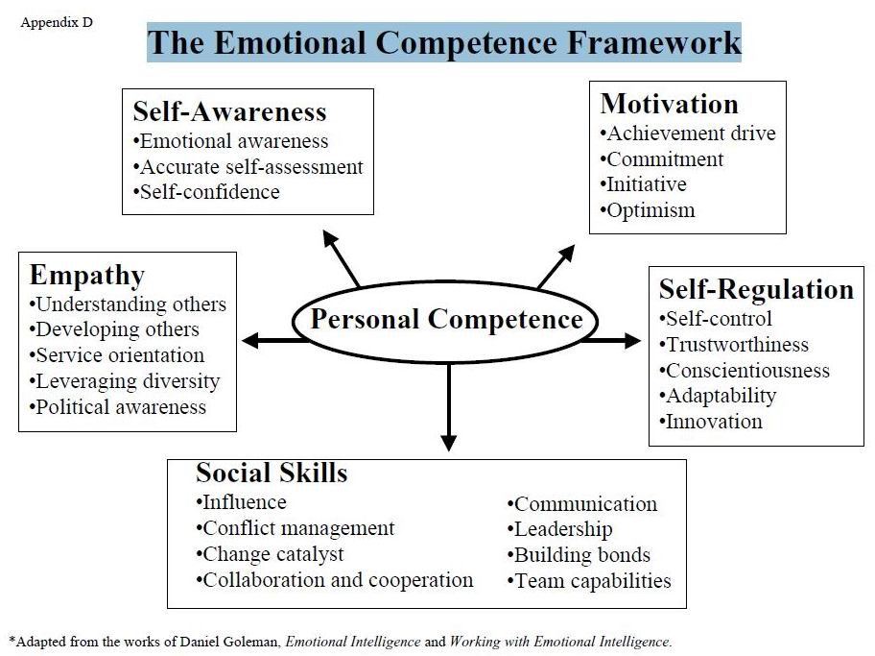
Notes:
This framework comes from the book “Working with Emotional Intelligence” by Daniel Goleman, and it outlines the different internal and external competencies. It is based on how you relate to others, as well as how you regulate/know yourself. We are going to take a closer look at each of these competencies. Daniel Goleman recommends that we have at least one or two strengths in each of these areas, and that we are balanced across the board. I.e. not being that self-aware but having good social skills. However, it doesn’t mean you have low emotional intelligence if you are not strong in all 25 skills.

Slide 8
Why Do You Think Emotional
Intelligence Is Important?
Notes:
Ask to the group to respond. It is important for the organization, for the team and individuals. For success at the highest levels, emotional intelligence is twice as important as cognitive abilities.

Slide 9

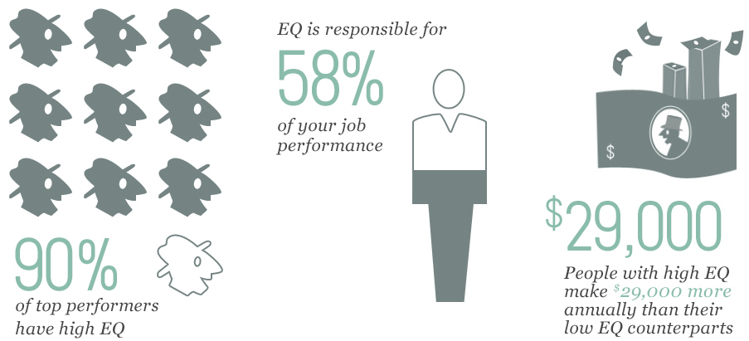
The Case for Emotional Intelligence
Schmidt, M. 2012
Image from talentsmart.com
Notes:
We are being judged not just by how smart we are, but also how well we handle ourselves and others. Emotional intelligence is the strongest predictor of performance, explaining a full 58 percent of success in all types of jobs.
Extra statistics:
CareerBuilder polled 2,662 private sector U.S. hiring managers about their priorities. The statistics clearly show emotional intelligence (EI) is highly valued: 34 percent of hiring managers are placing greater emphasis on emotional intelligence when hiring and promoting employees post-recession
71 percent value emotional intelligence in an employee more than IQ
59 percent of employers would not hire someone who has a high IQ but low EI
For workers being considered for a promotion, the high EI candidate will beat out the high IQ candidate 75 percent of the time

Slide 10
Misconceptions About
Emotional Intelligence
It’s just about being nice to everyone and thinking positively
It means letting emotions run freely, or being completely robotic
Women are better at it
It’s connected with intellectual or cognitive abilities
It’s fixed or genetic
Notes:
Studies have tracked people’s level of EI through the years show that people can get better and better in these capabilities as they grow more adept at handling their own emotions and impulses, at motivating themselves and at honing their empathy and social skills.
These are not just “soft skills.” If for example an individual in an organization is talented technically, but can’t get along with others, is critical, demanding, rigid, etc. he/she may end up one day out of a job.

Slide 11

Self-Awareness
Recognize your emotions early on and their effects
Know your strengths and limits
Have a strong sense of self-worth and capabilities
Notes:
Emotional awareness starts with being attune to the feelings that are present and recognizing how these emotions shape what we PERCEIVE, THINK, and DO. Also understanding that our feelings affect those we deal with. To be successful in this area, it is recommended that you take time for mental pauses, introspection, or solitary reflection

Slide 12
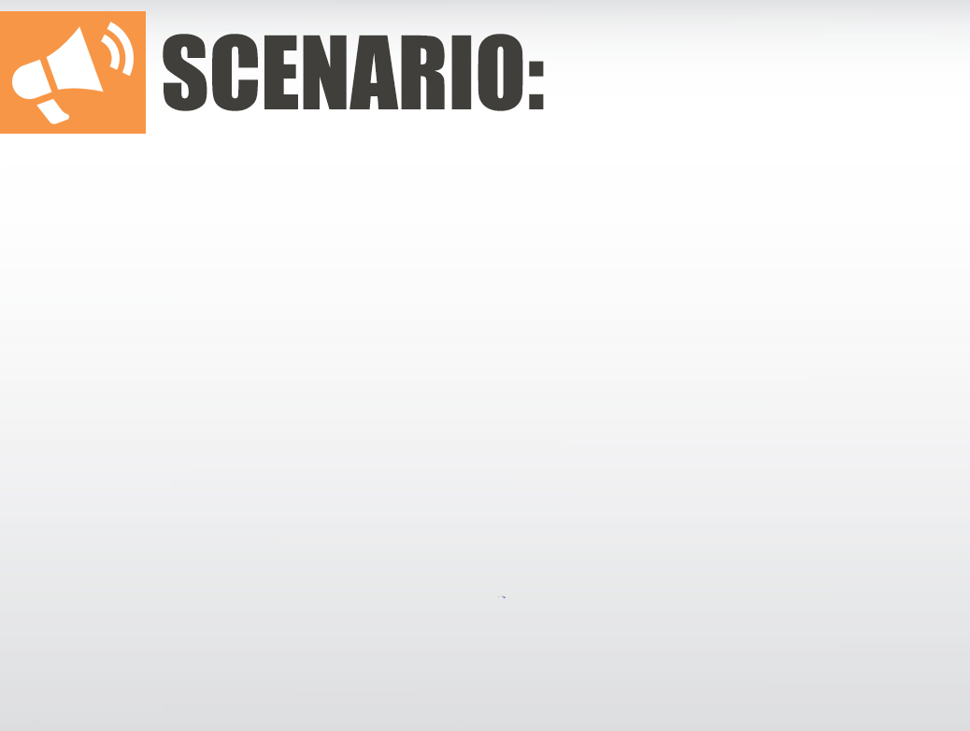

Self-Awareness
Case Study #1
Joe rushed in and interrupted Tonya during a meeting to get information he had been waiting for. In a stressful-demanding tone, Joe stated that he hadn’t heard back from Tonya and he must have it before the end of the day.
If you were Joe, how would you handle this differently?
Should Tonya and/or the meeting members respond or say anything?
How do you think Tonya views Joe’s behavior?
How do you think Joe’s interruption was perceived by members of the meeting?
How do you think this will effect Tonya and Joe’s working relationship?
Notes:
Joe needs to become more self-aware of how he is perceived. He can come across as demanding. He needs to recognize his triggers so he can change his approach and respond more effectively. Joe needs to work on better understanding how his behavior affects others work and emotional stress. Joe can do some reality testing and visualize the consequences before hand. If this behavior is chronic it will cause major issues for the team, such as low productivity, low morale, gossip, not wanting to work with others, etc.
Joe’s behavior has a ripple effect which in turn can be a factor in an unhealthy work environment.

Slide 13
Self-Awareness Checklist
Take time for mental pauses, introspection, and solitary reflection regularly
Be attuned to and identify your emotions early on
Accept that emotions are normal
Exclude negative judgements
Ask why
Recognize how your emotions shape what you PERCEIVE, THINK, and DO
Learn from your experiences and mistakes
Recognize where you need to improve
Be open to candid feedback and new perspectives
Show a sense of humor and perspective about yourself
Notes:
Slow down. Often naming your emotion can be helpful. If you are someone who is always “on edge” or anger gets in your way, you need to learn to manage this so that you are not always reacting. It can be harmful to your health and to your career.
None of us is completely aware of how we come across to others. We have to rely on the feedback of our peers, friends, and mentors. To have your friends play the role of honest mirror, let them know when you are seeking candid, critical, objective perspectives. Make your friend or colleague feel safe to give you an informal, but direct and honest view. This can mean saying something like, “Look, I am actually asking you as a friend, please just be straight with me on this matter. Okay?“

Slide 14
Internal Dialogue
Irrational Thinking |  | Realistic Thinking
"He can't say that to me – he has to give me more respect!" |  | "I would like him to treat me more respectfully but he's not doing it. So I'll just have to move on from this. As there's no law that says he must “treat me respectfully.”
"I absolutely must do well on this presentation!" | VS | "I want to do well, and I'll be well prepared and do my very best on it."
"I have to give this presentation exactly as it's written." |  | "If I miss a line, it won't be the end of the world.“ The concept is sound and well developed already."
Rewrite the thoughts that script your emotions
Notes:
Reframe harsh thoughts with challenging questions. For example, if you made yourself anxious by thinking, "I absolutely must do well in this presentation," you could respond like this, "Why must I do well in the presentation? What is the evidence that I must? I want to do well, of course. But how does it follow that because I want something I have to have it? Who made my wish the Universe's command?"
After you have successfully used challenging questions to show yourself that your demands - your musts, shoulds, oughts, and have tos - are unreasonable, restate them as realistic preferences - "I want . . . ," "I wish . . . ," "I would prefer . . . ." In this way you can rewrite the thoughts that script your emotions.

Slide 15
Empathy
Genuinely sense and understand people’s feelings and needs
Actively listen to others perspectives
Sensitive to group differences
It is something that you can learn at any age!
Notes:
Understanding is key to having empathy.
Understanding is the difference between knowing something and truly empathizing with it. If you catch yourself saying, “I know, but,” a lot, take that as an indicator that you should pause a bit more. When someone tells you about an experience that’s not your own, take some time to mull over how your life might be different if you experienced that on a daily basis.

Slide 16

Empathy
Case Study #2
Mark and Joyce are having a conversation at work. Joyce reports to Mark.
“This situation I am dealing with has proven to be especially difficult. It’s involved exceptionally long hours and it’s really tested my patience and stamina. I feel like it’s never going to be enough and my main workload is starting to suffer. Frankly, I’m exhausted.”
Joyce
Mark
“Joyce, you know that we’re super busy right now and we’ve had these crunch times many times before this. Everyone has to go the extra mile here. I’m super-stretched too but this is how it works here. If I can’t have two days off this weekend, then we all have to grin and bear it. I don’t see any way I can help you right now. And it might be some time before we get back to normal. By the way… how far along are you on the other project? It has to be completed by Monday.

Slide 17
Empathy
Case Study #2 - Questions
What was Joyce trying to communicate to Mark, and what did she want from him?
What do you think was going through Mark’s mind?
How do you think Joyce reacted to Mark’s comments, and what will she think as a result of this conversation?
How would you handle this differently? If you were Mark, what would you say instead?
Do you think it’s possible to express too much empathy?
Is it possible to pretend to be empathetic?
How can you learn to be empathic even if it’s not your natural tendency?

Slide 18
Empathy Checklist
Acknowledge feelings first, and let the other person know they have been heard (even if you can’t change the situation)
View the situation from the standpoint of the other person
Probe and listen to hear what’s important
Verbalize and/or normalize their concerns
Show you take the other person seriously by making eye contact or nodding
As a supervisor/mentor, give timely coaching, and offer assignments that challenge and foster a person’s skills
Notes:
It can be particularly difficult to show empathy for someone else, when you don’t agree with them, if they are annoying to you, or if you want them to know that you are in charge. However, it is still important to acknowledge that you understand their feelings first before moving on. It will make the conversation and situation much easier.
Put yourself inside of the other person’s “shoes” so you can experience what that might be like. Sense what the other person is worried about even if s/he can’t express it in words. Show that you take them seriously by making eye contact and nodding. Simply recognizing, understanding and verbalizing the other person’s concerns can significantly improve the situation. Acknowledge their emotions and the difficulty of the situation even if you don’t have a solution.

Slide 19
Social Skills
Nurture instrumental relationships
Build rapport and keep others in the loop
Work with others towards a shared goal
Find common ground
Be persuasive
Notes:
It’s not about being book smart, it’s about being heart smart.

Slide 20
Social Skills
Case Study #3
Emily’s boss, Kate, has asked that she partner with Ron, the most negative employee in the department.
How should Emily respond?
Roll her eyes, sigh, and say “Okay, whatever.”
Ask her boss for strategies on how to collaborate best with Ron based on his working style.
Have a discussion with Ron letting him know she doesn’t want his negativity to affect the project.
All of the above.

Slide 21
Social Skills
Case Study #3 - Questions
How could Kate, Ron’s boss, approach him about his negativity?
How could Ron help himself to be perceived as less negative?
How can Emily be more effective in dealing with Ron?
Notes:
Answer to question 1: “I’ve noticed that sometimes you are quick to shoot down an idea and you phrase your criticism harshly. How could you work to soften your approach and offer more suggestions? Let’s discuss ways in which you could do that.”
Answer to question 2: Saying good morning, smiling. For example: Counting to 10 before he says a negative comment.
Answers to question 3: Redirecting his negativity and asking for alternate suggestions on the project. Call her EAP to discuss strategies in dealing with negative coworkers.

Slide 22
Social Skills
True or False?
Having strong social skills and being easy to talk with are both signs of high emotional intelligence.
Notes:
Discuss: Is this a hard and fast rule?….probably not, but having strong social skills and knowing how to talk with and get along with others can be a contributor to success both at work and in your home life. Are there people out there who do not have good people skills who are successful in business? Yes, but it most cases, it is a huge advantage in life to have good social skills. It means you have empathy and can read other’s signals well.
If you are more introverted, it doesn’t mean you wont be successful. You don’t have to be the most talkative and outgoing individual to have good EI social skills.

Slide 23
Social Skills Checklist
Value others
Balance a focus on task with as much attention to relationships
Collaborate and openly communicate
Promote a friendly, cooperative climate
Share credit with team members
Handle and influence other people’s emotions effectively
Notes:
These people tend to see the relationship as at least as important as the task in hand: they value people as much or more as the activity.
They actively collaborate, sharing plans and ideas, and work together to build a better whole. In doing so, they promote a cooperative climate in which everyone is invited to contribute. They also actively seek out opportunities for collaborative working.
When good team-workers are in a team, the team performs better. They draw other members of the team in, and help them to collaborate. They build a team identity and therefore foster commitment. They may do this from a leadership role, or they may be a subordinate, but having people like this in a team is crucial to success.
People who are persuasive, or who have influence, read the emotional currents in a situation, and fine-tune what they are saying to appeal to those involved.

Slide 24

Self-Regulation
Managing disruptive emotions and impulses effectively
Flexibility in handling change and challenges
Being open to new information or perspectives
Notes:
Employees with high level of self-regulation, are able to keep themselves in-check, and don’t necessarily respond immediately when they feel strong emotions.

Slide 25


Self-Regulation
Case Study #4
Amy receives an email stating that she will not be able to take vacation time when she requested it. Amy kicks her desk and immediately turns to Jason, her co-worker that sits next to her and says loudly:
“I just received a nasty gram from that jerk in benefits saying that I can’t take vacation time. This is ridiculous! I am a senior employee and should be able to take time off when I want too! This sucks!!”
Jason agrees with Amy, and they continue discussing their complaints for a while – getting more and more riled up.
Questions:
If you were Amy, how would you handle this? What about Jason?
How do you think their conversation will effect the rest of the co-workers that can hear them?
What other consequences do you anticipate this can cause in the short and long term?

Slide 26
Self-Regulation
Alternate Case Study
Sandra, the director of the department enters the conference room where several employees are sitting and waiting to discuss a customer service issue. Sandra is visibly upset with a red splotchy face. She begins with a litany of questions for everyone, and doesn’t hold back.
What would be the best response by an employee:
Gary fumbles and stutters while trying to explain the reasons for the mistakes. He blames another department for the issue.
Amy keeps quiet and hopes Sandra calms down soon.
Helen looks at Sandra and addresses her clearly in an even tone, acknowledges the problem, and calmly explains the situation.
Dylan silently fumes and thinks of ways to get back at Sandra.
Rose defensively says “Sandra please calm down. This isn’t a big deal. Everyone here works very hard with our customers, and I don’t understand why you are so angry.”
Notes:
#3 is the correct answer. Helen is able to control her emotions and feelings and remain calm and composed. Instead of becoming overly stressed by this situation, Helen was able to use her wise mind to engage in self-talk to think about how she can make this situation better.
The others reacted to this situation instantaneously with emotion (the amygdala hijack). Amy and Rose responded with more of a “fight or flight” reaction.

Slide 27
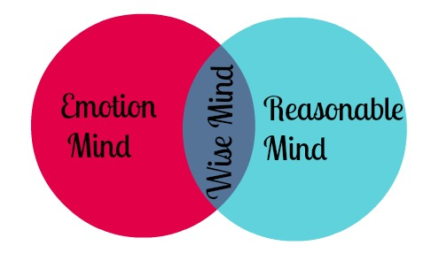
Self-Regulation
Learn to balance between the rational and emotional centers of the brain.
Notes:
When we get very emotional about something, our ability to make wise decisions can fail.
A person who is 'hot-headed' is considered to be rather emotional and likely to make rash decisions, while a person with a 'cool head' makes thoughtful, considered decisions. We talk about mental processes being 'clouded' by emotional states.
Emotion is a chemical state in our brains which we experience as basic 'feelings'. Those same chemicals inhibit our higher cognitive capabilities and limiting what we call rational thought. The more you practice mindfulness the better you will be able to balance between rational and emotional and use your wise mind/sweet spot.

Slide 28
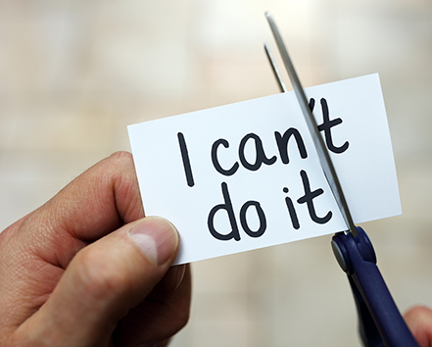
Motivation
Strive to improve or meet a standard of excellence
Personal drive to achieve goals
Show initiative and optimism

Slide 29
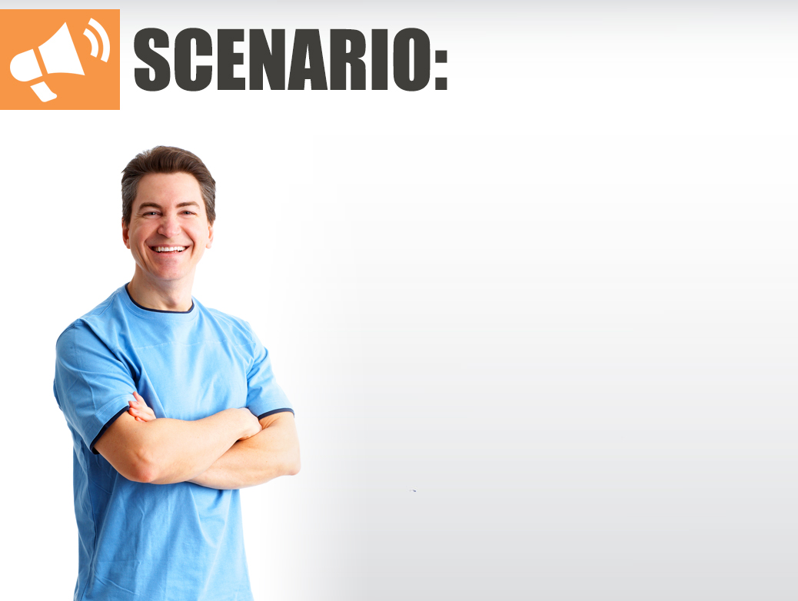
Motivation
Case Study #5
Lately Eduardo has been dealing with a lot of changes at work, de-moralized co-workers, and some personal problems at home. This past week, Eduardo has noticed that he hasn’t been his usual self, and that it is probably impacting others. Eduardo reminds himself that his role in the organization is really important, and that many people depend upon him. This helps Eduardo to begin to get back on track.
What are some other strategies that Eduardo can use?
What are the characteristics of a motivated person?
What can you do to stay motivated if there are barriers like organizational change?
Notes:
Eduardo is able to motivate himself by feeling good about the long term outcomes he has experienced in the past. He is very passionate about his career and future advancement within the organization. Eduardo doesn’t expect to receive outside feedback.
Sometimes you have to block out the noise and do what you need to. A paycheck isn’t the only motivator. . You have to practice this type of self-talk, and know that there are days where you need to let yourself off the hook. Also, know when to get outside help like the EAP.

Slide 30
Motivation Checklist
Develop a sense of personal satisfaction/fulfillment from being interested in what you are doing
Seek out other motivated individuals
Use realistic self talk and remind yourself of previous positive experiences
Set challenging goals and take calculated risks
Persist despite setbacks -- which are viewed as a manageable circumstance
Operate from hope of success
Know when to access outside resources or help to get back on track
Notes:
It’s much easier to cope with stress and long hours if you generally enjoy the work, and find tasks that you gain fulfillment from.
When thinking about what motivates you to perform a certain task, think about both intrinsic and extrinsic motivators – if you have trouble getting motivated to perform specific tasks it may be useful to write them down and list the motivators for each.

Slide 31
Emotional Competencies
 | Successful | Failure
Self-Control | Composed and calm under pressure | Moodiness and angry outbursts
Conscientiousness | Taking responsibility, fixing the problem and quickly moving forward | Acting defensive, covering up and assigning blame
Trustworthiness | High integrity and concern for others | Undermining the process and trying to get ahead at any cost
Social Skills | Empathic, tactful and show consideration | Lack empathy, abrasive, arrogant, and/or intimidating
Building Bonds | Cooperative and appreciate diversity | Insensitive and manipulative

Slide 32
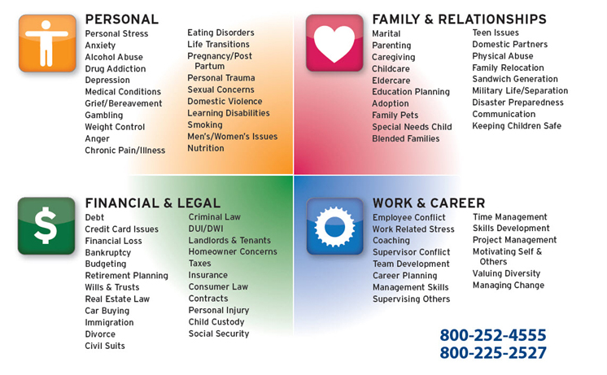

Slide 33

Questions & Discussion

