Slide 1
Emotional Intelligence
An introduction

Slide 2

Emotional Intelligence
AIM
To introduce and establish the importance of emotional intelligence
OBJECTIVES
To be aware of the different models of EI
To take away a quick win; a simple action point
To recognise how five EI components function

Slide 3
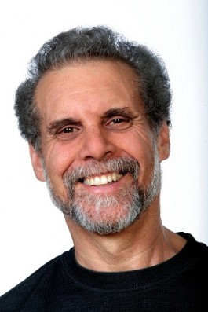
Background
EI has always been here, we’ve just got better at defining it
scholarly articles show EI was known about 3,000 years ago
the phrase ‘emotional intelligence’ was coined by John Mayer and Peter Salovey in 1990
Daniel Goleman: ‘go to’ author and specialist in the field
EI (sometimes referred to as EQ) is about abilities that are distinct from - but complementary to - academic intelligence (IQ)
(1995) Emotional Intelligence: Why It Can Matter More Than IQ

Slide 4



Myths
Sheldon
Penny
Rachel

Slide 5
EI Models
Ability – emotional perception, use of emotion, understanding emotion and managing emotion
Trait – how you perceive your emotional abilities, is deeply subjective and is resistant to measurement
Bar-on – differentiating between the ability to affect others, regulating own emotions and an ability to cope
Genos - transforming negative into productive characteristics and comprises seven dimensions
Mixed – self-awareness, self regulation, motivation, empathy and social skills…

Slide 6
EI Mixed model
Self Awareness
Self Regulation
Motivation
Empathy
Social Skills
Five categories

Slide 7

EI Mixed model
emotional awareness – an ability to recognise your own emotions and their effects
self-confidence – sureness about your self worth and capabilities

Slide 8

EI Mixed model
self control – managing disruptive impulses
trustworthiness – maintaining standards of integrity
conscientiousness – responsibility for your own performance
adaptability – handling change with flexibility
innovation – being open to new ideas

Slide 9
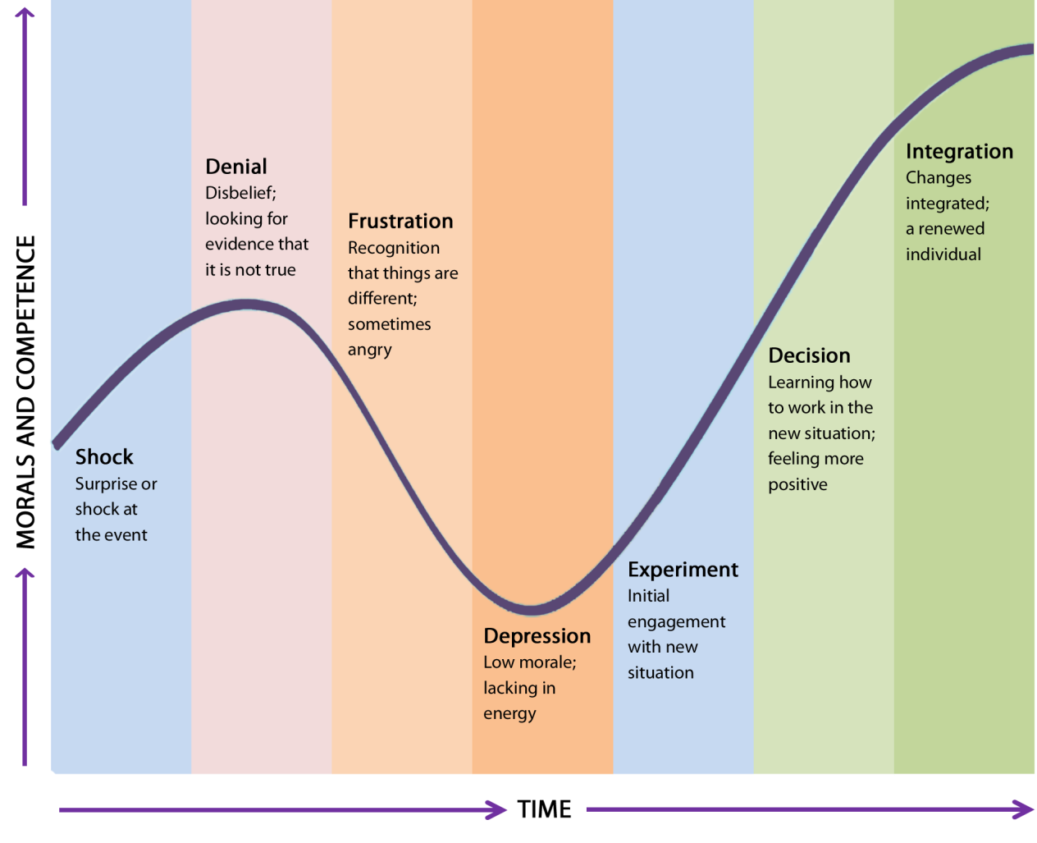
The Kübler-Ross Change Curve

Slide 10

EI Mixed model
achievement drive – constant striving to improve or meet a standard of excellence
commitment – aligning with the goals of your group or organisation
initiative – readying yourself to act on opportunities
optimism – pursuing goals persistently despite obstacles or setbacks

Slide 11
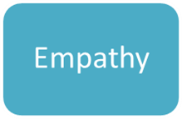
EI Mixed model
service orientation – anticipating, recognising and meeting clients’ needs
developing others – sensing what others need to progress and strengthening their abilities
diversity – cultivating opportunities through diverse people
political awareness – reading your group’s emotional currents
understanding others – discerning the feelings behind the needs and wants of others

Slide 12

EI Mixed model
connection – building effective relationships
influence – effective persuasion tactics
communication – clear messages
leadership – inspiring and guiding
catalyse – initiating and managing change
partnership – realising shared goals
conflict – understanding and resolving problems

Slide 13

EI Quick win
Lets challenge ourselves to make a positive EI change by starting to do, or by doing more of:
making others comfortable in social situations
differentiating between having an emotion and doing something about it
replacing selective listening with attentive listening
focusing on body language and translating its meaning
helping someone through the change curve
altering your response to setbacks and obstacles
noticing!

Slide 14
Emotional Intelligence
AIM
To introduce and establish the importance of emotional intelligence
OBJECTIVES
To be aware of the different models of EI
To take away a quick win; a simple action point
To recognise how five EI components function

Slide 15
Adrian Nash 01376 337063 www.radius360.co.uk

