Slide 1


Movie Recommendation System
Phạm Trung Hiếu 20176755

Slide 2

Outline
Dataset, Cleaning & Feature Extraction
Problem Formulation
Regression Model
Classification Model
Future Improvement

Slide 3
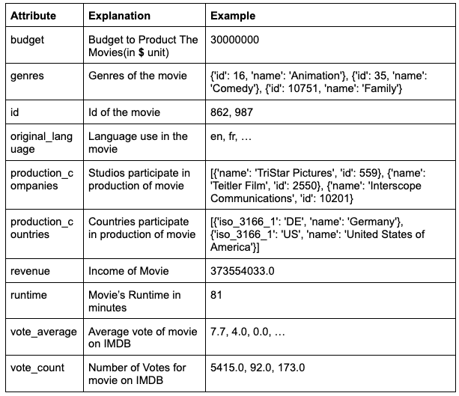
Dataset
Kaggle: The movies dataset
4 files:
movies_metadata.csv

Slide 4
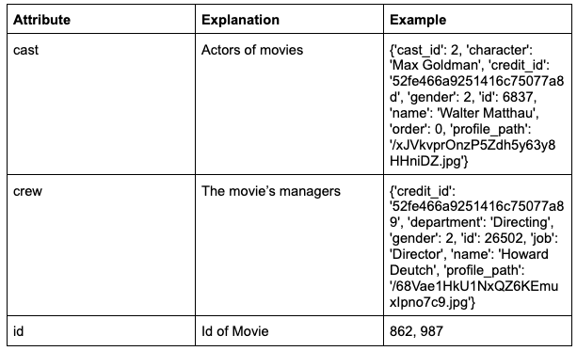
Dataset
Kaggle: The movies dataset
4 files:
movies_metadata.csv
credits.csv

Slide 5
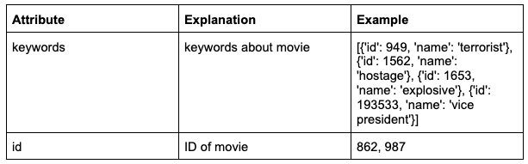
Dataset
Kaggle: The movies dataset
4 files:
movies_metadata.csv
credits.csv
keywords.csv

Slide 6
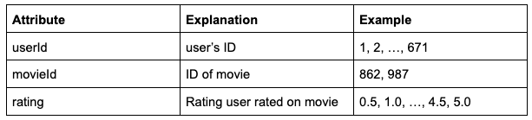
Dataset
Kaggle: The movies dataset
4 files:
movies_metadata.csv
credits.csv
keywords.csv
ratings_small.csv

Slide 7
Cleaning
Drop non-integer values
Drop the duplicate IDs
Merge 3 files movies_metadata, credits, keywords into 1 final dataset
Fill in null-value fields in the final dataset

Slide 8
Feature extraction
We have a module name FeatureExtractor.py to extract features (Create profile for each movies)
This module uses genres, production_companies, production_countries, cast, crew, keywords columns to generate features including Action, Adventure, Animation, Comedy, Crime, CastsRank, keywordRank, etc..
The generation is based on the revenue of movies to determine how famous casts, crews, production_companies are and for genres, it is one encoding.

Slide 9
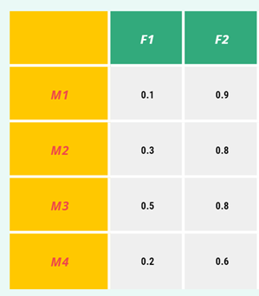
Problem Formulation
Given profile of movies M
M is a matrix shape of (n_movies, n_features + 1)
We add one more feature with all 1.0 values as intercept factor.
For example: (2830, 39) using ratings_small.csv and profile of movies.

Slide 10
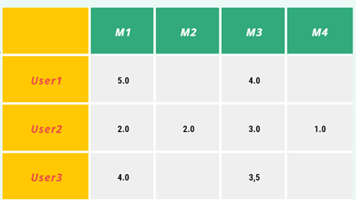
Problem Formulation
Also given R is ratings of users to movies
R is matrix with shape of (n_users, n_movies)
R with shape (671, 2830)
For classification model R will be the number in which 1 represent movies that user may rate more than 4.0 point (should recommend to user) else 0.

Slide 11
Problem Formulation
Given the two matrixes, we will find U and b
U and b represent user's model (interests)
U with shape (n_users, n_features) as (671, 38)
b with shape (n_users, 1) as (671, 1) is biased

Slide 12

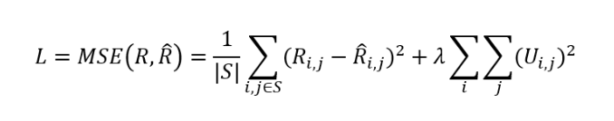

Regression Model
First predict R_hat
Then calculate Mean Squared Error Loss:
Compute derivatives L (loss) w.r.t U to learn the model

Slide 13
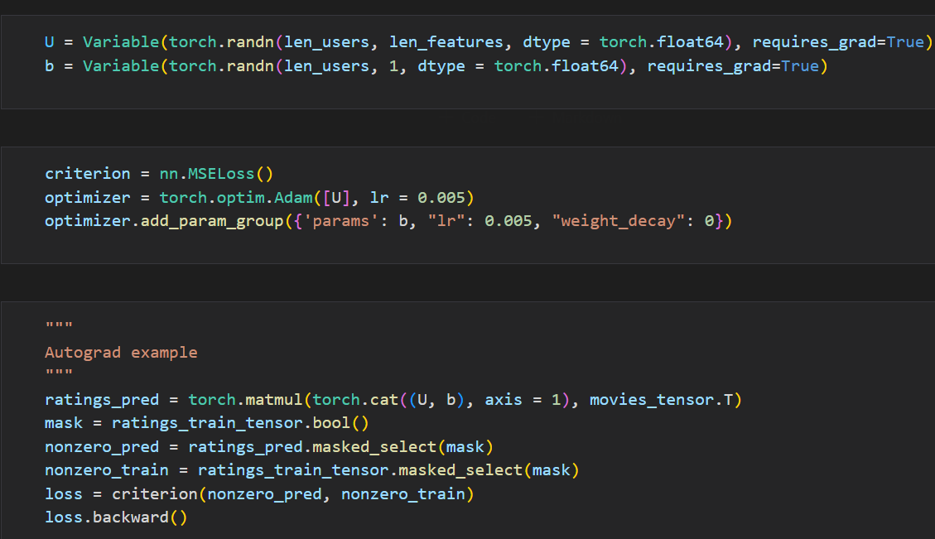
Regression Model Implementation in Pytorch

Slide 14
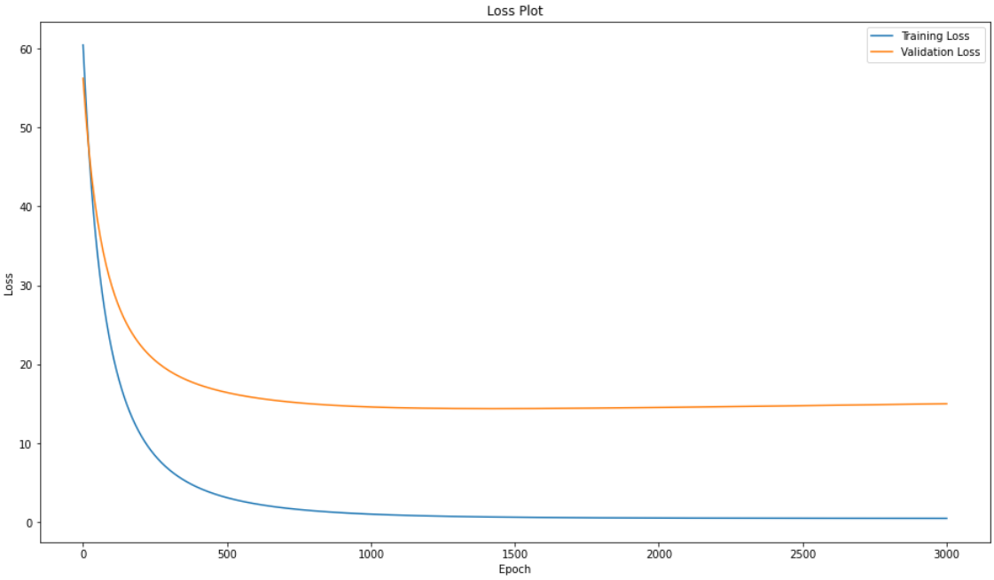
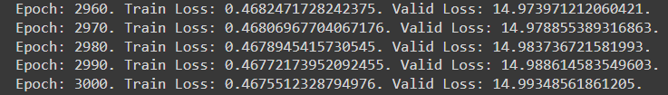
Regression Model Result
Using Hold-out 0.7/0.1/0.2
Try 3001 EPOCH
without regularization
Min loss Train Set: 0.467
Min loss Validation Set: 14.37
RMSE Valid: 3.79
Seem that overfitting.

Slide 15
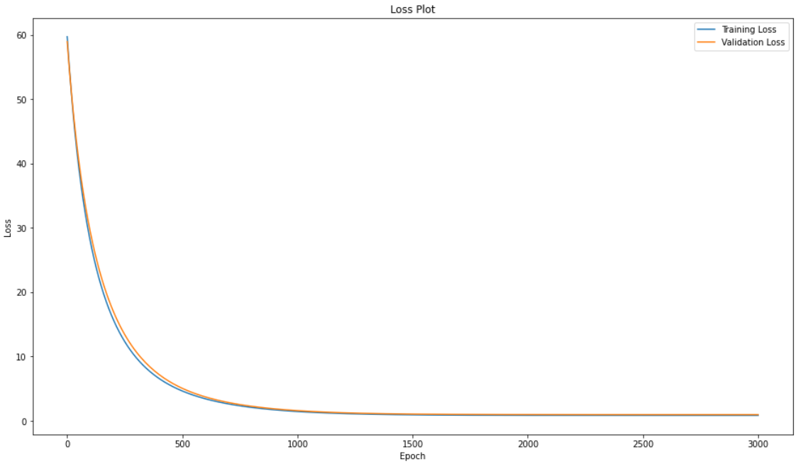

Regression Model Result
Try 3001 EPOCH
with regularization
of 0.05 on U
Min Loss Train Set: 0.85
Min Loss Valid Set: 0.96
RMSE Valid: 0.98

Slide 16
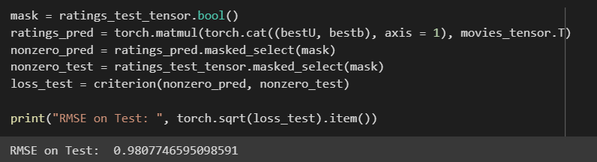
Regression Model Result
Test phase:
RMSE on Test: 0.981

Slide 17
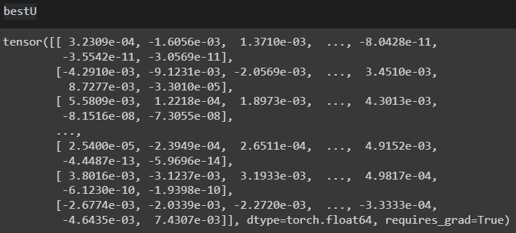
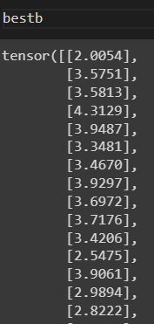
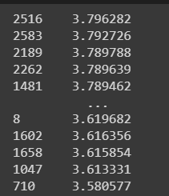

Regression Model Recommend
Recommend phase:
Experiment on user 10
Sort the predicted value
Problem of real value, not
natural, biased control the
prediction

Slide 18


Classification Model
Now let R be the matrix of should recommend to user. 1 represent that user may rate 4.0 or more than 4.0 to that movie.
First predict R_hat by
Then calculate Binary Cross Entropy Loss
Compute derivatives L (loss) w.r.t U to learn the model

Slide 19
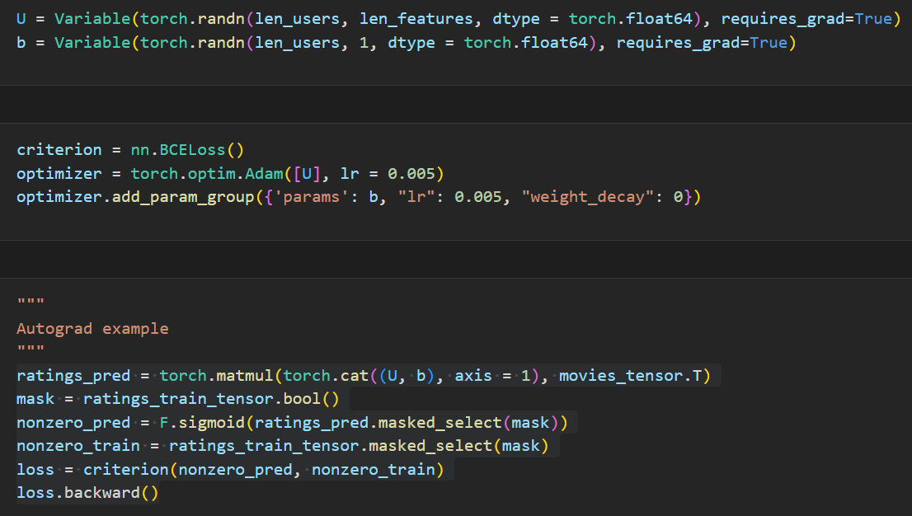
Classification Model Implementation in Pytorch

Slide 20
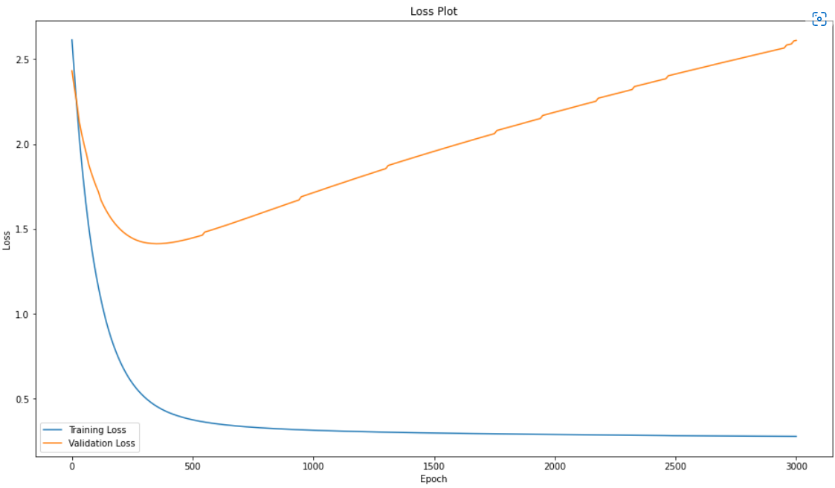
Classification Model Result
Using Hold-out 0.7/0.1/0.2
Try 3001 EPOCH
without regularization
Loss increasing rapidly after
EPOCH 500.
Min Loss Valid: 1.5

Slide 21
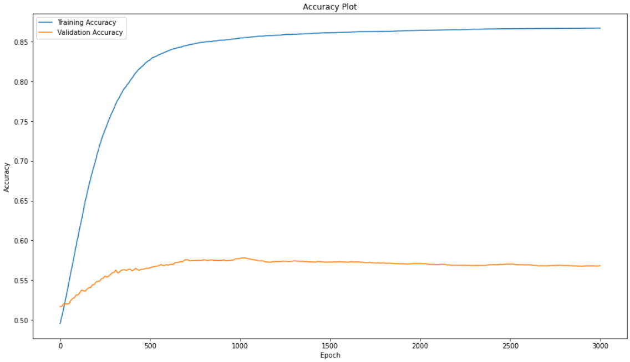
Classification Model Result
Max Valid Accuracy: 0.572

Slide 22
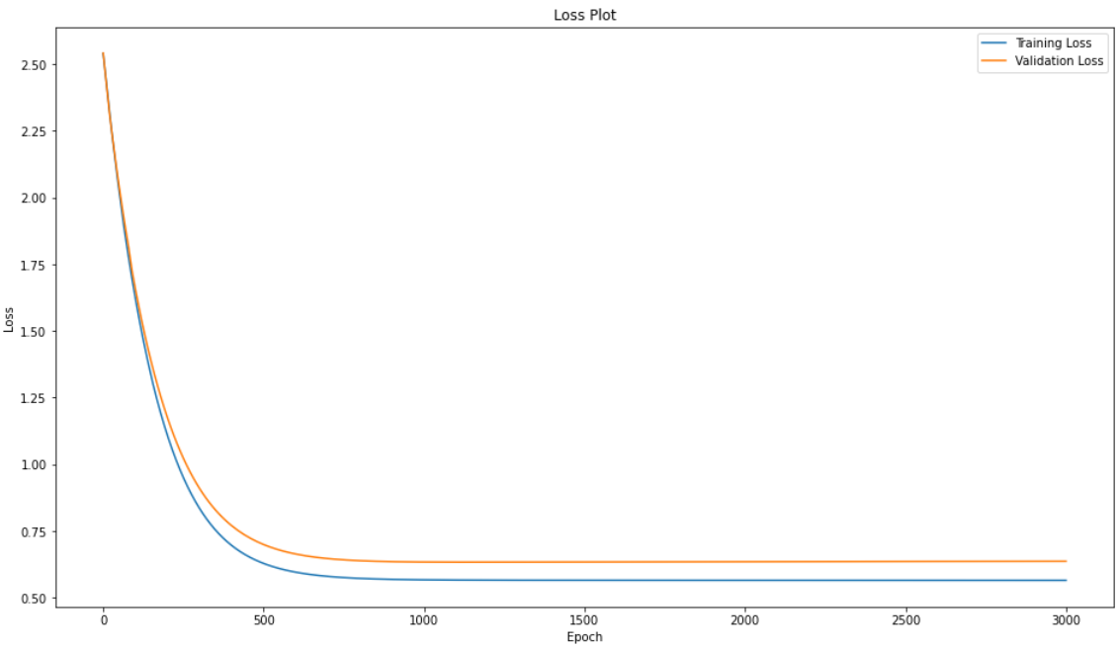
Classification Model Result
Try 3001 EPOCH
with regularization
of 0.05 on U
Min Loss Valid: 0.63
We have reduced overfit.
And improve accuracy validation
from 0.572 to 0.651

Slide 23
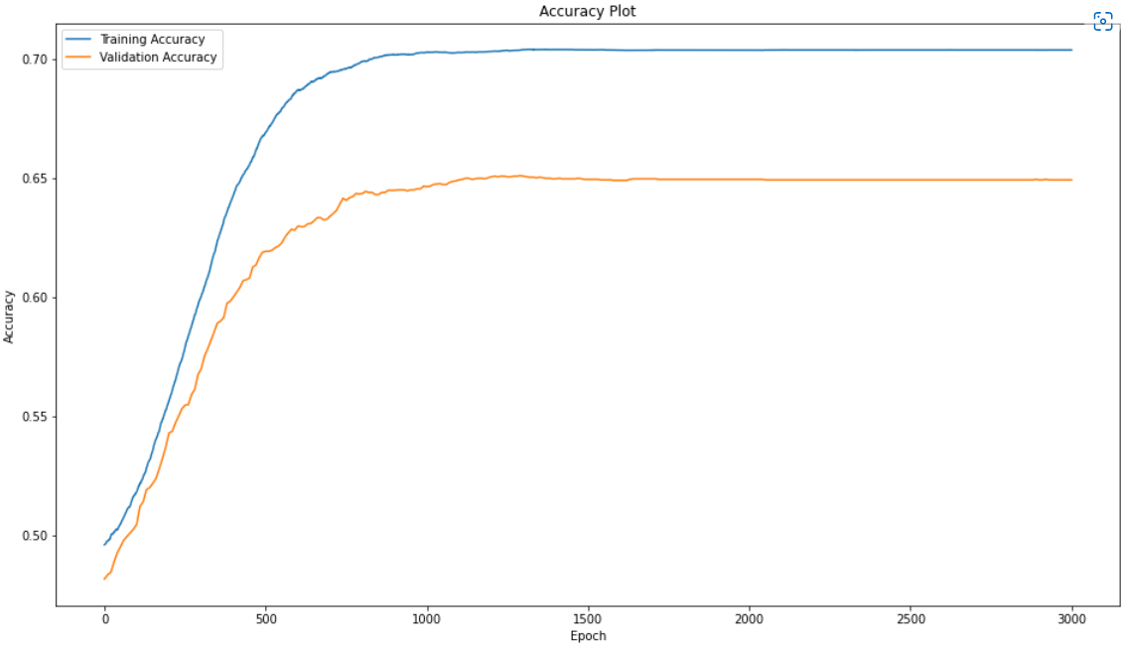
Classification Model Result
Max Valid Accuracy: 0.65

Slide 24
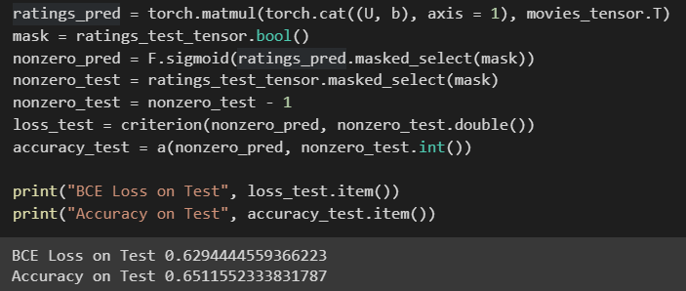
Classification Model Result
Test phase:
Test BCE: 0.629
Test Acc: 0.651

Slide 25
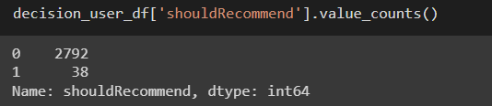
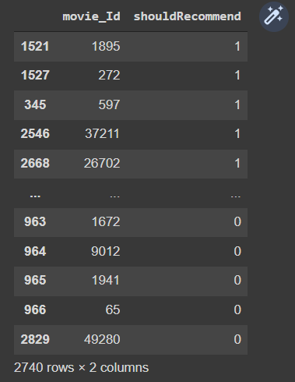
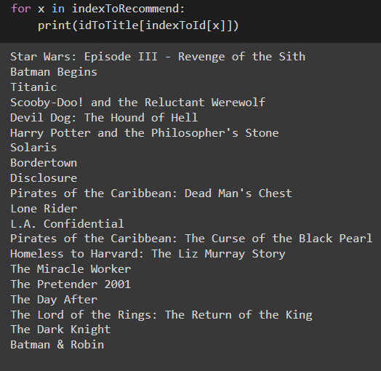
Classification Model Recommend
Recommend phase:
Experiment on user 22
Sort the predicted value by descending order
Choose in 38 movies to
Recommend user

Slide 26
Future Improvement
Matrix Factorization
Since Content-based is hard to create hand-engineered features
Try on larger dataset
Due to memory and optimizing memory problem, we only use the ratings_small.csv dataset. Later will try on ratings.csv dataset.
Multiclass Classification Model
Since Regression model rating prediction is ambiguous, later we will research on a multiclass classification model.

Slide 27

THANK YOU !

