Slide 1
DEEP LEARNING PRESENTATION
Optical Character Recognition Experiment

Slide 2
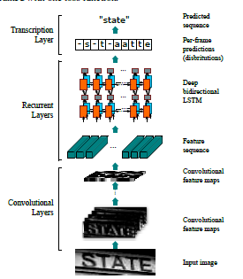
Theoretical background
Model name: CRNN
Idea: Use Convolutional Network to extract feature sequences from an Image, then use RNN network to predict per-frame characters from those sequences, finally use a transcription layer to convert prediction to text strings
Loss Function: CTC
Status: State of the art on three OCR datasets

Slide 3
Theoretical background
Pretraining models on: SynthText Datasets
Number of images: 8 millions cropped Images (41GB)
Not constrained to a lexicon.

Slide 4
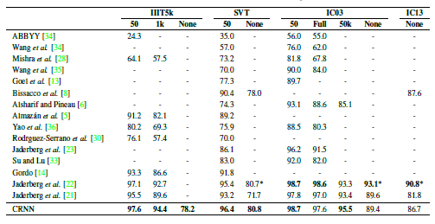
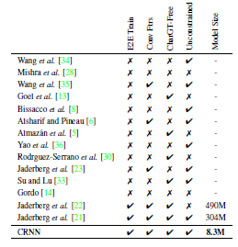
Theoretical background
We can use text processing techniques to further boost the performance
Lightweight models

Slide 5
Experiment details
Language | English | Vietnamese
Dataset | ICDAR2015 (cropped images) | Self-collected
Training examples | ~10000 | ~1800
Test examples | ~5000 | ~400
No. of character labels | 67 | 154
Max. acc without transfer learning | 59.36% | 3.7%
Max. acc with transfer learning | 70.5% | 34.18%

Slide 6
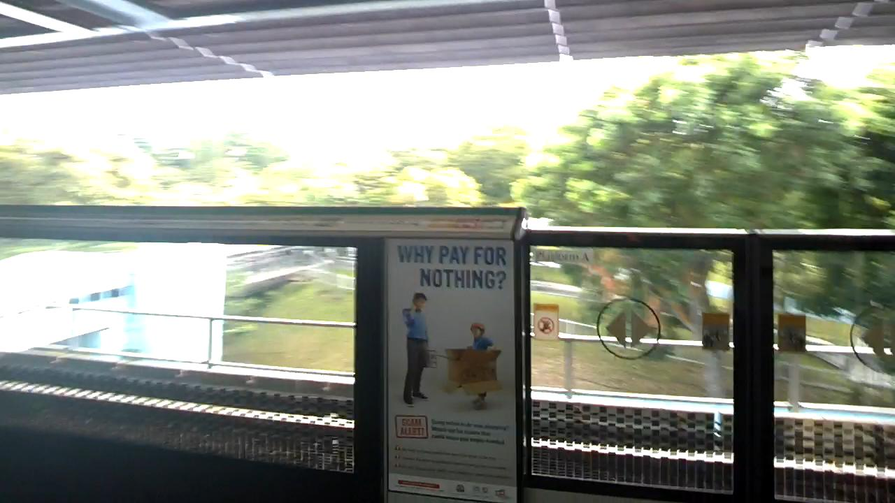
Experiment details

Slide 7

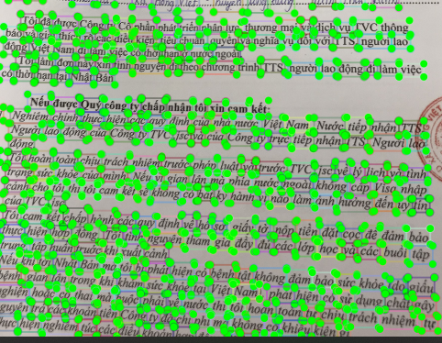



Experiment details

Slide 8
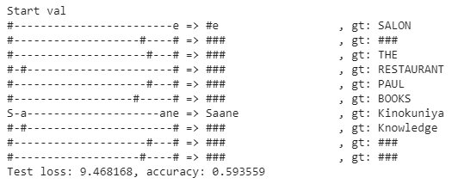
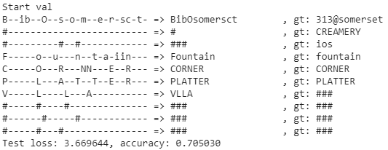
Experiment details English
Without transfer learning
With transfer learning

Slide 9
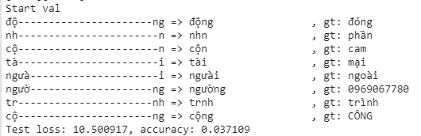
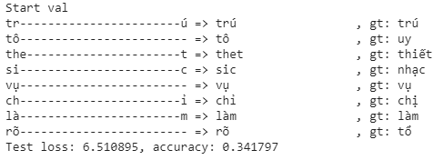
Experiment Details Vietnamese
Without transfer learning
With transfer learning

Slide 10
Possible future expansion
Increasing Performance: more data, Vietnamese Lexicon
Complete Detection and Recognition Pipeline
Big data storage solution

Slide 11
THANK YOU FOR LISTENING!

