Slide 1
NEWS-BASED STOCK TREND PREDICTION
By Pham Minh Hieu

Slide 2
Nội dung chính
I. Introduction
I.1. General Idea
I.2. Measurement of sentiment
I.3. Possible approaches
II. Implementation
II.1. Dataset
II.2. Code example
II. Results, drawbacks and lesson learned

Slide 3
I. INTRODUCTION

Slide 4

I.1. General Idea
According to Investopedia:
The overall consensus about a stock or the stock market as a whole (crowd psychology).
Bullish sentiment: when prices are rising.
Bearish sentiment: when prices are falling.
Effects on the stock market: Short-term price movement.
Who utilize: Day traders and technical analysts (as opposed to fundamental analysts).
The only two types of market sentiment that matter

Slide 5

I.2. Measurement of sentiment
Traditional, price-based measurement:
VIX (Fear Index)
High-Low Index
Bullish Percent Index
Moving Averages
New measurements:
Based on NLP techniques to extract sentiment data:
What to measure: News, social media…
Famous example: Ravenpack (U.S)
“Tesla stock plummets after Elon Musk smokes weed on live show…”
-NBCNews-

Slide 6
I.3. Possible approaches
APPROACH 1
Calculate news sentiment separately, and come up with a sentiment ratio (bullish/bearish)
Based on sentiment ratio to predict price (financial modeling)
APPROACH 2
Let news be input, and price movements be output.
Build an end-to-end prediction model.
Example: WorldQuant
I CHOSE THIS

Slide 7
II. IMPLEMENTATION

Slide 8
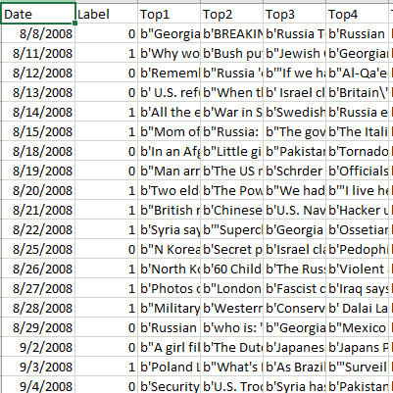
II.1. Dataset
Collected by author Aroon7sun on Kaggle.
A labelled dataset.
Consists of financial and economics news titles on about 2000 trading days (roughly 8 trading years*).
Each trading day is a training record.
The input is the top 25 news titles occurring during that day.
The output is the movement of the DJIA** index, with 0 denoting DJIA falling, 1 denoting the index rising or staying the same.
* A trading years only consists of 255 days, excluding weekends and the end-of-fiscal-year days.
** Dow Jones Industrial Average: The weighted-average stock price of top 30 US. Companies.

Slide 9



II.2. Code example
Train_test_split: 70/30
Embedding methods: Tfidf, Token_Count
Models experimented: Logistic Regression, Support Vector Machine

Slide 10
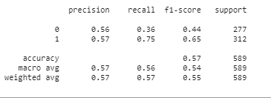
II.3. Results, drawback and lessons learned
Highest accuracy achieved: 57%
Drawback:
+ Inability to find a better dataset.
+ Inability to incorporate advanced techniques.
+ Still not considered news content, only stopped at news titles.
+ Fail to find a suitable dataset for approach 1.
Lesson learned:
+ How to carry out a solo machine learning project.
+ Need to improve at: Machine Learning Mastery, learn data crawling.
+ To improve the current problem: Dictionary Learning?
+ Try new techniques: semi-supervised?
My final results

Slide 11
BETTER LUCK NEXT TIME! THANK YOU FOR LISTENING!

