Slide 1
Indoor Monitoring Weather App
Group 9:
Lê Quốc Khánh – 21520978
Hoàng Trí Tường – 21521654
Trần Trọng Hiếu - 21520859

Slide 2
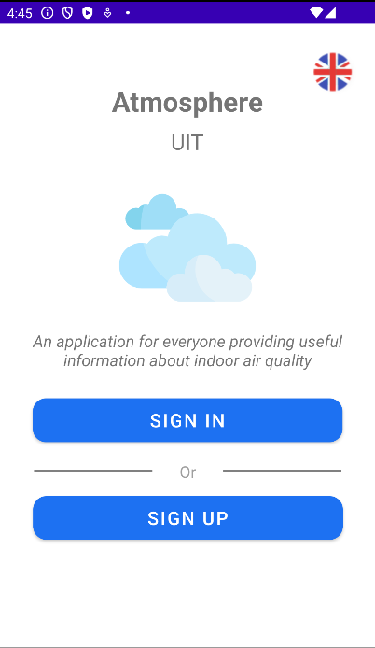
Screen Opening

Slide 3
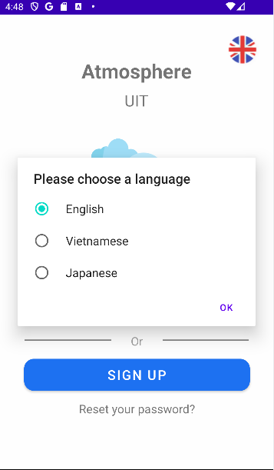
Supported Languages
English
Vietnamese
Japanese

Slide 4
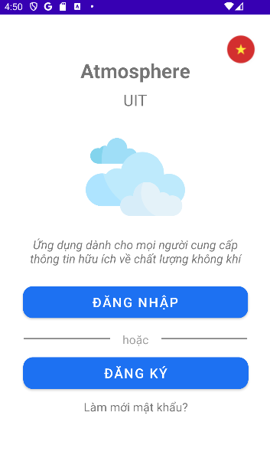
Supported Languages
English
Vietnamese
Japanese

Slide 5
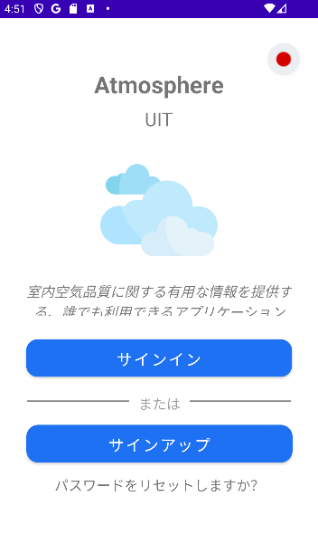
Supported Languages
English
Vietnamese
Japanese

Slide 6
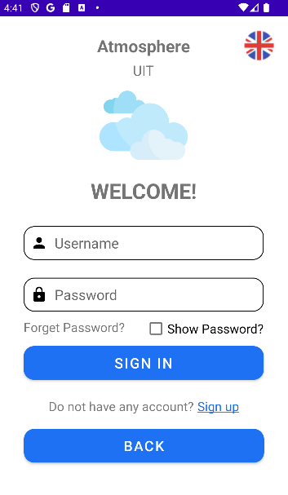
Screen Sign In

Slide 7
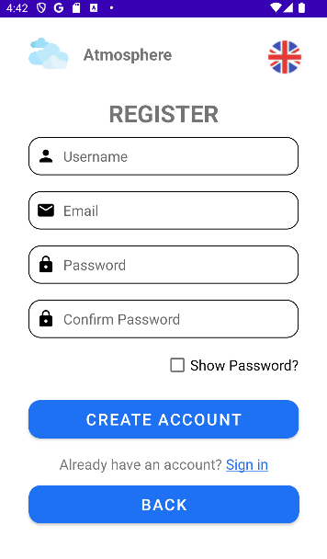
Screen Sign Up

Slide 8
MAIN CONTENTS
01
02
03
04
Screen Chart
Screen Home
Screen Features
Screen Account
Show line chart of each attribute with chosen time frame
View map with different devices
Some features of weather
User details and some functions

Slide 9
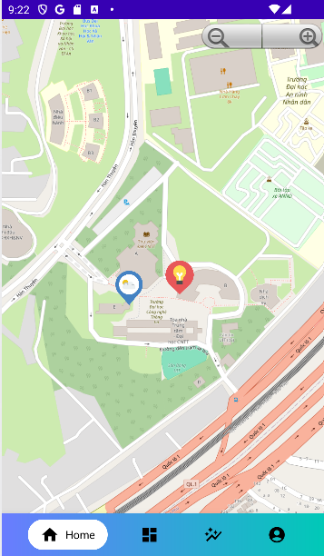
Screen Home
Use osmdroid library to create Open Street Map on Android: https://github.com/osmdroid/osmdroid
Two pins marking 2 devices based on asset ID.
Support zoom in/out buttons.
Use API: https://uiot.ixxc.dev/api/master/map

Slide 10
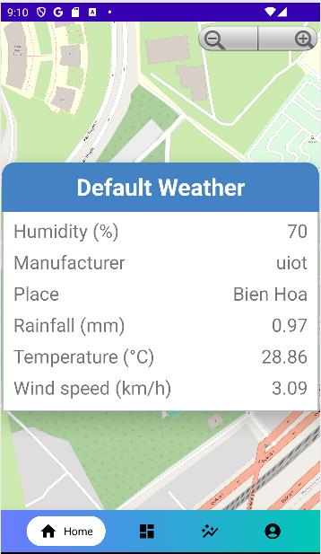
Screen Home
Default Weather Dialog
Use API: https://uiot.ixxc.dev/api/master/asset/{assetId}
Asset ID is 5zI6XqkQVSfdgOrZ1MyWEf.

Slide 11
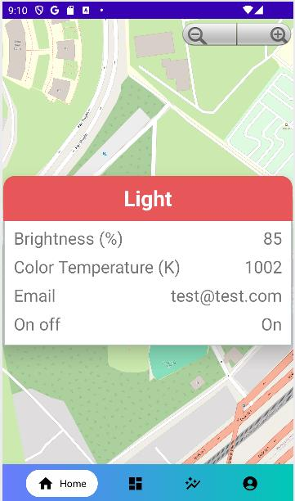
Screen Home
Light Dialog
Use API: https://uiot.ixxc.dev/api/master/asset/{assetId}
Asset ID is 6iWtSbgqMQsVq8RPkJJ9vo.

Slide 12
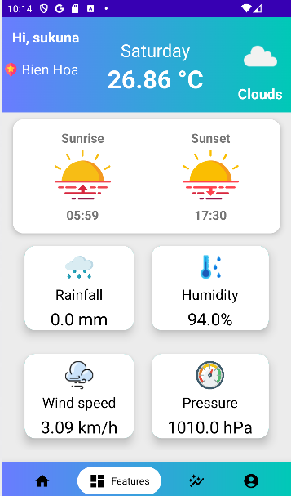
Screen Features
Use Open Weather Map’s API: https://api.openweathermap.org/data/2.5/weather?appid=63971ca355e720759dffc1bcedc8edb2&lon=106.803&units=metric&lat=10.8698
Response includes:
Day of a week
Weather conditions
Sunrise’ s and sunset’ s time
Rainfall
Humidity
Wind speed
Pressure

Slide 13
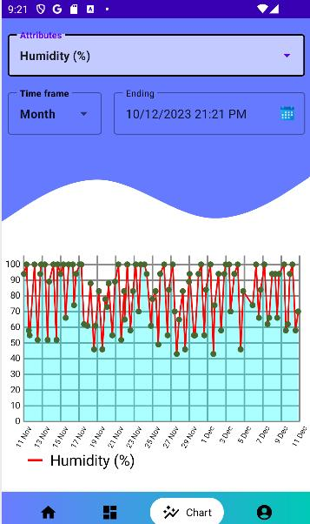
Screen Chart
Attributes: including Humidity, Rainfall, Temperature and Wind speed.
Time frame: including Hour, Day, Week, Month and Year.
Ending: time limit of displaying data based on time range.
Use external library mpandroidchart that supporting charts.

Slide 14
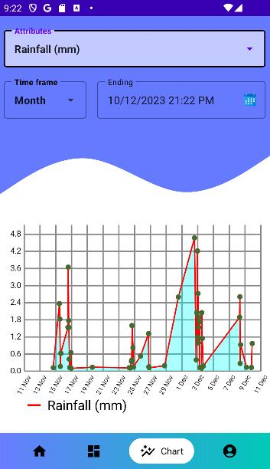
Screen Chart
Attributes: including Humidity, Rainfall, Temperature and Wind speed.
Time frame: including Hour, Day, Week, Month and Year.
Ending: time limit of displaying data based on time range.
Use external library mpandroidchart that supporting charts.

Slide 15
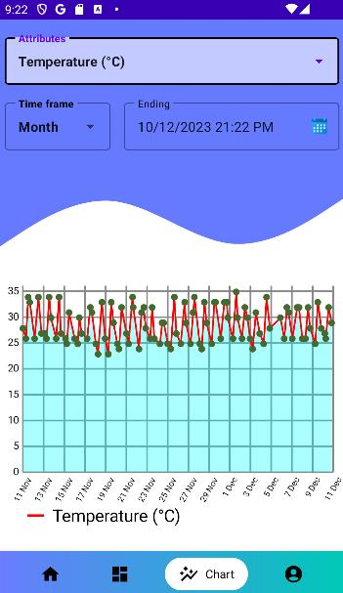
Screen Chart
Attributes: including Humidity, Rainfall, Temperature and Wind speed.
Time frame: including Hour, Day, Week, Month and Year.
Ending: time limit of displaying data based on time range.
Use external library mpandroidchart that supporting charts.

Slide 16
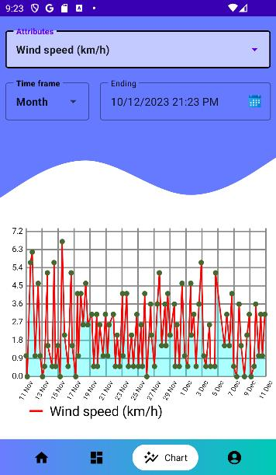
Screen Chart
Attributes: including Humidity, Rainfall, Temperature and Wind speed.
Time frame: including Hour, Day, Week, Month and Year.
Ending: time limit of displaying data based on time range.
Use external library mpandroidchart that supporting charts.

Slide 17
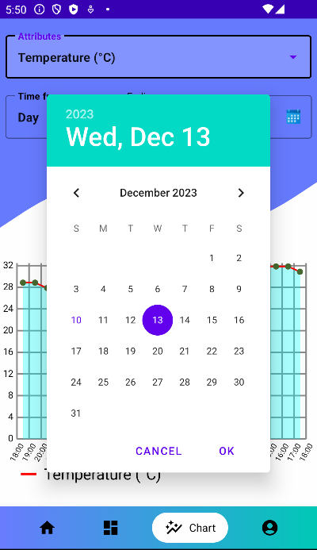
Screen Chart
User can click on calendar icon to choose other date with current time managed by system.

Slide 18
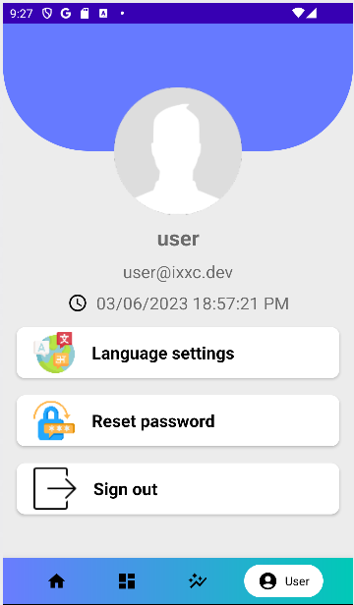
Screen Account
Use API: https://uiot.ixxc.dev/api/master/user/user
Response includes:
Username
Email address
Date when this account was created

Slide 19
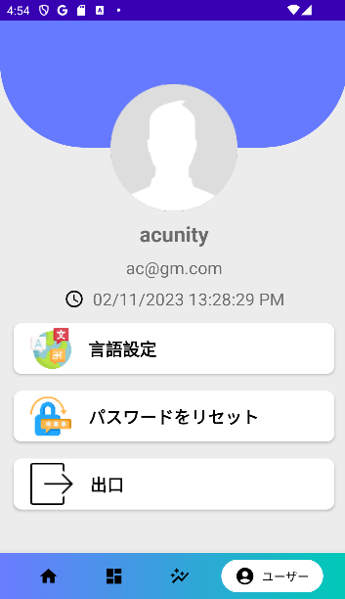
Screen Account
Others user has different user’s details

Slide 20
Screen Account
Function Sign out:
Clear session: erase login details including username, password, token and set login time = 0.
Go back to Opening Screen: use intent to open Opening Screen.

Slide 21
Further Development Directions
Dark Mode
Edit User Profile
Reset Password

Slide 22
THANK YOU

