Slide 1
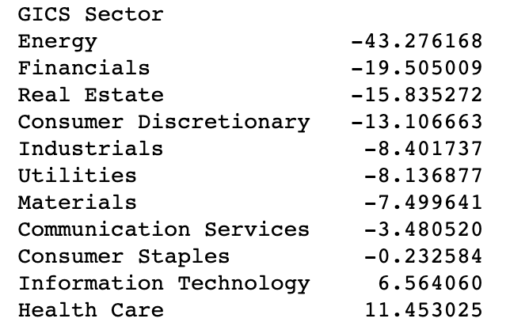
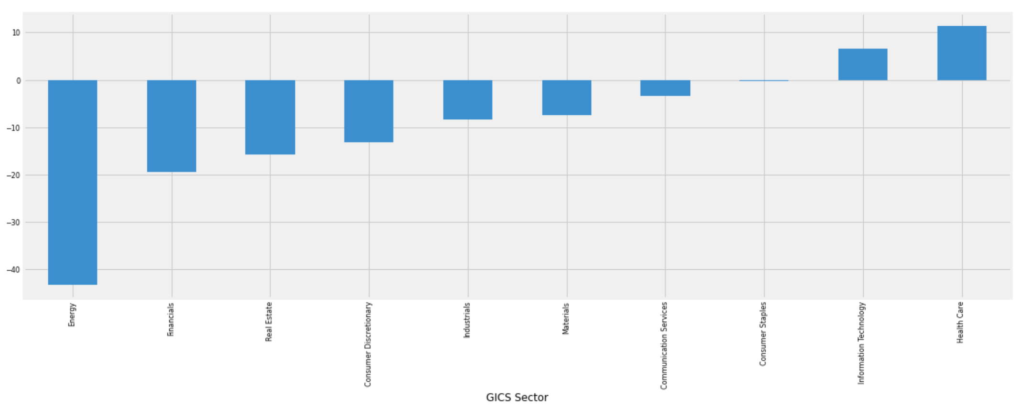
COVID-19: Measuring Industry Impact: data S&P 500 GICS Sector
The energy sector was the hardest hit with a 43% average drop in stock prices.
Only Health Care and IT was grow up
Source: S&P 500

Slide 2
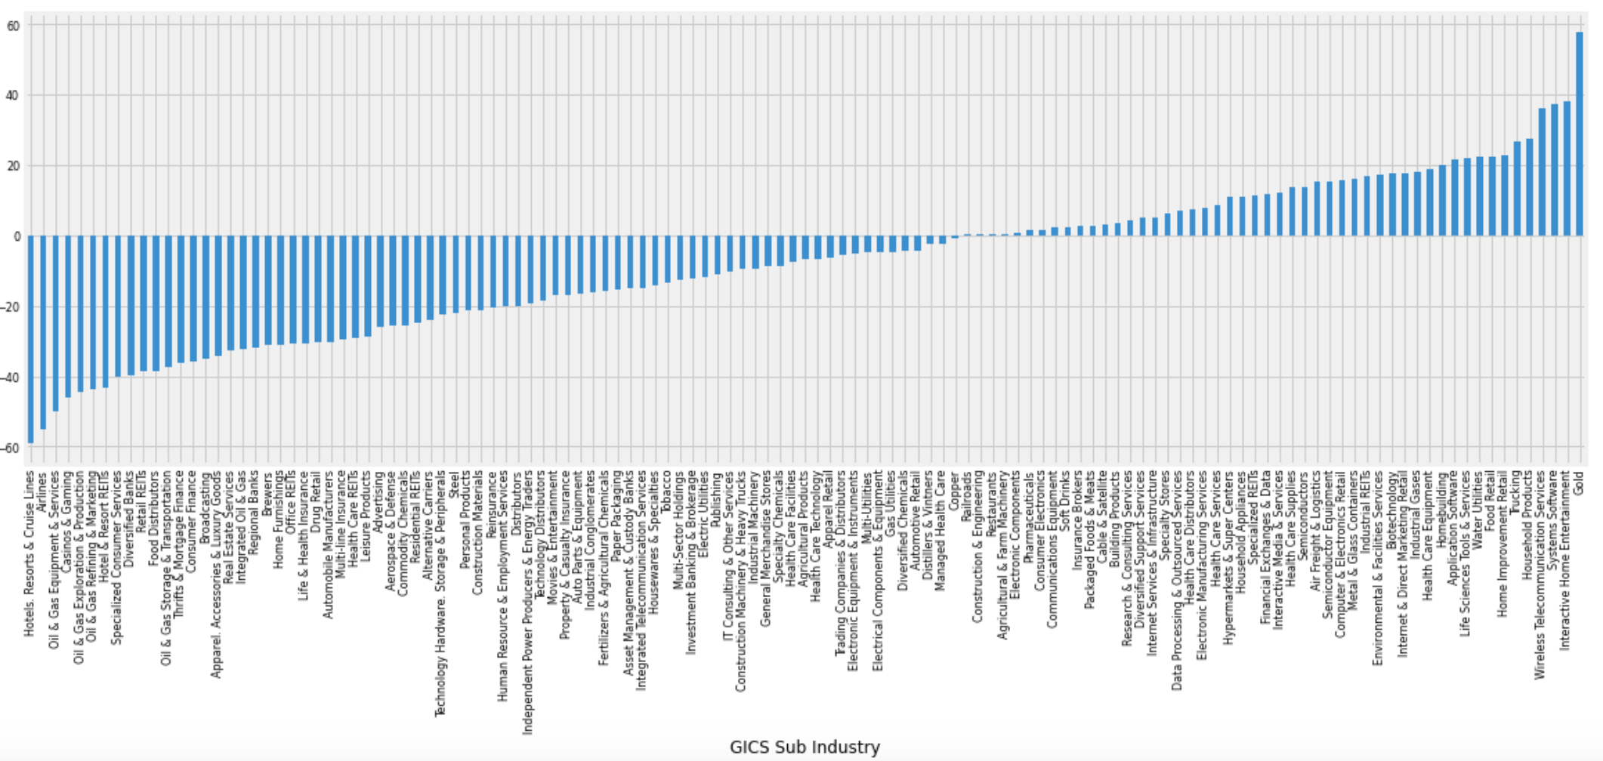
COVID-19: Measuring Industry Impact: data S&P 500 GICS Sub Industry
The travel related industries, Oil & Gas and Department Stores were the hardest hit.
Gold, interactive home entertainment, Telecommunication service, Food Retail was featured most prominently in these stories

Slide 3
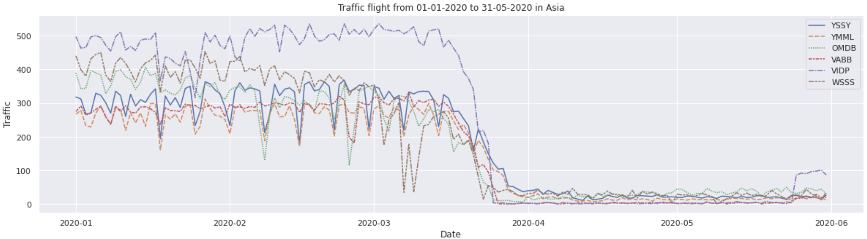
COVID-19: Measuring Industry Impact: Flight evolution per airport
The trend showed:
A slow decrease from February in Asian airports (an early one in Hong-Kong);
Airports plummeting since early day of March;
India almost stopped all traffic (VABB, VIDP).

Slide 4
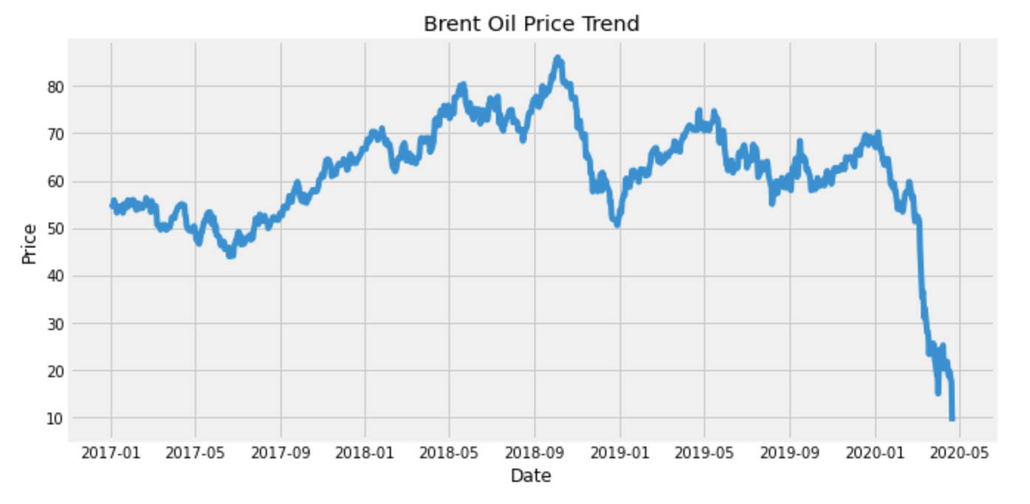
COVID-19: Measuring Industry Impact: The effect of COVID-19 on oil price
Relationship between World total Covid cases and price.
There is a steep decrease in price from Mid-Jan 2020 to Mar 2020.

Slide 5
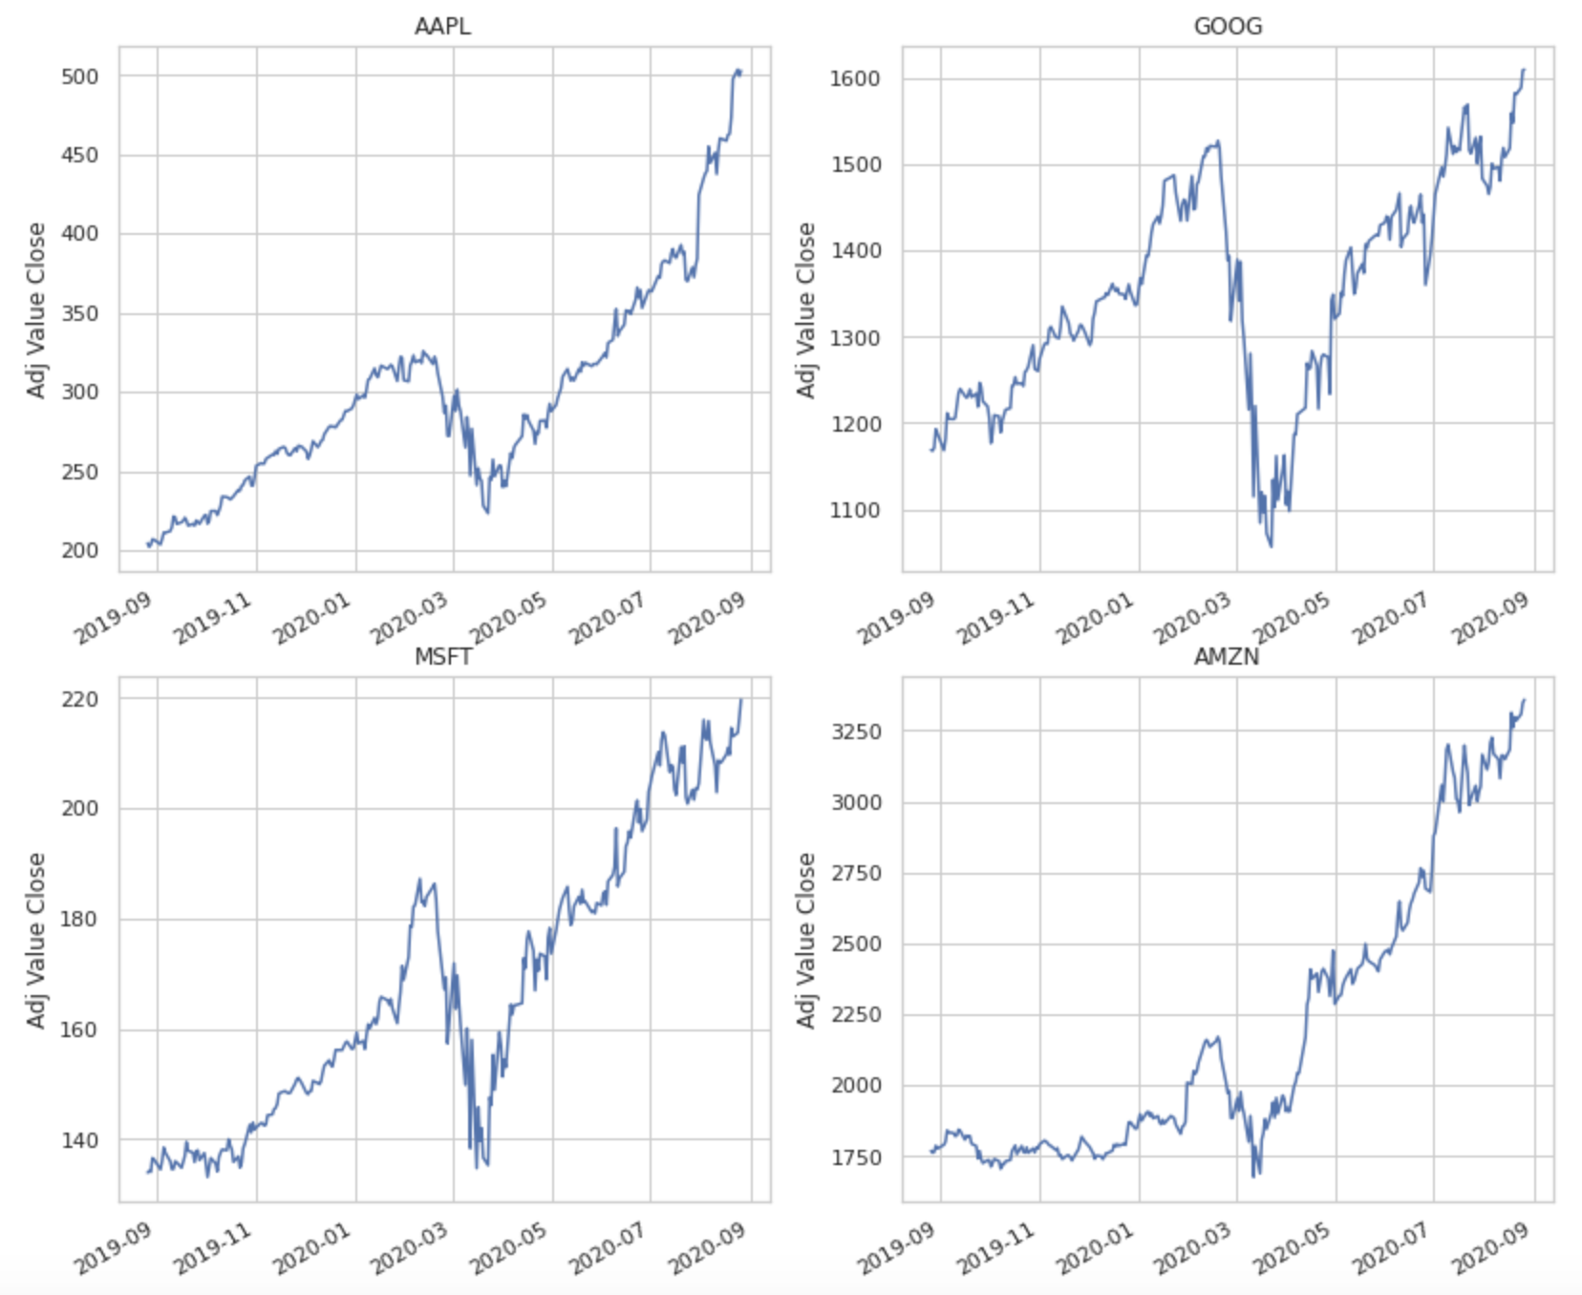
COVID-19: Measuring Industry Impact: Top company technology

