Slide 1
COVID-19
Analysis and Prediction
Group 1:
Nguyễn Trọng Tính (1970219)
Vũ Trung Hiếu (1970215)
Võ Tiến Đạt (1970214)
Nguyễn Tấn Nam Anh (1970013)
Nguyễn Tuấn Anh (1770153)

Slide 2
Content
Visualize Data
Time-Dependent SIR Model
Linear Regression Model
COVID Impact to Economy

Slide 3
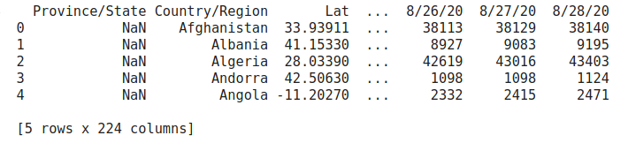
Data source
JHU CSSE COVID-19 Data

Slide 4
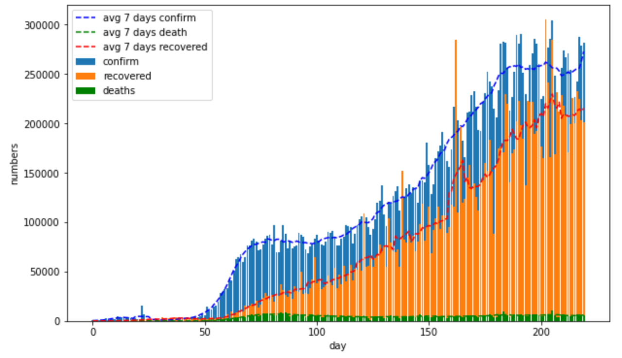
1. Visualize Data
In the world
- At the end 1/2020, there are the first case
- 4/2020 - 8/2020, the pandemic start outbreak and spread

Slide 5
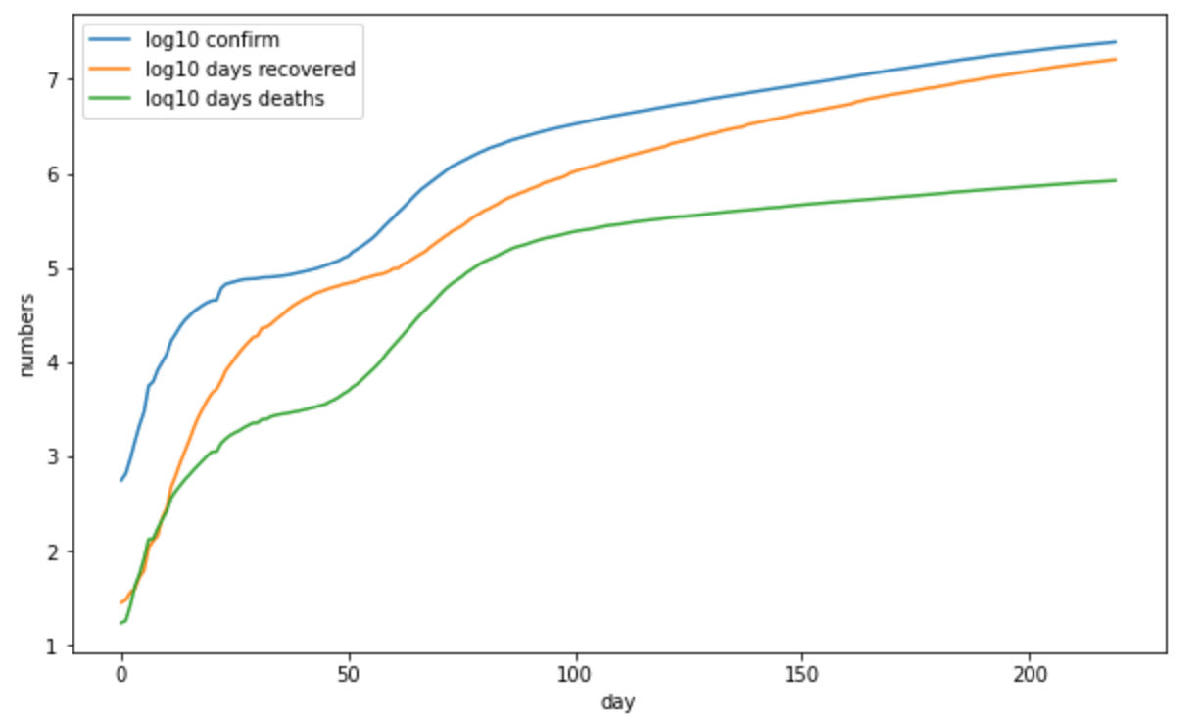
1. Visualize Data
The world
There are the two outbreak stages:
Asia
EU, America, Other

Slide 6
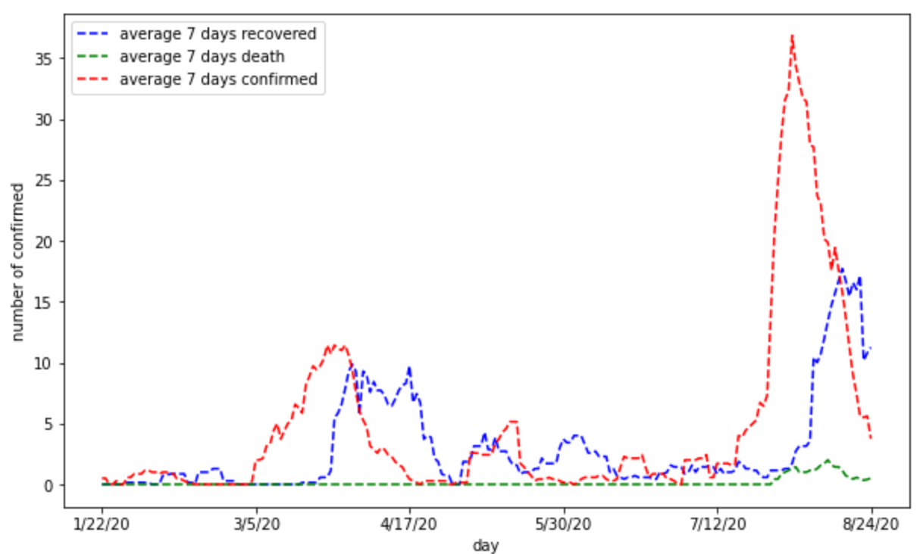
1. Visualize Data
Vietnam
Two stages:
3/5 - 4/17: Related to BN17
7/15 - Now: welcome international tourist, relax social distance

Slide 7
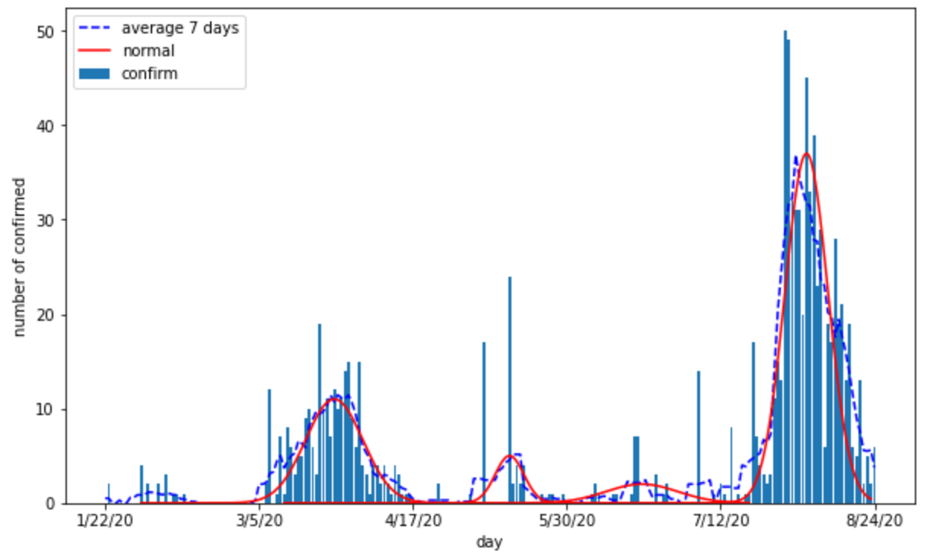
1. Visualize Data
Vietnam
The distribution of new case data is aggregate normal distributions

Slide 8
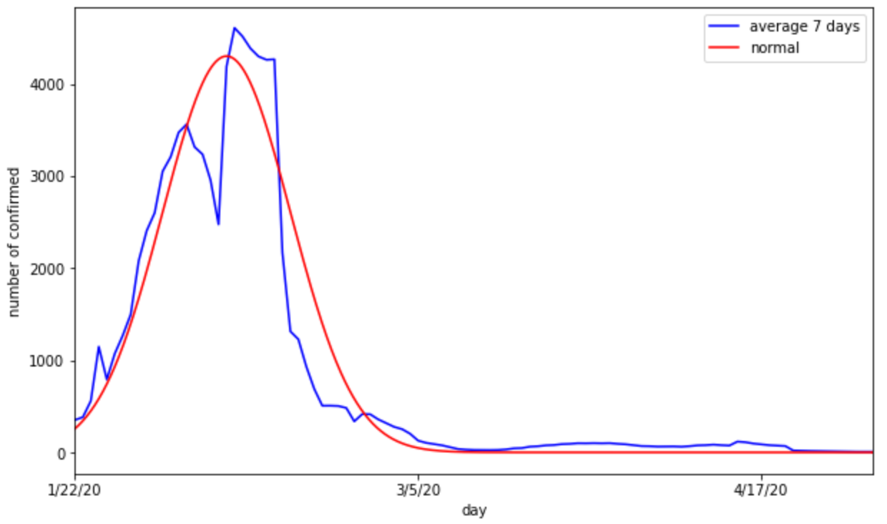
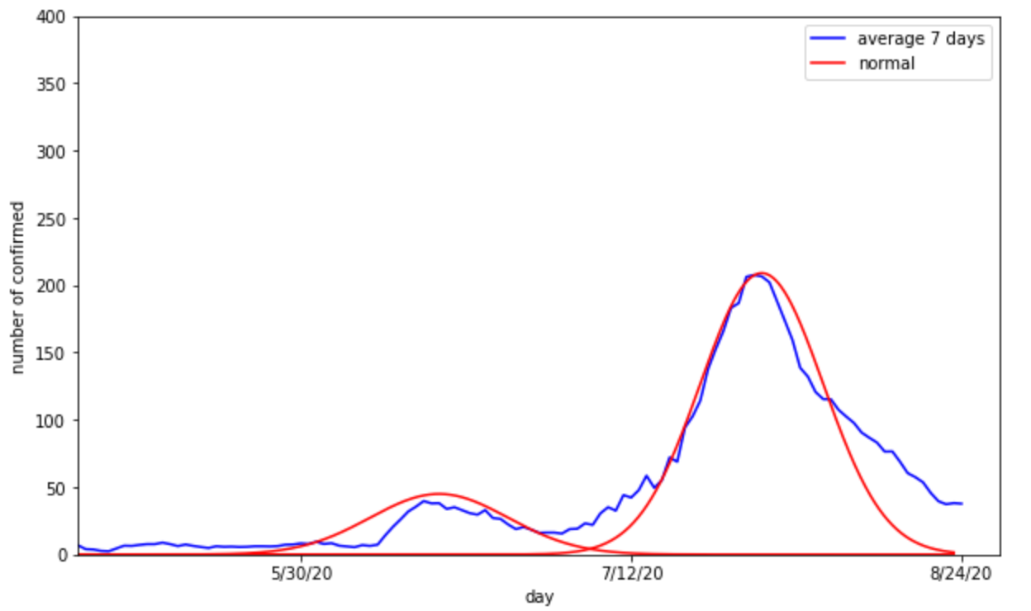
1. Visualize Data
There are some result from China

Slide 9
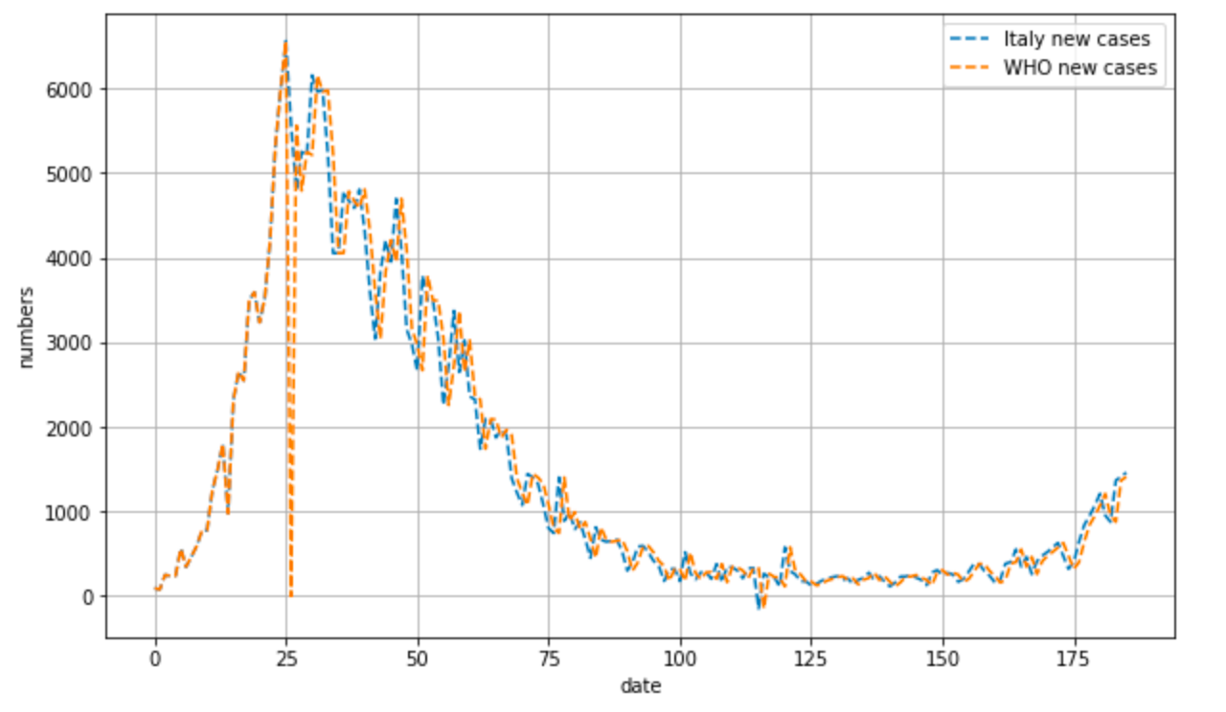
1. Visualize Data
WHO versus Italy Data

Slide 10


2. Time-Dependent SIR Model (1)
● SIR (Susceptible, Infected, Removed) is an epidemic model
S
I
R
● We need to determine: Infection Rate and Recover (or Die) Rate
● Two important assumptions:
The population N is constant: N = S(t) + I(t) + R(t)
Group R is immune.

Slide 11
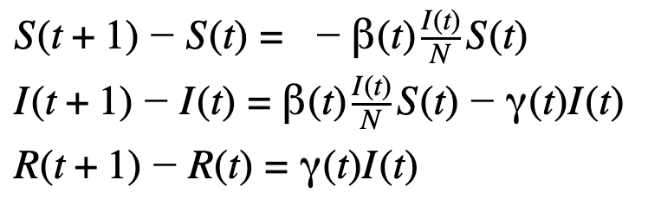
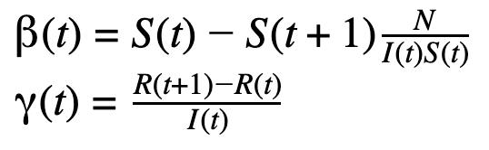
2. Time-Dependent SIR Model (2)
● Discrete Equations:
● Parameter Equations:
(𝝱: Transmission Rate 𝛄: Recovery/Death Rate)
● Use machine learning to estimate 𝝱(t) and 𝛄(t)
● Use the estimated 𝝱 and 𝛄 to predict the future values of S, I, R group.

Slide 12
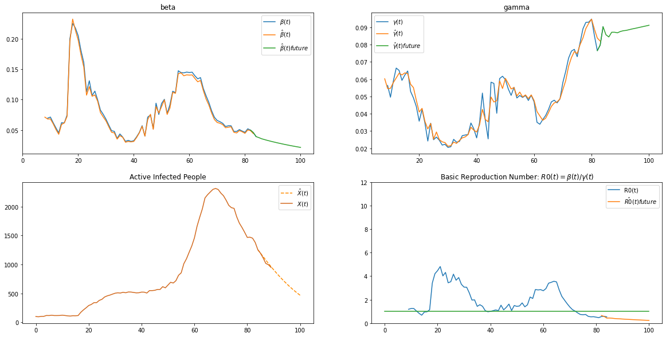
2. Time-Dependent SIR Model for China

Slide 13
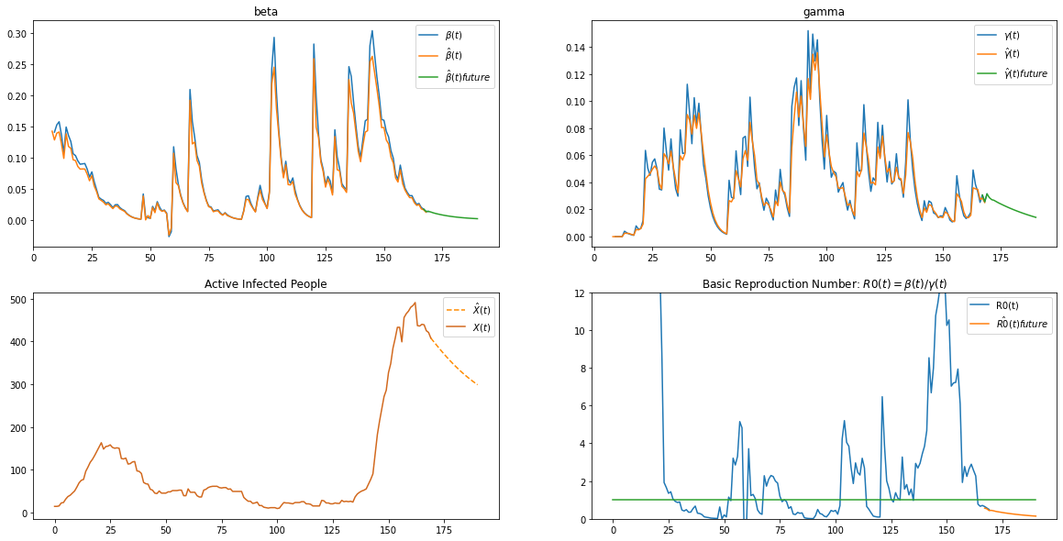
2. Time-Dependent SIR Model for Vietnam

Slide 14
2. Time-Dependent SIR Model: Pros/Cons
Pros:
Better than SIR with fixed 𝝱 and 𝛄
Tracking and predicting 𝝱(t) and 𝛄(t) to give more situation detail
Cons:
Sensitive with noise
Have low precision if applying for large area.

Slide 15

3. Linear Regression
A linear function has the form:
Objective of linear regression:
A univariate polynomial function has the form:
P(x) = a_{n}x^{n} + a_{n-1}x^{n-1} + … + a₂x² + a₁x + a₀
(n + 1 parameters)

Slide 16
3. Linear Regression
y(x): number of total cases/deaths/recovered cases as of day x since first day of collecting data (Jan 21st 2020 if using JHU CSSE COVID-19 Data).
Approach: Fit a n-degree polynomial function to the data before start day, then predict.
Linear regression model used: n = 6, day start = Aug 1st 2020

Slide 17
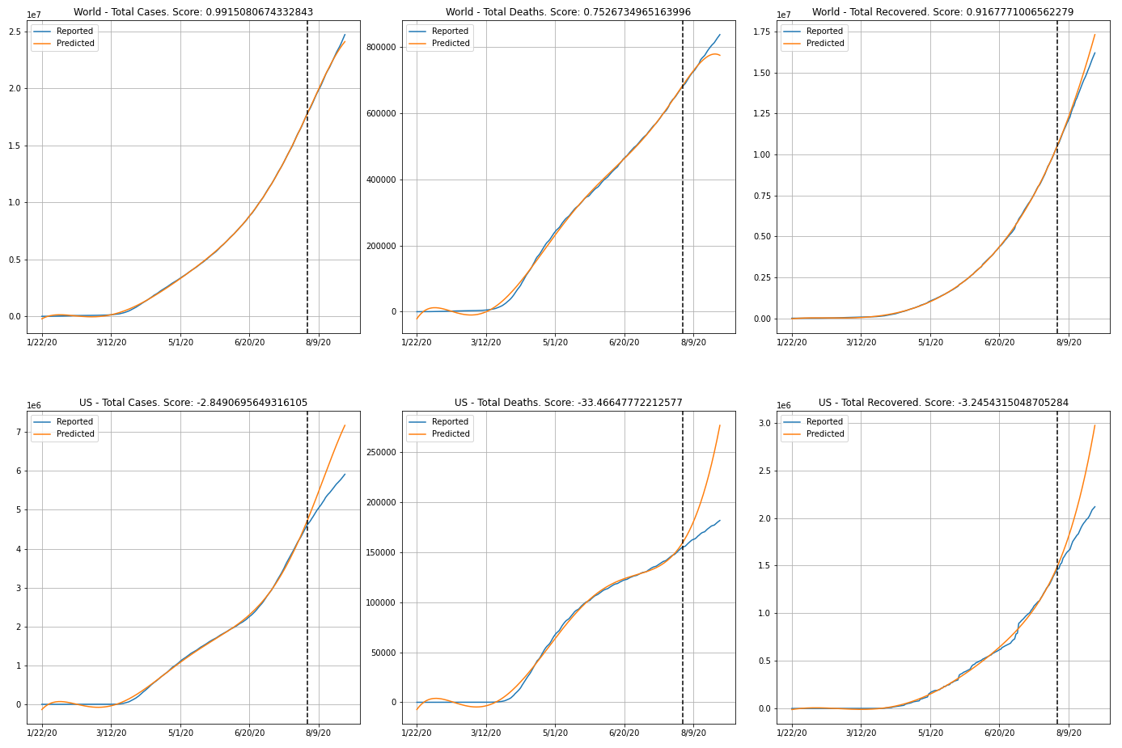
Worldwide & US

Slide 18
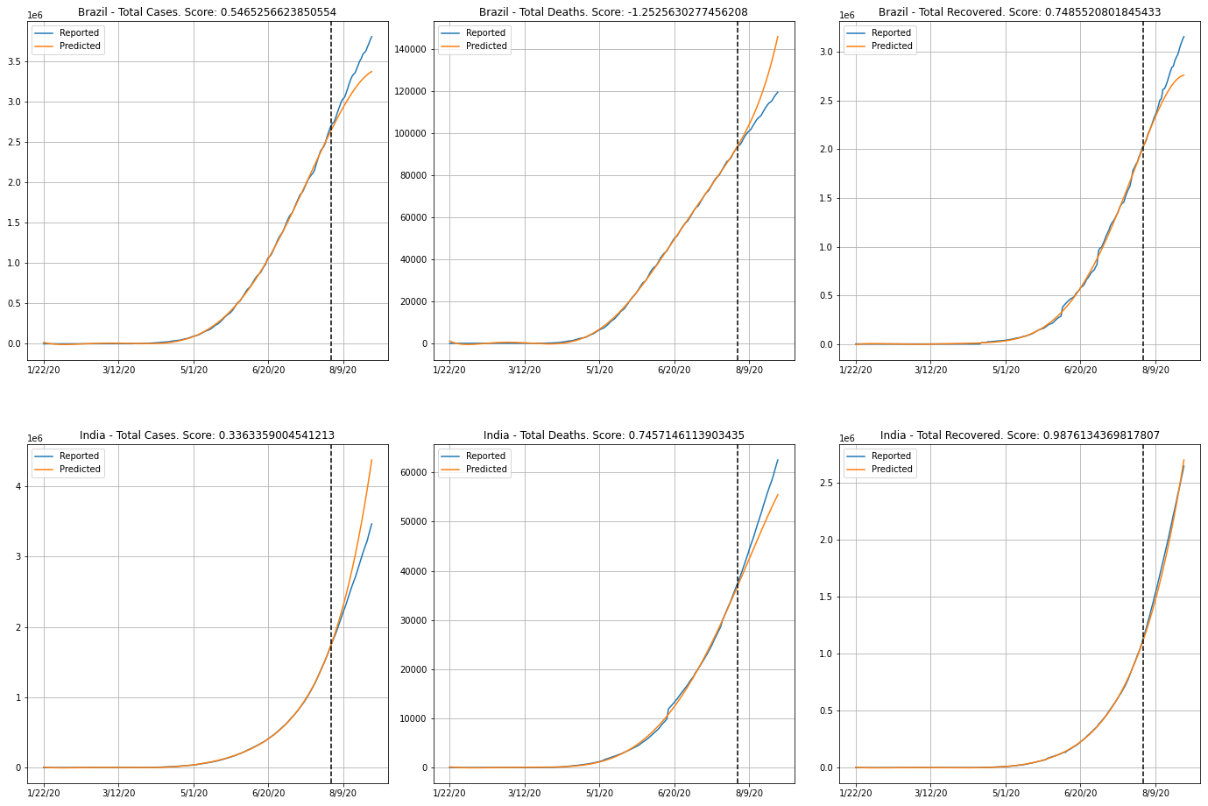
Brazil & India

Slide 19
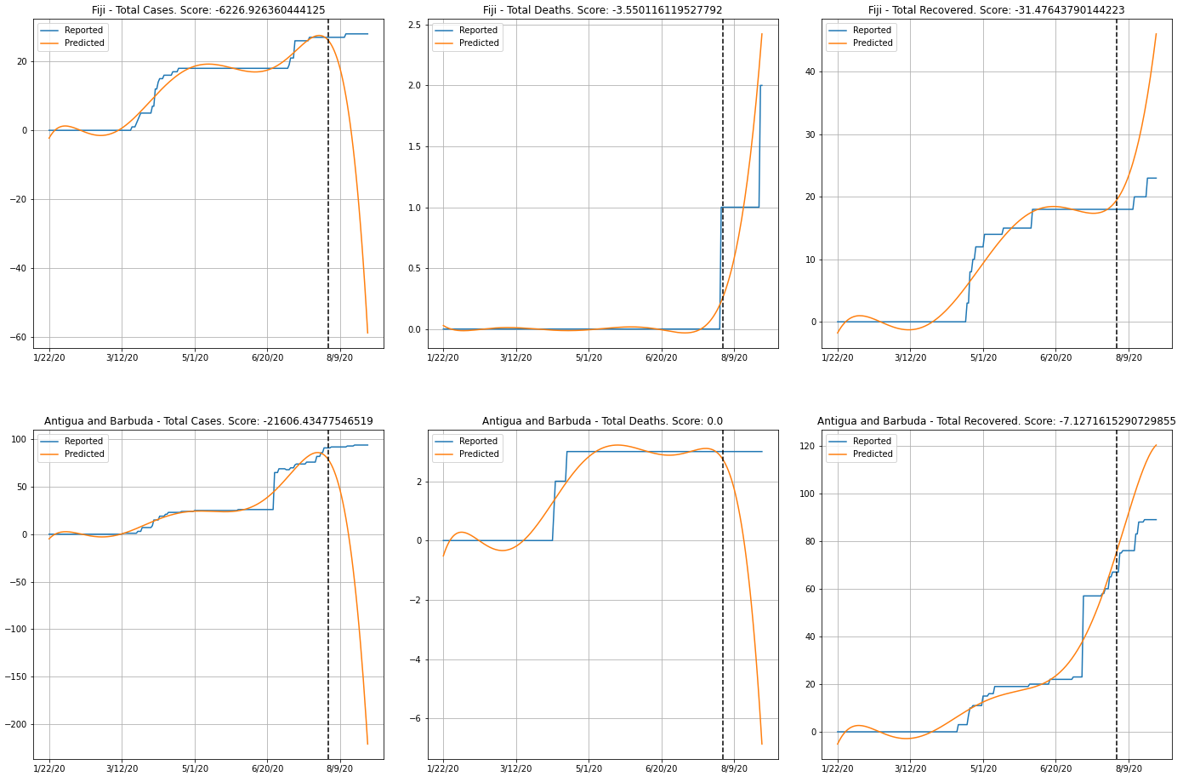
Fiji & Antigua and Barbuda

Slide 20
3. Linear Regression
Comments: Why reported data is not actual data
Tests do not cover all population
Errors in testing procedures & equipments
For detected cases: unclear date of infection
Unclear date of recovery
Some countries do not report recoveries, e.g UK, Sweden, Netherlands

Slide 21
3. Linear Regression
Pros:
very simple
univariate → complexity only scales linearly with n
Cons:
must search for number of degree
easy to overfit if n is large or few changes in data

Slide 22
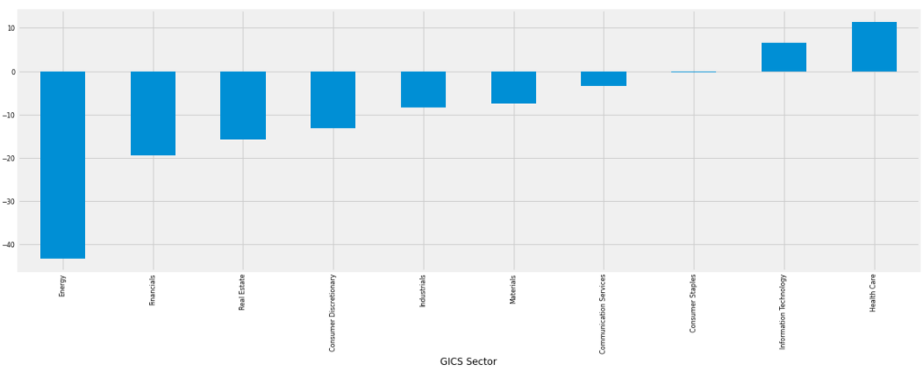
4. COVID Impact to Economy
The energy sector was the hardest hit with a 43% average drop in stock prices.
Only Health Care and IT was grow up
Source: S&P 500
Notes:
S&P 500 là một chỉ số cổ phiếu dựa trên cổ phiếu phổ thông của 500 công ty có vốn hóa thị trường lớn nhất niêm yết trên NYSE hoặc NASDAQ
GICS: Global Industry Classification Standard Tiêu chuẩn phân loại công nghiệp toàn cầu là một phân loại công nghiệp

Slide 23
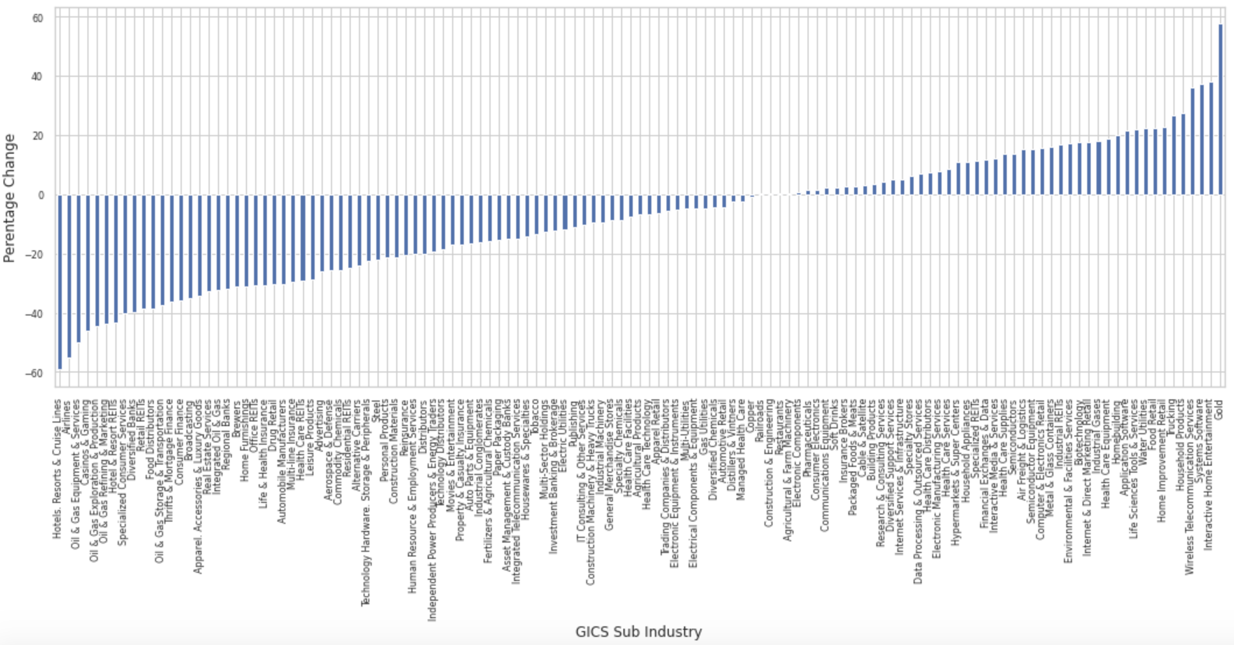
4. COVID Impact to Economy

Slide 24
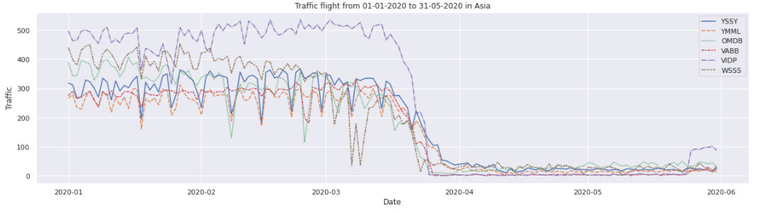
4. COVID Impact to Economy
The trend showed:
Airports plummeting since early day of March;
India almost stopped all traffic (VABB, VIDP).
Notes:
HongKong lockdown: 5/2/2020
Ấn Độ: 24/3
Australia: 20/3
Viet Nam: 1/4
yssy: sân bay sysdney, ymml: sân bay memboure, omdb: sân bay dubai, vabb, vidp: sân bay ấn độ, wss: singapore

Slide 25
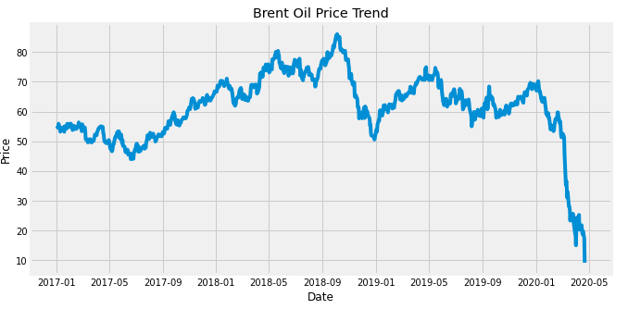
4. COVID Impact to Economy
Relationship between World total Covid cases and price.
There is a steep decrease in price from Mid-Jan 2020 to Mar 2020.

Slide 26
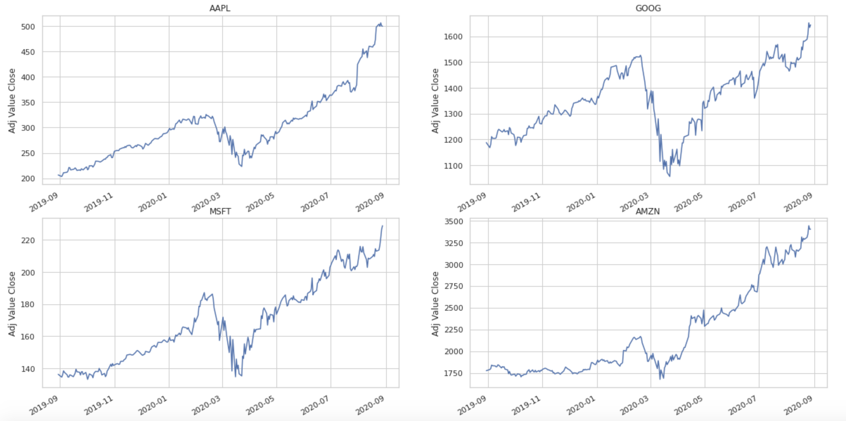
4. COVID Impact to Economy
Top company technology grow up value in early 2020
Notes:
20/8: Apple đạt 2000tỷ
Microsoft, amazon: 1600 tỷ

Slide 27
Reference
[1] Yi-Cheng Chen. “A Time-dependent SIR model for COVID-19 with Undetectable Infected Persons”.
[2] Luca Magri and Nguyen Anh Khoa Doan. “First-principles Machine Learning for COVID-19 Modeling”.
[3] Adilmoujahid. “Analyzing the Impact of Coronavirus on the Stock Market using Python, Google Sheets and Google Finance”
Notes:
20/8: Apple đạt 2000tỷ
Microsoft, amazon: 1600 tỷ

