Slide 1
TempoBiGen: A Curated Generative Model for Healthcare Mobility Logs with Visit Duration
Hieu Vu, Alberto M. Segre, Bijaya Adhikari
University of Iowa
Notes:
Hi everyone, I’m happy to be here to present on behalf of the authors, the work titled “TempoBiGen: A Curated Generative Model for Healthcare Mobility Logs with Visit Duration”, this is a joint work by Hieu Vu, Professor Segre, and Professor Adhikari from the University of Iowa.

Slide 2
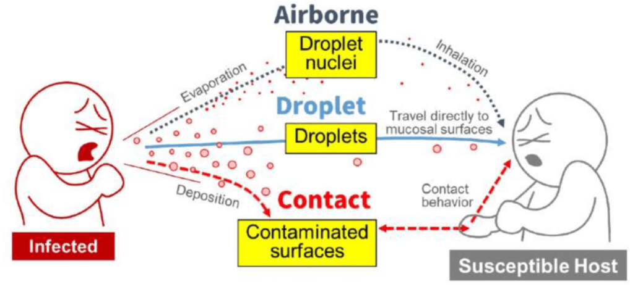

Healthcare-associated infections (HAIs)
“Healthcare-associated infections (HAIs) are infections that patients get while or soon after receiving health care” ^{[CDC]}
Great impacts and economic burden
Preventing HAIs is an important problem
~687,000 HAIs
~72,000 fatalities
HAI Prevalence Survey 2015
~$9.8 billion annual cost (5 major infections)
>$4.6 billion annual treatment cost for AR infections
Zimlichman et al. (2013)
Nelson et al. (2021)
Notes:
Let me start with the definition of healthcare associated infections.
According to CDC, healthcare associated infections or HAIs are infections that patients get while or soon after receiving health care.
[CLICK] To see the great impacts and economic burden of HAIs, here are some numbers:
[CLICK] According to a HAI survey in 2015, there are approximately 687,000 HAI cases in the US acute care hospitals, and 72,000 patients with HAI died during their hospitalization.
[CLICK] Another analysis in 2013 estimated that the annual costs for five major infections were approximately $9.8 billion, and that is $4.6 billion only for antimicrobial resistance treatment.
[CLICK] Thus, preventing HAIs is an important problem

Slide 3
Healthcare-associated infections (HAIs)
HAIs spread within hospitals via both people-people and people-location interactions
Great amount of disease pathogen load spread via HCWs and hospital rooms
HCWs mobility logs are valuable source for understanding of care patterns and disease progression.
Notes:
So how do these infections spread? Diseases can spread through the air, through droplets, and through contact.
[CLICK] Among that, a great amount of pathogen load spread via interactions with HCWs and hospital rooms.
[CLICK] Thus, healthcare workers mobility logs are valuable source for understanding of the care patterns, and disease progression.

Slide 4
The need of curated synthetic healthcare mobility data
However, …
Difficult to collect fine-grained high-resolution mobility data [*]:
Costly devices, complicated deployment process, inconsistency due to the quickly changing environment
Published data are usually available for short period and small cohort
Privacy concerns:
Data need to be anonymized
Specific policies/procedures need to be done to gain access
→ Solution: Generative model for fine-grained high-resolution mobility data
Notes:
However,
[CLICK] Collecting fine-grained, high-resolution mobility data is hard because of costly devices, complicated deployment process, or inconsistency due to quickly changing environment. Thus, published data are usually available for short period and small cohort.
[CLICK] Furthermore, privacy concern is also one of the reason why the available data is limited, they need to be anonymized properly before being released, and specific policies and procedures need to be done to gain access
[CLICK] That motivates our work: building a generative model, that can generate realistic synthetic data, to fill this gap.

Slide 5
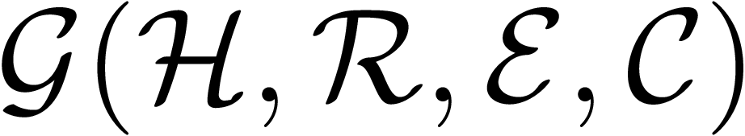

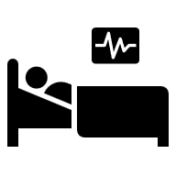
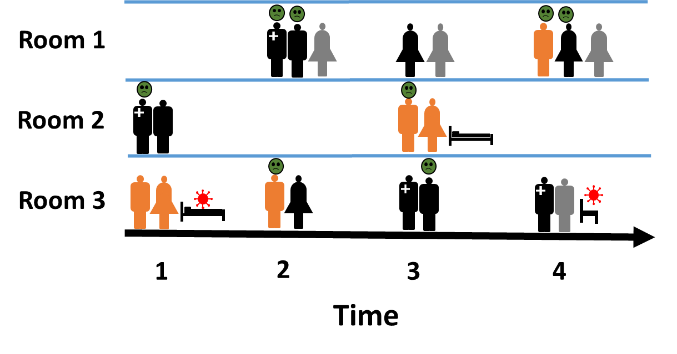






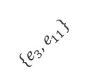
Problem Statement
Model mobility logs as Undirected Temporal Bipartite Graph
Set of HCWs , rooms , and set of unit types
Set of temporal edges:
Visit starting time , visit duration
$${\{e}_{1}\}$$
$${\{e}_{5}\}$$
$${\{e}_{3}, e_{11}\}$$
$${\{e}_{2}, e_{7}\}$$
$${\{e}_{6}, e_{9}\}$$
$${\{e}_{4}, e_{10}\}$$
Mobility logs
Notes:
To formalize the problem, we first represent the mobility logs as undirected temporal bipartite graph.
[CLICK] We have two node partitions: healthcare workers H and set of rooms R. Visits are collected from a set of unit types C.
[CLICK] A visit is a temporal edge including the source, and destination node, which are required to be in different partitions. We also have the visit starting time and the duration.

Slide 6






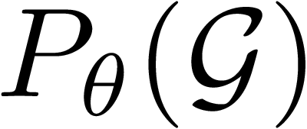
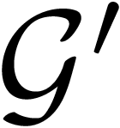









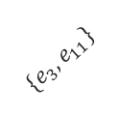


Problem Statement
$${\{e}_{1}\}$$
$${\{e}_{5}\}$$
$${\{e}_{3}, e_{11}\}$$
Given: a temporal graph
Goal: learn a generative model that maximizes the likelihood of
Outcome: a new synthetic temporal graph (set of mobility logs) that has similar structural and temporal properties as .
$${\{e}_{2}, e_{7}\}$$
$${\{e}_{6}, e_{9}\}$$
$${\{e}_{4}, e_{10}\}$$
Generative model
$${\{e}_{1}\}$$
$${\{e}_{5}\}$$
$${\{e}_{2}, e_{7}\}$$
$${\{e}_{3}, e_{11}\}$$
$${\{e}_{6}, e_{9}\}$$
$${\{e}_{4}, e_{10}\}$$
Notes:
Our problem can be stated as follows:
Given a temporal graph G, we want to learn a generative model P_theta that maximizes the likelihood of G,
from which, we can generate a new synthetic temporal graph G-prime, that has similar structural and temporal properties as G.
Thus, we expect that simulating diseases on G-prime leads to the similar dynamics compared to G.

Slide 7
Requirements
Existing approaches:
Often assume coarse-grained data (TIGGER ^{[1]}, TAGGEN ^{[2]})
Overlook the bipartite structure – important for HAIs modeling (DYMOND ^{[3]}, TG-GAN ^{[4]}), naively applying existing models create invalid interactions
Do not generate visit duration, assuming visit duration is the gap between two visits
Requirements:
Validity: satisfy bipartiteness constraint
Representative: capture the structural & temporal characteristic of the original data
Novelty: contain a good number of instances that are never observed in the original data
Notes:
When solving the temporal graph generation task, existing works usually assume coarse-grained data, which does not satisfy our requirement.
[CLICK] They also overlook the bipartite structure of the given data. As the result, naively applying existing models can generate invalid interactions.
[CLICK] Furthermore, they are not designed to generate event duration or usually assume duration to be the time gap between two consecutive visits.
[CLICK] Thus, we expect our model to satisfy three following requirements.
[CLICK] Validity - we want our model only generate valid interactions, or no within partition edges.
[CLICK] Representative - we want our model be able to capture the structural and temporal characteristic of the original data.
[CLICK] And Novelty - our model can generate a good number of temporal edges that are never observed before.

Slide 8
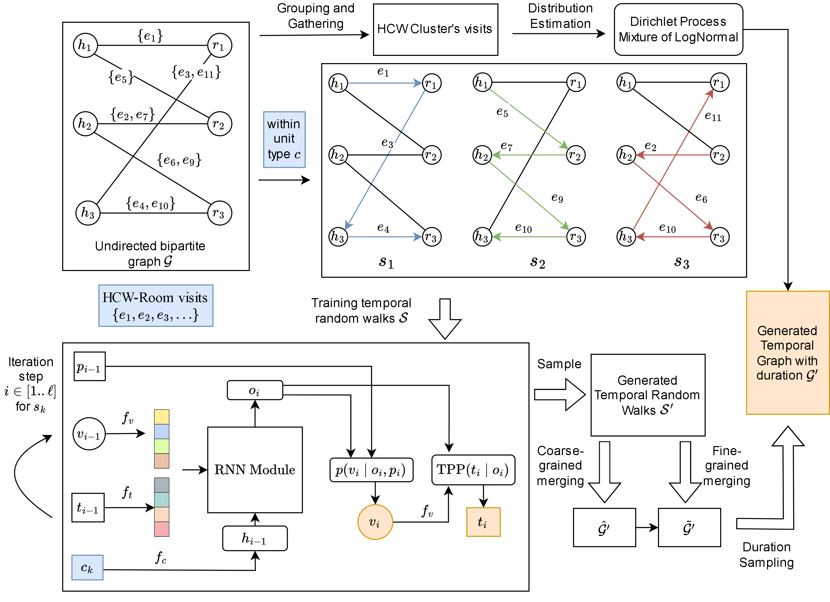
TempoBiGen: A two-stage framework
Stage 1: Learn a conditional bipartite recurrent generative model → Sample new set of HCW-Room visits
Stage 2: Estimate probability distribution of visit durations → Sample visit duration for each new visit.
Notes:
With that in mind, we develop TempoBiGen – a two-stage framework. The overall architecture is shown in this figure.
[CLICK] In stage one, we train a generative model to sample new set of visits.
[CLICK] In stage two, we estimate the duration distributions to sample realistic duration for each generated visit from stage one.

Slide 9
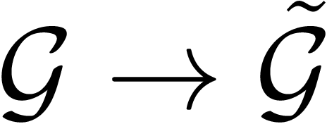
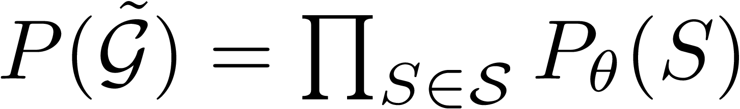
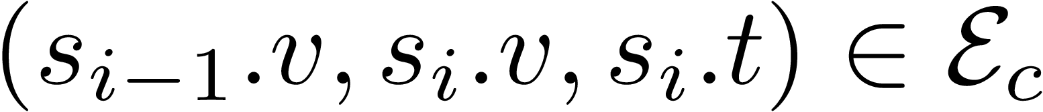
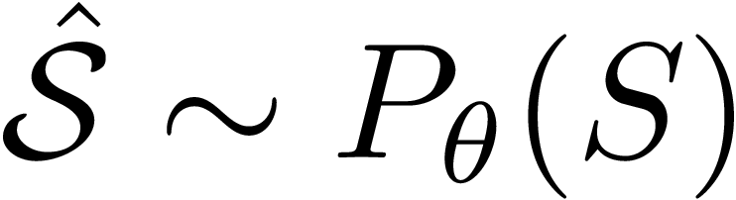
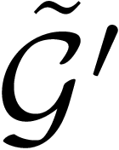
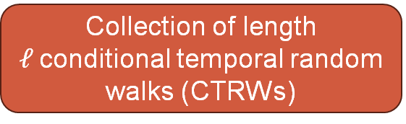
Stage 1: Learn visit distributions
Learning process:
Sampling process:
Temporal bipartite graph without durations
Extract
Collection of length $ℓ$conditional temporal random walks (CTRWs)
Train
Conditional generative model
Conditional generative model
Sample
Synthesized CTRWs
Synthesized HCW-Room visits
Coarse-grained and Fine-grained RWs merging
Notes:
Let us go over the details of stage 1. We first get G-tilde by ignoring the duration information.
[CLICK] From that, we extract a collection of temporal random walks, each of them has $ℓ$events with their source, destination, and starting time.
[CLICK] From this, we train a generative model, which I will present later. Note that, here, we made a simplified assumption, where the likelihood of the temporal graph can be represented as the product of individual random walk probabilities.
[CLICK] In the sampling process, we first draw a set of random walks from the model,
[CLICK] from which, we construct a set of visits through our proposed merging procedure.

Slide 10
Stage 1: Conditional bipartite recurrent generative model
Model details
Base model: we utilize a Recurrent Generative Model for scalable sequential events modeling with temporal point process for continuous time ^{[TIGGER]}
We made the following two improvements:
1) Class conditional generation
Empower model with diverse patterns
Representative requirement
Mitigate data limitation problem
2) Separate prediction heads for different node types
Ensure the bipartiteness of the generated random walks (validity requirement)
Reduces the prediction space of dedicated module, simplify the learning process
Notes:
Regarding our generative model, building on top of a recurrent generative model, which has been shown to be efficient and scalable in the previous work,
[CLICK] We made two following improvements: First, we make our model conditioned on the input unit type. This not only mitigates the data sparsity problem, but also lets the model leverage data across different units, while still preserving their unique patterns. Thus, it contributes to satisfying the representative requirement.
[CLICK] Second, we use separate prediction heads for different partitions, This guarantees validity requirement, and by reducing the prediction space for each head, we expect to simplify the learning process.

Slide 11





Stage 1: Visit sampling
Model details
Independent random walk sampling for scalability → Redundant sets of CTRWs
Simply taking the union of the generated events:
Large & noisy set of unique timestamps (continuous-time model)
Solution: Coarse-grained merging
Collect daily top frequent HCW-room pairs
Filter rare/noisy events
Preserve sparsity & statistics of daily graphs
$$t$$
$$(h_{1}{,r}_{1})$$
$$[t_{1}−ε_{1}, t_{1}+ε_{1}]$$
$$[t_{2}−ε_{2}, t_{2}+ε_{2}]$$
$$[t_{3}−ε_{3}, t_{3}+ε_{3}]$$
Training observations
Notes:
In sampling step, for scalability, we still follow the independent sampling scheme.
[CLICK] However, simply taking the union of the generated events can result in a large and noisy set of timestamps. As you can see in the illustration, even though the generated timestamps are around the training observations, there can be lots of unique values.
[CLICK] To solve this, we first do coarse-grained merging via collecting top frequent HCW-room pairs for each day.
[CLICK] This will filter out rare or noisy interactions, so it can preserve the sparsity and statistics of daily graphs.

Slide 12



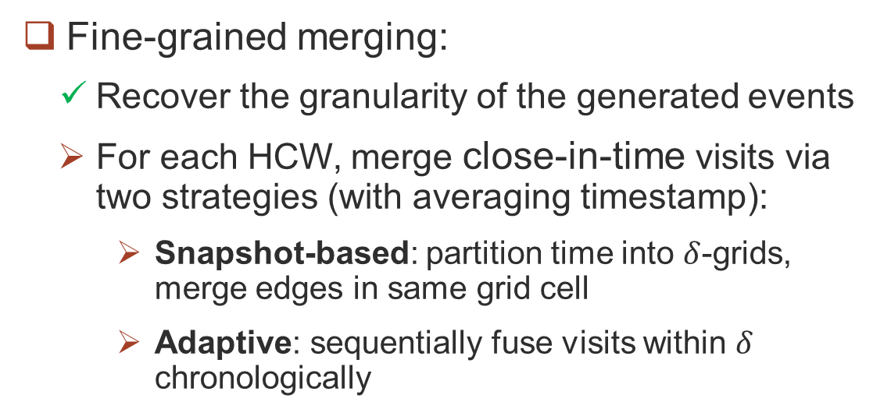




Stage 1: Visit sampling
Model details
Fine-grained merging:
Recover the granularity of the generated events
For each HCW, merge close-in-time visits via two strategies (with averaging timestamp):
Snapshot-based: partition time into $δ$-grids, merge edges in same grid cell
Adaptive: sequentially fuse visits within $δ$ chronologically
$$δ$$
$$Δt<δ$$
$δ$-grid
$δ$-adaptive
$$t$$
$$t$$
$$δ$$
$$Δt>δ$$
$$t_{0}$$
Notes:
Having the set of active pairs, we then try to recover the granularity of each event through the fine-grained merging process.
[CLICK] Specifically, we proposed two different schemes to merge visits that are too close in time for each HCW. The snapshot-based scheme divides each day into $δ$-second grid cells, then those occur within same cell are merged.
The adaptive scheme, alternatively, progressively merges events that occur within $δ$-second from the currently recorded one.
….
And that’s all for stage 1.

Slide 13
Stage 2: Duration sampling
Estimating distribution:
Sampling process:
Temporal bipartite graph
HCW clusters’ visit durations
Estimate
Dirichlet Process Mixture of LogNormal
Grouping & Gathering
multi-modal, right-skewed
DP Mixture of Normal in log-space
(Variational Bayesian (VB) Estimation)
Lower/Upper bounds for each sample
Extract
Synthesized visit durations
Synthesized HCW-Room visits
Conditional sampling
Dirichlet Process Mixture of LogNormal
Notes:
Coming to stage 2, duration sampling.
[CLICK] Noticing that single HCW may have limited visits, we first cluster them based on their embeddings, and gather their visits durations.
[CLICK] As the duration data for each cluster is strongly right-skewed with multiple peaks, we chose to model them with a Mixture of Log-Normal distribution.
Furthermore, for automatically inferring the number of components, we use the Dirichlet Process Prior. Note that, this is equivalent to a Mixture of Normal distribution in the log-space.
[CLICK] Then for the sampling step, a valid duration must be, first, smaller than the time gap between two consecutive visits, and second, must not be too small for realistic setting.
[CLICK] Then we extract those lower and upper bounds for each visit,
[CLICK] from which, we can conditionally sample new valid and realistic visit durations.

Slide 14
Experiments
Dataset & Tasks
Proprietary datasets:
more than 44 million HCP-room visits
25 different healthcare facilities in the US
ranging in size from small rural facilities to large-scale tertiary-care facilities
We use a subsampled two weeks of data for the experiments:
1939 HCWs (33 job types)
263 rooms
10 unit-types
118, 209 visits in total
Answering following questions:
Does the generated data maintain the statistical properties of the daily snapshots?
Is the disease dynamic the same in the generated graph compared to the original network?
Does our model generate realistic mobility logs that capture HCW shift patterns? (Please refer to our paper for more details)
Notes:
Next, I will then present our dataset and experiments.
[CLICK] We first extract a subset of a large in-house dataset, to get more than 100,000 visits, with around 2000 HCWs, more than 260 rooms, and across 10 unit-types.
[CLICK] To demonstrate the benefit of our proposed framework, we try to answer several questions, and we will present two of them here.

Slide 15
Results
Snapshot graph properties
Does the generated data maintain the statistical properties of the daily snapshots?
Construct daily snapshots
Compute common graph properties
Performance is the mean absolute error (MAE) between sampled and true daily-snapshot graphs
Notes:
The first question, “Does the generated data maintain the statistical properties of the daily snapshots?”
[CLICK] We construct daily-snapshot graphs for both original and generated data, and compute some common graph properties, such as: mean degree, wedge count, and largest connected component size.
We then report their mean absolute error w.r.t. those of the original data.

Slide 16
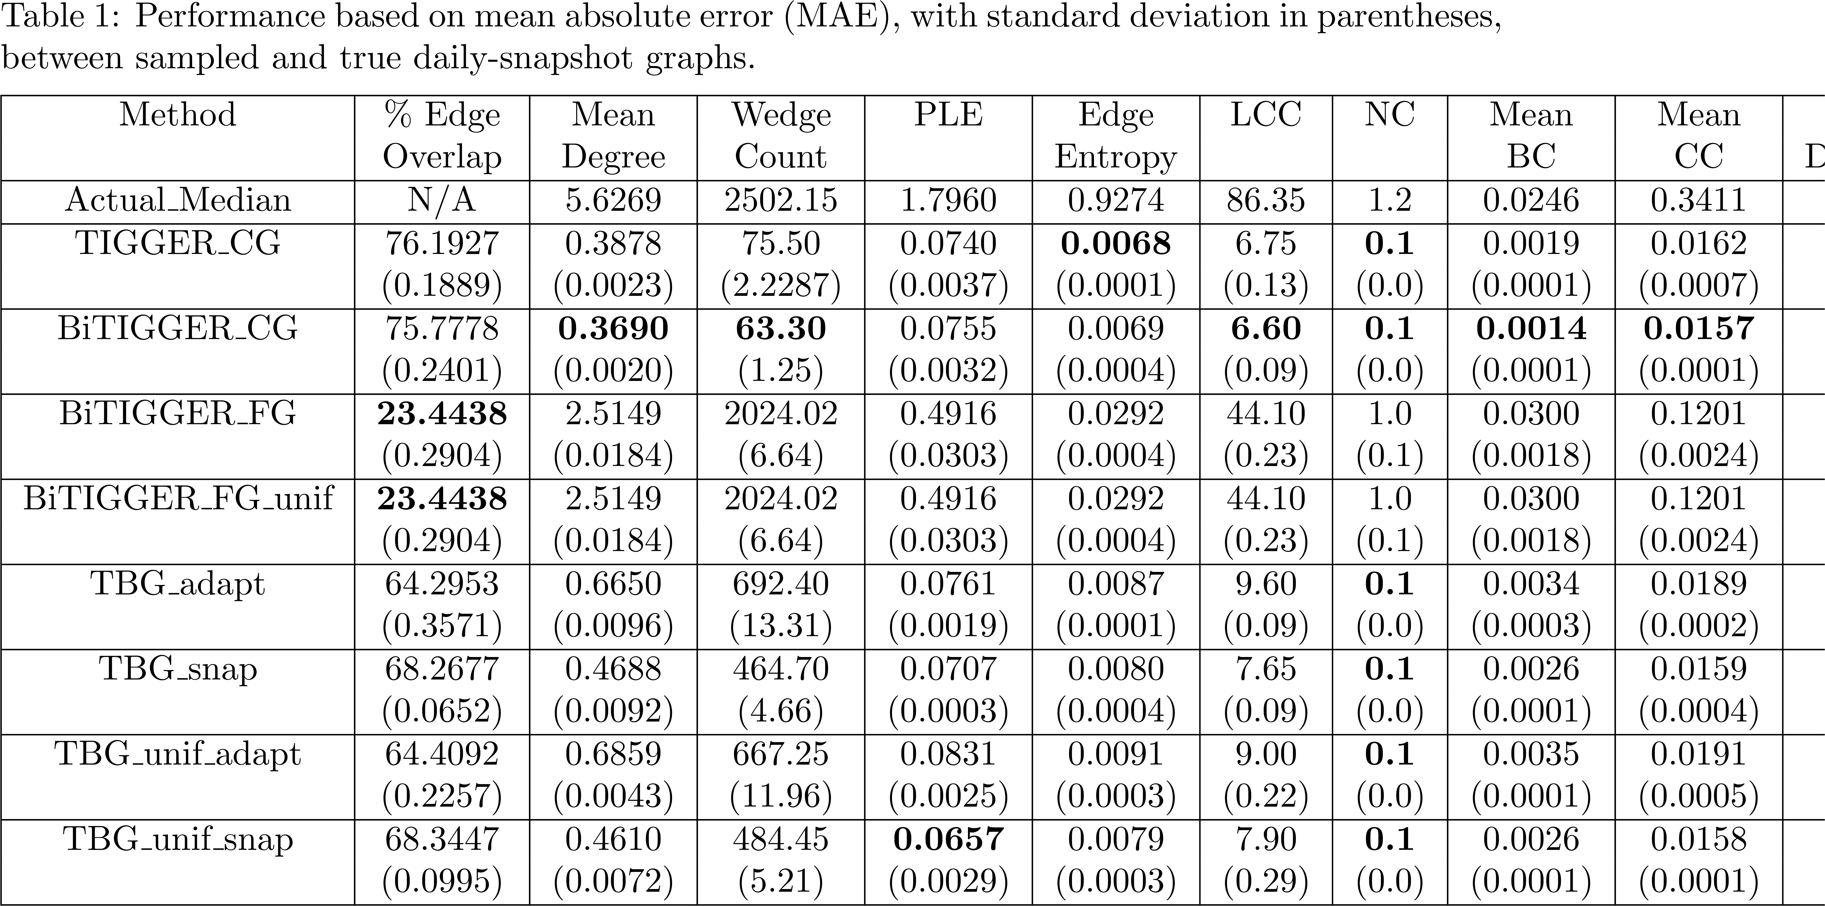
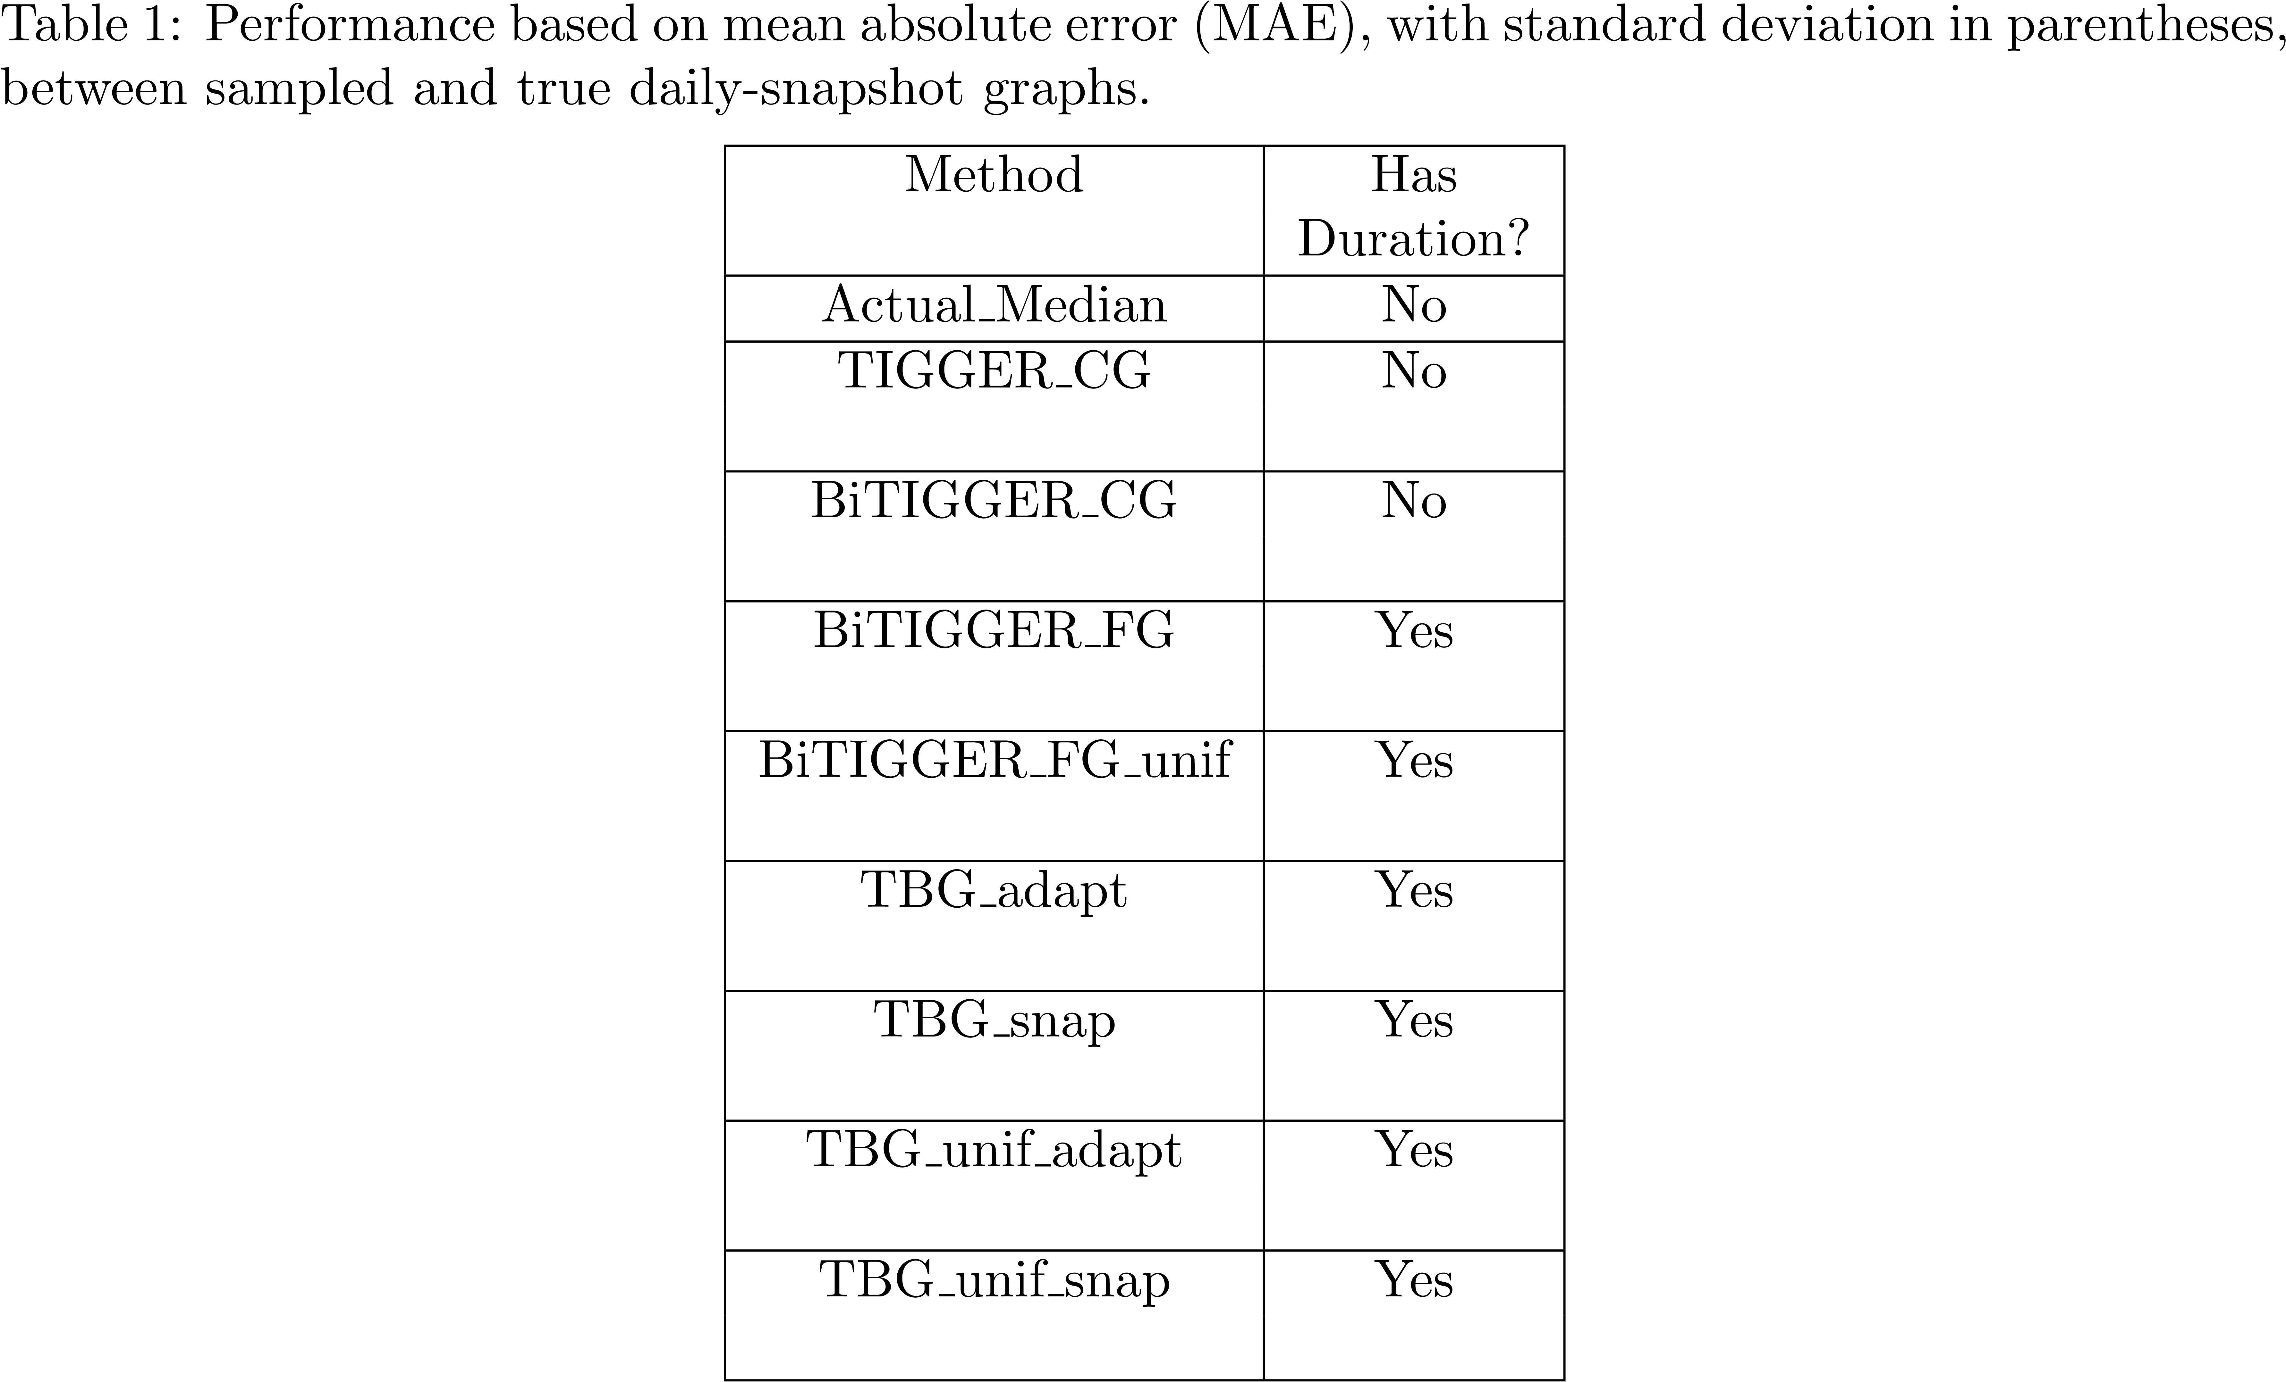
Results
Snapshot graph properties
Incorporating bipartiteness constraint improves the performance
High resolution data
Fine-grained only
Combination (our method)
Coarse-grained only
Low
High daily-snapshot properties
Notes:
Through this summary, we want to emphasize two main insights:
[CLICK] First, incorporating bipartiteness constraint improves the performance, as you can see, most of the metrics are improved,
[CLICK] with the largest improvement is up to 26% for “mean betweenness centrality”.
[CLICK] Second, while coarse-grained-only method can provide better daily graph properties, it lacks detail information. On the other hand, fine-grained-only method can give high-resolution data, but it comes with noisy information. So, our method strikes a balance, which provide high-resolution data with good enough graph properties.

Slide 17
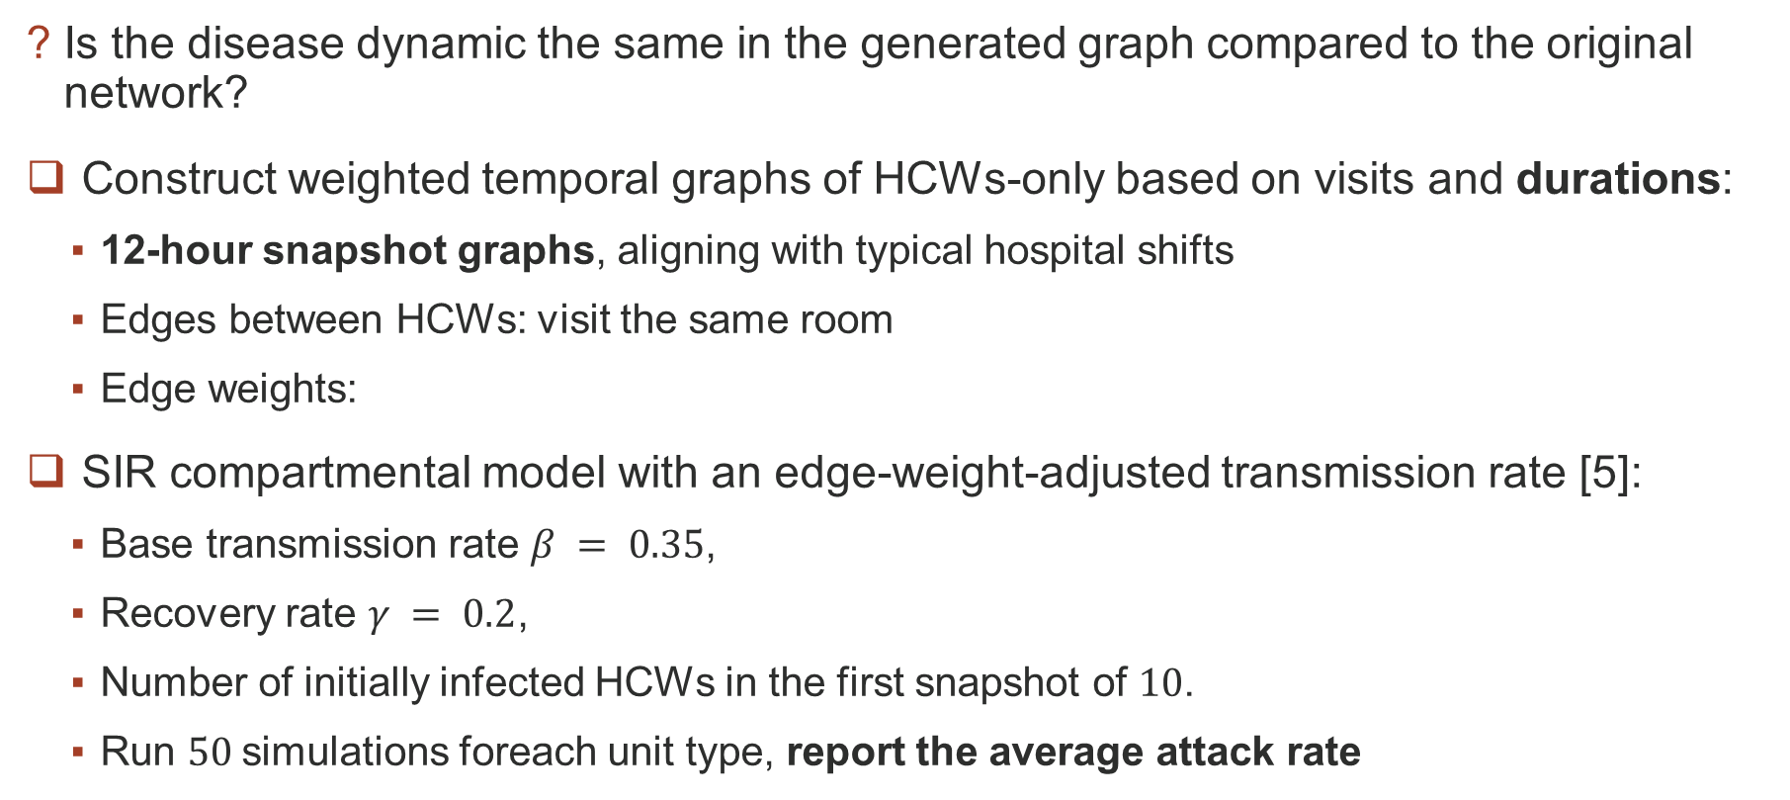
Results
Disease Simulation
Is the disease dynamic the same in the generated graph compared to the original network?
Construct weighted temporal graphs of HCWs-only based on visits and durations:
12-hour snapshot graphs, aligning with typical hospital shifts
Edges between HCWs: visit the same room
Edge weights:
SIR compartmental model with an edge-weight-adjusted transmission rate [5]:
Base transmission rate $β = 0.35$,
Recovery rate $γ = 0.2$,
Number of initially infected HCWs in the first snapshot of $10$.
Run $50$simulations foreach unit type, report the average attack rate
Overlapping duration
Notes:
The second question: “is the disease dynamic the same in the generated graph compared to the original network?”
We try to simulate a disease model on both temporal graphs and report their attack rates.
[CLICK] To construct weighted temporal graphs, we project them on the set of HCWs. Visits are grouped into 12-hour snapshot, which aligns with typical hospital shift. HCWs that visit the same room are connected, and the edge weights are visit durations, with emphasizing the overlapping time, giving higher infected probability.
[CLICK] For the disease model, we use SIR compartmental model. We run 50 simulations for each unit type and report the average attack rates.

Slide 18
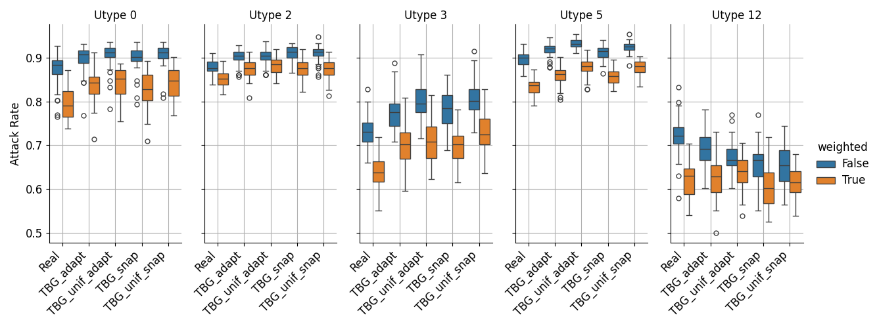
Results
Disease Simulation
Highlight the difference between considering and ignoring duration information
Given the same disease model, ignoring the duration information (unweighted) consistently leads to higher attack rates compared to the weighted version
Our generative model effectively captures the unique characteristics of the data from each unit type
Notes:
The results highlights the difference between considering and ignoring duration information.
[CLICK] As we can see, given the same disease model, ignoring the duration consistently leads to higher attack rates.
[CLICK] Also, we observe that the attack rates are quite different for each unit type, but highly correlated between synthetic and real data, which shows that, our generative model can effectively capture the unique characteristics of the data for each unit type.

Slide 19
Conclusion
We proposed TempoBiGen - a curated generative framework for realistic healthcare mobility logs
Key Contributions
Extended temporal graph generation model to conditional bipartite setting (HCWs ↔ rooms)
Developed coarse-grained & fine-grained merging procedure for high-resolution events generation
Incorporated a post-processing module to generate realistic visit durations
Results
Preserves daily snapshot graph properties
Produces realistic disease spread dynamics
Captures unit-specific shift patterns
Benefits
Enables privacy-preserving, high-fidelity synthetic mobility data
Supports epidemiological modeling & intervention planning in healthcare facilities
Notes:
In conclusion our contributions are in three folds.
First, we extended temporal graph generation model to conditional bipartite setting.
Second, we developed coarse-grained and fine-grained merging procedure for high resolution events generation.
Third, we incorporated a post processing module to generate realistic visit duration.
The synthetic data can preserve daily snapshot-graph properties, produce realistic disease spread dynamics. and also capture unit specific shift patterns.
Our work can enable privacy-preserving and high-fidelity synthetic mobility data. As the result, it supports the disease modeling and intervention planning in healthcare facilities.

Slide 20






Authors
Hieu Vu
Alberto M. Segre
Bijaya Adhikari
Contact: hieu-vu@uiowa.edu
Code: https://github.com/hieuvt29/TempoBiGen
Notes:
You can access the code at this link, and if you have any questions, please send it to the author’s email.
Thank you for listening!

Slide 21
References
[1] Gupta, Shubham, et al. "Tigger: Scalable generative modelling for temporal interaction graphs." Proceedings of the AAAI Conference on Artificial Intelligence. Vol. 36. No. 6. 2022.
[2] Zhou, Dawei, et al. "A data-driven graph generative model for temporal interaction networks." Proceedings of the 26th ACM SIGKDD International Conference on Knowledge Discovery & Data Mining. 2020.
[3] Zeno, Giselle, Timothy La Fond, and Jennifer Neville. "Dymond: Dynamic motif-nodes network generative model." Proceedings of the Web Conference 2021. 2021.
[4] Zhang, Liming, et al. "TG-GAN: Continuous-time temporal graph deep generative models with time-validity constraints." Proceedings of the Web Conference 2021. 2021.
[5] Kamp, Christel, Mathieu Moslonka-Lefebvre, and Samuel Alizon. "Epidemic spread on weighted networks." PLoS computational biology 9.12 (2013): e1003352.
Notes:
These are the references.

