Slide 1

2. Numbering systems
Subtitle
Notes:
NOTE:
To change the image on this slide, select the picture and delete it. Then click the Pictures icon in the placeholder to insert your own image.

Slide 2
Content
2.1 Introduction
2.2 Positional Number Systems
2.3 Conversion

Slide 3
Objectives
After studying this chapter, the student should be able to:
Understand the concept of number systems.
Distinguish between non-positional and positional number systems.
Describe the decimal system (base 10).
Describe the binary system (base 2).
Describe the hexadecimal system (base 16).
Describe the octal system (base 8).
Convert a number in binary, octal, or hexadecimal to a number in the decimal system.
Convert a number in the decimal system to a number in binary, octal, or hexadecimal.
Find the number of digits needed in each system to represent a particular value.

Slide 4
1-Introduction

Slide 5
1- Introduction
A number system (or numeral system) defines how a number can be represented using distinct symbols.
A number can be represented differently in different systems.
For example, the two numbers (2A)16 and (52)8 both refer to the same quantity, (42)10, but their representations are different. This is the same as using.
Figure -2.1 Types of number system

Slide 6
2 - Positional Number Systems

Slide 7
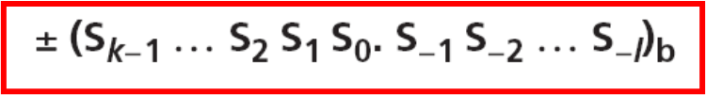
Introduction
In a positional number system, the position a symbol occupies in the number determines the value it represents.
In this system, a number represented as:
has the value of:
in which S is the set of symbols, b is the base (or radix)

Slide 8
The decimal system (base 10)
The word decimal is derived from the Latin root decem (ten). In this system the base b = 10 and we use ten symbols to represent a number.
The set of symbols is S = {0, 1, 2, 3, 4, 5, 6, 7, 8, 9}. As we know, the symbols in this system are often referred to as decimal digits or just digits.
In the decimal system, a number is written as:

Slide 9
The binary system (base 2)
The second positional number system we discuss in this chapter is the binary system.
The word binary is derived from the Latin root bini (or two by two). In this system the base b = 2 and we use only two symbols, S = {0, 1}. The symbols in this system are often referred to as binary digits or bits (binary digit.
Data and programs are stored in the computer using binary patterns, a string of bits.
Example 2.1 the number (101.11)2 in binary = 5.75 in decimal

Slide 10
The hexadecimal system (base 16)
Problems :
The decimal system does not show what is stored in the computer as binary directly—there is no obvious relationship between the number of bits in binary and the number of decimal digits. Conversion from one to the other is not fast, as we will see shortly.
To overcome this problem, two positional systems were devised: hexadecimal and octal.
We first discuss the hexadecimal system, which is more common. The word hexadecimal is derived from the Greek root hex (six) and the Latin root decem (ten).
To be consistent with decimal and binary, it should really have been called sexadecimal, from the Latin roots sex and decem. In this system the base b = 16 and we use 16 symbols to represent a number. The set of symbols is S = {0, 1, 2, 3, 4, 5, 6, 7, 8, 9, A, B, C, D, E, F}.
Example 2.2 the number (2AE)16 in hexadecimal = 686 in decimal

Slide 11
The octal system (base 8)
The second system that was devised to show the equivalent of the binary system outside the computer is the octal system.
The word octal is derived from the Latin root octo (eight). In this system the base b = 8 and we use eight symbols to represent a number.
The set of symbols is S = {0, 1, 2, 3, 4, 5, 6, 7}. The symbols in this system are often referred to as octal digits
Example 2.3 the number (1256)8 in octal = 686 in decimal:

Slide 12

The decimal system (base 10)
1235
1₃2₂3₁5₀
1x10³ + 2x10² + 3x10¹ + 5x10⁰
135.46
1₂3₁5₀.4₋₁6₋₂
1x10² + 3x10¹ + 5x10⁰ + 4x10⁻¹ + 6x10⁻²

Slide 13
The binary system (base 2)
1011
1₃0₂1₁1₀
1x2³ + 0x2² + 1x2¹ + 1x2⁰
101.11
1₂0₁1₀.1₋₁1₋₂
1x2² + 0x2¹ + 1x2⁰ + 1x2⁻¹ + 1x2⁻²

Slide 14
The hexadecimal system (base 16)
B9A2
B₃9₂A₁2₀
11x16³ + 9x16² + 10x16¹ + 2x16⁰
9A2.45
9₂A₁2₀.4₋₁5₋₂
9x16² + 10x16¹ + 2x16⁰ + 4x16⁻¹ + 5x16⁻²

Slide 15
The octal system (base 8)
1235
1₃2₂3₁5₀
1x8³ + 2x8² + 3x8¹ + 5x8⁰
135.46
1₂3₁5₀.4₋₁6₋₂
1x8² + 3x8¹ + 5x8⁰ + 4x8⁻¹ + 6x8⁻²

Slide 16
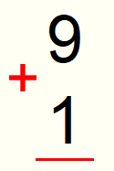


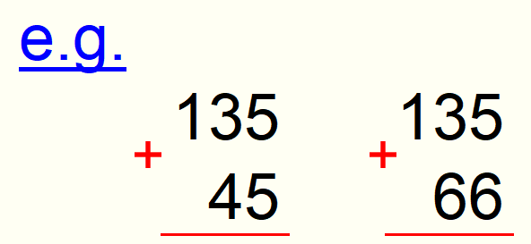



Counting in the decimal system (base 10)

Slide 17
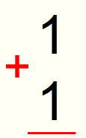


Counting in the binary system (base 2)

Slide 18
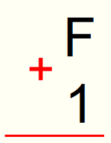
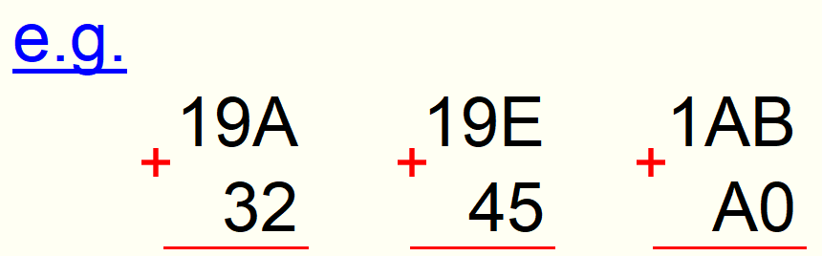



Counting in the hexadecimal system (base 16)

Slide 19
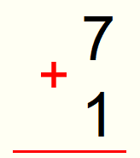
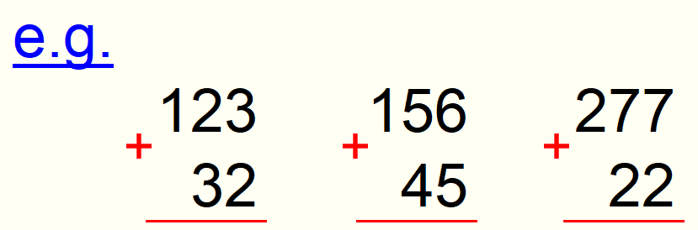



Counting in the octal system (base 8)

Slide 20
Summary of the four positional systems
Table 2.1 Summary of the four positional number systems

Slide 21
Discussion
Why is the base 2 system used in computers?
Why are base 16 and base 8 systems used by computers instead of base 10 systems?

Slide 22
3 - Conversion

Slide 23
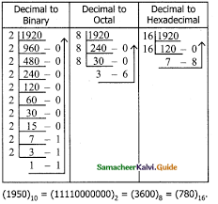
Introduction
We need to know how to convert a number in one system to the equivalent number in another system. Since the decimal system is more familiar than the other systems,.
First show how to covert from any base to decimal.
Then show how to convert from decimal to any base.
Finally, show how we can easily convert from binary to hexadecimal or octal and vice versa.

Slide 24
Covert from any base to decimal
Figure 2.2 Converting other bases to decimal

Slide 25
Covert from any base to decimal (examples)
Example 3.1 Convert the binary number (110.11)2 to decimal: (110.11)2 = 6.75
Example 2.3 Convert the hexadecimal number (1A.23)16 to decimal : 1A.23 = 26.137

Slide 26
Convert from decimal to any base.
We can convert a decimal number to its equivalent in any base. We need two procedures, one for the integral part and one for the fractional part.
Convert 35 in decimal to binary.
Convert 126 in decimal to Octal.
Figure 2.3 Algorithm to convert the integral part

Slide 27
Convert from decimal to any base (cont).
Convert decimal number 0.625 to binary
Convert 0.634 to octal using a maximum of four digits
Figure 2.4 Algorithm to convert the fractional part

Slide 28

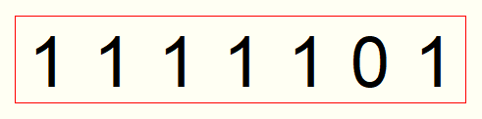
Convert from decimal to binary system (base 2)

Slide 29

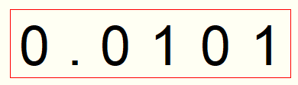
Convert from decimal to binary system (base 2)

Slide 30
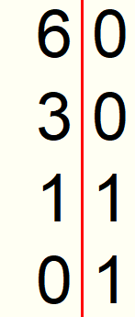
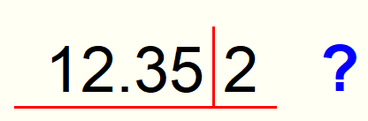
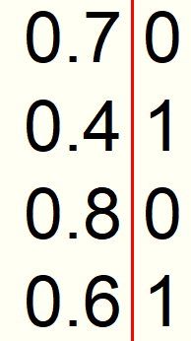
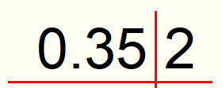
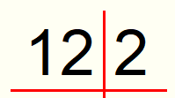


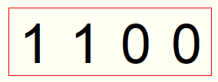
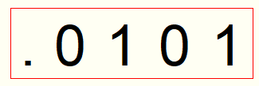
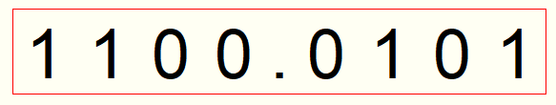
Convert from decimal to binary system (base 2)

Slide 31
Binary–hexadecimal conversion
Figure 2.5 Binary to hexadecimal and hexadecimal to binary
Example 2.4
What is the binary equivalent of (24C)16?
Solution
Each hexadecimal digit is converted to 4-bit patterns: 2 → 0010, 4 → 0100, and C → 1100.
The result is (001001001100)2.

Slide 32
Binary–octal conversion
Figure 2.6 Binary to octal conversion
Example 2.5
What is the binary equivalent of for (24)8?
Solution
Write each octal digit as its equivalent bit pattern to get (010100)2.

Slide 33
Octal–hexadecimal conversion
Figure 2.7 Octal to hexadecimal and hexadecimal to octal conversion

