Slide 1
Hi
Febriansyah

Slide 2

Professional Scrum Master
Hi
Febriansyah
Certification Experience

Slide 3
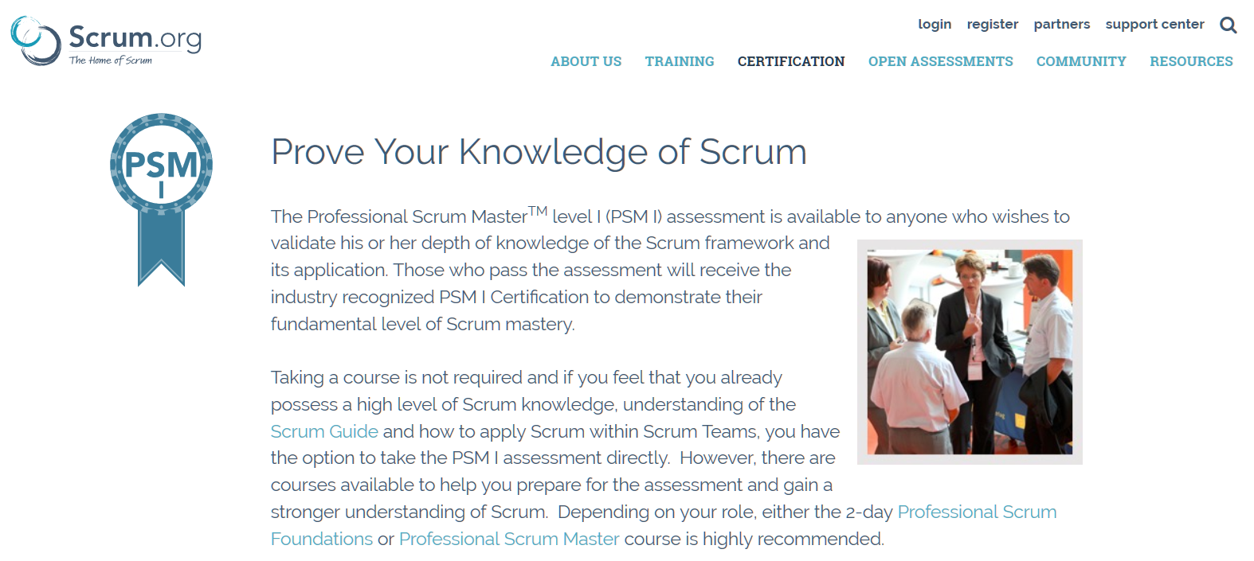
Professional Scrum Master
Febriansyah
Certification Experience
#1
PSM
what and why?

Slide 4
Professional Scrum Master
Certification Experience
#1
PSM
what and why?

Slide 5
PSM
#1
what and why?
Scrum
!
Knowledge
Validation

Slide 6

!
Scrum
Benefits
of
Knowledge
Validation

Slide 7
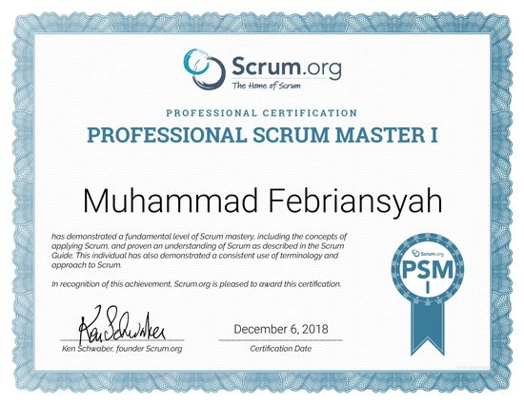
!
Scrum
Benefits
of
Knowledge
Validation
Only paper?

Slide 8
Benefits
Know which do / not
Avoid Assumptions
of
Knowledge
Validation
Increase Reputation
Only paper?

Slide 9
!
Scrum
Benefits
Knowledge
Know which do / not
Validation
Avoid Assumptions
Increase Reputation
Only paper?

Slide 10
Benefits
Know which do / not
Avoid Assumptions
=
$
$
$
Increase Reputation

Slide 11

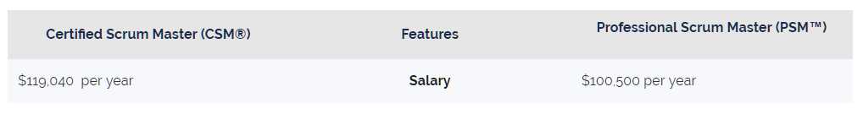
=
$
$
$
Increase Reputation
Knowledgehut.com
vs
By Frederik Vannieuwenhuyse, 2018.

Slide 12
Increase Reputation
=
$
$
$
Knowledgehut.com
vs
By Frederik Vannieuwenhuyse, 2018.
$
1
0
0
K

Slide 13
Knowledgehut.com
vs
By Frederik Vannieuwenhuyse, 2018.
#1
PSM
=
Rp
$
1
0
0
K
1
1
8
Jt
what and why?
yearly
monthly

Slide 14

=
$
Rp
1
0
0
K
1
1
8
Jt
yearly
monthly

Slide 15
=
$
Rp
1
0
0
K
1
1
8
Jt
yearly
monthly
Challenging

Slide 16
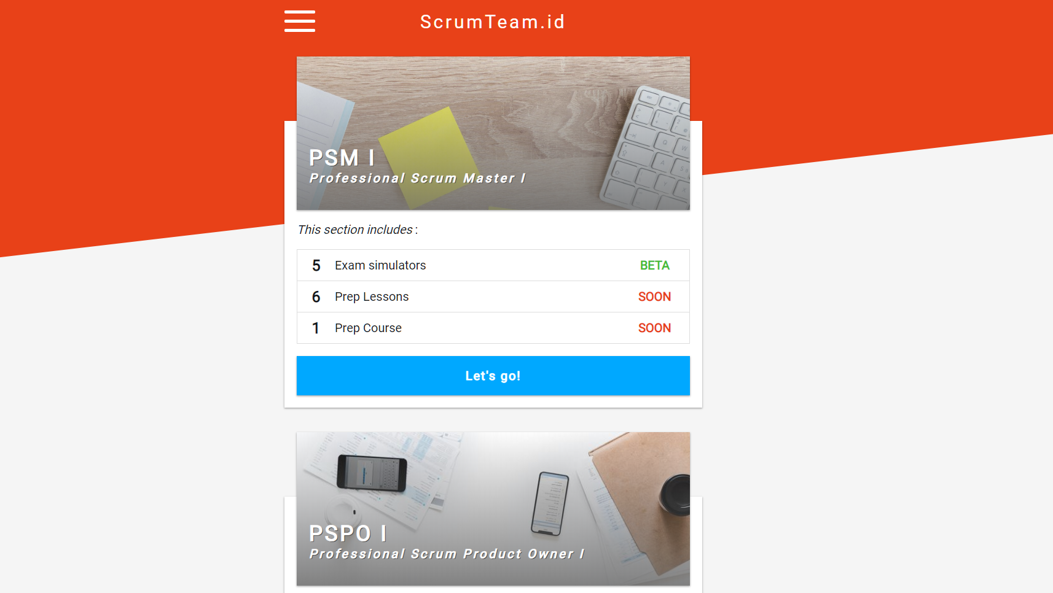
Rp
Challenging
1
1
8
Jt
monthly

Slide 17
Challenging
>
$
$
$
$
$

Slide 18


>
$
$
$
$
$

Slide 19
>
$
$
$
$
$
Leave comments

Slide 20
Leave comments
See You!

Slide 21
Leave comments
See You!

