Slide 1
Hi
Febriansyah

Slide 2
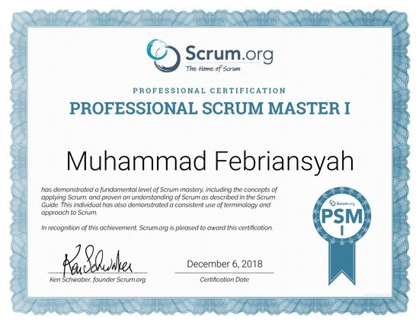
Hi
Febriansyah

Slide 3
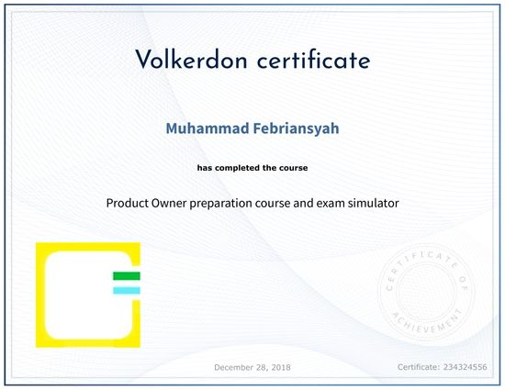
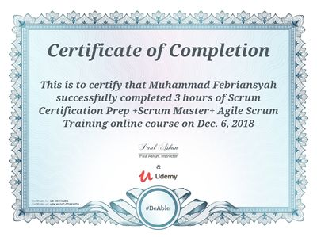
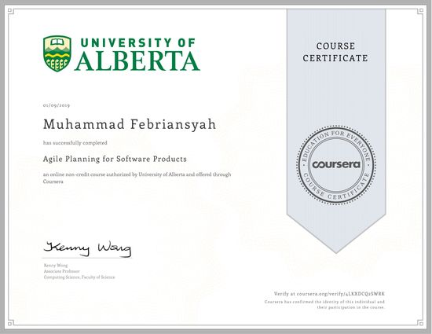
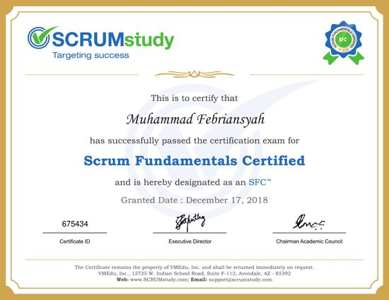
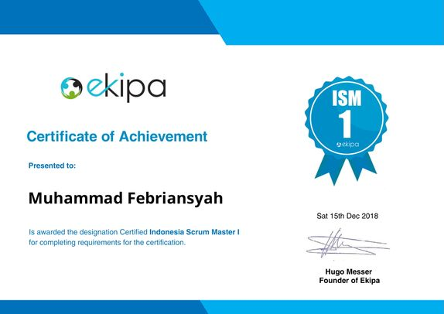
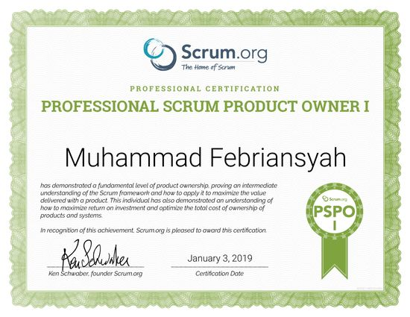
Febriansyah

Slide 6

Professional Scrum Master
A lot more
Certification Experience
Certification

Slide 7
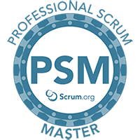
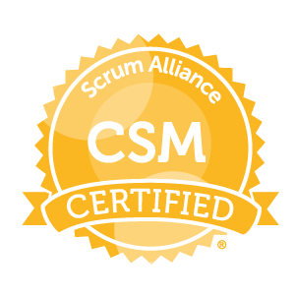

Professional Scrum Master
A lot more
Certification Experience
PSM, CSM and ISM
The differences

Slide 8

Professional Scrum Master
Certification Experience
PSM, CSM and ISM
The differences
PSM I Lessons
Training or Self Learning?

Slide 9
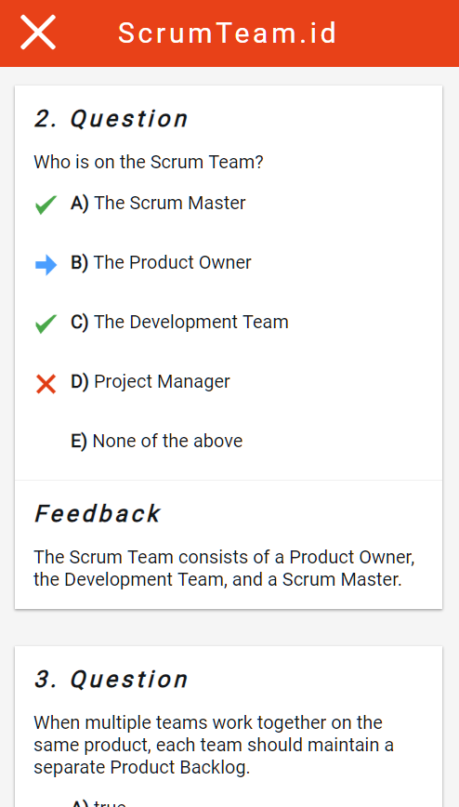
PSM I Mock Test
PSM I Lessons
Recommendations
Training or Self Learning?
PSM, CSM and ISM
The differences

Slide 10
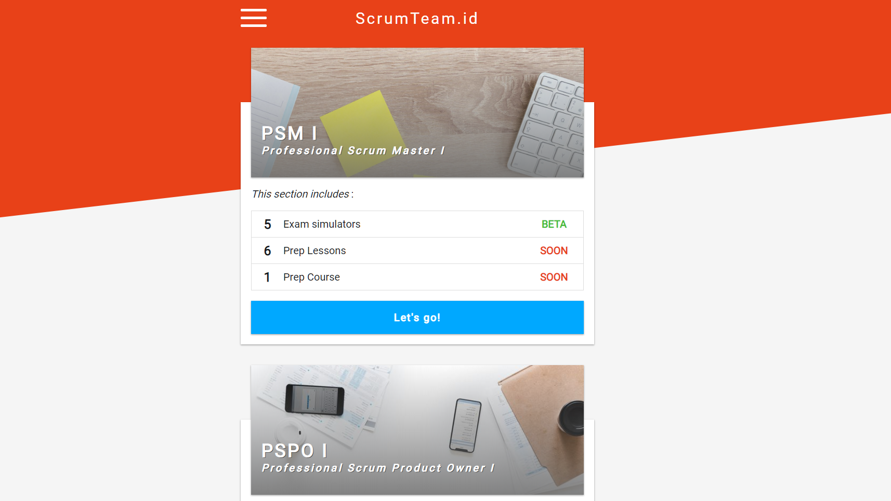
PSM I Mock Test
PSM I Lessons
Recommendations
Training or Self Learning?

Slide 11

PSM I Mock Test
Recommendations
Many more to come!

Slide 12


Many more to come!

Slide 13
Many more to come!
See You!

Slide 14
See You!

