Slide 1
Hi
Febriansyah

Slide 2

Professional Scrum Master
Hi
Febriansyah
Certification Experience

Slide 3
Professional Scrum Master
Febriansyah
Certification Experience
#2
Assessment
Easy or not?

Slide 4
Professional Scrum Master
Certification Experience
#2
Assessment
Easy or not?
PSM
|
Knowledge
Validation

Slide 5
Assessment
#2
Easy or not?
PSM
|
Knowledge
Validation
Assessment

Slide 6
PSM
|
Knowledge
Assessment
Validation
80 Questions

Slide 7
Knowledge
Validation
|
Assessment
80 Questions
60 Minutes

Slide 8
80 Questions
|
Assessment
60 Minutes
Passing
Score
85%

Slide 9

Assessment
60 Minutes
Passing
|
85%
Not Easy!
Score

Slide 10
85%
Passing
|
Not Easy!
Score
Tricky!

Slide 11
85%
Not Easy!
Tricky!
Rigorous!

Slide 12
Not Easy!
Passable!
Tricky!
Rigorous!

Slide 13

Not Easy!
With good
Passable!
Tricky!
Preparations
Rigorous!

Slide 14
With good
Training
Passable!
or
Self Study
Preparations

Slide 15
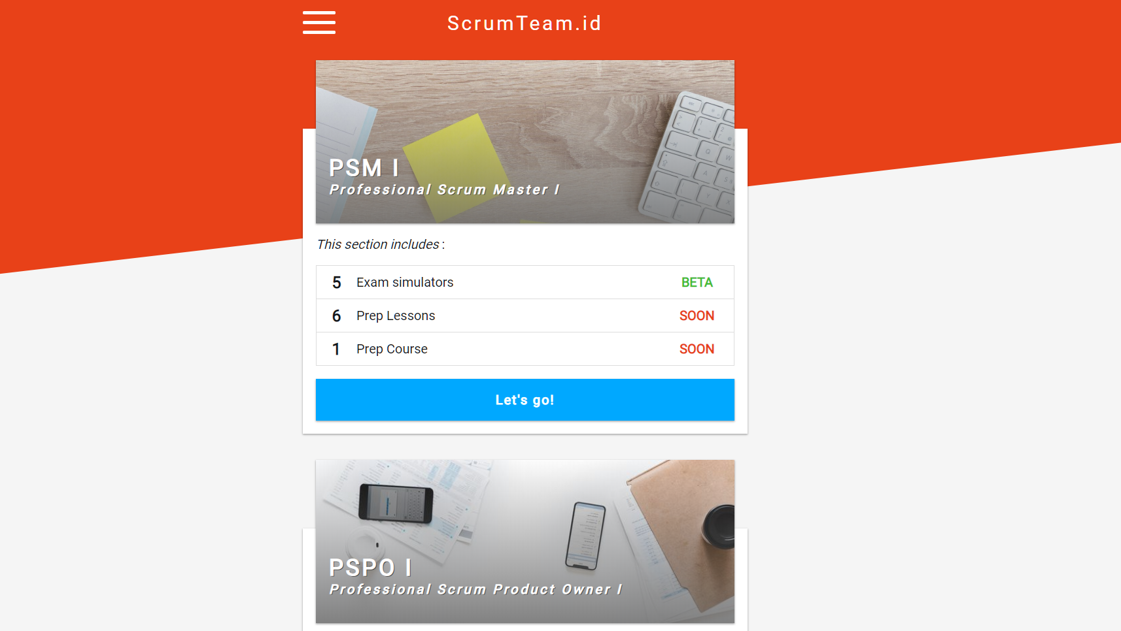
With good
Training
or
Self Study
Preparations

Slide 16
Good
Preparations!
Self Study
or
Training

Slide 17


Good
Preparations!

Slide 18
Good
Preparations!
Leave comments

Slide 19
Leave comments
See You!

Slide 20
Leave comments
See You!

