Slide 23
Like & Subsribe!

Slide 24
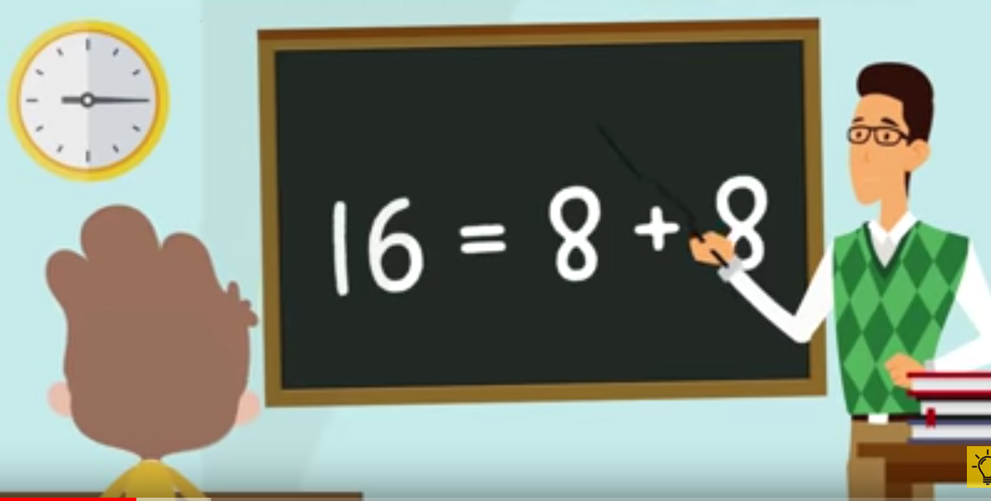

Slide 25
