Slide 1

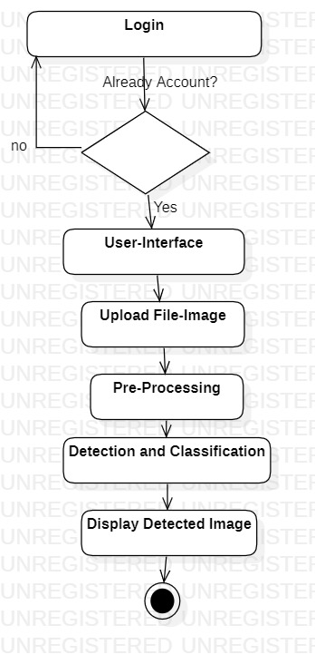
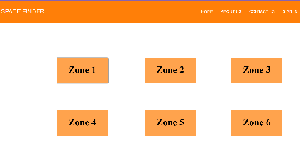
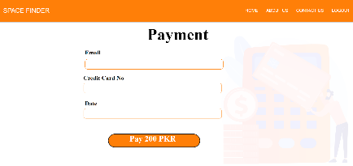
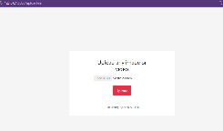
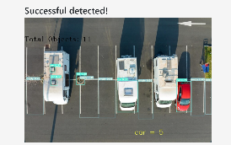

VEHICLE DETECTION & PARKING LOTS MANAGEMENT SYSTEM ^{Final Year Project (2019-2023)} ^{Department of Computer Science} COMSATS University Islamabad, Attock Campus
Introduction
Automated Vehicle Detection and Assign Parking Area to their respective vehicle.
Our System will detect upcoming vehicle using CCTV camera and then automatically allocate space to them.
Record vehicle information taken from detection in database for assigning space to vehicle available in the parking lot.
User (Driver) will use our web based system to login itself first then will find parking space according to his/her vehicle type.
This will help user(driver) to find vacant space easily without wastage of time.
Motivations
Motivation behind implementing a smart parking lot management system using surveillance cameras is to create a more efficient, user-friendly, secure, and sustainable parking experience for both drivers and parking lot operators. Searching for parking can be a frustrating experience for drivers, leading to stress and wasted time. Through smart parking system, drivers can access information about available parking spaces using website.
System Background
There are some problems with the existing systems which are identified below:
They are connected through Bluetooth and sensors.
Manually system not gathered the accurate data and not understand the future issues.
These system cannot handle real time issues .
In manual system not provide the vehicle safety and security.
Architecture
Results
Conclusion
The algorithm was first analyzed to run on the images, specifically on the parking images of different conditions. It detected the cars and free spaces in the parking but some extra detections are not required in our project.
Our primary goal was to detect the filled and empty. We can claim to have achieved almost 85% accuracy. Whenever a car leaves the parking, the live video is fed into the code, it detects the new slots and updates the database, The Website asks the database to send data and the website is updated. Another achievement is the real-time updating of parking slots. whenever a car leaves the parking slot, the website is updated as soon as it leaves the slot.
User Application
Main pages of interface of our App.
Future Directions
In future we can extend its functionality and it performs the basic task of providing information about free slots.
The only zone that is working in this application is zone 1. The remaining zones are left for future work.
We can also represent the parking info in a graphical way in the future in a better interaction of interface.
In this system we can also use Google maps in future to for approaching international market because its is basically we developed in Pakistan environment.
Objectives
Group Members
Sidra Fayyaz
fa19-bse-023@cuiatk.edu.pk
Hifza Umer
fa19-bse-043@cuiatk.edu.pk
Supervisor:
Dr.Muazzam Maqsood
Automated Parking allocated system for Drivers.
Automated capture and detect vehicles using system from CCTV.
To increase the effectiveness of the utilization of CCTV cameras by employing them as the project's primary input source.
To save the people time and money.
To assist the community in overcoming this pointless annoyance brought on by the parking issue to advance our understanding of computer vision.

