Slide 1
RNNs

Slide 2
Hidden Recurrent Layer Outputs: ho1, ho2, ..
Previous sample hidden layer output: ph1, ph2, ..
Hidden Recurrent Layer
Next sample hidden layer input
Sample X2: x1, x2,..

Slide 3
Output
Dense Layer
Input

Slide 4
LABEL
RNN output
Dense Layer
Hidden Recurrent Layer Outputs: ho1, ho2, ..
Previous sample hidden layer output: ph1, ph2, ..
Hidden Recurrent Layer
Next sample hidden layer output: ph1, ph2, ..
Sample X2: x1, x2,..

Slide 5
LABEL
RNN output 1
RNN output 2
Dense Layer
Dense Layer
Hidden Recurrent Layer Outputs: ho1, ho2, ..
Hidden Recurrent Layer Outputs: ho1, ho2, ..
Previous sample hidden layer output: ph1, ph2, ..
Hidden Recurrent Layer
Previous sample hidden layer output: ph1, ph2, ..
Hidden Recurrent Layer
Sample X1: x1, x2,..
Sample X2: x1, x2,..
2 TIME-STEPS SEQUENCE

Slide 6
LABEL
RNN output
Dense Layer
Hidden Recurrent Layer Outputs: ho1, ho2, ..
Hidden Recurrent Layer Outputs: ho1, ho2, ..
Previous sample hidden layer output: ph1, ph2, ..
Hidden Recurrent Layer
Previous sample hidden layer output: ph1, ph2, ..
Hidden Recurrent Layer
Sample X1: x1, x2,..
Sample X2: x1, x2,..
2 TIME-STEPS SEQUENCE

Slide 7
LABEL
RNN output
Dense Layer
Hidden Recurrent Layer Outputs: ho1, ho2, ..
Hidden Recurrent Layer Outputs: ho1, ho2, ..
Previous sample hidden layer output: ph1, ph2, ..
Hidden Recurrent Layer
Previous sample hidden layer output: ph1, ph2, ..
Hidden Recurrent Layer
Sample X1: x1, x2,..
Sample X2: x1, x2,..
2 TIME-STEPS SEQUENCE

Slide 8
LSTMs

Slide 9
To next layer/ output prediction
Next sample LSTM input
(what was predicted at this sample)
LSTM cell
Filter output
Previous sample LSTM filter output
(what was memorized at the previous sample)
Filter new input and update short memory
Next sample LSTM short memory
(what was memorized at this sample)
Output Gate
Unfiltered Values
Input gate
Forget gate
Previous sample LSTM block output
(what was predicted at the previous sample)
Sample X1: x1, x2,..
Sample X1: x1, x2,..

Slide 10
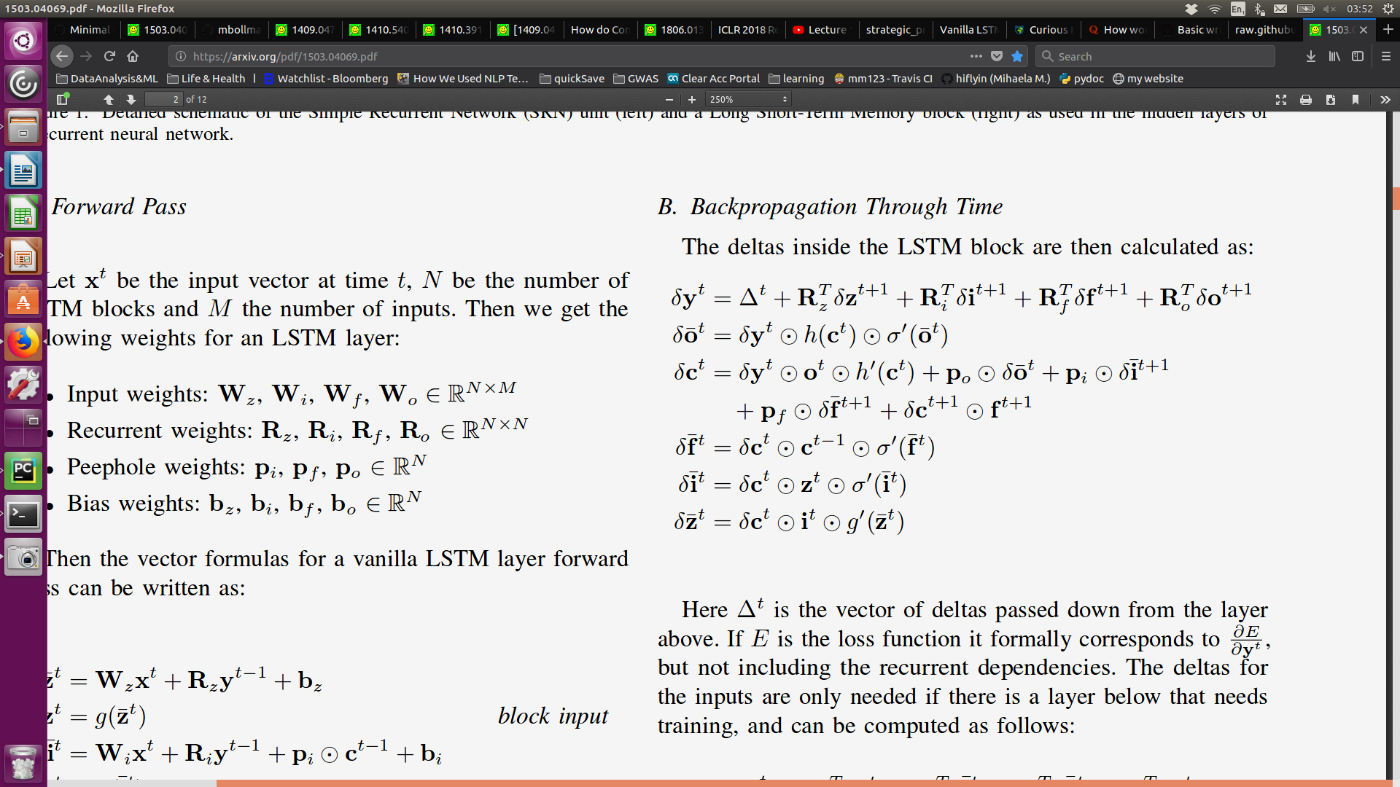
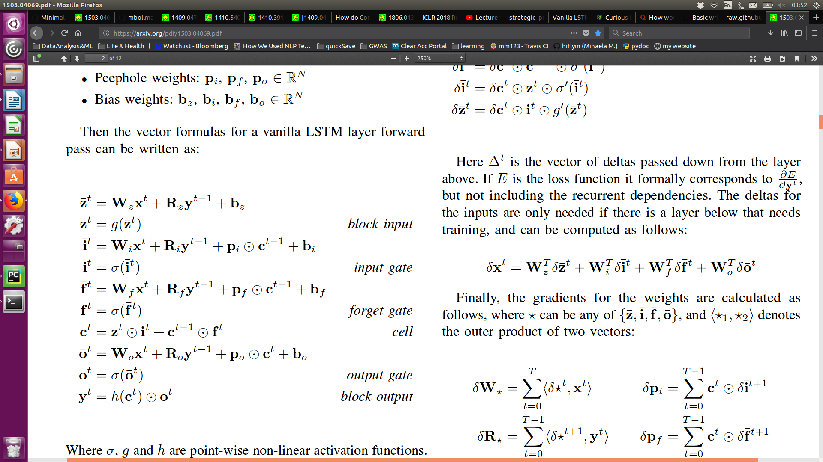
Filter new input and update short memory
Step 2. Append to existing network short term memory
(the previous sample short memory, filtered )
Step 1. Filter using network long term memory (the input gate)
Delta error back:
Raw prediction – without consulting network memory
Previous sample LSTM block output
(what was predicted at the previous sample)
Unfiltered Values
New Sample X: x1, x2,..
New Sample X: x1, x2,..

Slide 11
Filter new input and update short memory
Step 2. Append to existing network short term memory
(the previous sample short memory, filtered )
Step 1. Apply the input gate filter
to the raw prediction values
Delta error back:
Prediction of what information is useful from the new sample
and the previous sample prediction
Previous sample LSTM block output
(what was predicted at the previous sample)
Input Gate
New Sample X: x1, x2,..
New Sample X: x1, x2,..

Slide 12
Filter new input and update short memory
Step 2. Append to existing network short term memory
(the previous sample short memory, filtered )
Step 1. Use the forget prediction to update existing short term memory
Delta error back:
Prediction of what information is useful for updating the short
term memory
Previous sample LSTM block output
(what was predicted at the previous sample)
Forget Gate
New Sample X: x1, x2,..
New Sample X: x1, x2,..

Slide 13
Filter output for prediction
Step 2.Filter raw prediction to output
Step 1. Receive raw prediction based on sample input and short memory
Delta error back:
Prediction of what information is useful for deciding the output prediction
Previous sample LSTM block output
(what was predicted at the previous sample)
Output Gate
New Sample X: x1, x2,..
New Sample X: x1, x2,..

Slide 14
Output Filter
Filter exisiting memory to make prediction of the current sample
Delta error back:
Filter new input and update short memory
1. Apply the input gate filter to the unfiltered values
2. Apply to forget gate to existing short term
memory and update this memory with the new input
Delta error back:
Next sample LSTM
filter
(what was memorized at this sample)
Previous sample LSTM filter output
(what was memorized at the previous sample)
Total filter delta error:
What information is useful for both this sample prediction and next sample as memory
(short-term memory)
What information is useful as memory for next sample
prediction (short-term memory)
What information from previous sample (short-term memory) is useful for this sample and next sample prediction
Unfiltered Values
Input gate
Forget gate
Unfiltered Values

Slide 15
Next sample LSTM input
(what was predicted at this sample)
To next layer/ output prediction
Output delta
error back:
Next sample delta error back:
Filter output
Filter short memory values using output gate, to output
prediction for current sample
Total delta:
Prediction of what information is useful for deciding the output prediction
Short Memory values
Output Gate
Filter new input and update short memory

Slide 16
LABEL
output
Dense Layer
LSTM cell output/ prediction
Previous sample LSTM prediction
LSTM Cell
Current LSTM short memory
Sample X2: x1, x2,..

Slide 17
LABEL
LSTM output 1
LSTM output 2
Dense Layer
Dense Layer
LSTM cell output/ prediction
LSTM cell output/ prediction
Previous sample LSTM prediction
Previous sample LSTM prediction
LSTM Cell
LSTM Cell
Current LSTM short memory
Current LSTM short memory
Sample X1: x1, x2,..
Sample X2: x1, x2,..
2 TIME-STEPS SEQUENCE

Slide 18
LABEL
network output
Dense Layer
LSTM cell output/ prediction
LSTM cell output/ prediction
Previous sample LSTM prediction
Previous sample LSTM prediction
LSTM Cell
LSTM Cell
Current LSTM short memory
Current LSTM short memory
Sample X1: x1, x2,..
Sample X2: x1, x2,..
2 TIME-STEPS SEQUENCE

Slide 19
LABEL
network output
Dense Layer
LSTM cell output/ prediction
LSTM cell output/ prediction
Previous sample LSTM prediction
Previous sample LSTM prediction
LSTM Cell
LSTM Cell
Current LSTM short memory
Current LSTM short memory
Sample X1: x1, x2,..
Sample X2: x1, x2,..
2 TIME-STEPS SEQUENCE

Slide 20
RL: Breakout

Slide 21
Agent
- decide action
- take action and get reward
- attribute some of the reward to preceding actions
- learn from mistakes / improve reward model
Reward model
Objective
Maximize reward
Learn from mistakes
Take actions (play games)
Acumulate (action, reward)
experience samples

Slide 22
Attention Mechanism

Slide 23
LABEL
output
Dense Layer
LSTM cell output/ prediction
Previous sample LSTM prediction
LSTM Cell
Current LSTM short memory

Slide 24
Current Network State / Current LSTM short memory
Attention Layer
Attention Inputs
LSTM output 1
LSTM output 2
Dense Layer
Dense Layer
LSTM cell output/ prediction
LSTM cell output/ prediction
Previous sample LSTM prediction
Previous sample LSTM prediction
LSTM Cell
LSTM Cell
Current LSTM short memory
Current LSTM short memory
Sample X1: x1, x2,..
Sample X2: x1, x2,..
2 TIME-STEPS SEQUENCE

Slide 25
.. whatever the desired layers further
LSTM cell output/ prediction
LSTM cell output/ prediction
Previous sample LSTM prediction
Previous sample LSTM prediction
LSTM Cell
LSTM Cell
Current LSTM short memory
Current LSTM short memory
Attention Layer
Attention Layer
Attention Inputs
Attention Inputs
LSTM output 1
LSTM output 2
Sample X1: x1, x2,..
Sample X2: x1, x2,..
2 TIME-STEPS SEQUENCE

Slide 26
.. whatever the desired layers further
.. whatever the desired layers further
Some recurrent layer
Some recurrent layer
Current net memory/ state
Current net memory/ state
Attention Layer
Attention Layer
Attention Inputs
Attention Inputs
Input 1: x1, x2,. ….. Input n: x1, x2,..
Input 1: x1, x2,. ….. Input n: x1, x2,..
Several Inputs or Sequence
Several Inputs or Sequence

Slide 27
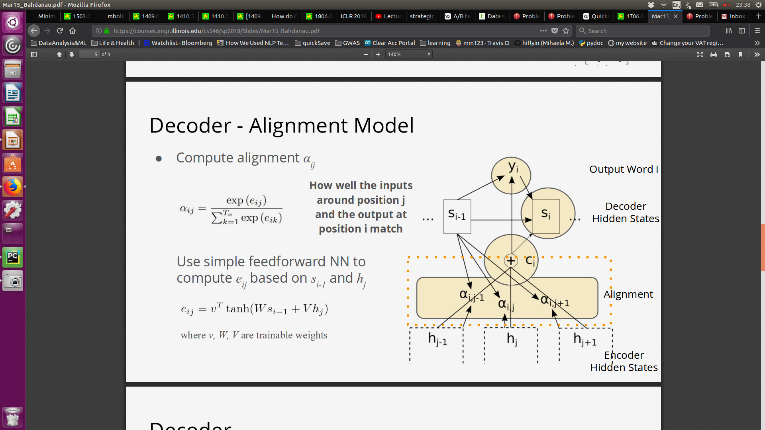
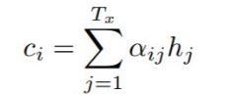
.. whatever the desired layers further
.. whatever the desired layers further
Some recurrent layer
Some recurrent layer
Current net memory/ state
Current net memory/ state
Attention Layer
Attention Layer
Attention Inputs
Attention Inputs
Input 1: x1, x2,. ….. Input n: x1, x2,..
Input 1: x1, x2,. ….. Input n: x1, x2,..
Several Inputs or Sequence
Several Inputs or Sequence

