Slide 1


Linux
END GOAL: Grasp a fundamental understanding of Linux and bash shell scripting in 15 minutes.

Slide 2

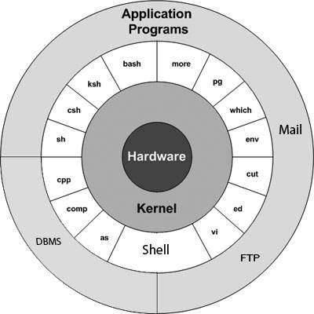
Brief history
Linux is a free and open-source operating system based on the Unix operating system.
Linux had become an alternative to operating systems such as Windows and macOS around mid-90s.
Used in smartphones, servers, supercomputers and embedded systems.
Distros: Ubuntu, Debian, and Red Hat.
Ted Talk: The mind behind Linux
Notes:
https://github.com/torvalds/linux
What is the Unix operating system?
Unix is a family of multi-tasking, multi-user computer operating systems.
Unix introduced many innovative concepts that have since become standard features of modern operating systems, including the file system hierarchy, the use of a shell for command-line interaction, and the idea of small, single-purpose utilities that can be combined to perform complex tasks.
How is linux used in smartphones, servers, supercomputers, and embedded systems?
Linux is a versatile operating system that can be used in a wide range of applications. Here are some examples of how Linux is used in different types of systems:
Smartphones: Linux is used as the operating system in many smartphones, particularly those based on the Android platform. Android is a modified version of Linux that is designed for use on mobile devices.
Servers: Linux is a popular choice for server operating systems, particularly in enterprise and cloud computing environments. Linux-based servers are known for their stability, security, and flexibility.
Supercomputers: Linux is widely used in supercomputing clusters due to its scalability and high-performance capabilities. Some of the world's fastest supercomputers, such as the Tianhe-2 in China, run Linux.
Embedded Systems: Linux is often used in embedded systems, which are computer systems that are integrated into other devices such as cars, appliances, and industrial machinery. Linux's flexibility and open-source nature make it well-suited for use in embedded systems.
In each of these applications, Linux provides a reliable and customizable operating system that can be tailored to meet the specific needs of the system. Its open-source nature allows developers to modify and enhance the system to improve performance, security, and functionality.

Slide 3
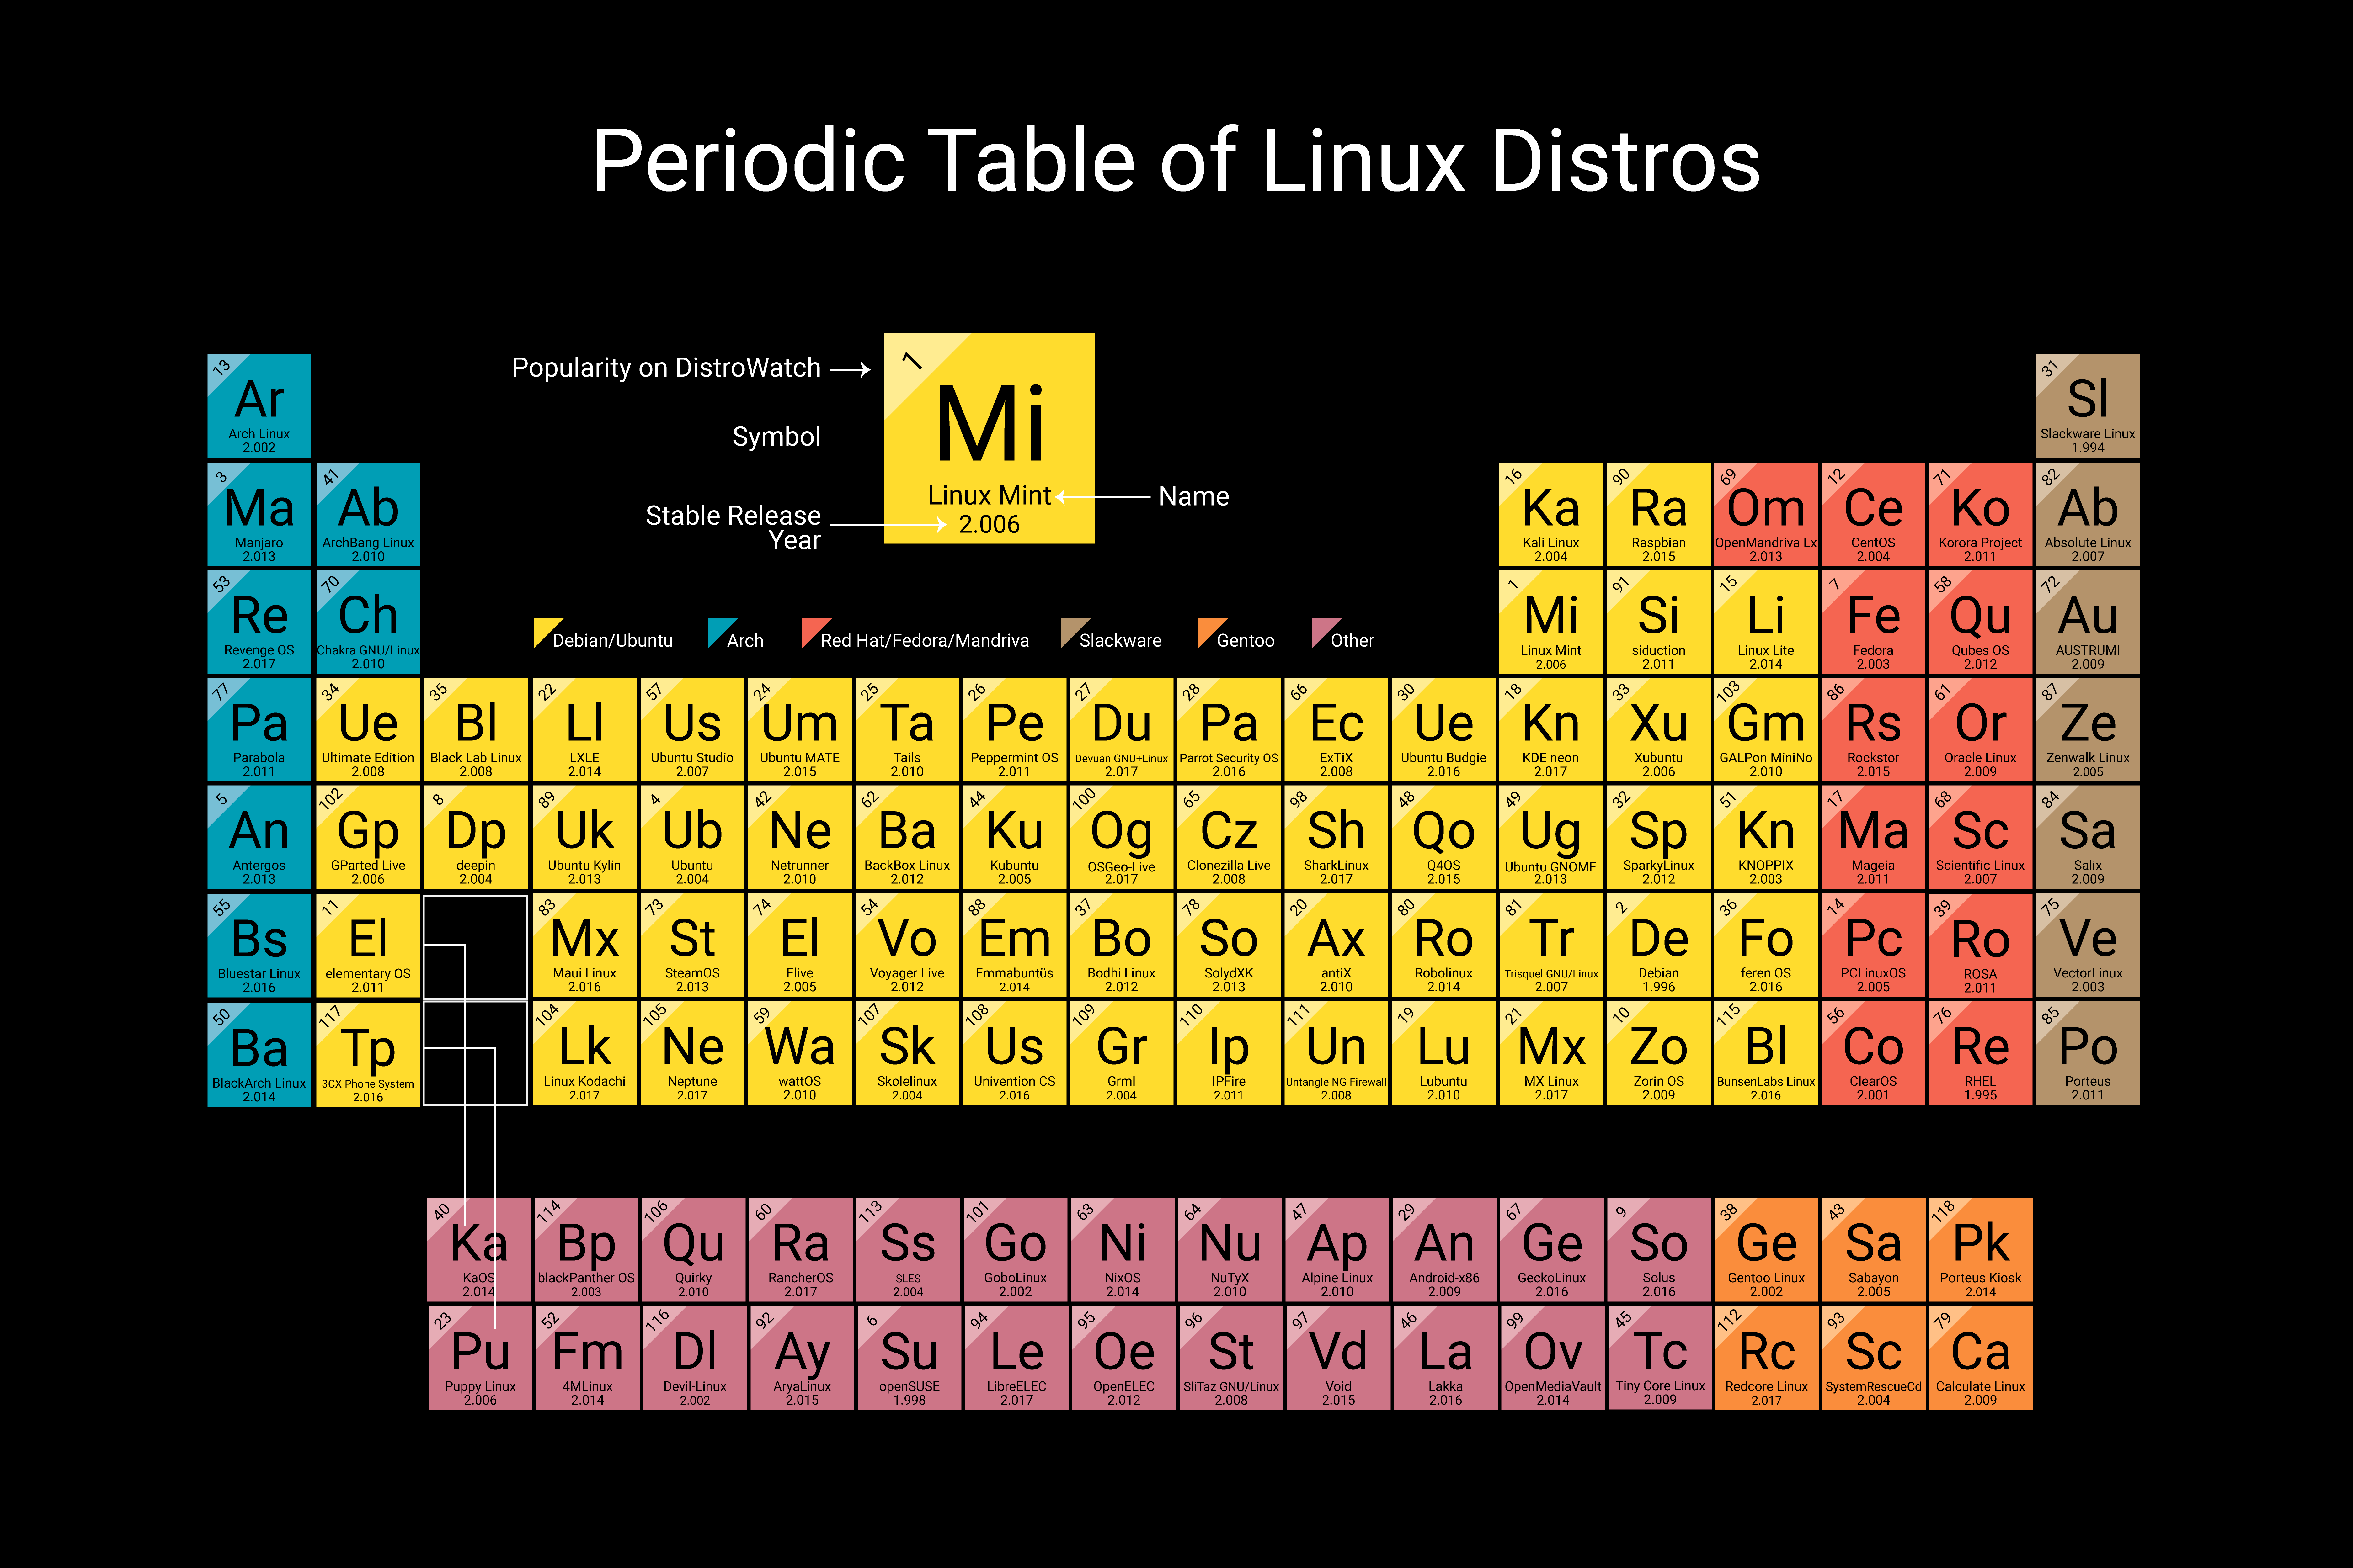
Notes:
Linux distros are named after characters from popular culture or places. For example, Ubuntu is named after a South African philosophy that means "humanity to others", while Fedora is named after a type of hat that was popular in the early 20th century.
Many Linux distros are community-driven, which means that they are developed and maintained by volunteers around the world. These volunteers are often passionate about open-source software and the ideals behind it.
Linux distros can be incredibly lightweight, and are often used on older or less powerful hardware. For example, the Raspberry Pi, a popular small computer for hobbyists, often runs on a lightweight Linux distro called Raspbian. This allows the Raspberry Pi to perform many tasks while using minimal resources.

Slide 4
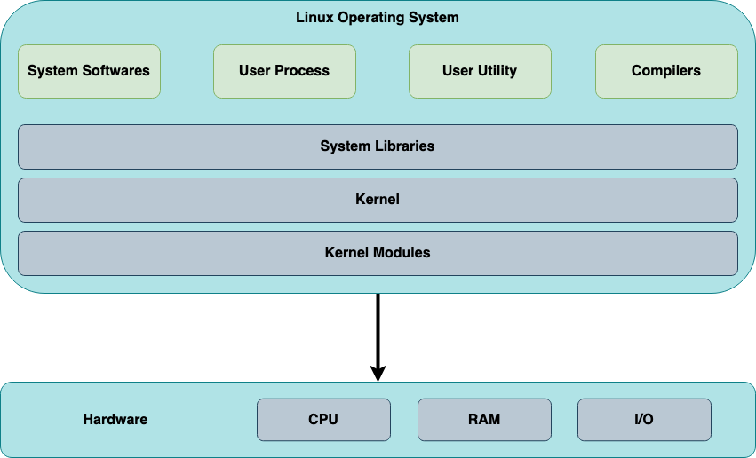
Notes:
Here's an overview of the Linux operating system and its components:
System Softwares: These are essential software components that provide the basic functionality of the operating system. Examples include the shell, which is used to interact with the system, and the system initialization software.
User Process: These are programs that are launched by users and run in user space. They typically perform a specific task, such as word processing or web browsing.
User Utility: These are small programs that perform a specific task and are typically used by users to manage files or perform system administration tasks.
Compilers: These are programs that convert source code into executable code.
System Libraries: These are collections of pre-written code that can be used by programs to perform common tasks, such as reading and writing files.
Kernel: The kernel is the core component of the operating system that manages system resources and provides services to user processes.
Kernel Modules: These are loadable kernel components that can be added to the running kernel to provide additional functionality.
Hardware:
CPU: The central processing unit is the main processor of the computer and executes instructions.
RAM: Random access memory is the main memory of the computer and is used to temporarily store data and instructions.
I/O: Input/output devices allow users to interact with the computer and include devices such as keyboards, mice, and displays.
Here are some examples for each component:
System Softwares: GNU Compiler Collection (GCC), GNU Debugger (GDB), Text editors like Vim or Emacs, Package managers like APT, YUM or Pacman
User Process: Firefox, LibreOffice, VLC media player, GIMP
User Utility: Command-line interface (CLI) tools like grep, sed, awk, cat, find, etc.
Compilers: GCC, LLVM, Clang, Python interpreter, Java Virtual Machine (JVM)
System Libraries: C Standard Library (libc), GTK, Qt, OpenSSL, ALSA, zlib
Kernel: Linux kernel, FreeBSD kernel, NetBSD kernel
Kernel Modules: Device drivers for hardware components such as USB, Wi-Fi, Ethernet, graphics cards, etc.
CPU: Intel Core i7, AMD Ryzen 9, ARM Cortex-A7, etc.
RAM: DDR4 SDRAM, LPDDR4, etc.
I/O: Keyboard, mouse, touchpad, printer, scanner, USB devices, Ethernet controller, Wi-Fi adapter, Bluetooth adapter, sound card, graphics card, etc.

Slide 5
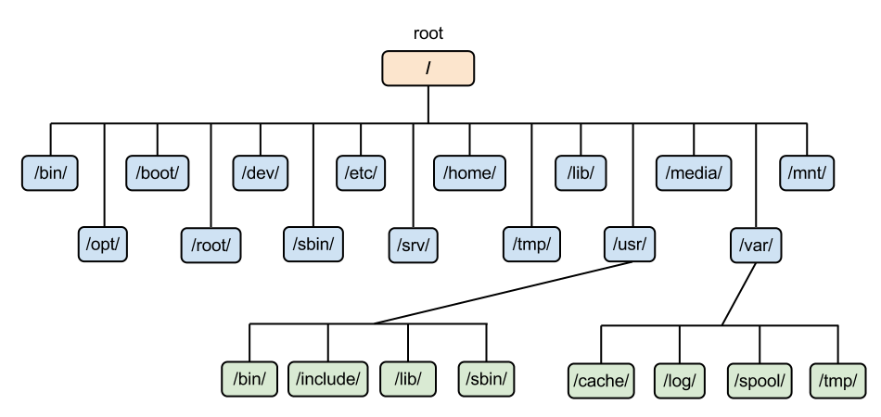
File system hierarchy
Notes:
The Linux file system hierarchy is a structure that organizes files and directories in a logical manner. Here is an overview of each directory:
/root/: This is the home directory for the root user.
/bin/: This directory contains essential system binaries that are required for booting the system and performing other basic tasks.
/opt/: This directory is used for installing additional software packages that are not part of the default system.
/boot/: This directory contains the files required for booting the system, such as the kernel and boot loader.
/root/: This is the home directory for the root user.
/dev/: This directory contains device files that represent hardware devices connected to the system.
/sbin/: This directory contains system binaries that are used for system administration tasks.
/etc/: This directory contains system-wide configuration files.
/srv/: This directory is used for storing data files for services provided by the system.
/home/: This directory contains the home directories for regular users.
/tmp/: This directory is used for storing temporary files.
/lib/: This directory contains libraries that are used by the system and other applications.
/usr/: This directory contains user binaries, libraries, documentation, and source-code.
/media/: This directory is used for mounting removable media such as USB drives and CDs.
/var/: This directory contains variable data files that are expected to grow in size during the system's operation.
/mnt/: This directory is used for mounting file systems from other devices.
Within the /usr/ directory:
/bin/: This directory contains user binaries, similar to the /bin/ directory in the root directory.
/include/: This directory contains header files that are used for compiling software.
/lib/: This directory contains libraries that are used by user programs.
/sbin/: This directory contains system binaries that are used for system administration tasks, similar to the /sbin/ directory in the root directory.
Within the /var/ directory:
/cache/: This directory is used for storing cached data.
/log/: This directory contains log files for various system and application services.
/spool/: This directory is used for storing files that are waiting to be processed, such as print jobs.
/tmp/: This directory is used for storing temporary files.

Slide 6
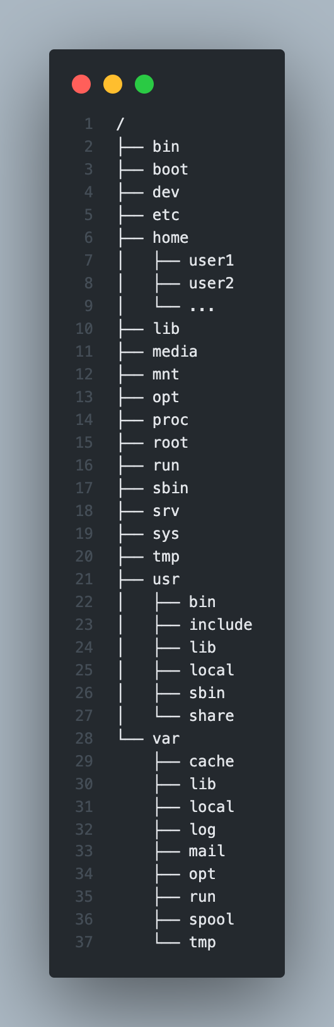
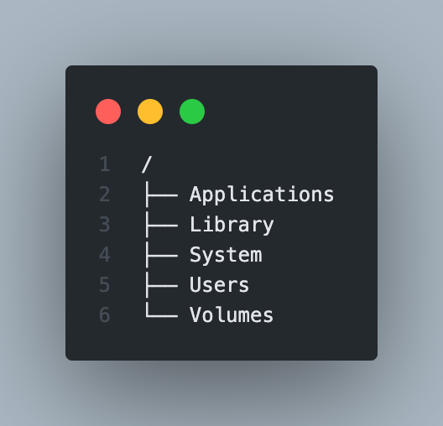
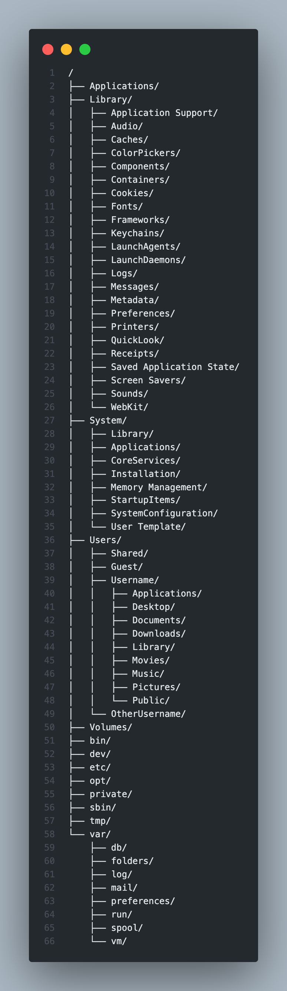
Notes:
The macOS file system hierarchy consists of several main directories:
Applications: This directory contains all installed applications on the system. Each application is typically contained within its own folder.
Library: This directory contains system libraries and other files required for the proper functioning of the operating system and installed applications. The Library directory is split into two main subdirectories:
/Library: This directory contains system-wide files, such as user accounts, preferences, and extensions.
/System/Library: This directory contains files required for the proper functioning of the operating system itself.
System: This directory contains the core files required for the proper functioning of the operating system. It includes the kernel, system frameworks, and other system-level files.
Users: This directory contains the home directories for all user accounts on the system. Each user has their own directory, which contains their personal files and settings.
Volumes: This directory contains all mounted volumes, such as external hard drives or network shares. Each mounted volume is typically represented as a separate directory within the Volumes directory.
Overall, the macOS file system hierarchy is similar to that of Unix and Linux systems, with a few differences in directory names and organization.

Slide 7
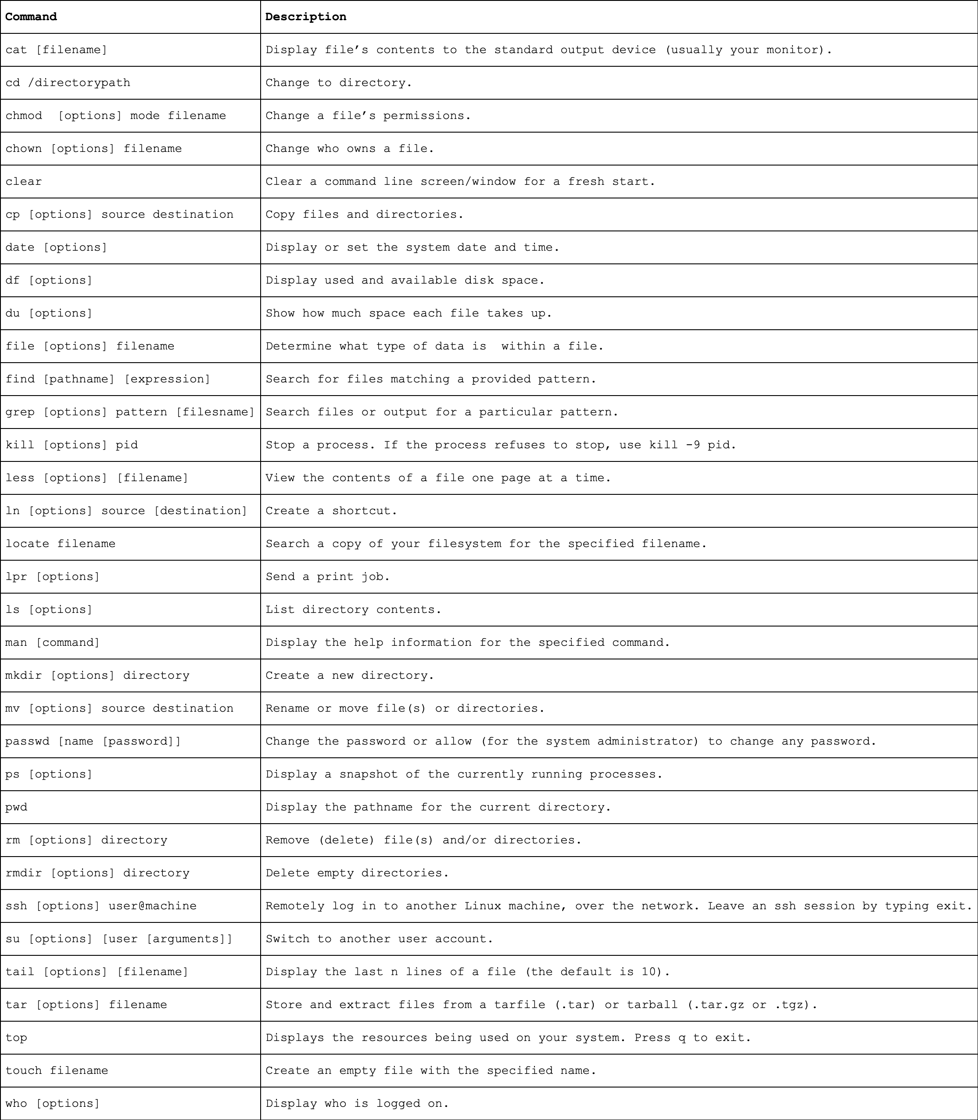
COMMANDS

Slide 8
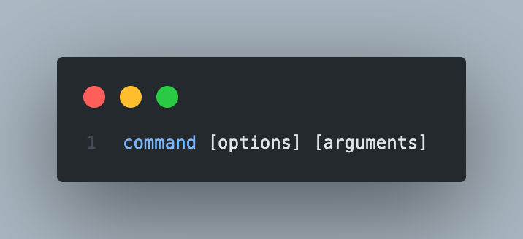
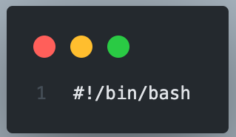
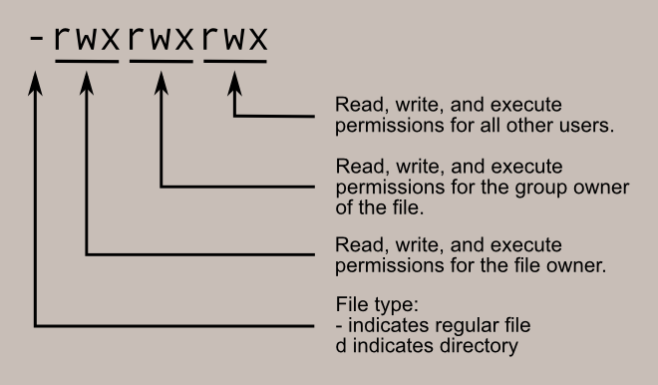
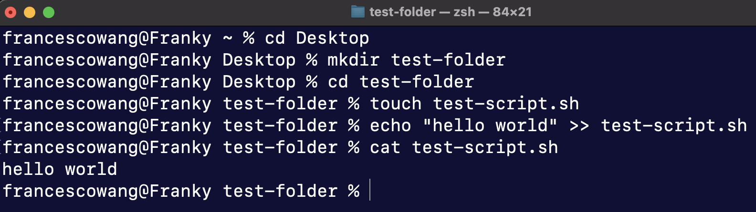
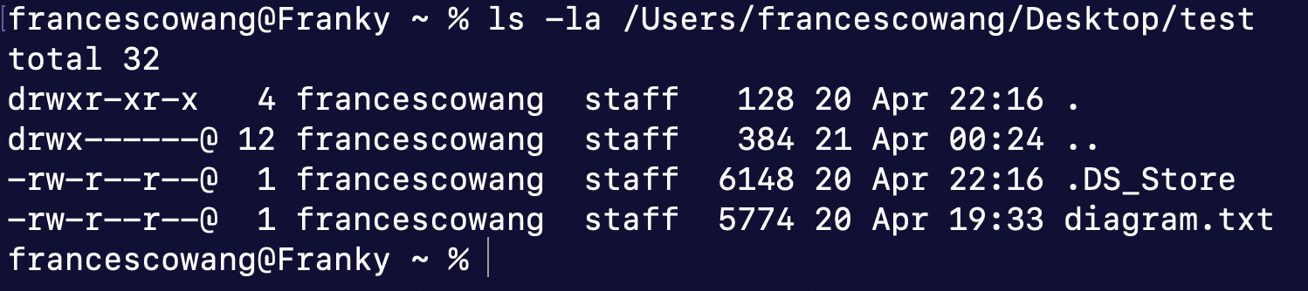
Command structure
Notes:
Here is an example of a command with options and arguments:
Command: ls
Options: -l (long listing format), -a (include hidden files)
Arguments: /home/user/Documents
Full command: ls -la /home/user/Documents
This command will list all files (including hidden files) in the /home/user/Documents directory in long format.
---
One command you could use is find.
Here's an example of how to use it with an option and argument:
arduino
find /home/user/Documents/ -name "*.txt"
In this example, /home/user/Documents/ is the directory you want to search in, -name is the option you're using to search for files with a certain name, and *.txt is the argument you're using to specify that you want to find all files with a .txt extension.
---
What is #!/bin/bash?
#!/bin/bash is called a shebang or a hashbang. It is a special sequence of characters that appears on the first line of a shell script and is used to specify the interpreter that should be used to run the script. In this case, #!/bin/bash specifies that the Bash shell should be used to execute the commands in the script.
When the script is run, the operating system reads the shebang line and uses the interpreter specified in the line to execute the commands in the script. In other words, it tells the shell which program to use to interpret and execute the script.
Note that the shebang is not specific to Bash; it can be used to specify any interpreter. For example, #!/usr/bin/python would specify that the Python interpreter should be used to run the script.
Why is #!/bin/bash needed?
The #!/bin/bash shebang is needed in a Bash script because it specifies the path to the Bash interpreter, which is the program that will be used to execute the script.
When you run a script, the operating system needs to know which interpreter to use to execute the commands in the script. The shebang line tells the operating system which interpreter to use. In this case, #!/bin/bash specifies that the Bash shell should be used to execute the commands in the script.
Without the shebang line, the operating system would not know which interpreter to use and would not be able to run the script.
In summary, the #!/bin/bash shebang is necessary to specify the interpreter for a Bash script and to enable the operating system to run the script properly.
Examples of pure compiled languages are C, C++, Erlang, Haskell, Rust, and Go.
In general, programs written in compiled languages tend to be faster than those written in interpreted languages. This is because compiled languages are translated into machine code before execution, while interpreted languages are translated at runtime. However, the performance of a program also depends on various other factors, such as the complexity of the algorithm, the efficiency of the code, the hardware it is running on, and so on. So, while compiled languages can offer a speed advantage, it's not always guaranteed.
Python is an interpreted language and does not require a compiler. Instead, the Python interpreter executes the code directly. However, Python code can be compiled into bytecode for optimization purposes using the "pyc" or "pyo" file format. These compiled files can be executed by the Python interpreter more quickly than the original source code.

Slide 9
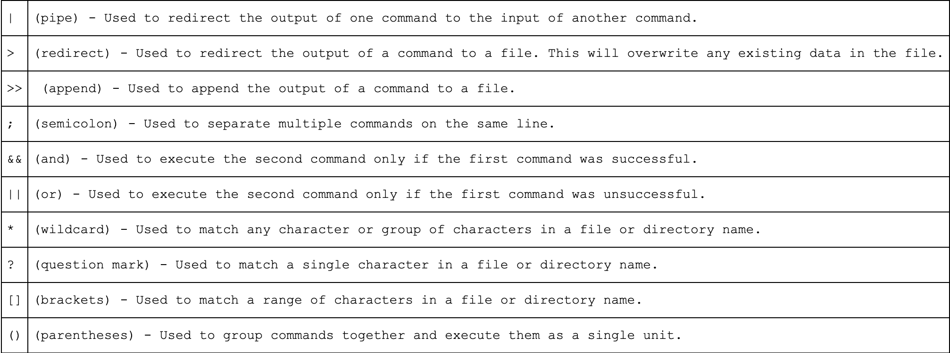
LINUX OPERATORS
Notes:
In Linux, operators are used to perform various operations on files, folders, and other system resources.
Commands and Linux operators can be combined in a Bash shell script to automate a series of tasks or perform more complex operations. Bash scripts allow you to write a series of commands and logic that can be executed in order or conditionally based on certain criteria, such as the output of a command or the presence of a file. You can also use variables, loops, and functions in Bash scripts to make them more powerful and flexible.

Slide 10
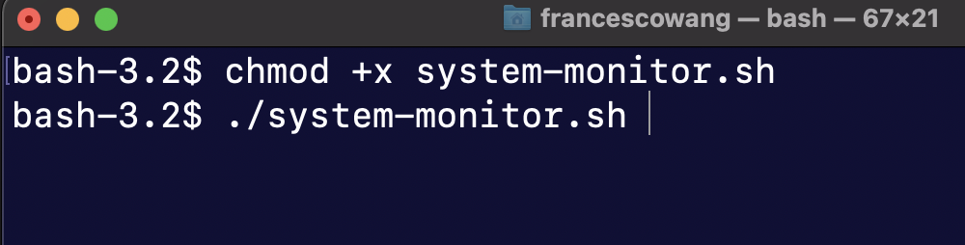

BASH SHELL SCRIPTING
A Bash script is a plain text file which contains a series of commands.
Anything you can run normally on the command line can be put into a script and it will do the same thing. Similarly, anything you can put into a script can also be run normally on the command line and it will do the same thing.
Notes:
You need to run chmod +x file-name.sh to make a Bash script executable.
The chmod command is used to change the permissions of a file or directory. In this case, the +x option is used to add executable permission to the script.
By default, when you create a new file in Linux, it does not have the executable permission. This means that you cannot run the file as a program.
When you run chmod +x file-name.sh, you are giving the file permission to be executed as a program. This makes it possible to run the script by typing ./file-name.sh in the terminal.
Note that the ./ in front of the filename is necessary to specify that the file should be executed from the current directory. Without it, the terminal may not be able to find the file and execute it properly.
---
chmod +x is a command in Linux and other Unix-like operating systems that changes the permissions of a file or directory to allow executing the file or script as a program.
The chmod command stands for "change mode" and it allows the user to modify the access permissions for a file or directory. The +x option adds the executable permission to the file, which means that the file can be run as a program or script.
So, when you use chmod +x filename, you are allowing the file to be executed as a program.

Slide 11
Some references
https://www.geeksforgeeks.org/linux-file-hierarchy-structure/
https://www.oreilly.com/openbook/debian/book/ch04_02.html
https://www.linuxtrainingacademy.com/linux-commands-cheat-sheet/
https://docs.github.com/en/actions/creating-actions/creating-a-composite-action
https://ryanstutorials.net/bash-scripting-tutorial/bash-script.php
https://itsfoss.com/ascii-art-linux-terminal/
Notes:
- How to write Bash Shell Scripts
- Combine it using GitHub Actions

Slide 12
DEMO TIME
Let’s do TEST SOME SCRIPTS

