Slide 1


Linux
END GOAL: Grasp a fundamental understanding of Linux and bash shell scripting in 15 minutes.

Slide 2
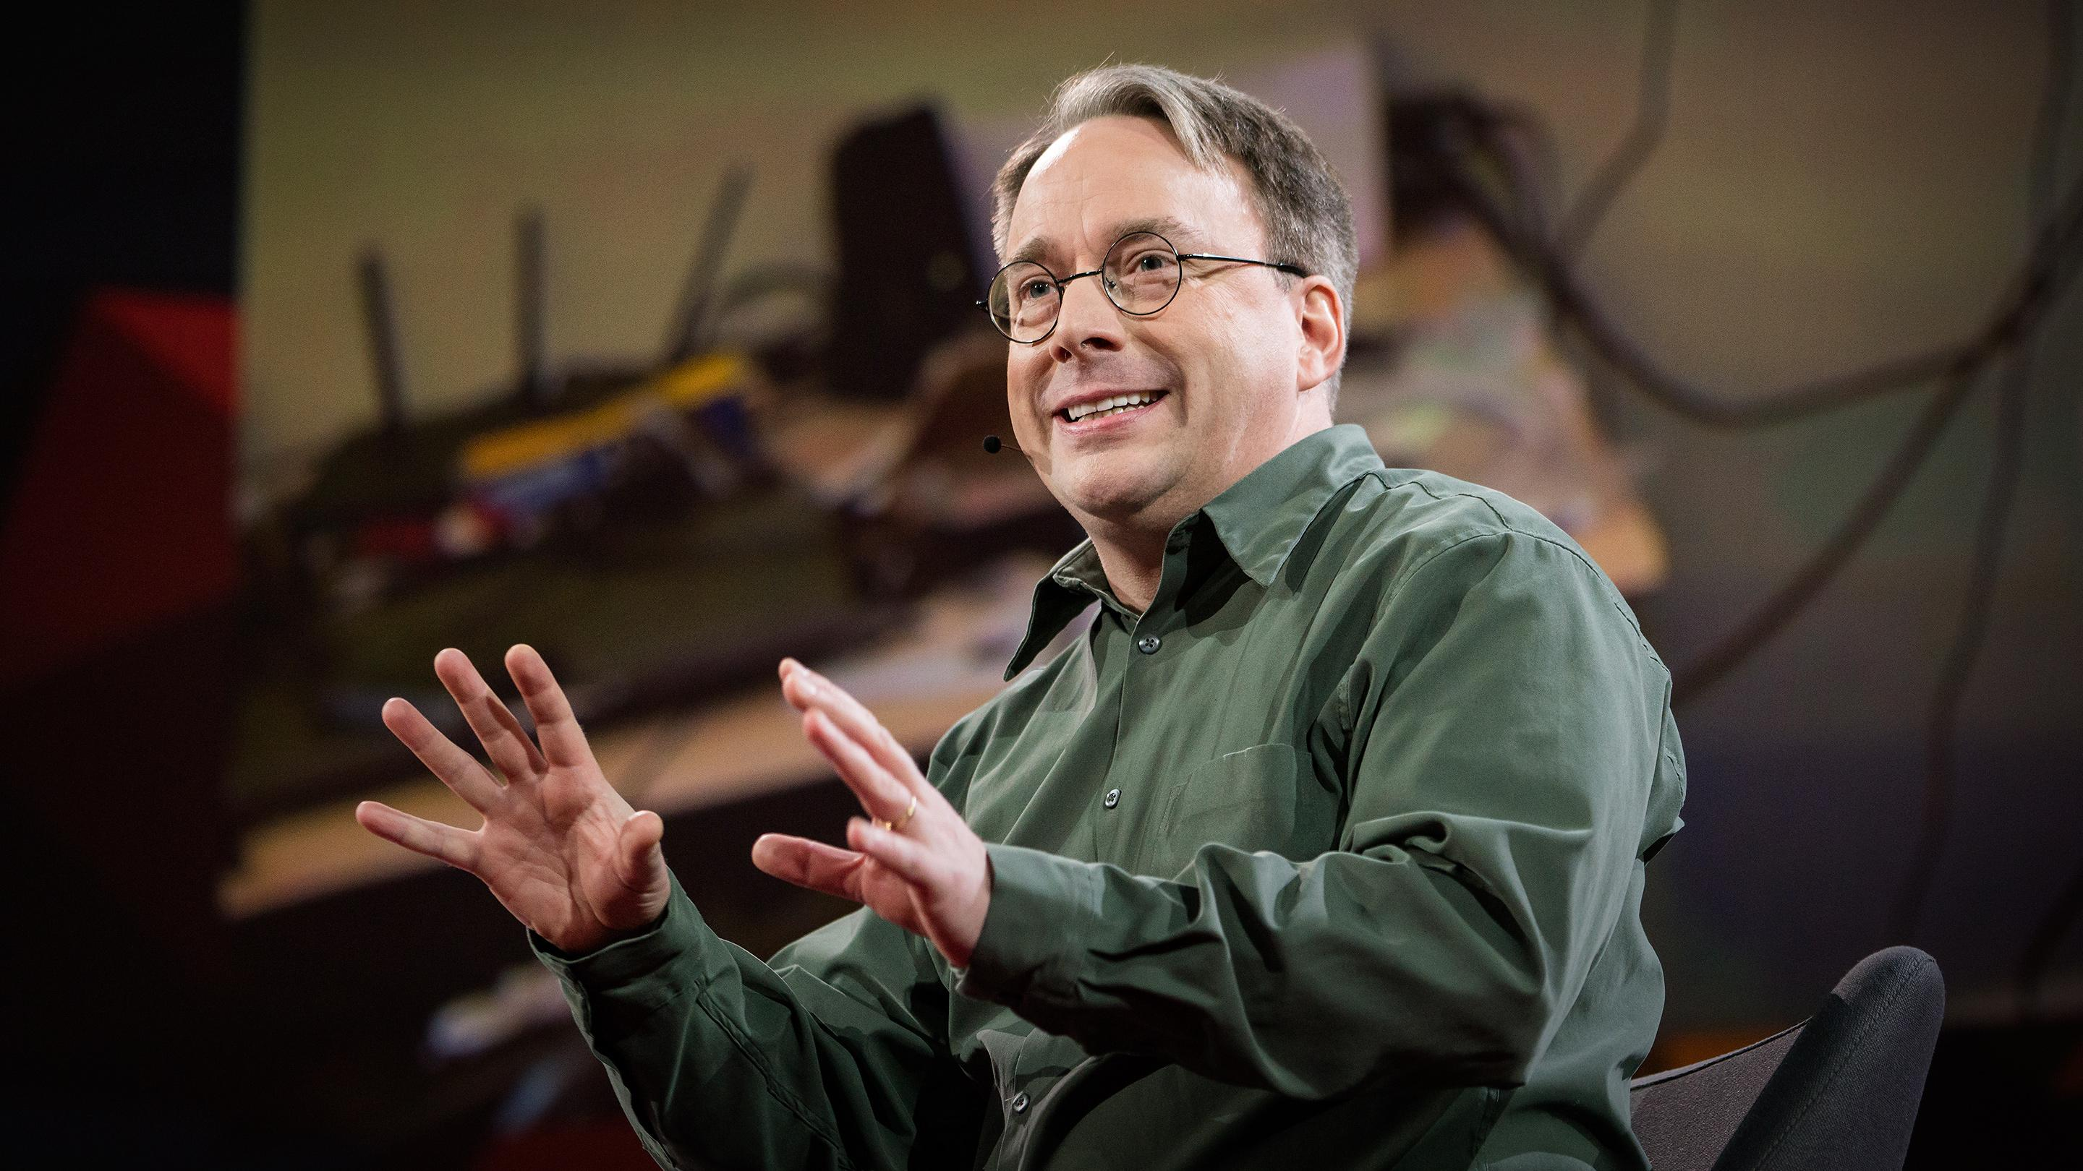
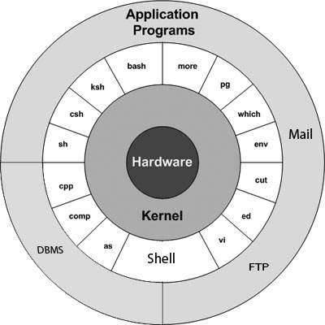
Brief history
Linux is a free and open-source operating system based on the Unix operating system.
Linux had become an alternative to operating systems such as Windows and macOS around mid-90s.
Used in smartphones, servers, supercomputers and embedded systems.
Distros: Ubuntu, Debian, and Red Hat.
Ted Talk: The mind behind Linux

Slide 3
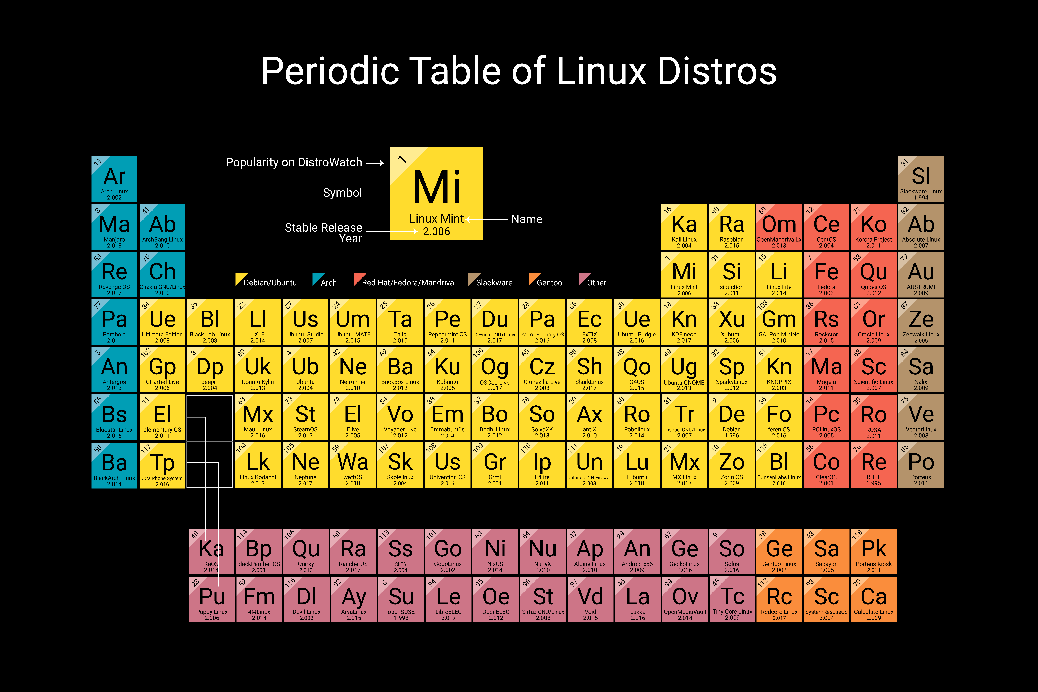

Slide 4
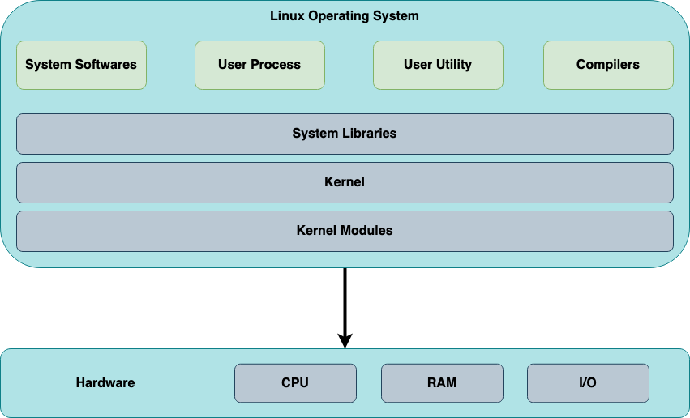

Slide 5
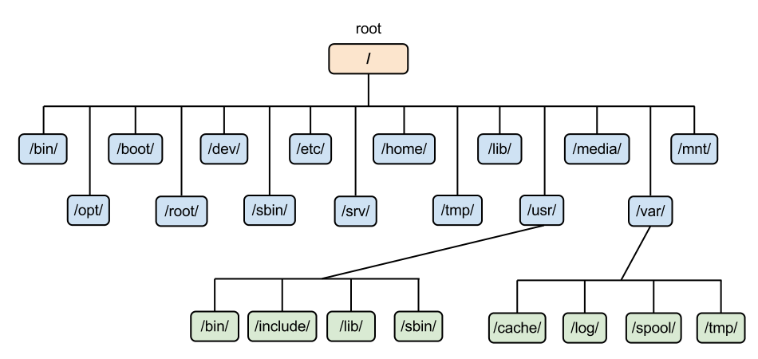
File system hierarchy

Slide 6
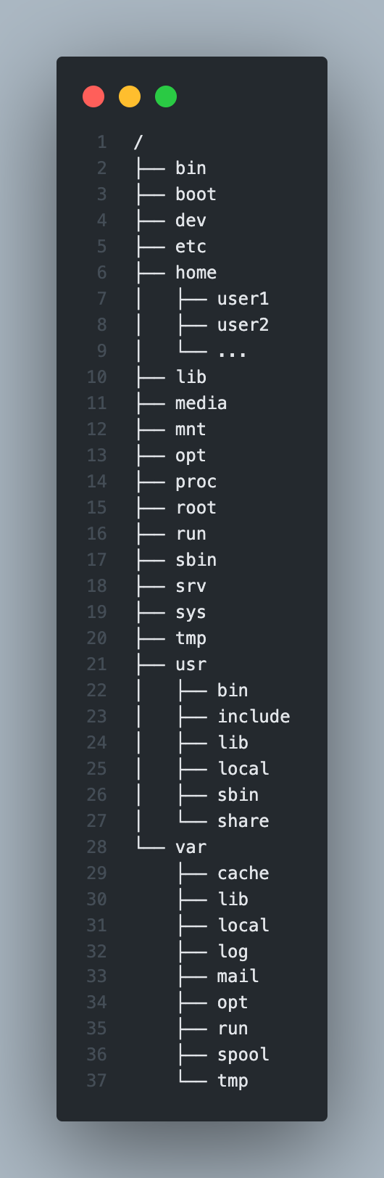
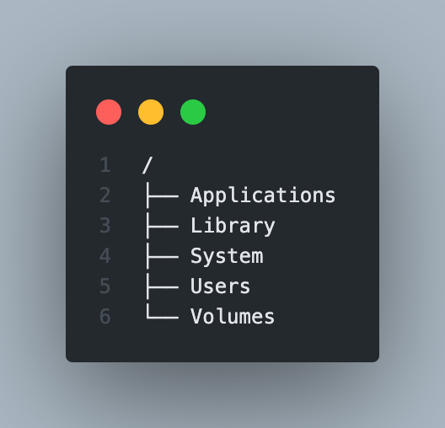
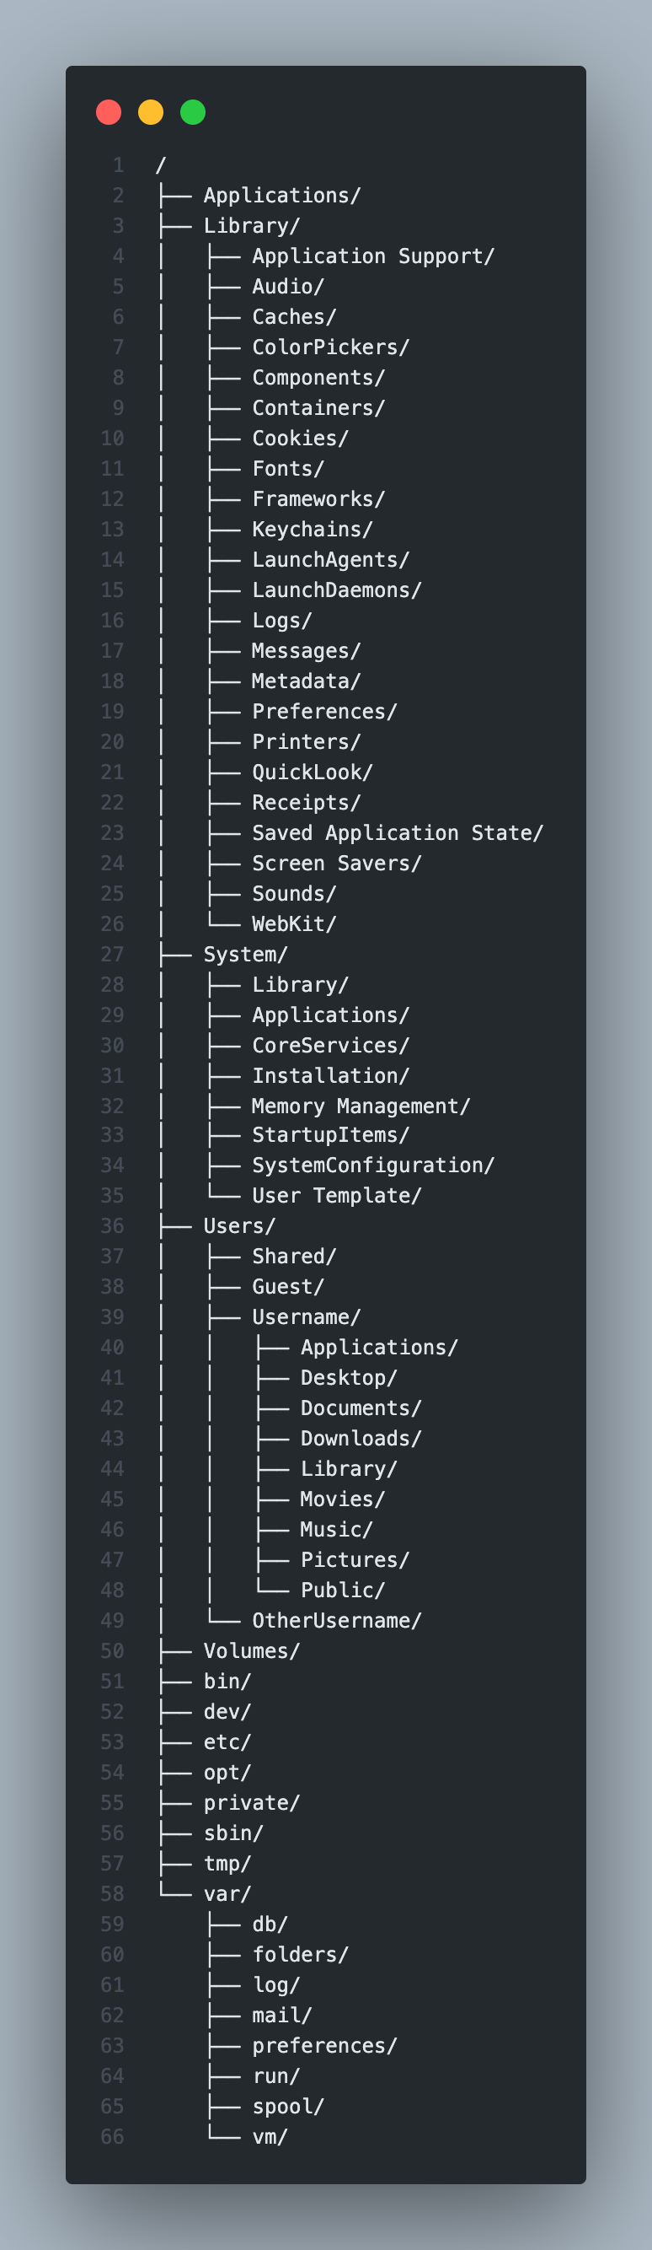

Slide 7
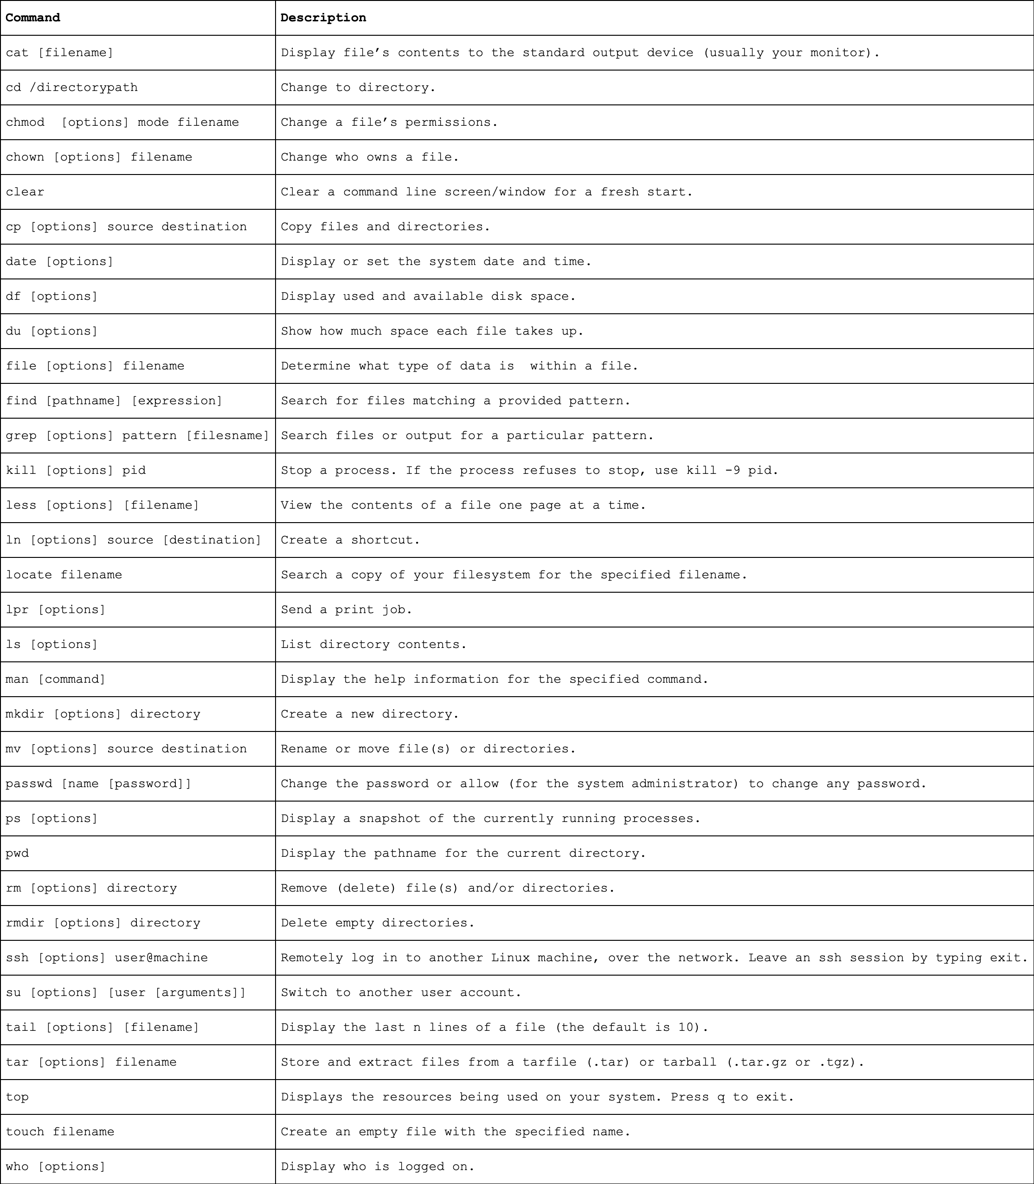
COMMANDS

Slide 8
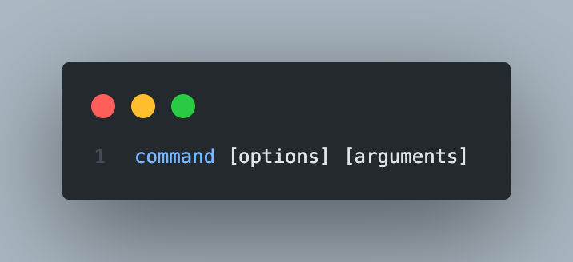
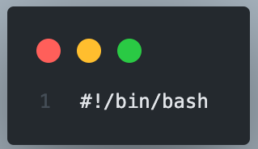
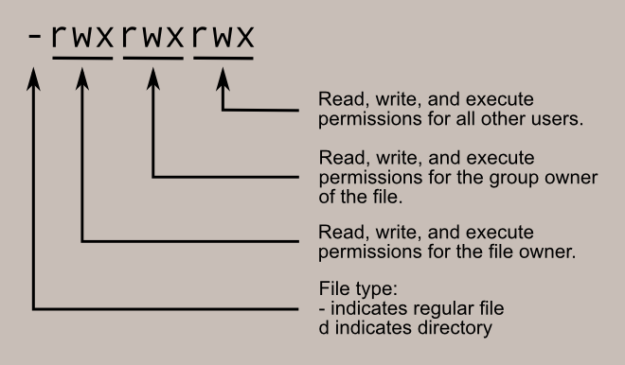
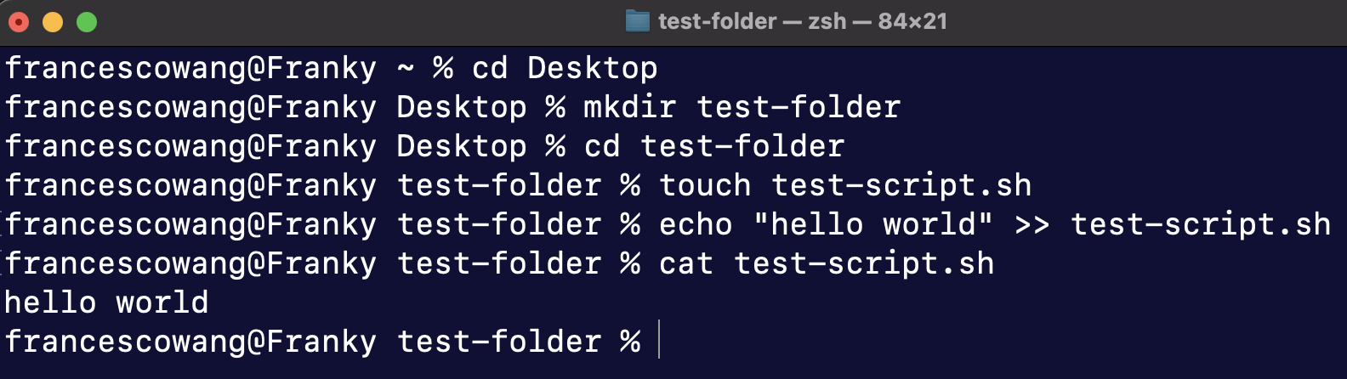
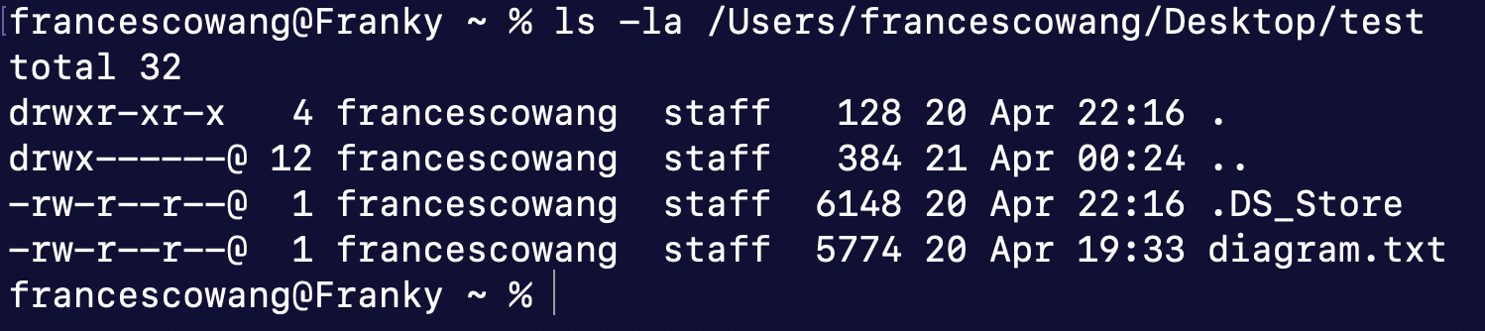
Command structure

Slide 9
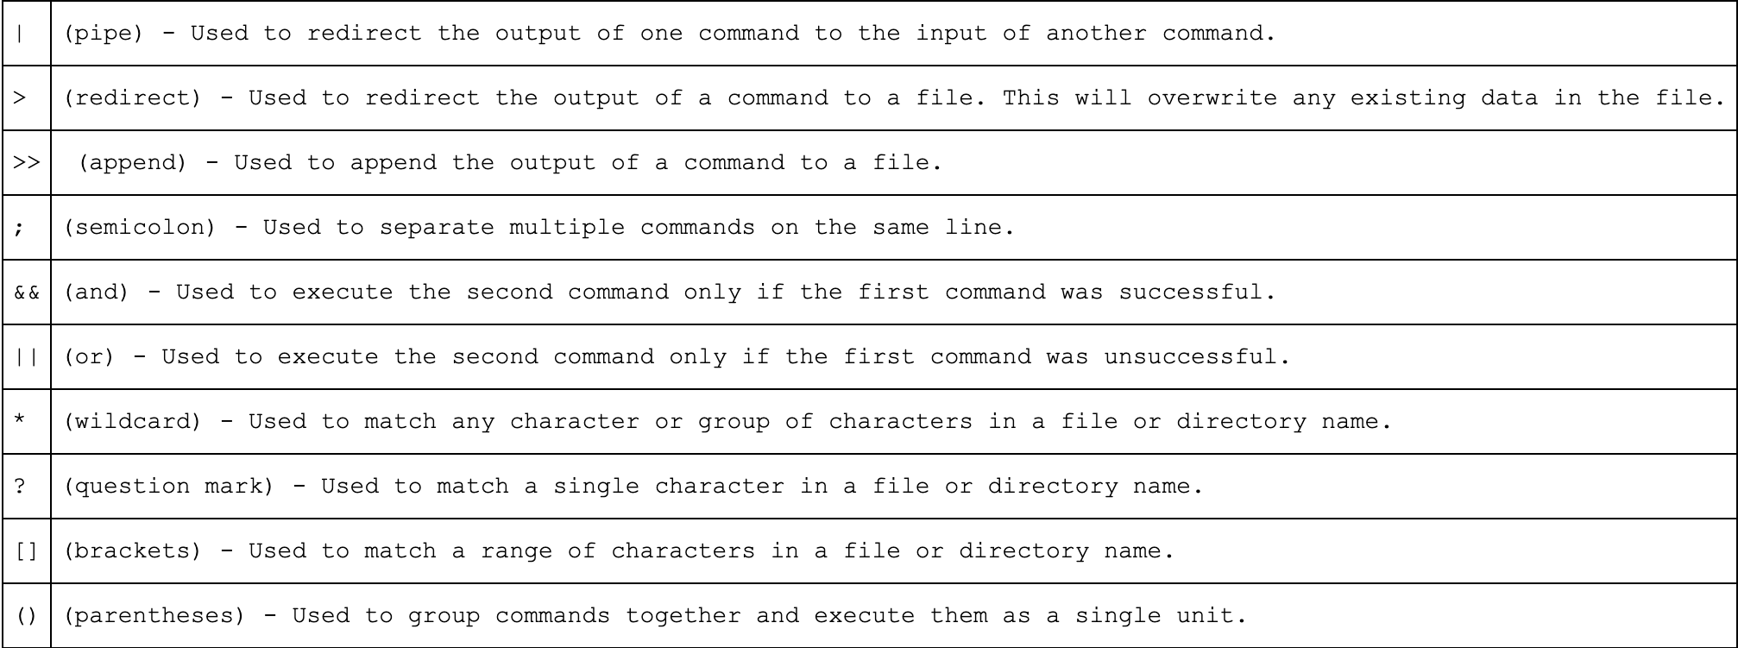
LINUX OPERATORS

Slide 10
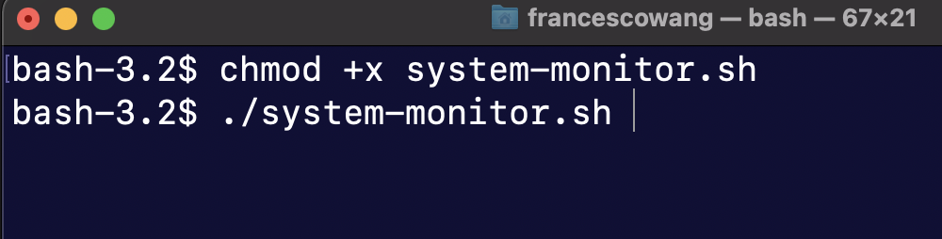

BASH SHELL SCRIPTING
A Bash script is a plain text file which contains a series of commands.
Anything you can run normally on the command line can be put into a script and it will do the same thing. Similarly, anything you can put into a script can also be run normally on the command line and it will do the same thing.

Slide 11
Some references
https://www.geeksforgeeks.org/linux-file-hierarchy-structure/
https://www.oreilly.com/openbook/debian/book/ch04_02.html
https://www.linuxtrainingacademy.com/linux-commands-cheat-sheet/
https://docs.github.com/en/actions/creating-actions/creating-a-composite-action
https://ryanstutorials.net/bash-scripting-tutorial/bash-script.php
https://itsfoss.com/ascii-art-linux-terminal/

Slide 12
DEMO TIME
Let’s do TEST SOME SCRIPTS

