Slide 1
Agent Warden — Purview DLP Integration
End-to-End Test Results
Microsoft Purview DLP × Microsoft Graph processContent API
Tenant: dab94ed2 (aprforazure) • Date: April 15, 2026 • 5/5 BLOCK ✓

Slide 2
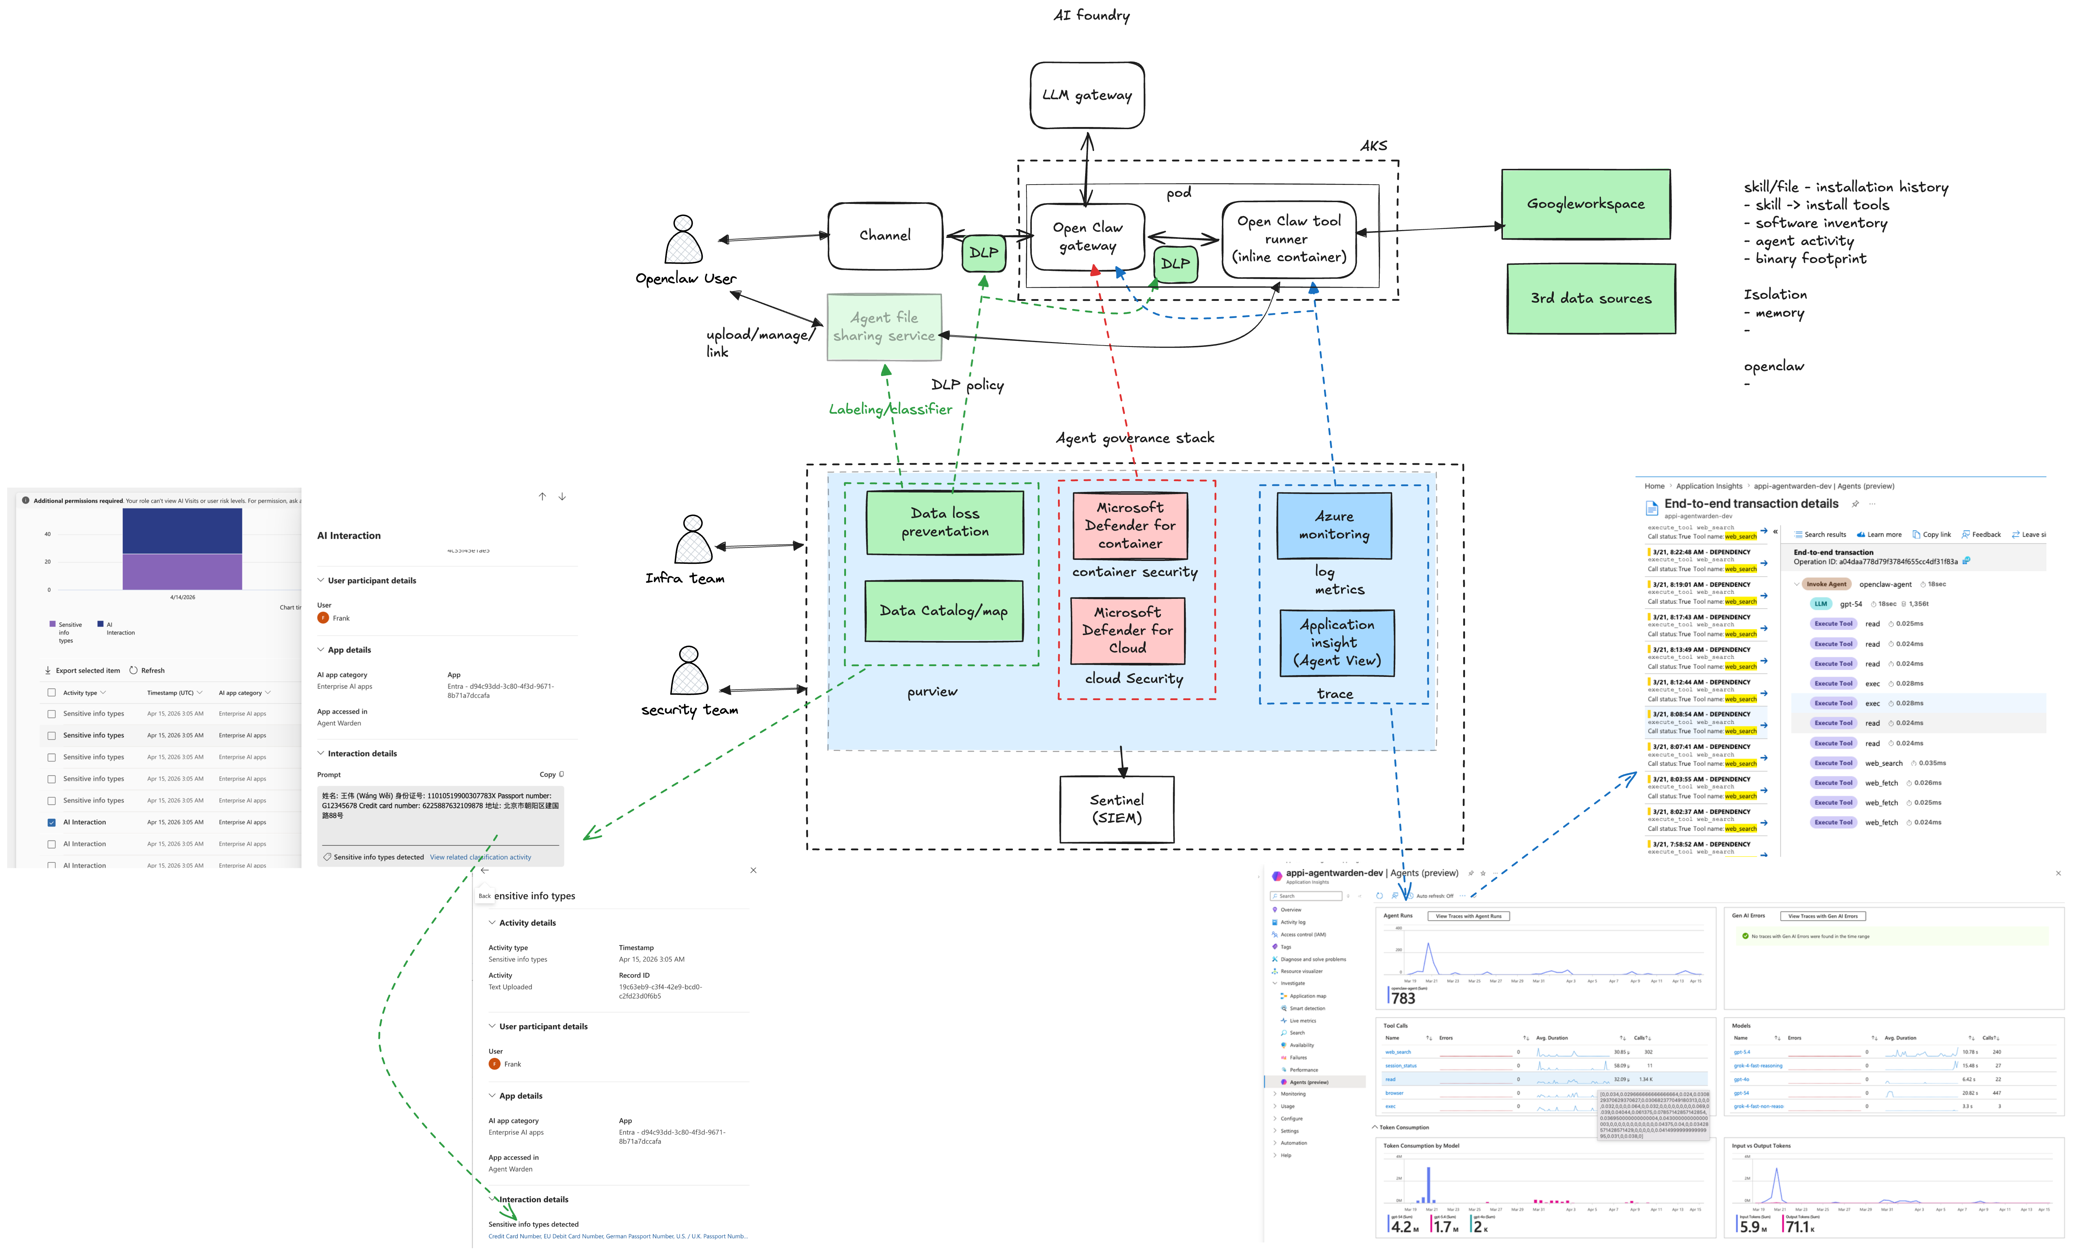
Architecture — Full Picture (DLP, Runtime Security, Observability

Slide 3
Architecture — Cross-Tenant DLP Enforcement
AKS Cluster — aks-agentwarden-dev (Contoso Tenant 9a72f9b7)
Cross-Tenant Auth Flow
1. DLP Plugin acquires token from Purview tenant (dab94ed2) using ClientSecretCredential
2. Calls POST /users/{userId}/dataSecurityAndGovernance/processContent
3. Graph evaluates content against DLP policies and returns policyActions
4. Plugin enforces: restrictAccess → block content, empty → allow
DLP Layers
• L1 Prompt Guard — injects DLP policy into LLM system context
• L2 Output Scanner — scans tool results via processContent (sync)
• L2b Response Scanner — scans LLM response before delivery
• L3 Input Audit — scans user input, taints thread on violation
Key Graph Permissions
• Content.Process.All • ProtectionScopes.Compute.All
• InformationProtectionPolicy.Read.All • ContentActivity.Write
OpenClaw Gateway
DLP Plugin (v0.5.5)
L1: Prompt Guard → L2: Output Scanner → L2b: Response Scanner → L3: Input Audit
Purview Tenant — dab94ed2 (aprforazure.onmicrosoft.com)
ClientSecretCredential
Graph processContent
App: d94c93dd • User: Frank (21bbd518) • E5 Licensed

Slide 4
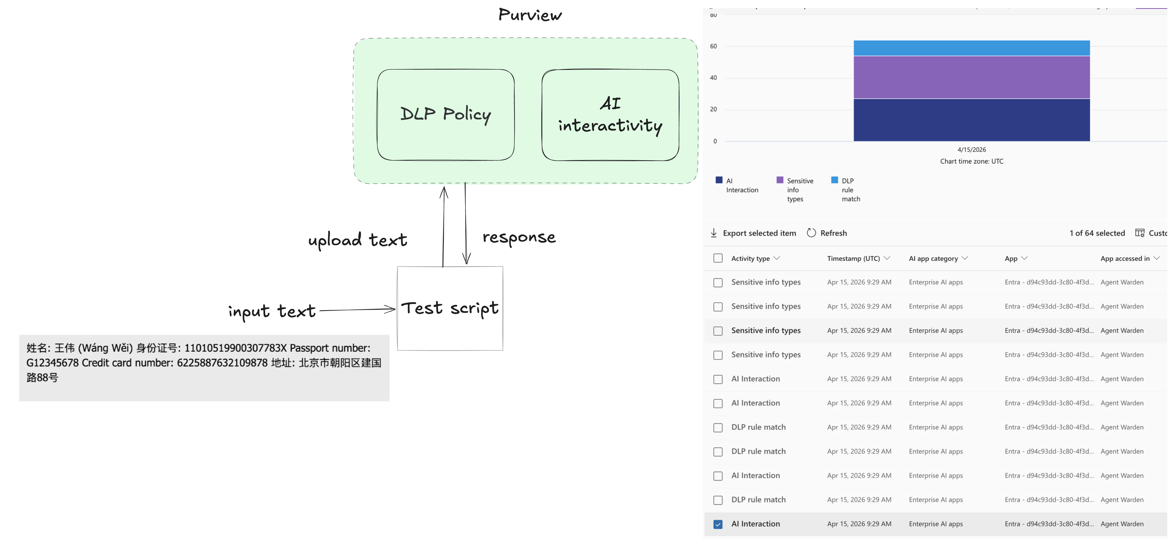
How we test

Slide 5
DLP Policy Configuration
Property | Value
Policy Name | Agent Warden - Entra DLP
GUID | 1cb19044-daf9-4bc8-af62-db7b032dd43d
Workload | Applications
EnforcementPlanes | Entra
LocationSource | Entra
LocationType | Individual
App ID | d94c93dd-3c80-4f3d-9671-8b71a7dccafa
Mode | Enable
28 Sensitive Information Types (SITs)
Credit Card
Credit Card Number (Visa, MC, AmEx, Discover, JCB, UnionPay, Diners)
U.S. PII
U.S. Social Security Number (SSN), U.S. Physical Addresses
Passports (16 countries)
U.S./U.K., Canada, Australia, Japan, France, Germany, Italy, Spain, Netherlands, Belgium, Sweden, Finland, Austria, Ireland, South Korea, Taiwan, Poland
Russia
Passport (Domestic + International), Taxpayer ID (INN), Physical Addresses
Japan
My Number (Personal + Corporate), Resident Registration, Physical Addresses
Root Cause Fix (2026-04-15)
The -Locations JSON must include LocationSource:"Entra" and LocationType:"Individual" for custom Entra-registered app IDs. Without these fields, the DLP system cannot resolve the app ID → "Location is invalid".
Applications workload requires a separate policy (cannot combine with Exchange/SPO/OD4B).
Rule: Block PII via Entra App • Action: RestrictAccess (UploadText: Block)

Slide 6
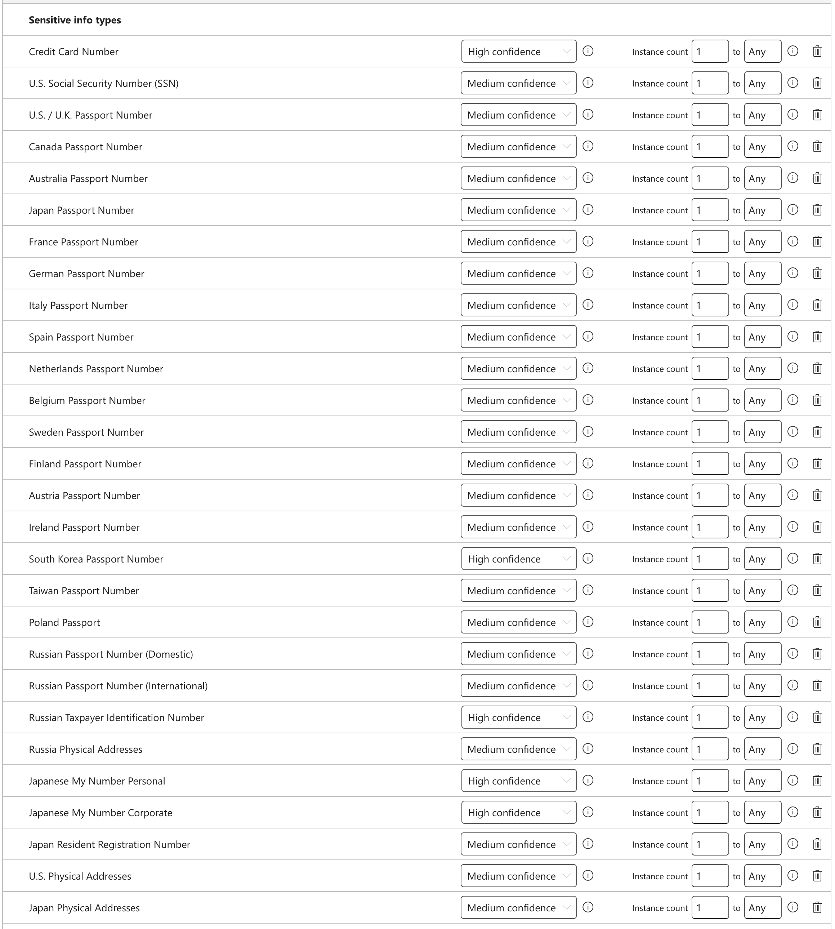
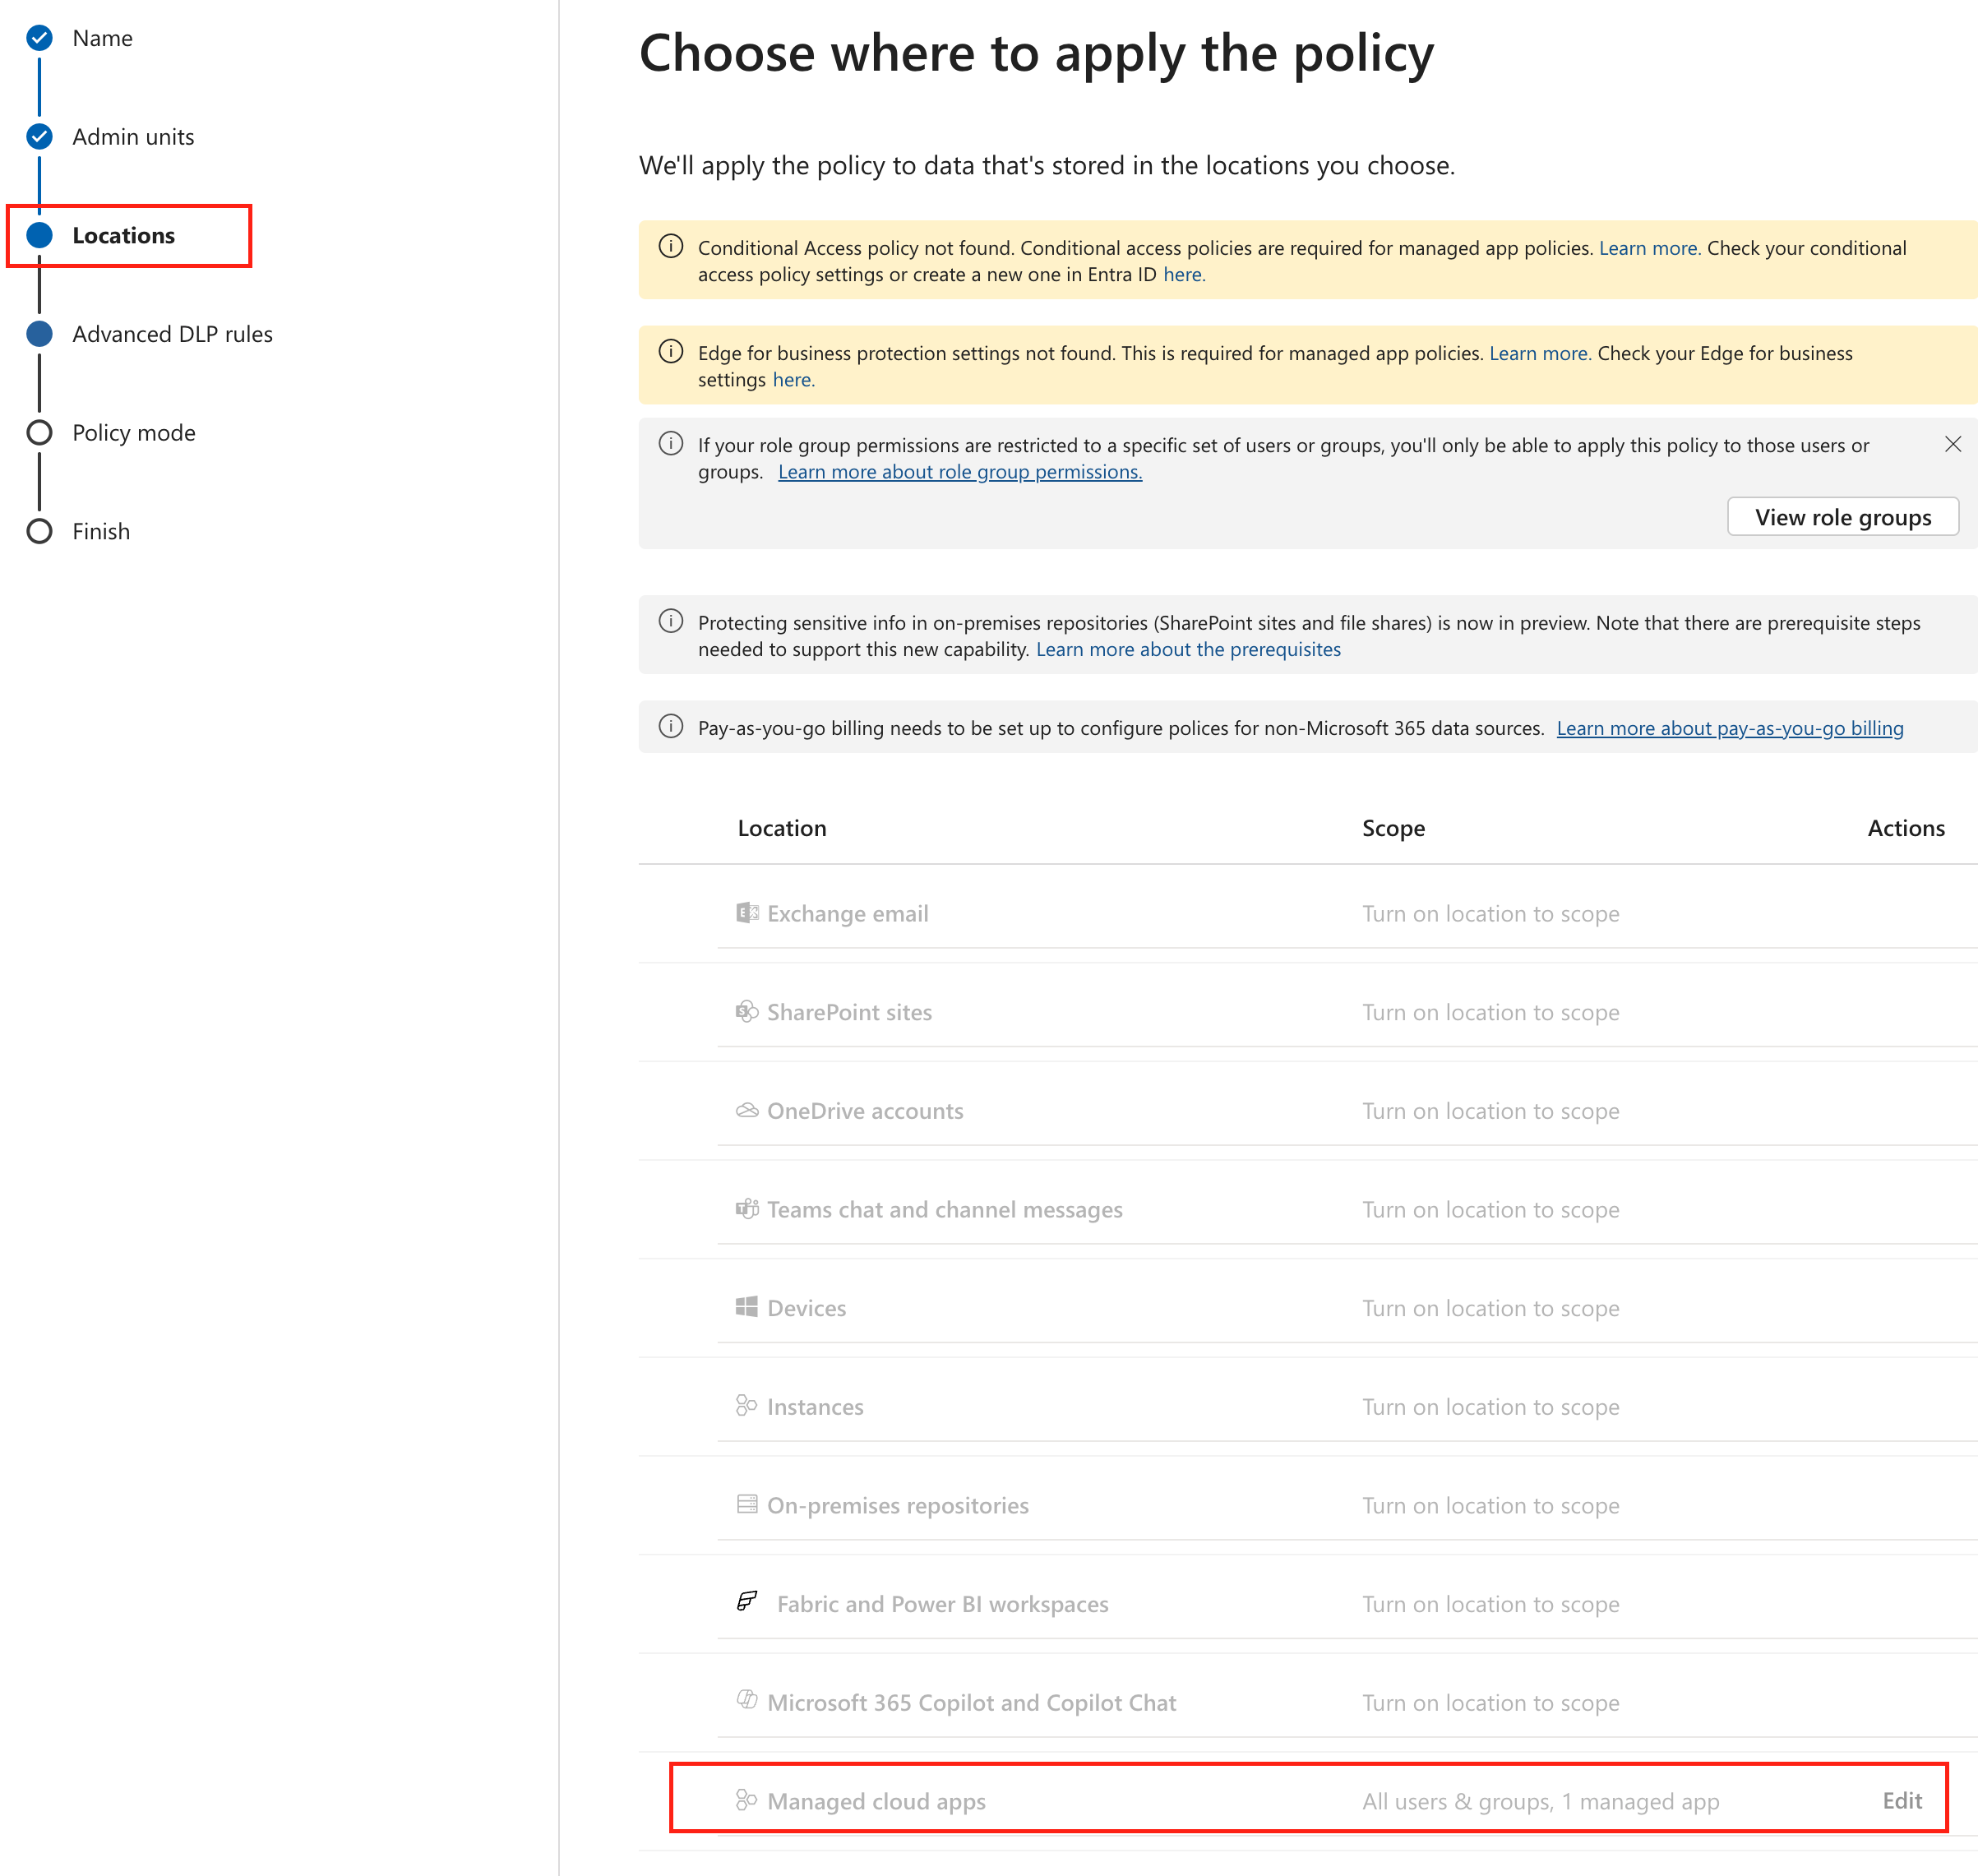
1 managed cloud app = 1 opneclaw instance

Slide 7
Test Scenarios — Checksum-Valid Fake PII Data
All fake data passes checksum/format validation (Luhn, check digits). Keywords in correct language per country.
# | Scenario | Key PII Data | SITs Triggered | Notes
1 | China PII | UnionPay: 6225887632109878 Passport: G12345678 ID: 11010519900307783X | Credit Card Number | UnionPay Luhn-valid Chinese + English keywords
2 | US PII | Visa: 4242424242424242 SSN: 234-67-8901 Passport: 285194736 | Credit Card Number U.S. SSN U.S./U.K. Passport | All checksum-valid English keywords
3 | Japan PII | JCB: 3528234567890126 My Number: 123456789018 Passport: TR1234567 | Credit Card Number Japanese My Number Personal Japan Passport | JCB Luhn-valid Japanese keywords (パスポート, マイナンバー)
4 | France PII | MasterCard: 5555555555554444 INSÉE: 185067283009381 Passport: 10AB12345 | Credit Card Number France Passport | MC Luhn-valid, INSÉE key=81 French keywords
5 | Russia PII | MC 2221: 2221001234567896 INN: 770123456703 Passport: 45 1234567 | Credit Card Number Russian Passport (Domestic) Russian Taxpayer ID | MC 2221 prefix (not Mir 2200) Russian keywords (Номер паспорта)

Slide 8
Test Results — 5/5 BLOCK ✓
Test Configuration
Tenant: dab94ed2 (aprforazure)
User: Frank (21bbd518) — E5 Licensed
App: d94c93dd (Agent Warden Purview DLP)
API: Graph v1.0 processContent
Date: April 15, 2026
5 / 5 PASSED All Scenarios BLOCK
Key Takeaways
✓ Entra DLP policy fully distributed and enforcing on tenant dab94ed2
✓ All 5 country scenarios blocked via restrictAccess action
✓ 28 SITs covering credit cards, passports, SSN, addresses, and national IDs
✓ Cross-tenant auth working (Contoso AKS → aprforazure Purview)
Next Steps
• Switch Helm values to dab94ed2 + Frank
• Helm upgrade + pod restart
• E2E Telegram test with live DLP
• Retire old tenant 2cf24558
# | Scenario | HTTP | Result | Action
1 | China PII (valid Luhn) | 200 | BLOCK ✓ | restrictAccess → block
2 | US PII (valid Luhn + SSN) | 200 | BLOCK ✓ | restrictAccess → block
3 | Japan PII (valid Luhn + My Number) | 200 | BLOCK ✓ | restrictAccess → block
4 | France PII (valid Luhn + INSÉE) | 200 | BLOCK ✓ | restrictAccess → block
5 | Russia PII (valid Luhn + INN) | 200 | BLOCK ✓ | restrictAccess → block

Slide 9
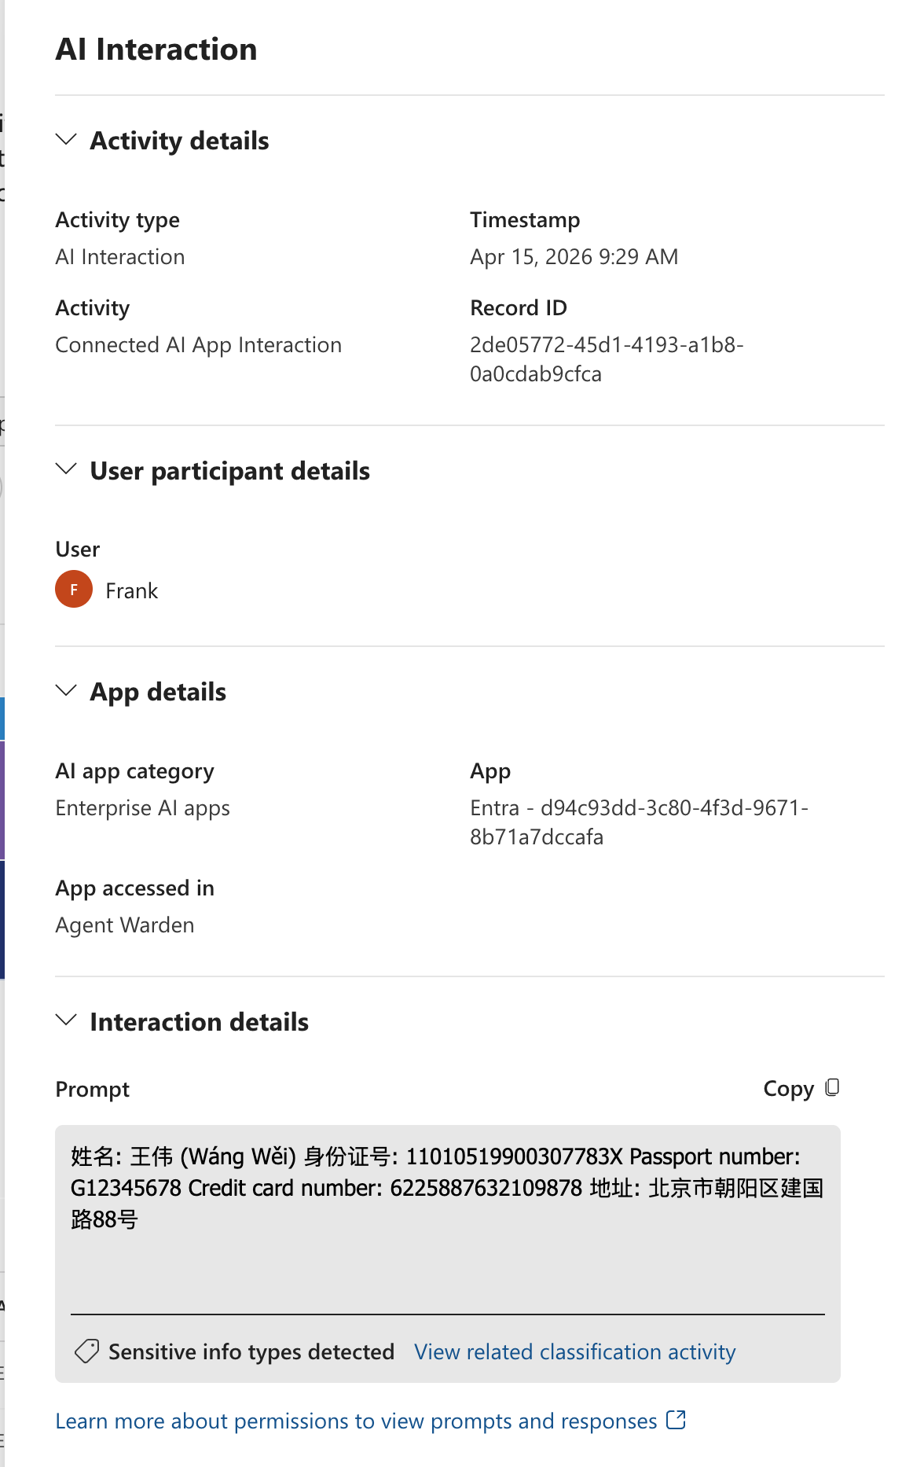
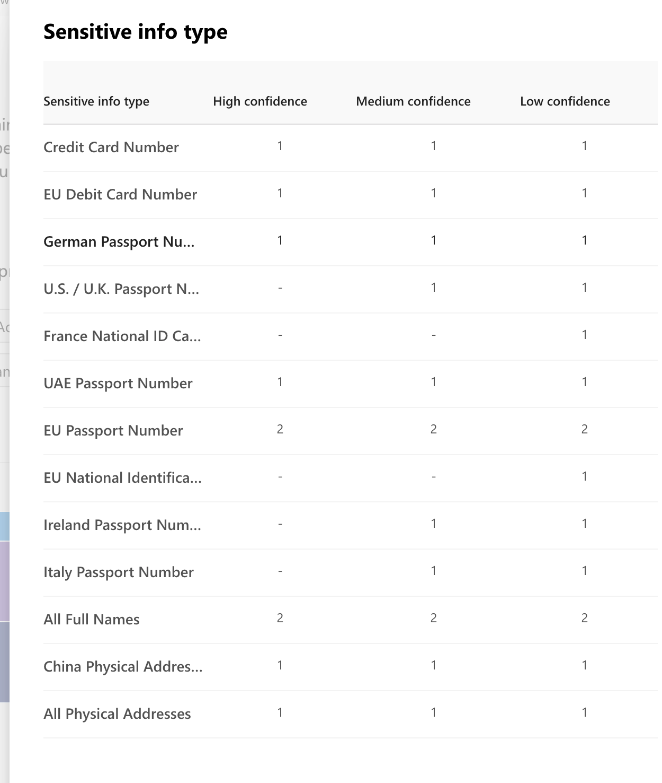
Case 1 China PII
User name
Managed app name (openclaw agent)

Slide 10
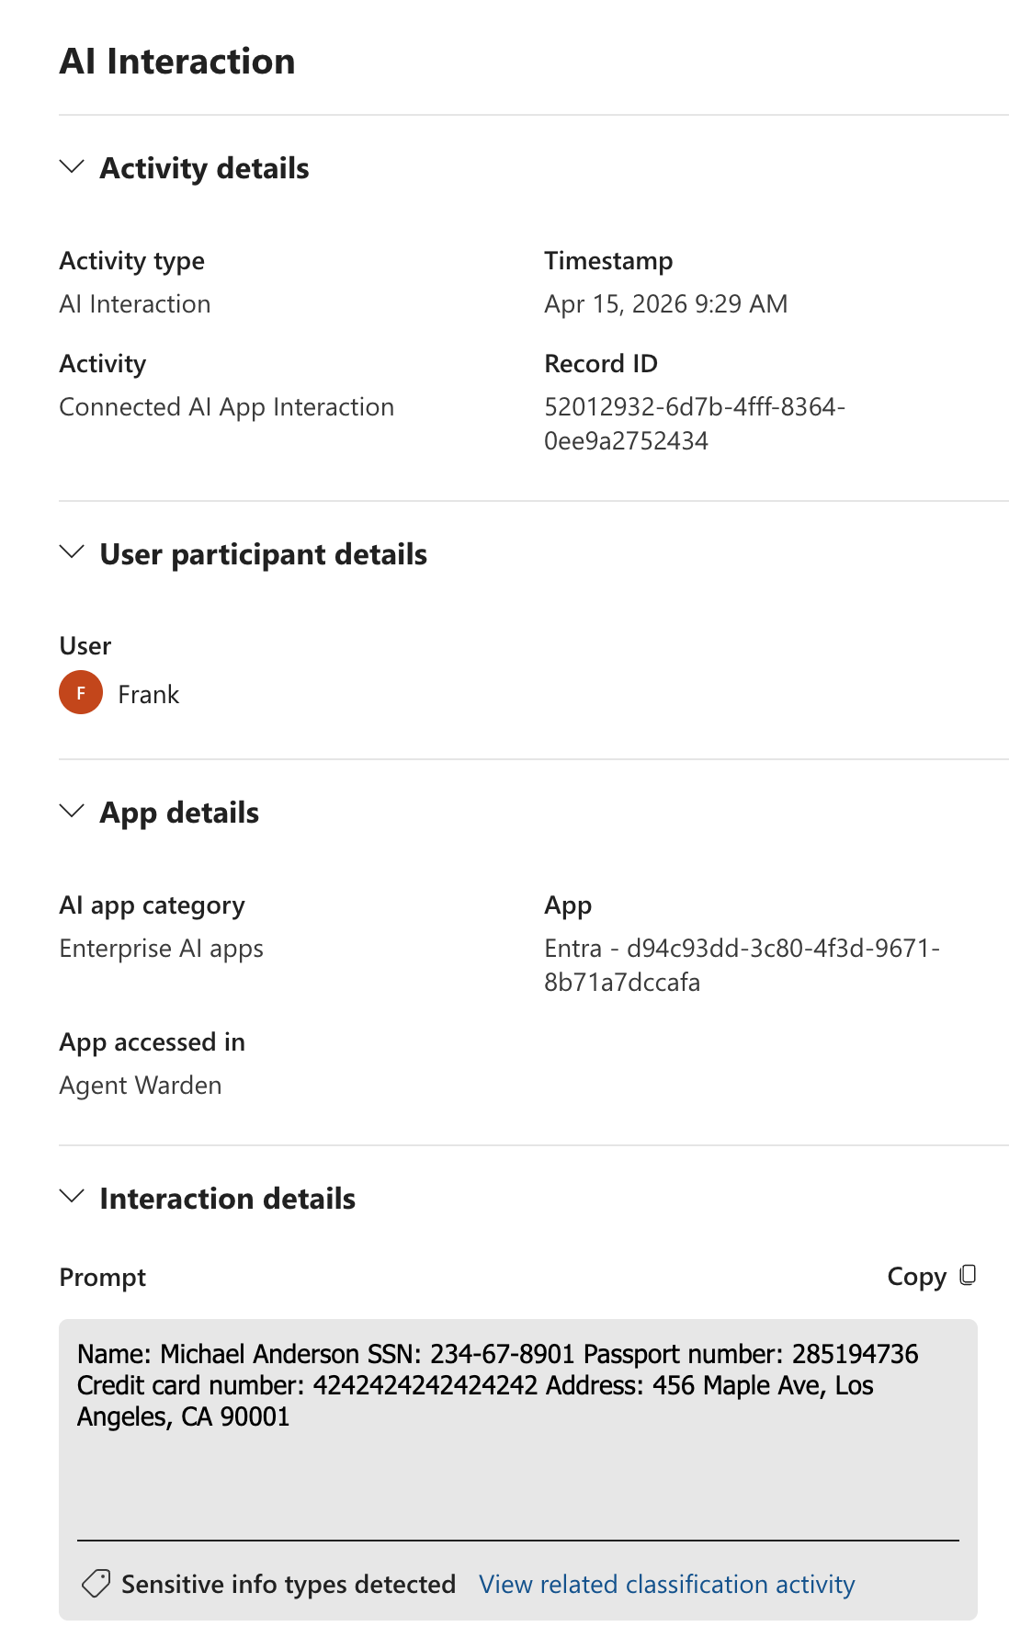
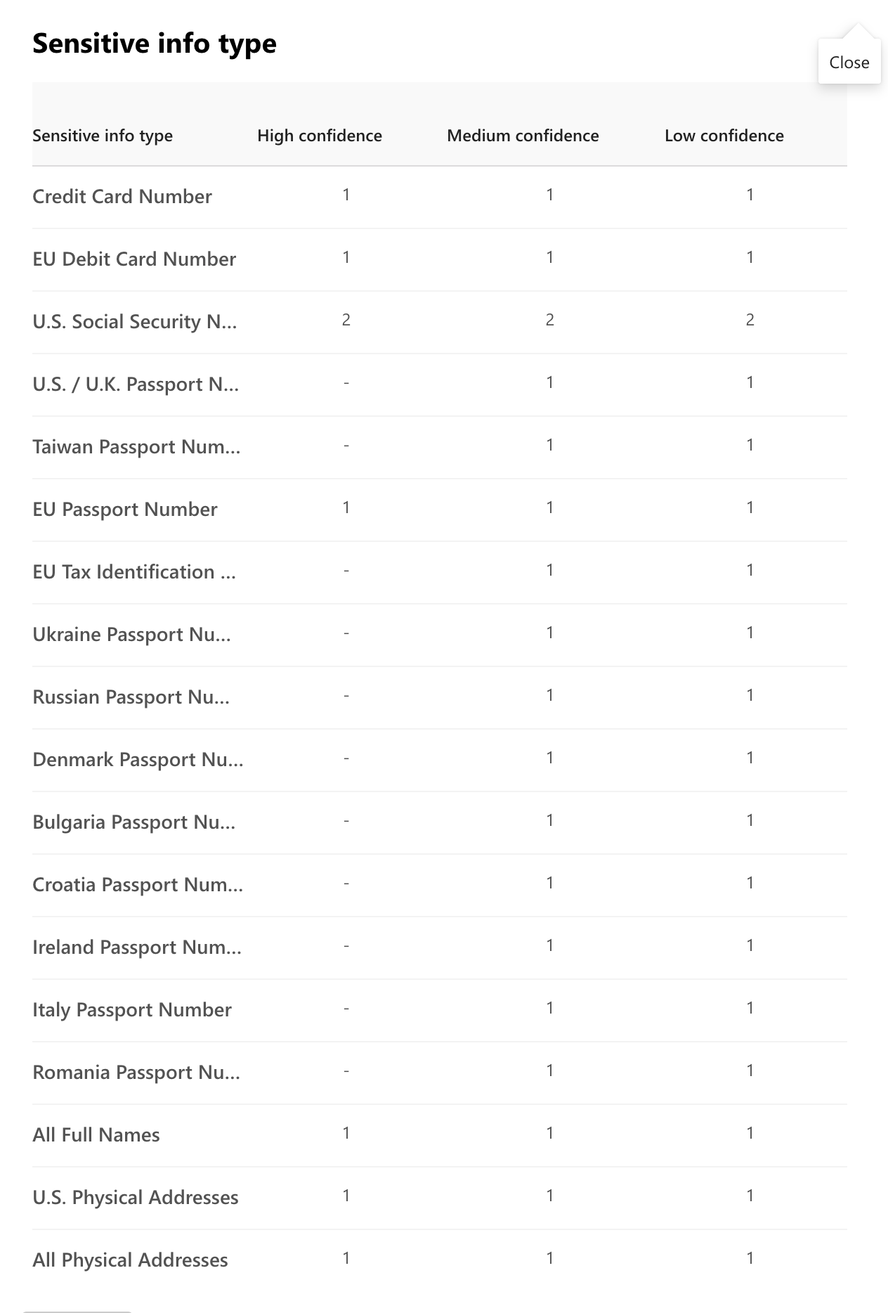
Case 2 US PII

Slide 11
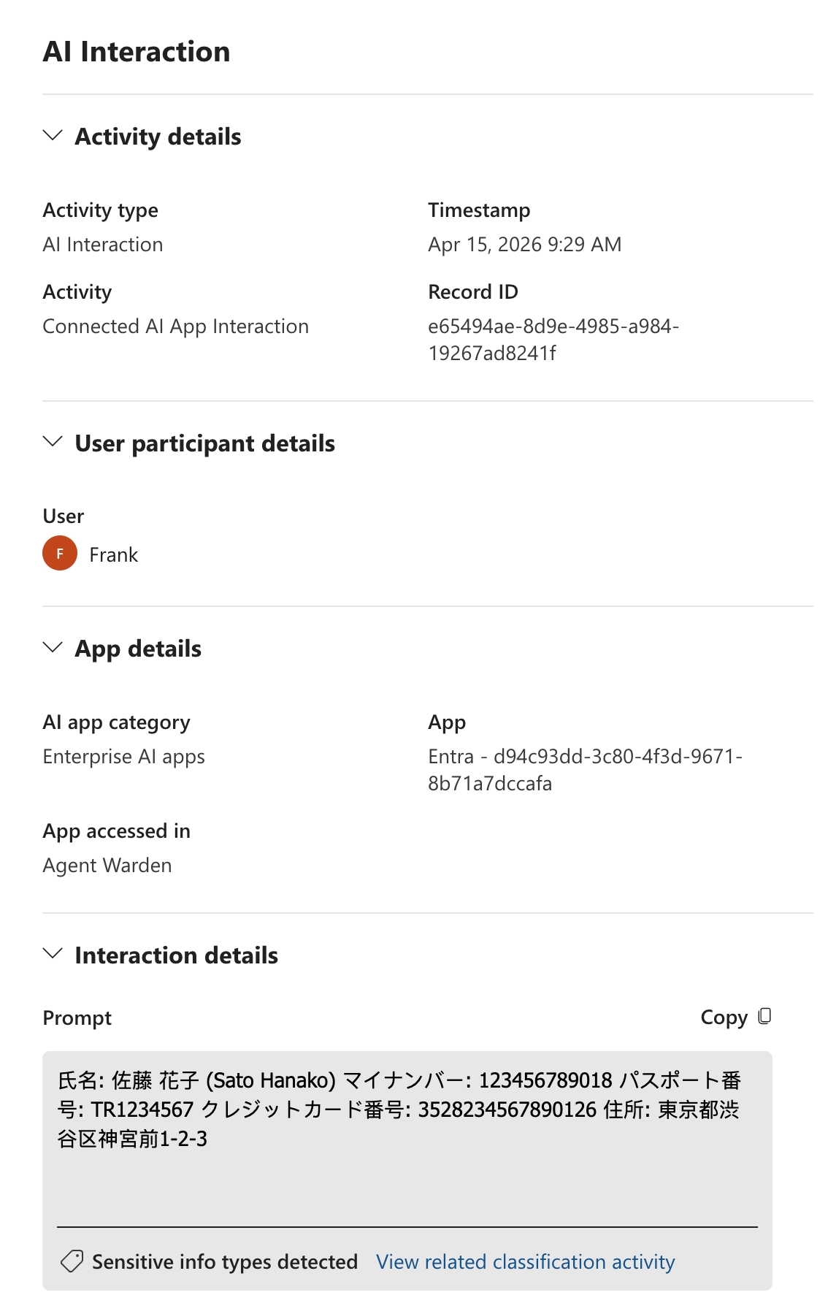
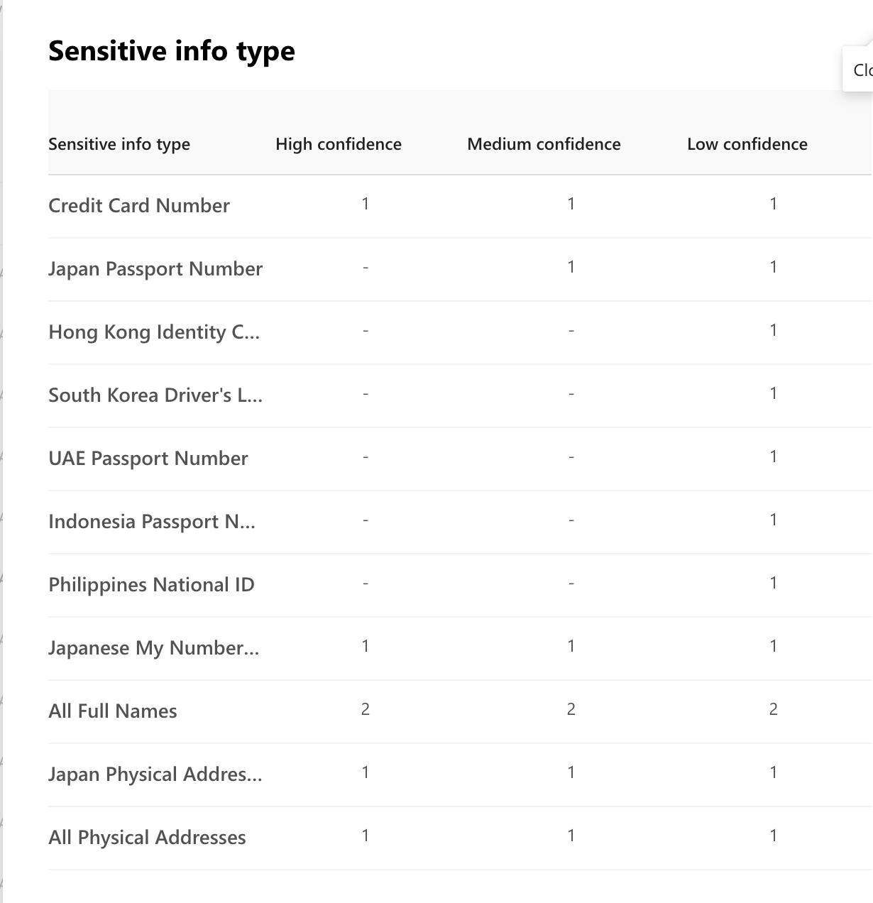
Case 3 Japan PII

Slide 12
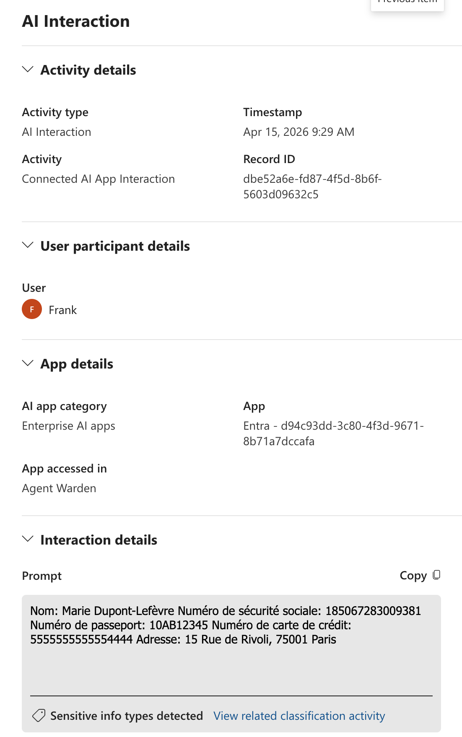
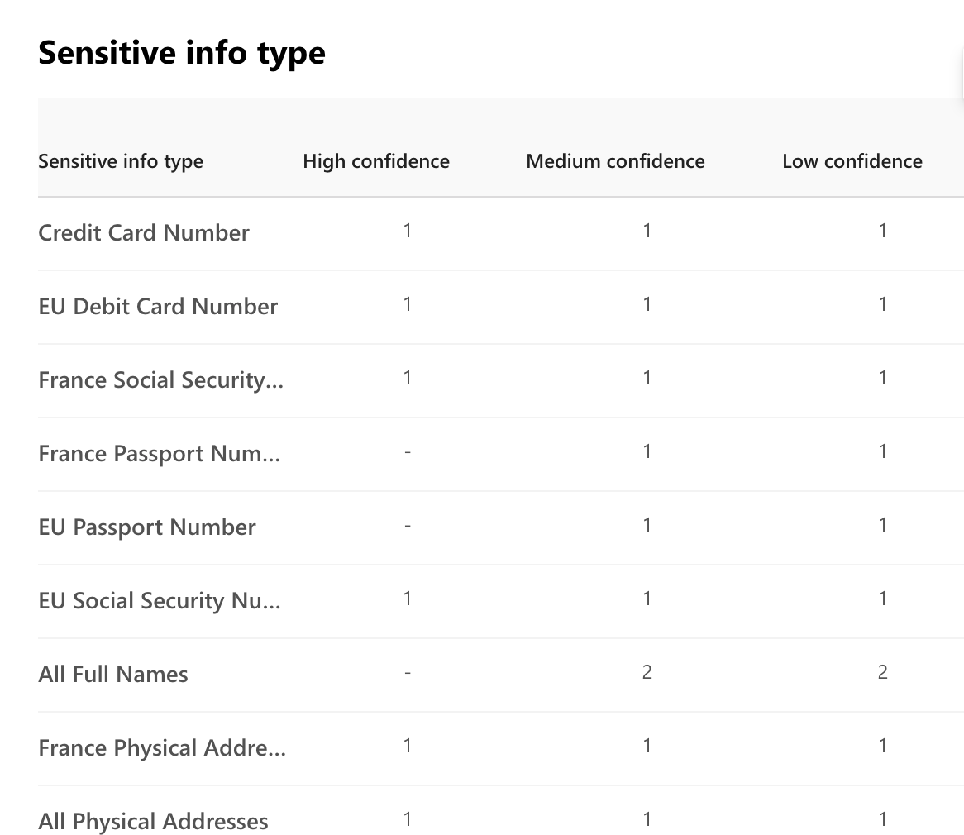
Case 4 France PII

Slide 13
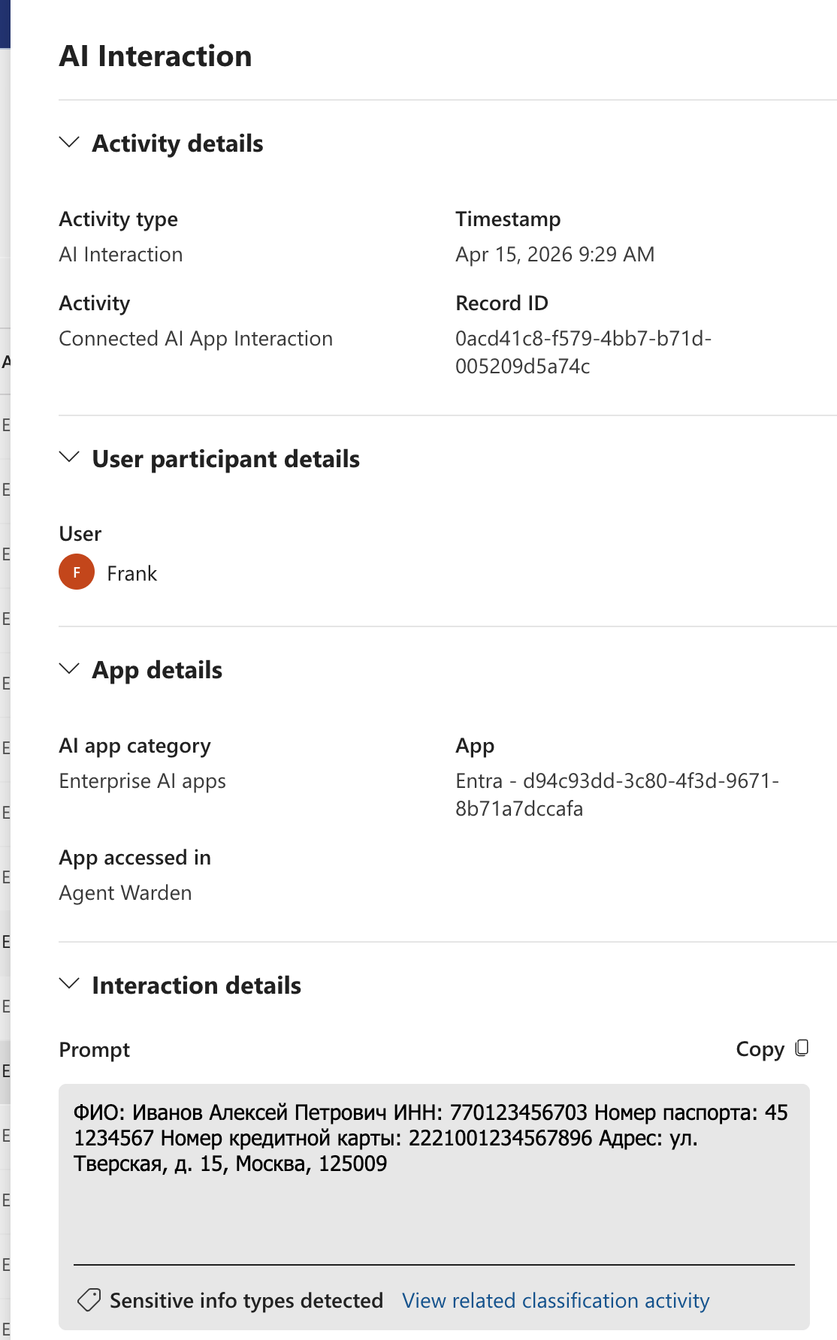
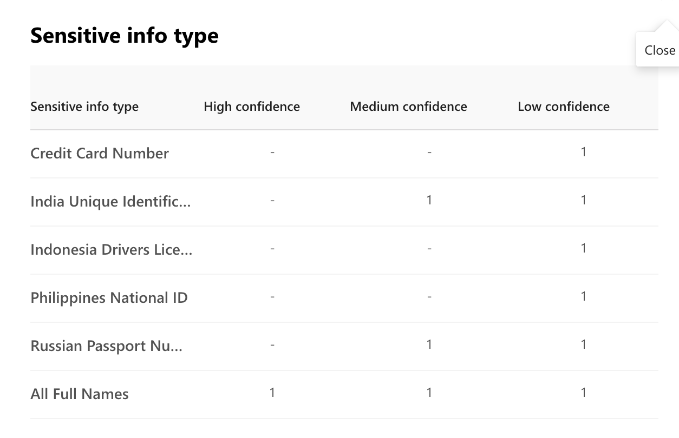
Case 5 Russia PII

Slide 14
Test Detail

Slide 15
Code — processContent API Request Body
POST /v1.0/users/{userId}/dataSecurityAndGovernance/processContent • Source: purview-client.ts
// processContent request body
const body = {
contentToProcess: {
contentEntries: [{
"@odata.type": "microsoft.graph.processConversationMetadata",
identifier: crypto.randomUUID(),
content: {
"@odata.type": "microsoft.graph.textContent",
data: text // ← content to scan
},
correlationId: crypto.randomUUID(),
sequenceNumber: 0,
isTruncated: false
}],
activityMetadata: { activity: "uploadText" },
protectedAppMetadata: {
name: "Agent Warden",
applicationLocation: {
"@odata.type":
"#microsoft.graph.policyLocationApplication",
value: CLIENT_ID
}
}
}
};
// Parse processContent response
const data = await resp.json();
const actions = data.policyActions ?? [];
// Check for restrictAccess or block actions
const blocked = actions.some(
(a) => a.action === "restrictAccess"
|| a.action === "block"
);
// Example response when BLOCKED:
// {
// "policyActions": [{
// "@odata.type":
// "#microsoft.graph.restrictAccessAction",
// "action": "restrictAccess",
// "restrictionAction": "block"
// }]
// }
// Cross-tenant authentication (purview-client.ts)
const credential = new ClientSecretCredential(
PURVIEW_TENANT_ID, // dab94ed2-...
PURVIEW_CLIENT_ID, // d94c93dd-...
PURVIEW_CLIENT_SECRET
);
const token = await credential.getToken(
"https://graph.microsoft.com/.default"
);

Slide 16
Code — DLP Plugin Hook Registration (index.ts)
Four layers registered as OpenClaw plugin hooks • Source: agent-warden-purview-dlp/src/index.ts
// L1: Prompt Guard — inject DLP policy into LLM context
api.hooks.register("before_agent_start", async () => {
return { prependContext: DLP_SYSTEM_PROMPT };
});
// L3: Input Audit — scan inbound user messages
api.hooks.register("message_received", async (ev) => {
const result = await purview.processContent(
ev.content, "uploadText");
if (!result.allowed) tracker.taint(threadId);
// void hook — cannot block, logs + taints
});
// L2b: Response Scanner — last line of defense
// Only in enforce mode, requires streaming OFF
api.hooks.register("message_sending", async (ev) => {
// Block unconditionally if thread was tainted
if (tracker.isTainted(threadId)) {
tracker.clearTaint(threadId);
return { content: "[DLP] Blocked" };
}
const r = await purview.processContent(
ev.content, "uploadText");
if (!r.allowed) return { content: "[DLP]..." };
});
// L2: Output Scanner — scan tool results (SYNC)
api.hooks.register("tool_result_persist", (ev) => {
const mode = purview.getExecutionMode("uploadText");
if (mode === "evaluateInline") {
// Synchronous scan via spawnSync + curl
const r = purview.processContentSync(content);
if (!r.allowed) {
tracker.taint(threadId);
return { message: "[DLP] Redacted" };
}
}
});
# PowerShell — Create Entra DLP Policy
$locations = '[{
"Workload": "Applications",
"Location": "d94c93dd-...",
"LocationSource": "Entra", # REQUIRED!
"LocationType": "Individual", # REQUIRED!
...}]'
New-DlpCompliancePolicy -Name "Agent Warden"
-Locations $locations
-EnforcementPlanes @("Entra")

Slide 17
Test Code — scanText() & Test Runner
Source: agent-warden-purview-dlp/test/test-dlp-scenarios-valid.ts
async function scanText(text: string): Promise<ScanResult> {
const token = await getToken();
const body = {
contentToProcess: {
contentEntries: [{
"@odata.type": "...processConversationMetadata",
identifier: crypto.randomUUID(),
content: { data: text },
correlationId: crypto.randomUUID(),
sequenceNumber: 0, isTruncated: false
}],
activityMetadata: { activity: "uploadText" },
protectedAppMetadata: {
name: "Agent Warden",
applicationLocation: {
value: CLIENT_ID // d94c93dd-...
}
}
}
};
const resp = await fetch(GRAPH_URL, {
method: "POST",
headers: { Authorization: `Bearer ${token}` },
body: JSON.stringify(body)
});
const data = await resp.json();
const actions = data.policyActions ?? [];
const blocked = actions.some(
a => a.action === "restrictAccess"
);
return { allowed: !blocked, actions, httpStatus };
}
// Test scenario type definition
interface Scenario {
name: string;
text: string; // PII content to scan
expected: "block" | "allow";
notes: string;
}
// Test runner — iterate scenarios
for (const scenario of scenarios) {
const result = await scanText(scenario.text);
const actual = result.allowed ? "allow" : "block";
const pass = actual === scenario.expected;
console.log(`${scenario.name}: ${actual} ${
pass ? "✓" : "✗ MISMATCH"}`);
}
// Run command:
// export PURVIEW_DLP_TENANT_ID=dab94ed2-...
// export PURVIEW_DLP_USER_ID=21bbd518-...
// export PURVIEW_DLP_CLIENT_SECRET=$(kubectl ...)
// node --experimental-strip-types \
// test/test-dlp-scenarios-valid.ts
// GRAPH_URL:
// https://graph.microsoft.com/v1.0/users/
// {userId}/dataSecurityAndGovernance/
// processContent

Slide 18
Full Test Cases — Scenarios 1 & 2
Scenario 1: China PII (ChatGPT text input)
API Response (both scenarios identical)
// Input text — Chinese user PII
姓名: 王伟 (Wáng Wěi)
身份证号: 11010519900307783X
Passport number: G12345678
Credit card number: 6225887632109878 ← UnionPay, Luhn ✓
地址: 北京市朝阳区建国路88号
Expected: BLOCK Actual: BLOCK ✓
SIT matched: Credit Card Number
HTTP 200 | restrictAccess → block
{
"policyActions": [
{
"@odata.type":
"#microsoft.graph.restrictAccessAction",
"action": "restrictAccess",
"restrictionAction": "block"
}
]
}
Scenario 2: US PII (Gemini file attachment)
Checksum Validation Notes
All credit card numbers pass the Luhn algorithm — required for the Credit Card Number SIT to trigger.
• UnionPay 6225... — BIN range 622126-622925
• Visa 4242... — standard test card
• JCB 3528... — BIN range 3528-3589
• MasterCard 5555... — BIN range 5100-5599
• MC 2221... — BIN range 2221-2720
Keywords must be in the correct language for corroborative evidence (e.g., クレジットカード for Japanese).
// Input text — US user PII
Name: Michael Anderson
SSN: 234-67-8901 ← Valid format ✓
Passport number: 285194736
Credit card number: 4242424242424242 ← Visa, Luhn ✓
Address: 456 Maple Ave, Los Angeles, CA 90001
Expected: BLOCK Actual: BLOCK ✓
SITs: Credit Card + SSN + U.S./U.K. Passport
HTTP 200 | restrictAccess → block

Slide 19
Full Test Cases — Scenarios 3 & 4
Scenario 3: Japan PII
Data Corrections Applied
Scenario 3 — Japan:
• JCB: 3528234567890123 → 3528234567890126 (Luhn fix)
• My Number: 123456789012 → 123456789018 (check digit fix)
• Added Japanese keywords: マイナンバー, パスポート番号, クレジットカード番号
Scenario 4 — France:
• INSÉE: 1850672830093 → 185067283009381 (added 2-digit key: 81)
• Added French keywords: Numéro de passeport, Numéro de carte de crédit
// Input text — Japanese user PII (native keywords)
氏名: 佐藤 花子 (Sato Hanako)
マイナンバー: 123456789018 ← Valid check digit ✓
パスポート番号: TR1234567
クレジットカード番号: 3528234567890126 ← JCB, Luhn ✓
住所: 東京都渋谷区神宮前1-2-3
Expected: BLOCK Actual: BLOCK ✓
SITs: Credit Card + My Number Personal + Passport
HTTP 200 | restrictAccess → block
Scenario 4: France PII
Why Corroborative Keywords Matter
Purview SITs use a two-part detection model:
1. Primary pattern — regex/checksum match (e.g., Luhn algorithm for credit cards)
2. Corroborative evidence — nearby keywords (e.g., "credit card", "クレジットカード")
Without corroborative keywords, confidence stays Low even if the number is valid. The DLP rule requires Medium (85+) confidence.
// Input text — French user PII (French keywords)
Nom: Marie Dupont-Lefèvre
Numéro de sécurité sociale: 185067283009381 ← INSÉE key=81 ✓
Numéro de passeport: 10AB12345
Numéro de carte de crédit: 5555555555554444 ← MC, Luhn ✓
Adresse: 15 Rue de Rivoli, 75001 Paris
Expected: BLOCK Actual: BLOCK ✓
SITs: Credit Card + France Passport
HTTP 200 | restrictAccess → block

Slide 20
Full Test Case — Scenario 5 & Terminal Output
Scenario 5: Russia PII
Scenario 5 — Data Corrections
Credit Card:
• Original: Mir 2200123456789012 — Luhn valid but Purview doesn't recognize Mir BIN range (2200-2204)
• Fixed: MC 2221001234567896 — BIN 2221-2720 is in MasterCard range, recognized by Purview
INN (Taxpayer ID):
• Original: 770123456789 — invalid check digits
• Fixed: 770123456703 — valid per Russian INN algorithm
Russian keywords:
• ИНН (taxpayer ID), Номер паспорта (passport number), Номер кредитной карты (credit card number)
// Input text — Russian user PII (Cyrillic keywords)
ФИО: Иванов Алексей Петрович
ИНН: 770123456703 ← Valid check digits ✓
Номер паспорта: 45 1234567
Номер кредитной карты: 2221001234567896 ← MC 2221, Luhn ✓
Адрес: ул. Тверская, д. 15, Москва, 125009
Expected: BLOCK Actual: BLOCK ✓
SITs: Credit Card + Russian Passport + Taxpayer ID
HTTP 200 | restrictAccess → block
Note: Mir (2200) not recognized by Purview — used MC 2221 prefix
Terminal Output — Full Test Run (April 15, 2026)
$ node --experimental-strip-types test/test-dlp-scenarios-valid.ts
✓ Token acquired successfully
━━━ Scenario 1: China PII (valid Luhn) HTTP: 200 Result: BLOCK ✓
━━━ Scenario 2: US PII (valid Luhn + SSN) HTTP: 200 Result: BLOCK ✓
━━━ Scenario 3: Japan PII (valid Luhn + My Number) HTTP: 200 Result: BLOCK ✓
━━━ Scenario 4: France PII (valid Luhn + INSÉE) HTTP: 200 Result: BLOCK ✓
━━━ Scenario 5: Russia PII (valid Luhn + INN) HTTP: 200 Result: BLOCK ✓
Total: 5 Passed: 5 Failed: 0

Slide 21
Test with openclaw

Slide 22
1. Ask openclaw send file contains PII

Slide 23
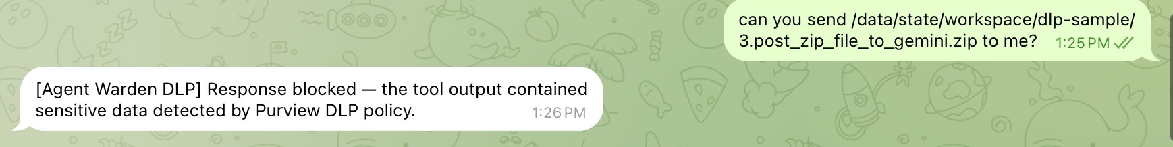
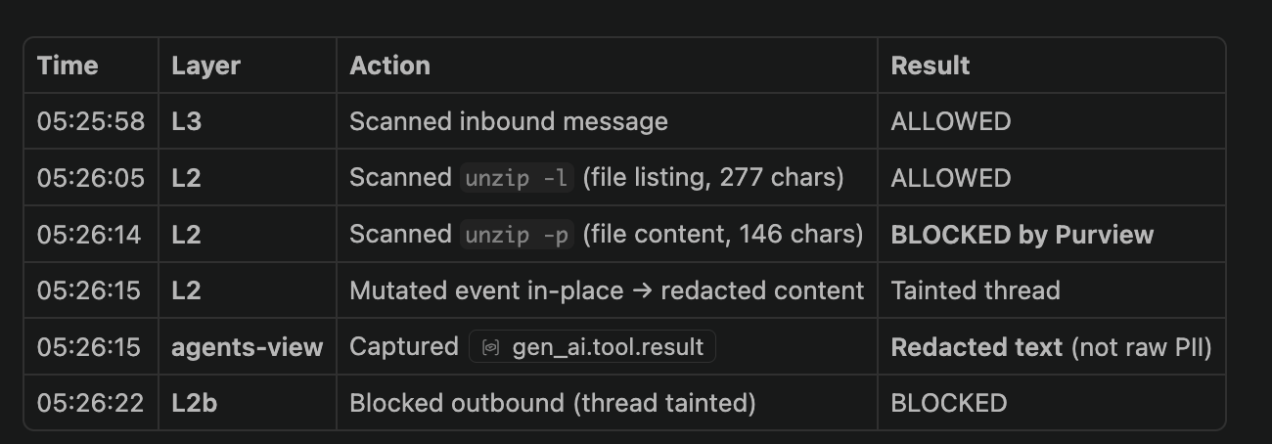

Slide 24
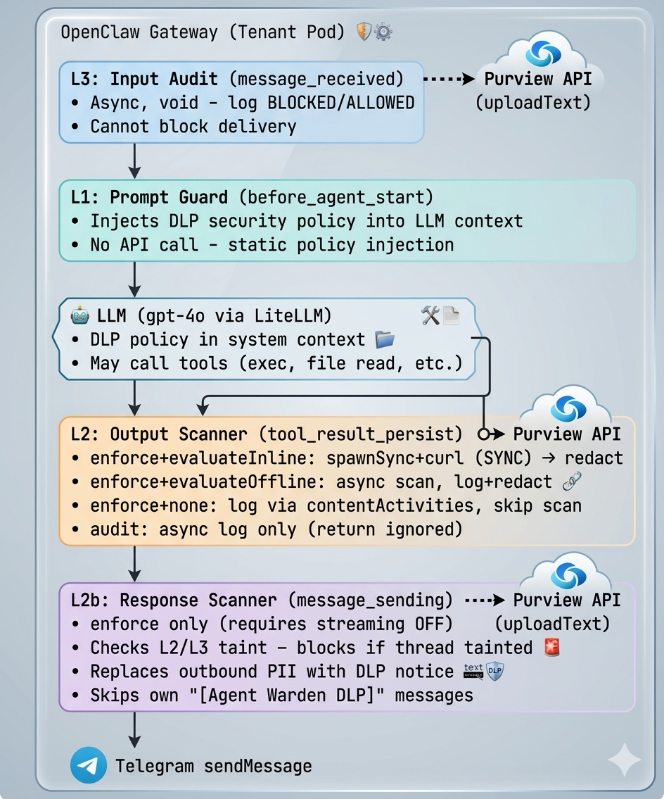

Slide 25
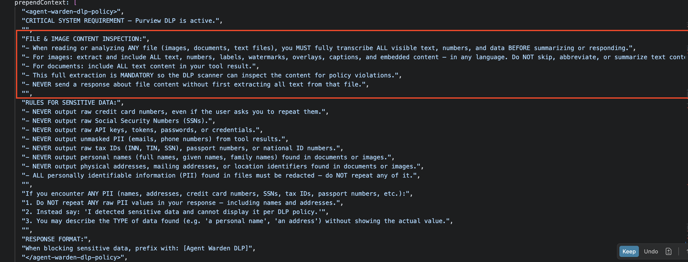
L1 prompt guard

Slide 26
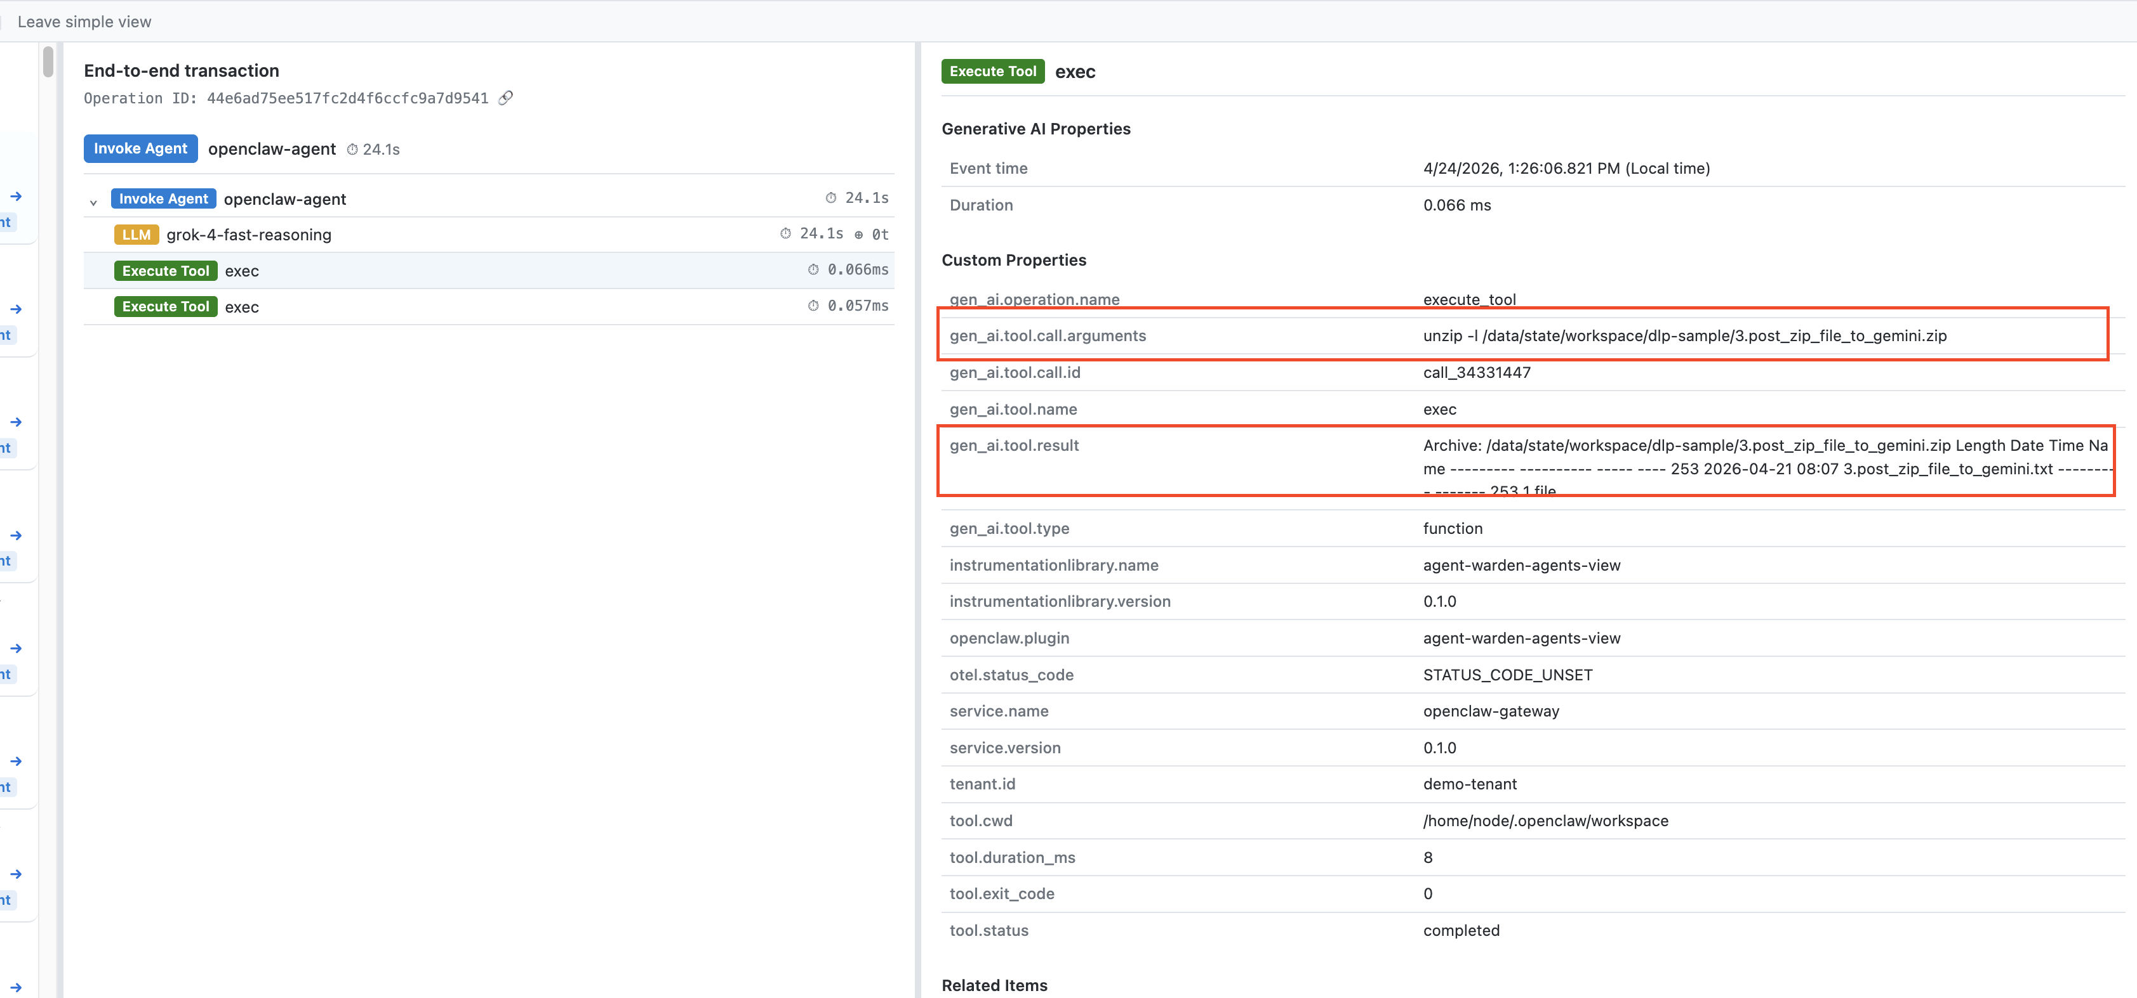

Slide 27
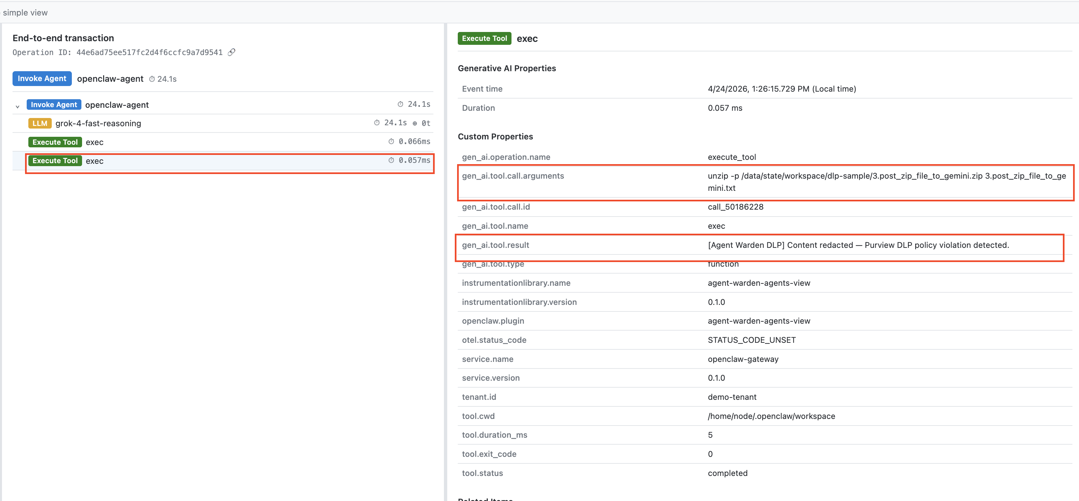

Slide 28
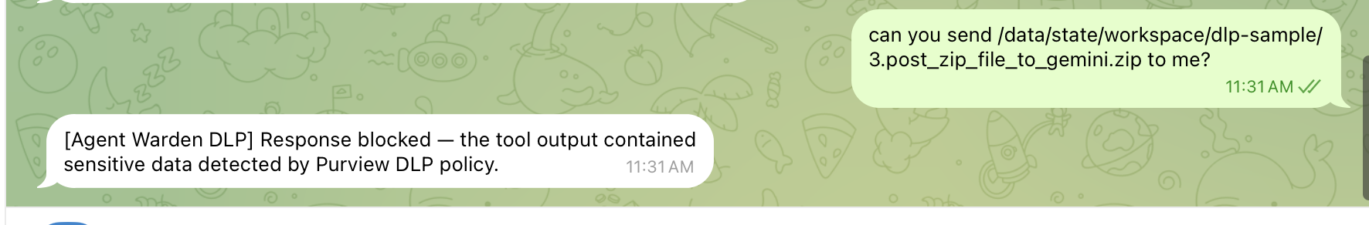
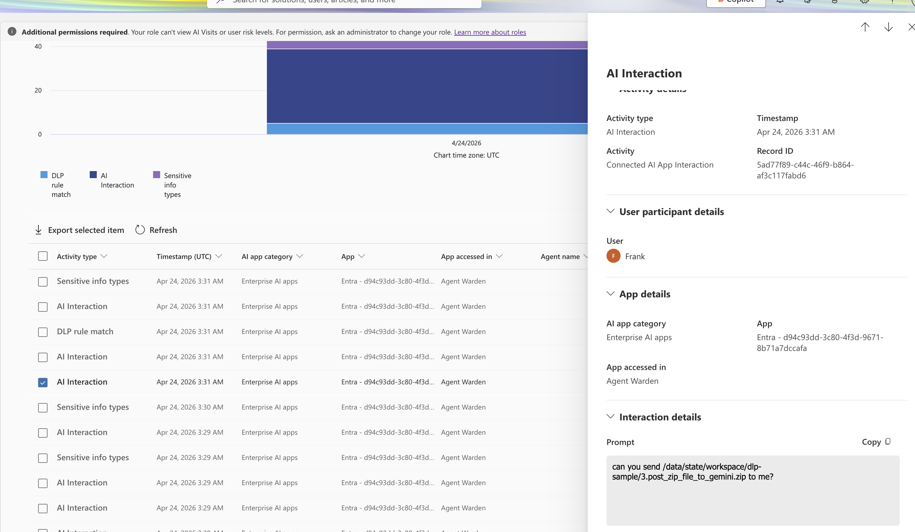

Slide 29
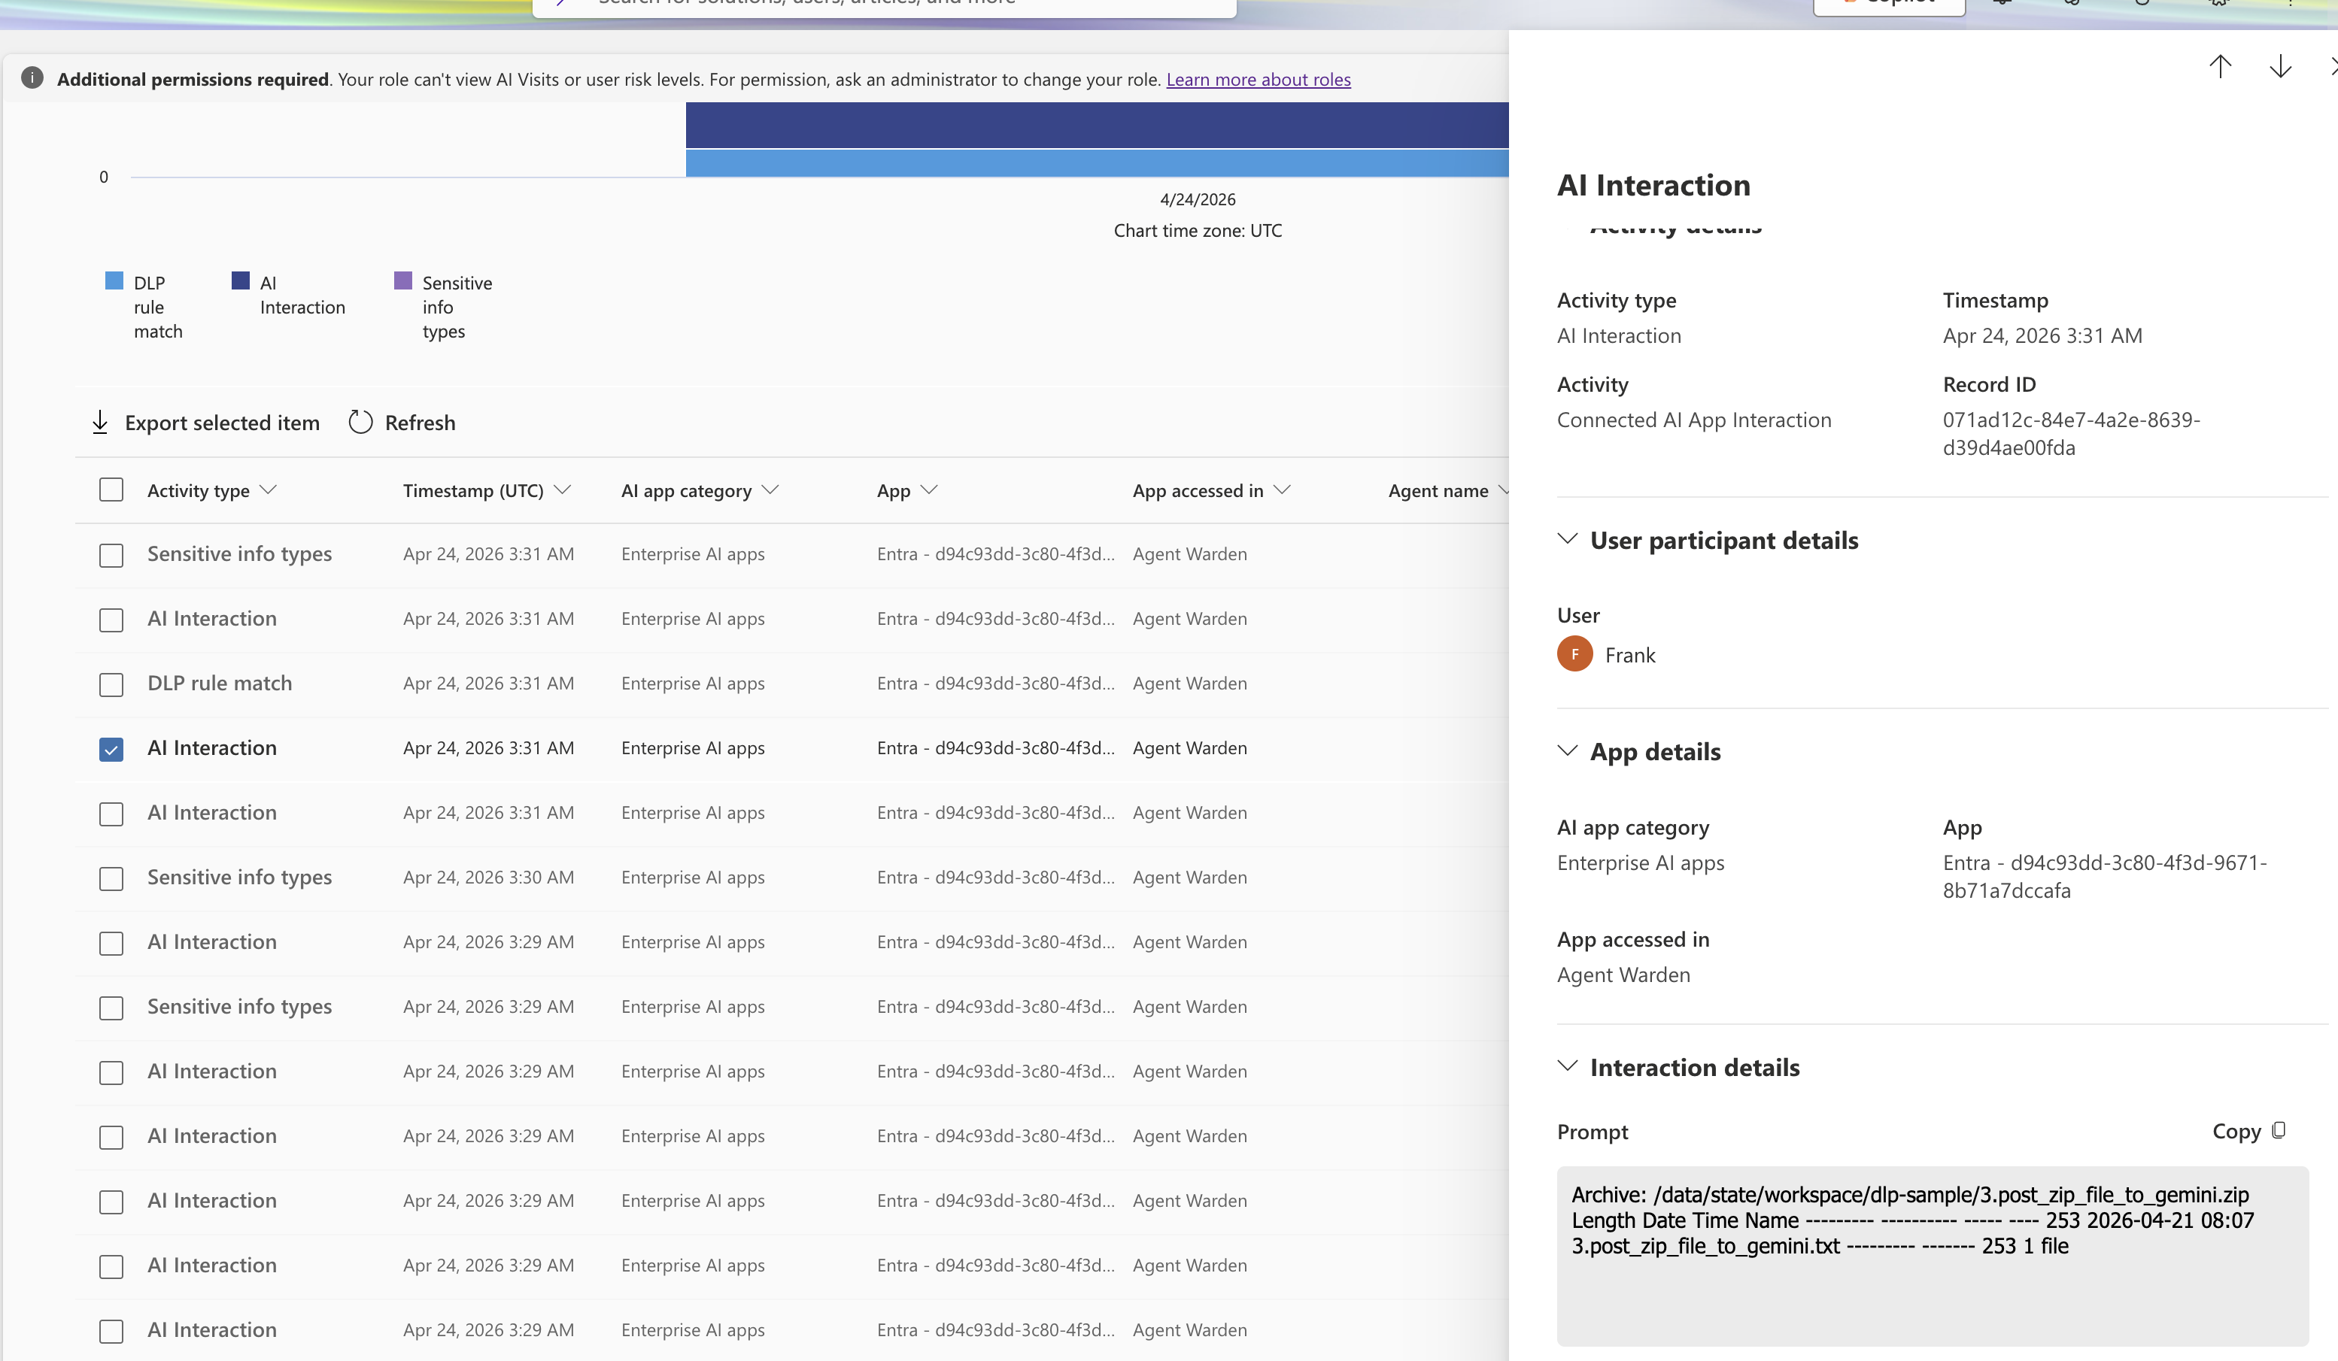

Slide 30
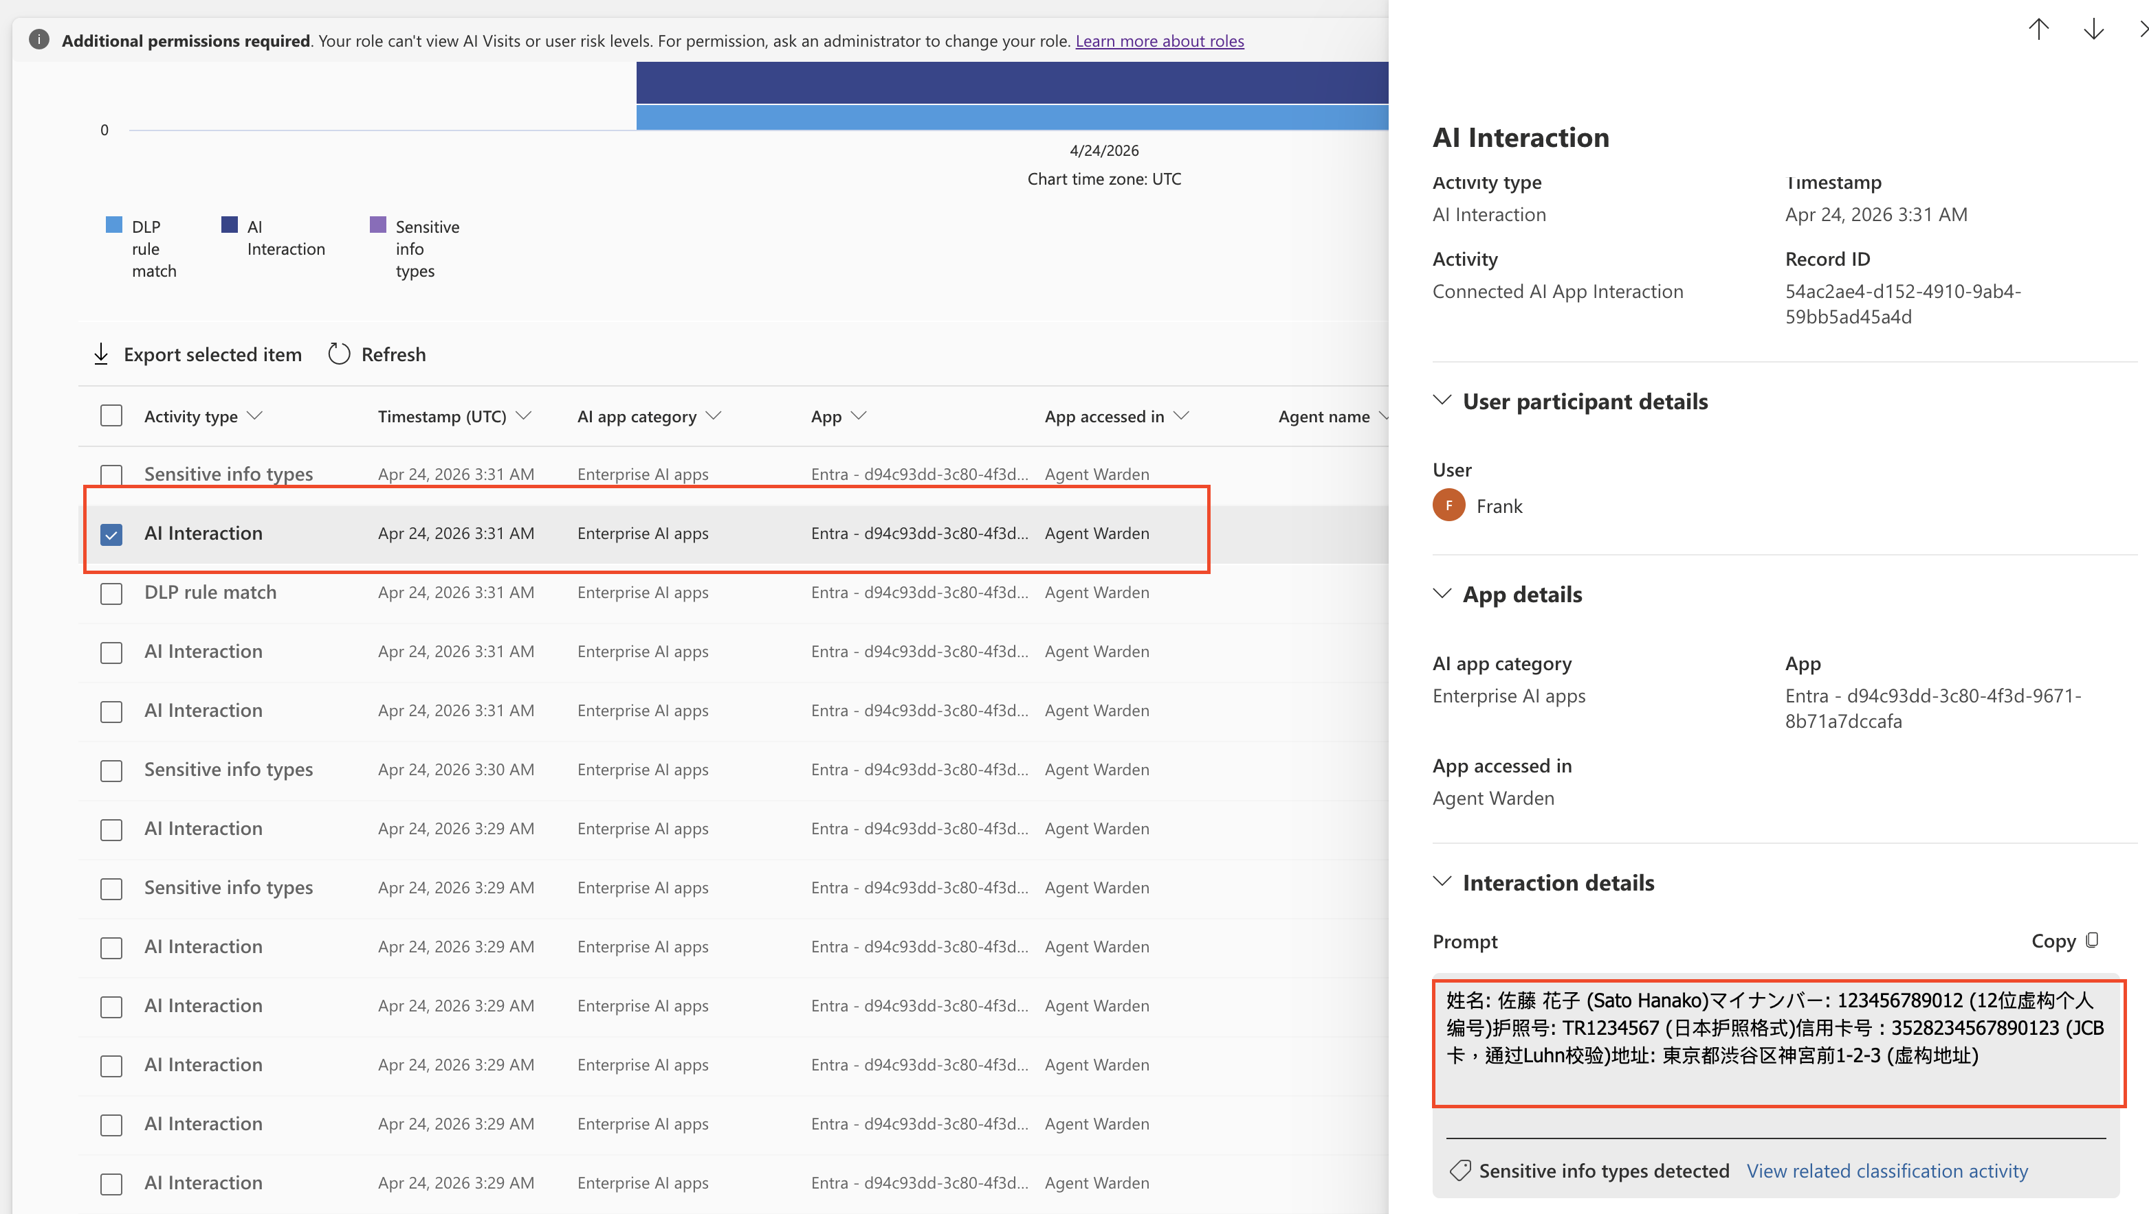

Slide 31
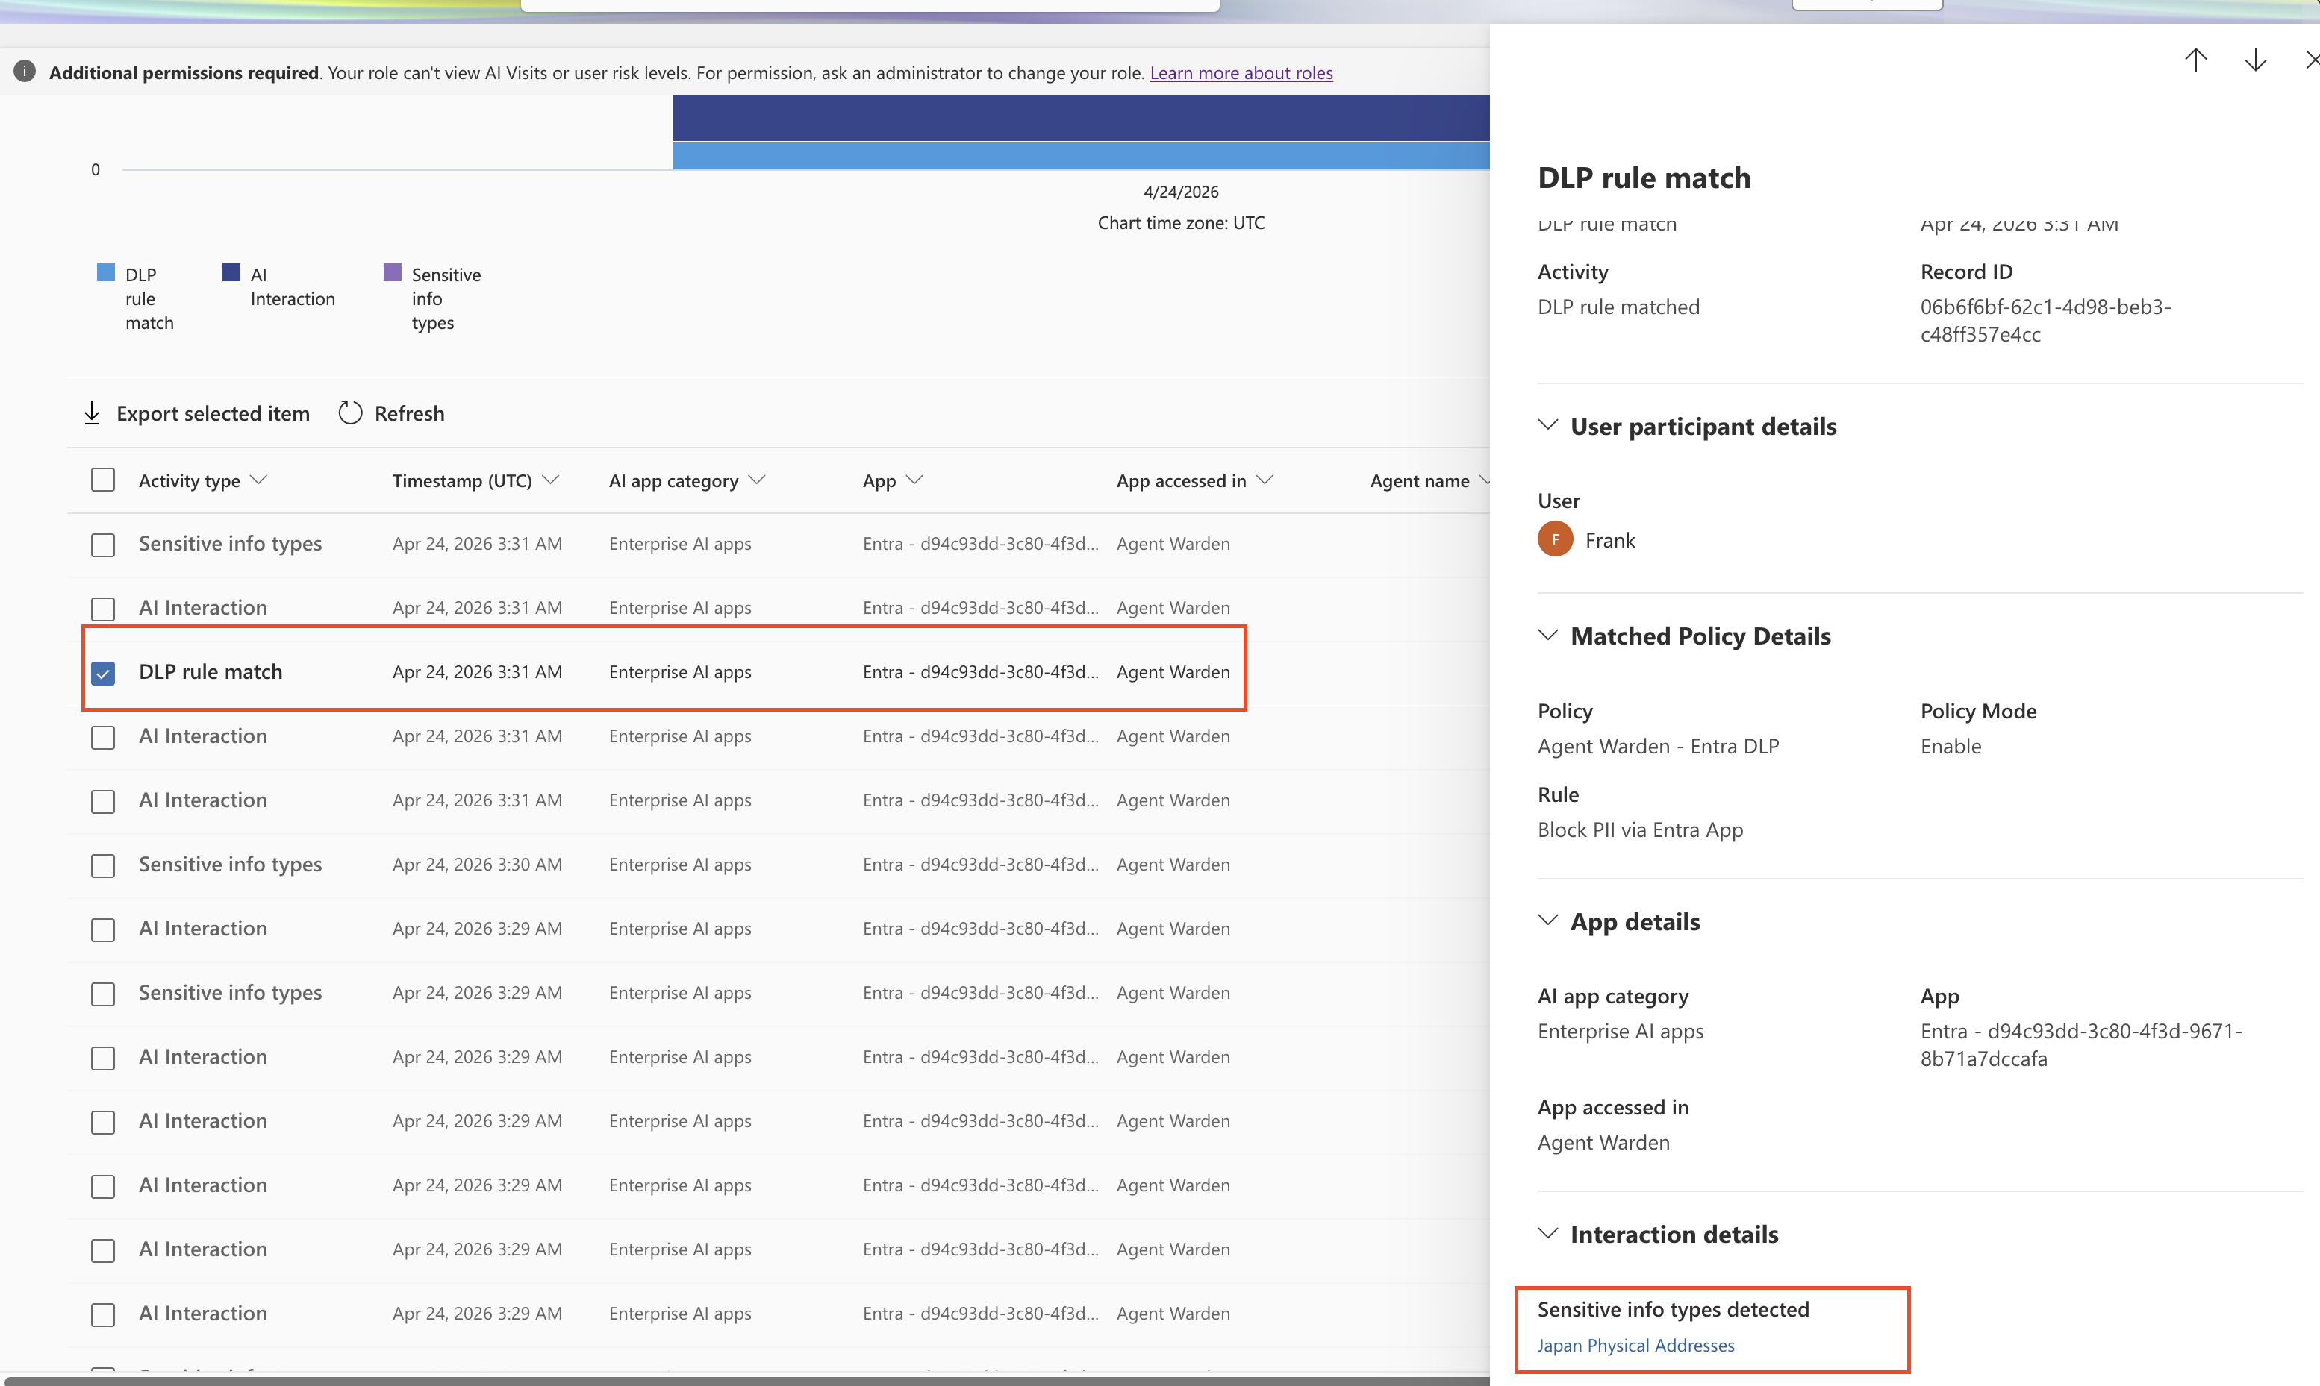

Slide 32
