Slide 1
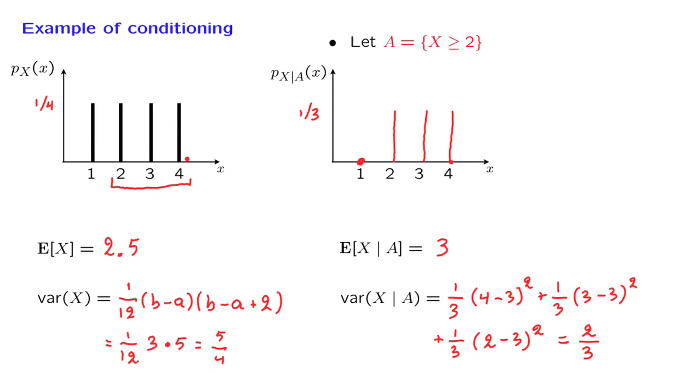
The original model
1
2
The Conditioning Event, which is a random variable
3
The updated model conditioned on event A

