Slide 1
AWS Regulation
Problem:
The character of war is changing fast and the ethics needs to keep pace with that change. But we should not imagine the fundamental ethical issues have changed. So need to apply fundamental ethical issues to AWS development and deployment.
western militaries ought to ethically design AWS – that are competitive with rival nations
Why: hypocrisy of the west to tout freedom and democracy if AWS breaches those tenets. If not, risk taking moral and ethical shortcuts in war.
But need more deeply technical and ethical force in this area to lead in a time when its an unattractive place to work. Freedom of individual to choose where to deploy their talents. Unlike China, conscripted software engineers.
By academics
Blind to what’s happening in industry.
Not working
Conventionally think robotic kinetic systems
because
Cyber domain: take out power grids, water treatment, food production, internet infrastructure
Definition too broad
Military necessity: monopoly on violence. World peace
Fait a compli: dual purpose technology
Resulting in: ongoing experimental development work
State sponsorship
Companies developing independently to their own values and policies
Cyberwarfare appears to be entirely unaddressed by traditoinal morality and laws of war because they emphases damage to human lives an material objects.
Single policy statement as coverage for the holding company doesn’t
Translate into engineering processes around AWS ethics.
But individual ethicists are insufficient. Complex systems are designed and manufactured through the design methodologies that define the interactions of such people
So what?
Why?
What can we do?
Left to the values and beliefs of the individual engineer to imbue into their work. OK because CPEng exposes ethical merit.
H2: Ignore because academic concern decades ahead of production systems i.e. irrelevant for today’s implementation. Short term focus: deliver contracts.
H3: Precedent. Similar systems already exist and trust the development process
H4: Rare to find deeply technical engineer and deep philosophical ethicist in the defence industry. Those people self-select out.
Bottoms up derivation of AWS engineering ethical framework/
Procedural Norms
Inevitable proliferation through technology diffusion: exports, capture, espionage, copy-cat, price decrease over time
Create systems that aren’t verifiably ethical. Because no definition for that.
technical implementation of basics still hard
Win stakeholders: keys are principal technologists who have ear of CEO.
Form public cooperation with other defence contractors on ethically development standards.
Ambiguous moral position
No public dialogue because distraction of time and resources. Pessimistic outlook: no consensus to be reached with public because they don’t understand military systems development. Invitably trigger hardline anti-defence people that derail productive discussions = quagmire. Defence companies already have public relations uphill battle - stereotype of cold, greedy, war-profiteering people. Add AWS debate = lose.
Dedicated AI ethicists?
Work with DoD
US DoD: Defnecse Innovation Board AI ethics seeks to institutionalise -
Won’t attract talent required. Matters in free capitalist systems where individuals can choose to deploy their talent
engineering code of conduct ethics. Inconsistent for AWS military systems
Significant rework and cost to refactor late
Engage with allies and partners to reinofrce norms for the ethical employment of AI-enalbe AWS in future military operations.
without strong ethical foundation to start, risk of drift in times of war: risk of taking moral and ethical shortcuts to win.
Downward spiral for AWS engineering and AI safety in military at a time when need deeply technical people and AI ethicists to be stewards for AWS development
Lose to countries like China that conscript their top software engineers
No evaluation of AWS design ethics
Pursue prgamactic bilateral and multilateral cooperation on AI safety and testing of complex systems
What line will we never cross?

Slide 2
No Global regulation
Federal Government too slow, non-technical
Autonomous Weapon Systems
Do I even know what the ethical risks are? (Identify)
Hazard ID. Use concerns from IEEE
Where in my design have I introduced ethical risks (analysis)
What am I doing about it now? (Implement)
Use Functional Hazard Analysis
If I can’t do anything about it now, how do I ensure that I will do something about it in the future? (Monitor)
Annual review – Ethics Officer
Department of Defence working on it – committees, workshops
Companies – ethical policy at Holding Company but not engineering processes
Development Teams should self-police because closest to the technology
Engineering Risks Techniques Inadequate: Limited to Product Safety
What about ethical risk assessments?
Engineering ehtics codes have existed for a century, it is only during the past thirty years that such codes have been revised to include explicity the notion that engineers have a responsibility for protected in the public safety, health and welfare… [IEEE 1994]
.[Guntzburger 2016] analyses the nexus between ethics and risk managemetn in engineerin education reserarch literature by reviewing 135 articles publisehd between 1980-2016 from 21 major journals in ‘engineering education, engineering ethics and ethics eudcation’. Guntzburger considers them two distinct topics.
‘the notion of responsibilty clearly bridges risk managemetn and ethics’.
The small number of papers seriously considering ethics while focusing on risk management education is striking
that ethics should not only be a reason for doing risk management, but that it should also be used as a powerful educational and professional asset, allowing critical evaluation and reflection, in order to improve risk management methods

Slide 3
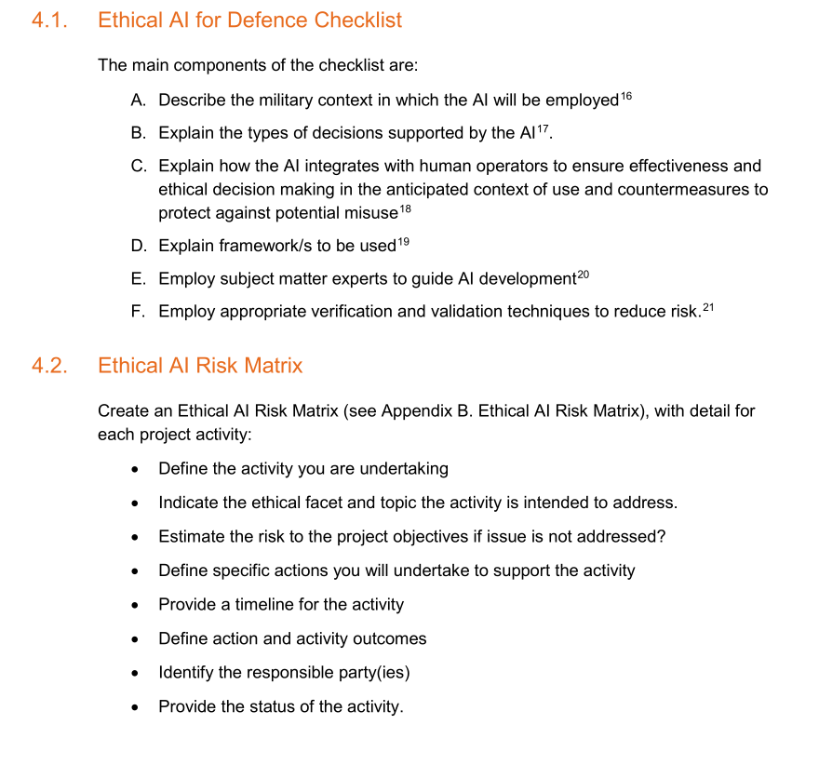
How can AI be used lawfully?
Protected symbols and surrender
There are multiple ways in which accountability for the actions of AWS can be compromised
Automated reactions of AWS could result in initiation or escalation of conflicts outside decisions by political and military leadership. AWS could escalate a conflict rapidly AWS could engage with other AWS and could escalate a conflict rapidly before humans are able to intervene
AWS could be used for deliberation violations of human rights
Organisation
De-escalation
Review their ethics wrt to AWS
Could my system be modified and repurposed?
Ethical Risks
Conform to professional code of ethics
Professional organizations need to have resources
for their members to make inquiries concerning
whether a member’s work may contravene (IHL)
or (IHRL).
AWS could be used for covert, obfuscated and non-attributable attacks
Non-state actors, individuals, terror attacks against civilians. Be concerned about use by malicious actors
Automated Targeting
IEEE Reframing Issue 2
Product safety
Risks
Automated Firing
IEEE Reframing Issue 2
Learning algorithms non-deterministic, devolve over time
Proliferation: AWS could be deployed by
domestic police forces and
threaten lives and safety. AWS
could also be deployed for
private security. Such AWS
may have very different design
and safety requirements than
military AWS.
Product development, maintenance, operation
Combine traditional hazard identification with the ethical concerns for AWS

