Slide 1
CS2033a/b Review Notes Vivi Tryphonopoulos Section 002

Slide 2
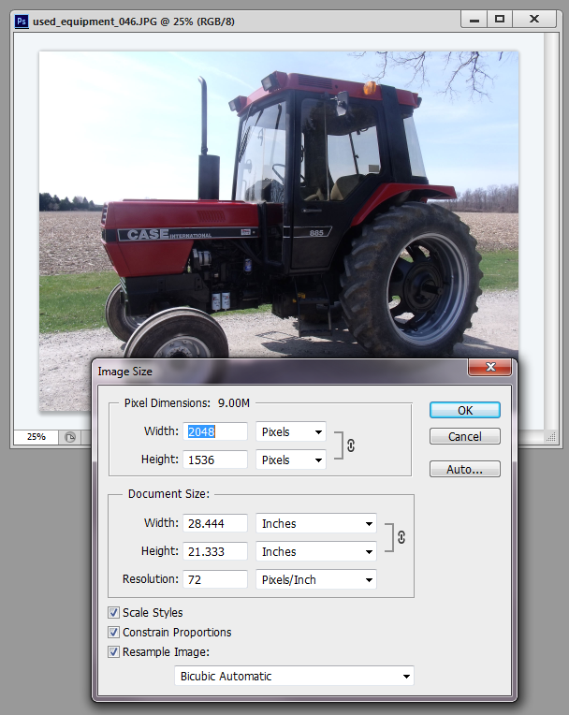
Lecture 2
What does Photoshopped mean
Bitmapped vs Vector based images
What is Resizing
What is Resampling
Which part controls resizing and resampling
1 megapixel = 1,000,000 pixels
Downsampling vs Upsampling
What is decimation vs interpolation
6 interpolation methods and what they mean
Selection Tools: and what are they best used for ie. Marquees,Lasso, Magnetic lasso, polygonal lasso, Quick Selection ,Wand

Slide 3
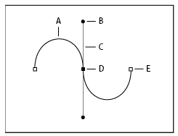
Lecture 2
What is a Clipping Mask
What is a Path: types and parts of path
Clone stamp: how it works, specify sample spot
Spot healing brush: objective, paints with sampled pixels
Healing brush: best used for what purpose; requires a sample spot
Content Aware Tool – what does it do

Slide 4
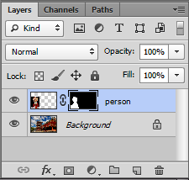
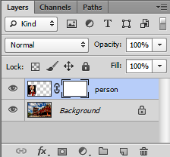
Lecture 3
What is a Clipping Mask
What is a mask?
Why do we use masks?
Problems with other techniques and why masks are preferred
How do you create a mask?
Problems of using Eraser tool and why a mask is better
What is masking? Uses of masking
You create a mask based on the selection
The selected portion of a mask can be altered/changed
The area outside/around the selection is protected from change
The area you didn’t select is masked or thought of as being protected from editing
Layer mask is filled with black and white vs just white- why?
A black mask versus a white mask
Masks –brushing with white, black, grey and what does it do to the areas (pixels)- hide or make visible?

Slide 5
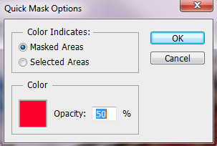
Lecture 3
Differences of Erase vs masking and advantages
What is tilt-shift photography
Clip mask from text, layer masks, Quick Masks
Quick Masks – it is a mode... Why does it paint with red overlay?
What does it mean why you select option: Masked areas vs Selected areas
What can you do with a quick mask
See slide on Summary of masks

Slide 6
Lecture 4
What are Forms
You do not need to know the various case scenarios and how they dealt with redesigns
Keep, Cut Postpone – what does it mean
Form lengths – when to use one over another- summary slide
Form Structure – Sequential, Non-Linear,In-Context
Removing unnessary information
Clear path to completion
Problems with two column forms
Input labels positioning: left, right, top
What is Eye Fixation mean?
Form Interactions: Primary vs Secondary
Do not need to memorize the different variations and the speed comparisons etc. For options (A)-(F) – slides 45-47.. But understand it.. And review the summary slide
What happens upon Submission – problems
Error Messaging – Inline variation, Dynamic Inline
Gradual Engagement
Purpose of Success feature

Slide 7
Lecture 5
Continuing with Forms
Online Form vs. Paper Form
What makes up a form advantages of each: On-line Form Builder, Open Source, Do it Yourself
What is cloud based service
Creating a form and what’s involved: creating the form, the email template, the success page, data collections files.
What are the form elements: Text field, text area, checkbox, radio buttons et.
Form Elements: ID, Label, Attributes
Understanding the E-mail template and relationship to form
Email.conf – purpose of it.. What do you use it for
What is a form handler
3 Validation Types: Required fields, correct format, confirmation fields
What is real-time validation
What is captcha?

Slide 8
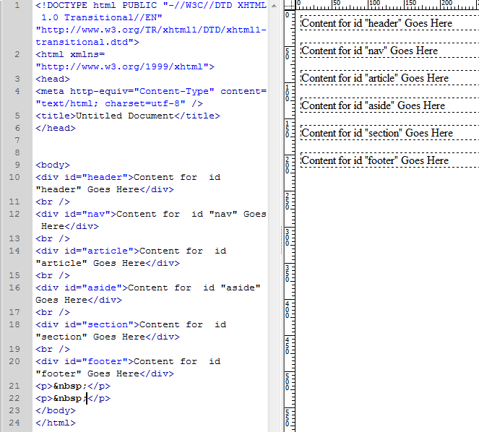
Lecture 6
CSS and Box model
Building a website without tables:
What is CSS ?
What does HTML control; what does CSS control?
Styles can be embedded in a webpage or stored in external file – what are the advantages?
CSS order of precedence
What is the box model? It’s properties (width, height,padding, margin, border)
Element width=content width (what is taken into account)
Difference between a div ID and a class? Restrictions with each
What does this mean? margin: 0 auto
Calculating box elements

Slide 9
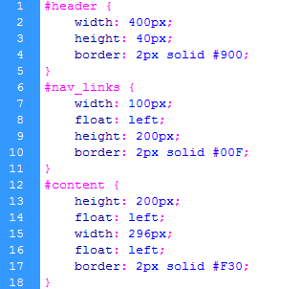
Lecture 7
What are CSS Styles?
Style Selector types: Tag (Type),Class,ID. Compound – know what they each do
Selector Definition syntax
Placement of Selector Definitions: embedded or external
Div id purpose and how it is used for box model
Compound Selectors and how they are used

Slide 10
Lecture 8
Dropdown Menus, Templates, Library items
What are library items.. And used for what.. Characteristics
Library item file formats.. File organization
Advantages of Library items
What are templates, file format... File organization
Parts of a template.. Editable vs non-editable
How to tell if website is based on template
Differences between library items and templates
Dropdown menus, types of dropdown menus
Basis for a menu with CSS is unordered list
Know what the code looks like for a 1 tiered menu, and what needs to be done for a horizontal dropdown.
Property Titles – and how to correctly use them.

Slide 11
Lecture 9
What are blogs?
History dates/founders
Difference between website and weblog
Parts of a blog
Difference between Personal, Group, Business Blogs
Blogging platforms: Wordpress, Blogger, Posterous, Tumblr
Successful blogging formula
Blogging tools to maximize your blogs presence online
How to make money with blogs
Increasing traffic to your blog

Slide 12
Lecture 10
What is Content Management Systems
Purpose of CMS
How do you set one up
Software for CMS: WordPress, Joomla, Drupal
Open source: pros and cons
CMS from Maintainer, Admin, developer
CMS Advantages and Disadvantages
What is a Wiki
Wiki History

Slide 13
Lecture 11
What is RSS
What is internet syndication
How to create an RSS Feed
What are RSS Feeders
What is xml
What is a RSS Reader
How does an RSS Feed work. The publisher and subscriber
Benefits of RSS Feed

Slide 14
Lecture 12
What is E-commerce
Advantages of E-commerce: Business Owner, Shopper
Types of E-commerce: B2B, B2C,C2C
F-Commerce, M-Commerce
Things to include in a E-commerce website
How to start E-commerce site: merchant, shopping cart
What is a payment gateway – what does it do?
Enterprise Computing
Virtual hosting services
Simplified e-commerce
History of E-commerce

Slide 15
Good luck on the Exam!!
Monday, April 18, 2016
Thames hall Gym
2:00 pm (2hours long)
Multiple choice and true/false

