Slide 1
Bank Analysis
G. Nishanth Reddy
Emp_id: 166333
Batch-2B

Slide 2
OBJECTIVE
Development of a Analysis & Reporting System of Bank Account Details

Slide 3
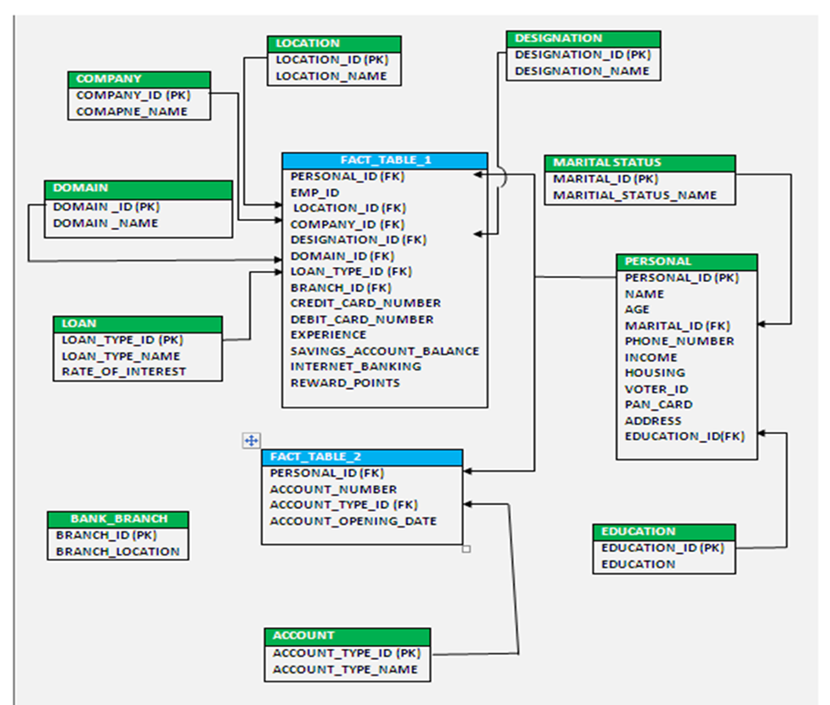
Schema Design

Slide 4
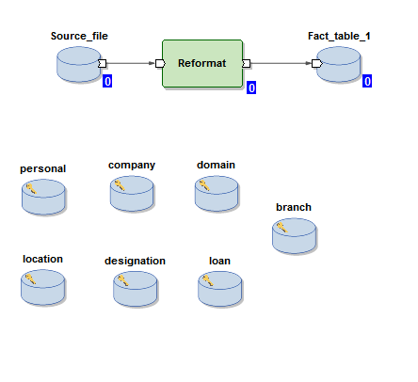
Fact Tables

Slide 5
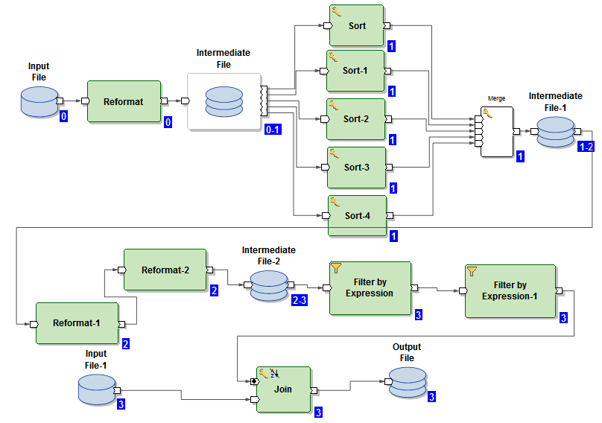

Slide 6
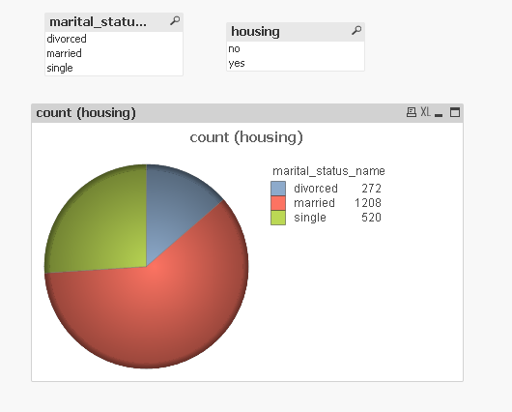
REPORTS
Analysis based on marital status and housing to provide loans

Slide 7
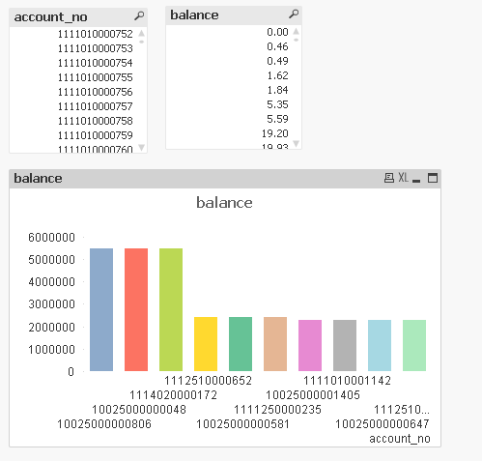
Top 10 accounts according to balance

Slide 8
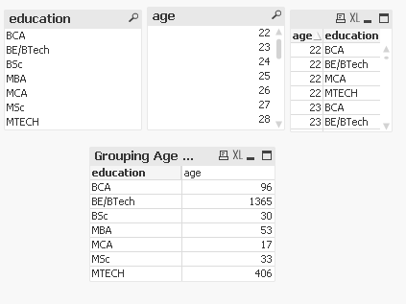
Grouping age using education

Slide 9


