Slide 1
Analysis of MST-41 Anti-Fibrotic Therapy
Peter Higgins

Slide 2
Anti-fibrotic Therapy Data

Slide 3
Background
Intestinal Fibrosis leads to surgery in 70% of Crohn’s disease
Intestinal Myofibroblasts are stimulated to generate scar by:
injury/ wounding
matrix stiffness

Slide 4
Background 2
Matrix Stiffness Activates Myofibroblasts
Activated Myofibroblasts Synthesize Stiff Matrix
Positive Feedback Loop –> More Fibrosis
This is Bad
It gets worse
It can get even worse

Slide 5
Hypothesis and Aims
Hypothesis
Determine whether Anti-fibrotic drug can reverse fibrosis
Aims
Determine whether Colon Weight is reduced by AFD
Determine whether Gene Expression of Collagen 1, TGFb, CTGF is reduced by AFD
Determine whether Protein expression of Collagen 1, aSMA, FN is reduced by AFD

Slide 6
Experimental Design

Slide 7
Experimental Design 1
Get mice
Strep cleanout

Slide 8
Experimental Design 2
Infect with Salmonella
Wait 8 days
Levo x 5 days in the water
Rest Day
Anti-fibrotic drug x 10 days
Image
Ultrasound + SWV + Strain
Photoacoustic
Sac

Slide 9
Experimental Design Diagram

Slide 10
Results

Slide 11
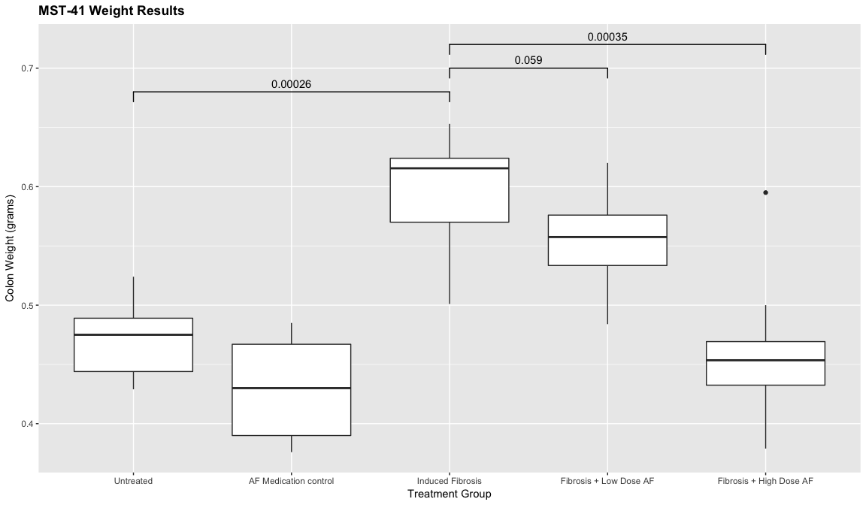
Weight Result

Slide 12
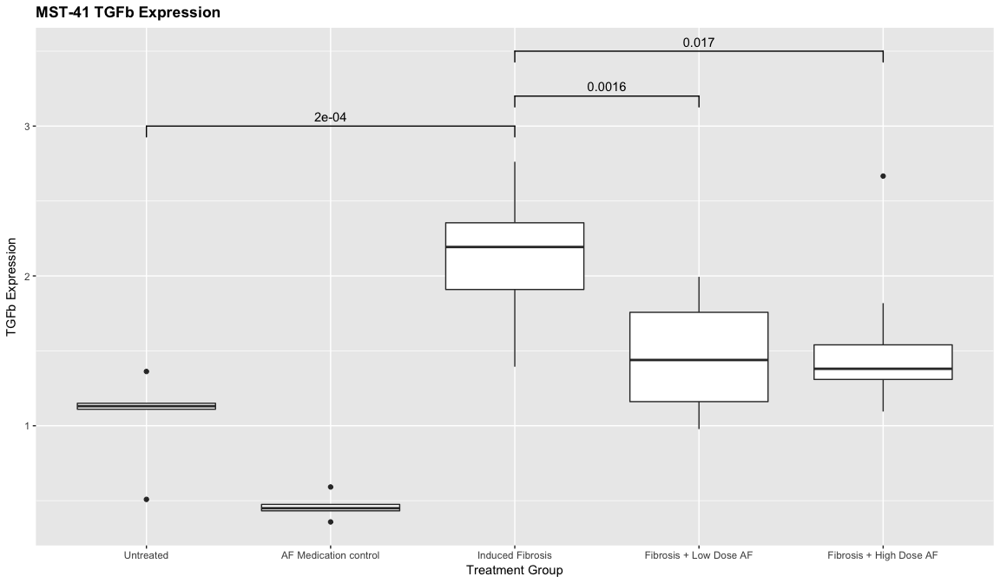
TGFb Result

Slide 13
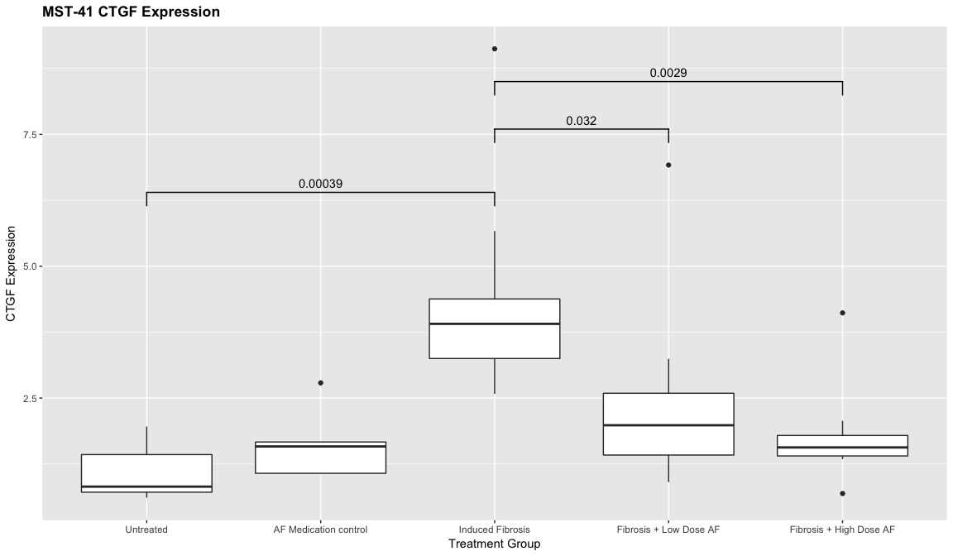
CTGF Result

Slide 14
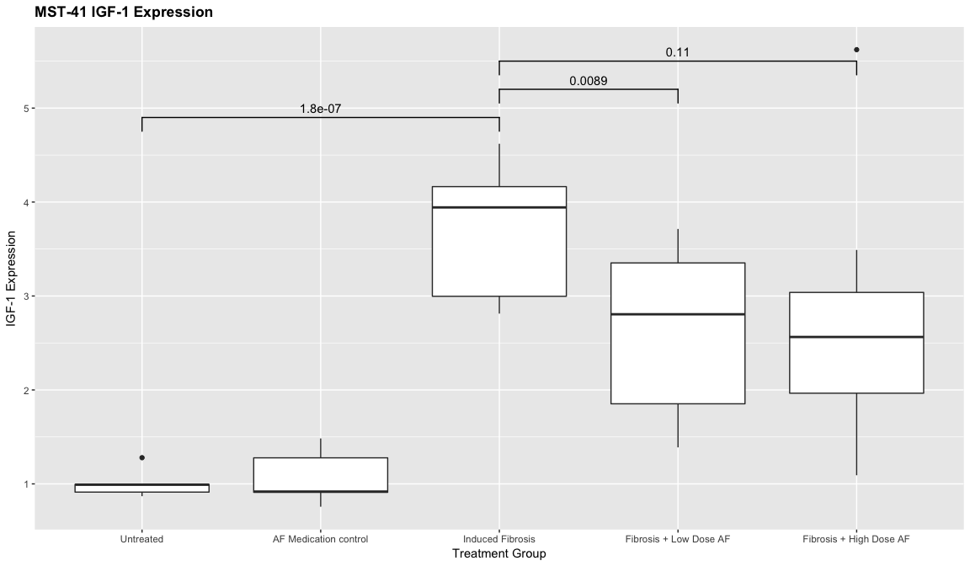
IGF-1 Result

Slide 15
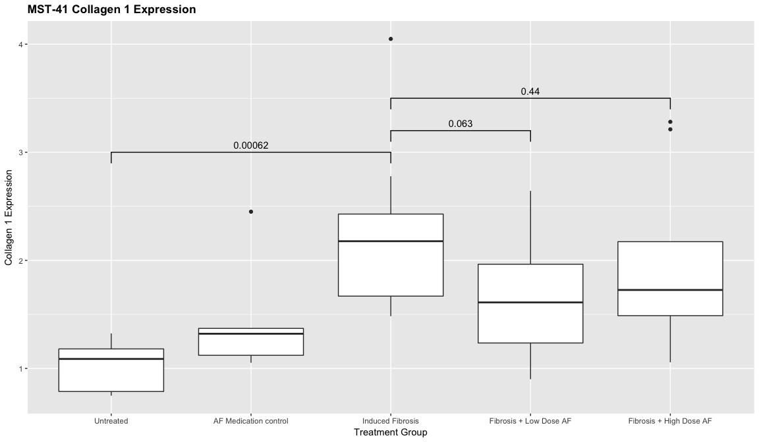
Collagen 1 Result

Slide 16
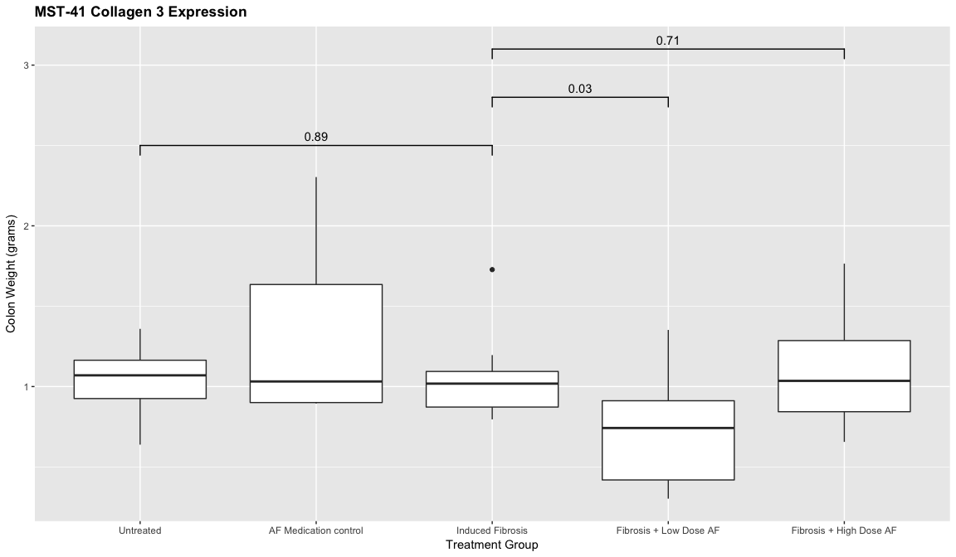
Collagen 3 Result

Slide 17
Conclusions

Slide 18
Conclusions
Antifibrotic Drug Works in Human Intestinal Organoids
Antifibrotic Drug Works in Salmonella Mouse Model
Antifibrotic Drug Works in TNBS Rat Model
This is Amazing
Clinical Trials to Follow
Sure Hope the Ultrasound Works

Slide 19
Examples of other stuff you can do with Rmd

Slide 20
R Markdown
This is an R Markdown document. Markdown is a simple formatting syntax for authoring HTML, PDF, MS Word, and now PowerPoint documents. For more details on using R Markdown see
When you click the Knit button a document will be generated that includes both content as well as the output of any embedded R code chunks within the document.

Slide 21
Block Quotes
A friend once said:
It’s always better to give than to receive. Totes magotes, my friend, he said. I don’t know why he said this.

Slide 22
You can embed an R code chunk like this:
summary(cars)
## speed dist ## Min. : 4.0 Min. : 2.00 ## 1st Qu.:12.0 1st Qu.: 26.00 ## Median :15.0 Median : 36.00 ## Mean :15.4 Mean : 42.98 ## 3rd Qu.:19.0 3rd Qu.: 56.00 ## Max. :25.0 Max. :120.00

Slide 23
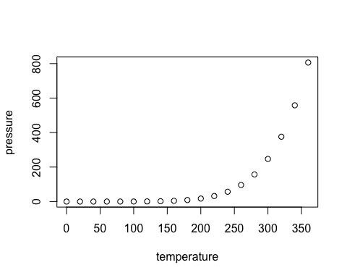
Including Plots

Slide 24
And Tables
Treatment Arm | Colon Weight (gm)
Control | 17.2
S.typhi | 23.7
S.typhi+ AFD | 17.9

Slide 25
Inline R code
Inline R Code
There were 50 cars studied

Slide 26
R Code Chunks
summary(cars$dist)
## Min. 1st Qu. Median Mean 3rd Qu. Max. ## 2.00 26.00 36.00 42.98 56.00 120.00
summary(cars$speed)
## Min. 1st Qu. Median Mean 3rd Qu. Max. ## 4.0 12.0 15.0 15.4 19.0 25.0

Slide 27
Add Links
Links
Use a plain http address or add a link to a phrase:

Slide 28
Miscellaneous
Manual Line breaks, end line with 2 or more spaces Roses are red, Violets are blue.
superscript²
strikethrough

Slide 29
Horizontal Line break
Horizontal Rule / Page Break
Three or more asterisks or dashes:

Slide 30
and continue

Slide 31
Use of the echo parameter
Note that the echo = FALSE parameter was added to the previous plotting code chunk to prevent printing of the R code that generated the plot.
If you want to see the R code and the output, like in the previous summary table, then set the parameter to echo=TRUE

