Slide 1
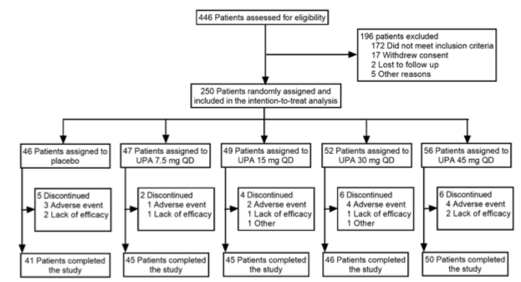
Top
N=1
crossbar at y=0
Bottom
N=n_arms
centered at x=0

Slide 2
assessment_box 10
exclusion_box 20
Line 10
Line 20
randomization_box 30
Line 40, crossbar at y=0
Line 30
assignment_lines
51-5n
assignment_boxes
51-5n
Bottom
N=n_arms
discont_boxes
61-6n
discont_lines
61-6n
complete_boxes
71-7n
complete_lines
71-7n

Slide 3
num | name | label | max_char | lines | xmin | xmax | ymin | ymax | x | xend | y | yend
10 | assessment_box | 446 patients assessed… | 41 | 1 | -30 | 30 | 80 | 90 | 0 | 0 | 80 | 30
20 | exclusion_box | 196 patients excluded… | 34 | 5 | 35 | 60 | 40 | 70 | 0 | 35 | 55 | 55
30 | randomization_box | 250 patients randomly… | 40 | 2 | -35 | 35 | 10 | 30 | 0 | 0 | 10 | 0

