Slide 1
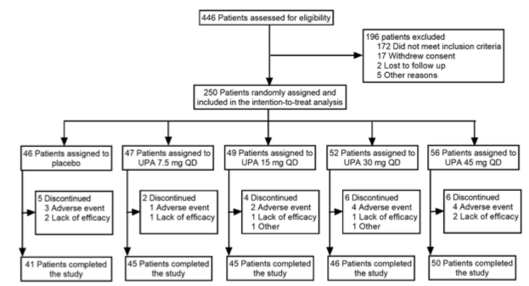
Top
N=1
crossbar at y=0
Bottom
N=n_arms
centered at x=0

Slide 2
assessment_box 10
exclusion_box 20
Line 10
Line 20
randomization_box 30
Line 40, crossbar at y=0
Line 30
assignment_lines
51-5n
assignment_boxes
51-5n
Bottom
N=n_arms
discont_boxes
61-6n
discont_lines
61-6n
complete_boxes
71-7n
complete_lines
71-7n

Slide 3
num | name | label | max_char | lines | xmin | xmax | ymin | ymax | x | xend | y | yend
10 | assessment_box | 446 patients assessed… | 41 | 1 | -30 | 30 | 80 | 90 | 0 | 0 | 80 | 30
20 | exclusion_box | 196 patients excluded… | 34 | 5 | 35 | 60 | 40 | 70 | 0 | 35 | 55 | 55
30 | randomization_box | 250 patients randomly… | 40 | 2 | -35 | 35 | 10 | 30 | 0 | 0 | 10 | 0

Slide 4
num | name | loc | label | max_char | lines | xmin | xmax | ymin | ymax | x | xend | y | yend
51 | assignment_box_51 | -2 | 46 patients assigned to… | 25 | 2 | -120 | -80 | -40 | -20 | -100 | -100 | 0 | -20
52 | assignment_box_52 | -1 | 47 patients assigned to… | 25 | 2 | -70 | -30 | -40 | -20 | -50 | -50 | 0 | -20
53 | assignment_box_53 | 0 | 49 patients assigned to… | 25 | 2 | -20 | 20 | -40 | -20 | 0 | 0 | 0 | -20
54 | assignment_box_54 | 1 | 52 patients assigned to… | 25 | 2 | 30 | 70 | -40 | -20 | 50 | 50 | 0 | -20
55 | assignment_box_55 | 2 | 56 patients assigned to… | 25 | 2 | 80 | 120 | -40 | -20 | 100 | 100 | 0 | -20

