Slide 1
RAC Update on Junior Research Faculty
Peter D.R. Higgins

Slide 2
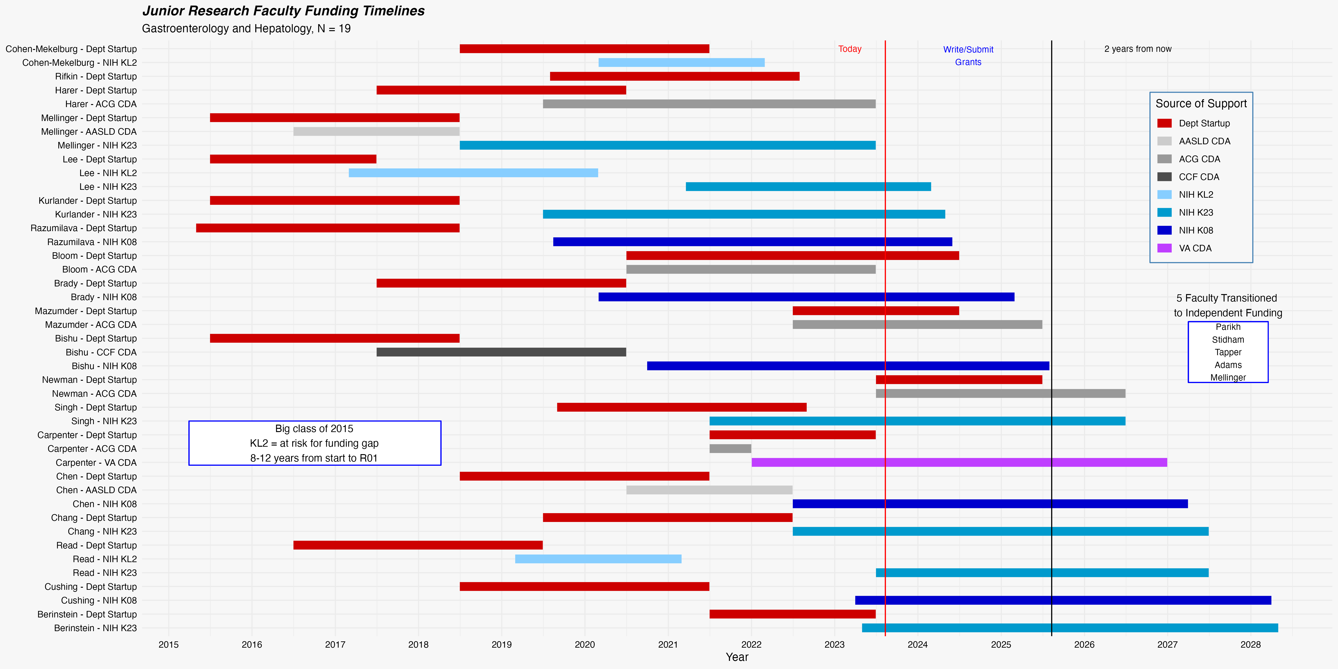
Timelines – Who is At Risk?
SCM has 8/8 VA
SR departing
KH illness
JM got R01

Slide 3
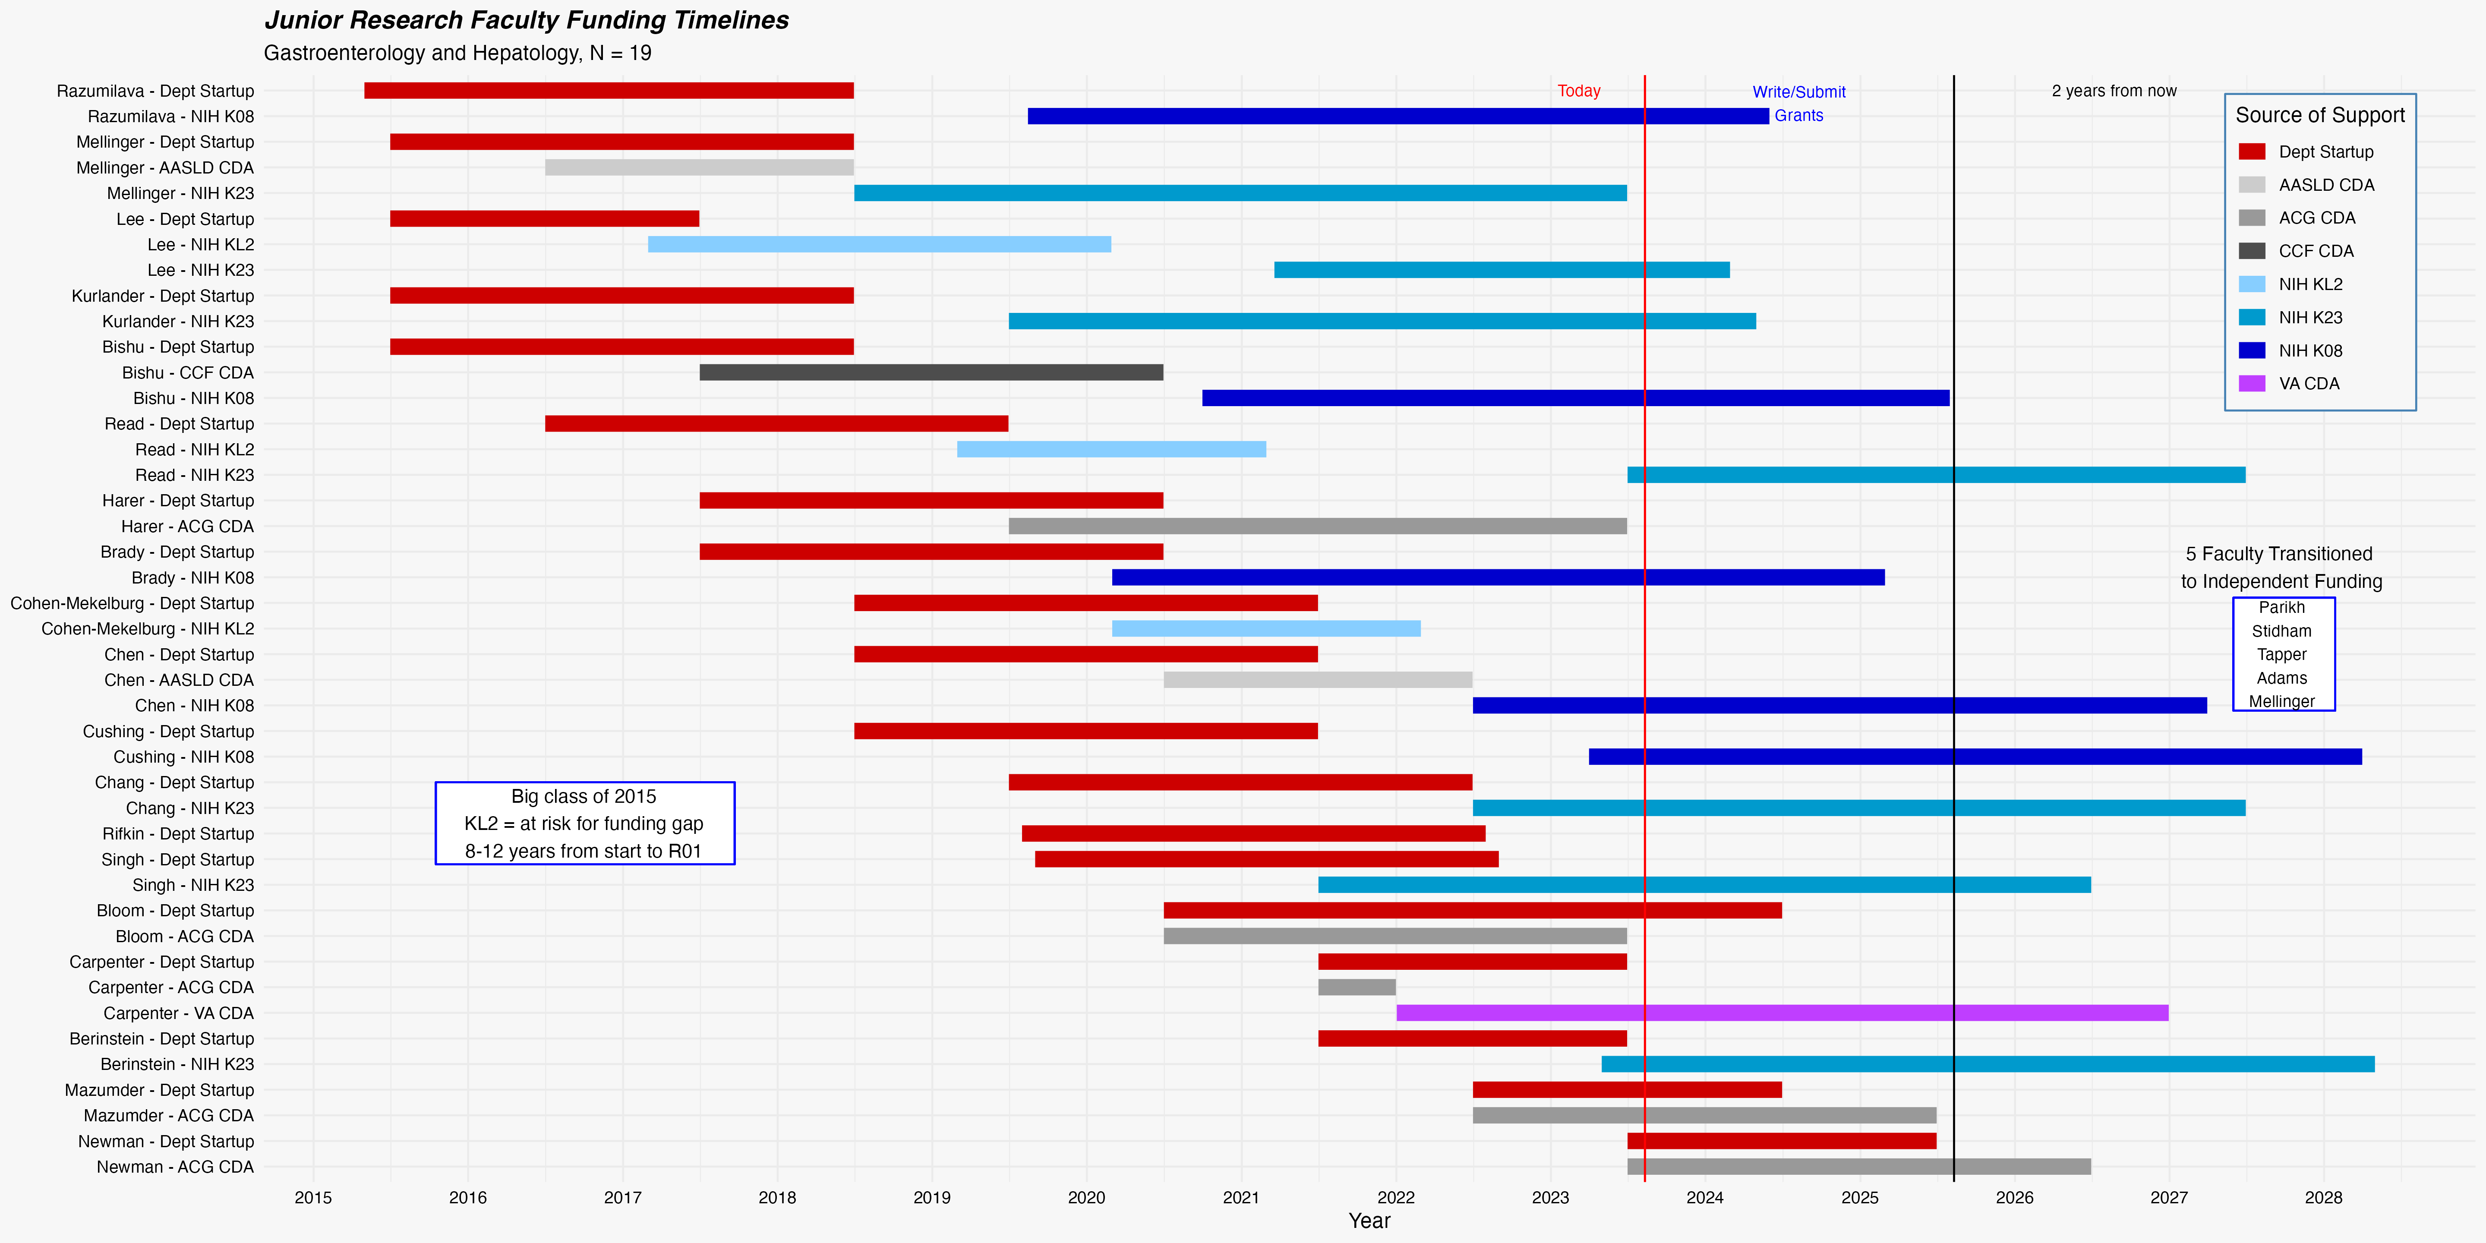
Look at This by Year Hired

Slide 4
Thinking about Timelines
Samara Rifkin – 1st failure in a while
Came here with scored K, seemed like a shoo-in
Left JHU mentor, reviewers turned against proposal
Expect most to have funding gaps
4/5 of those hired in 2015
Average funding gap 458 days (these folks had 3y department support)
Expect funding gap of 2.3y if only 2y of department support.
KL2 = 100% have funding gap
Takes 8-12 years to go from hire to 1st R01
Average age at UM if takes 10y from hire would be age 41
NIH median 46yo at first R01 for people with MDs in 2020 (44 for MD-PhD)

Slide 5
Questions from Junior Research Faculty
Should most people start with a foundation CDA, then try for K?
Covers 2-3 years in addition to 2y faculty support
When does startup commitment expire?
If get CDA, then have gap, do remaining months of startup fill in?
If gap between K and R01, do remaining months of startup fill in?
What are the predictors of external K grant?
3 of 4 who had foundation grant 2015-2018 got a K (not KH yet)
What are predictors of funding gaps?
KL2
Only 2y of department support

Slide 6
Long term Likelihood of Success for Junior Research Faculty
Only 162 applications for K grants to NIDDK in 2022
Lots of people never get to the point of applying for a K
Funding rate about 45% for K08, K23
31/70 K08s (44%), 43/92 K23s funded (46%)
Then to get R01 from NIDDK
R01 payline 16
Funded 18.8% (494/2628) of all NIDDK R01s in 2022
Normal is 1/11 make it from hire to R01 by age 46 – 45% x 19% ~ 9%
We are doing WAY better than 9%

Slide 7
Chances of R01 – Climbing the Mountain
At hire = 9%
Get foundation CDA grant ~= 20%
Apply for NIH K = 27%
Get K from NIH = 50%

Slide 8
Would like to
Dig up data on 2005-2014 hires
Has the RAC made a difference?
Try not to hire 5 Junior research faculty in a single year (2015)
Discourage KL2
Encourage foundation grants
Encourage K Boot Camp in 1st year of foundation grant, apply year 2
Encourage K08, K23 – doubles your likelihood of R01 success
NIAID data: of people who applied for a K grant
Got K grant – 50% eventually got an R01
Rejected – 27% eventually got an R01
Encourage R01 Boot Camp in 2nd year of K grant, apply year 3

