Slide 1

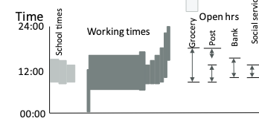


Spatial movement
Activity organization
Individual level
Time
24:00
12:00
Waking time
0:00
Resting time
Age of people
Person-based
Space-time accessibility
Place-based
Land use and transportation
Time schedules
Urban level
Spatial dimension
Temporal dimension

