Slide 1
Tutorial VIII Advanced Image Analysis
By Lauren Higgins

Slide 2
Task I
2 steps

Slide 3
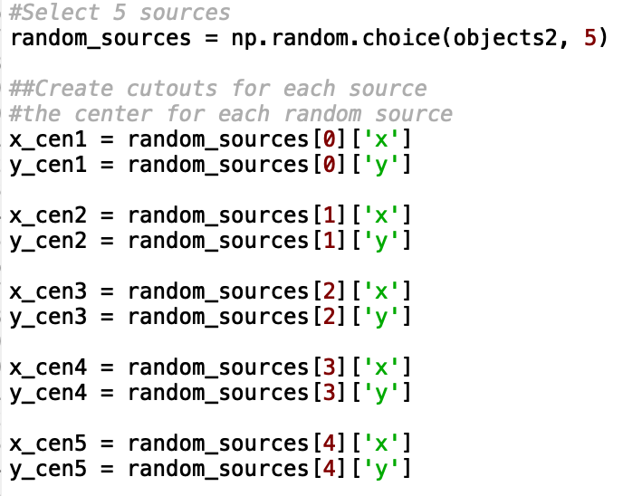
Task I: Steps 1 & 2
Step 1.
This is my postage stamp image. I used 99% interval scaling with ﻿Asinh Stretch. I also smoothed the image using a Box kernel with a box size of 3. There are three obvious and distinct sources that I pointed to with blue, solid arrows and several smaller and diffuse sources, ~ 8, that are within the two blue, dashed ellipses.
Step 2.
I ran source extraction on large_mosaic.fits, using the same input from CONFIG 2 in the last tutorial. Then, I created (100,100) size cutouts of 5 randomly selected objects using the same logic as in step 1. I gathered the central coordinates from each cutout source using the code pictured to the left. Where ‘objects2’ are the objects generated from the source extraction. I also saved each source in its own .fits file. These are in the data folder of my submission zip file.

Slide 4
Task II
2 steps

Slide 5
Task II: Steps 1 & 2
Step 1 & 2. Above is a figure for step 1 (the left panel) and step 2 (the right panel). Step one has red circles with a radius of 7 on each of the 5 sources. Step 2 has ellipses on each of the 5 sources. Each ellipse has a size that is 6 times the semi-major and 6 times the semi-minor axis of their respective object.¹ I used the code written in the documentation to create the circles and ellipses on each object.

Slide 6
Task III
4 steps

Slide 7
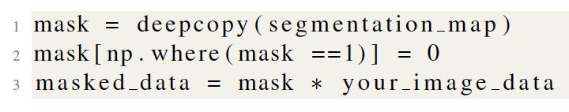
Task III: Steps 1 & 2
Step 1.
In line one mask is assigned a deep copy of the segmentation_map. The deepcopy() function is used to protect the integrity of the original segmentation_map. Line two assigns the value of zero forall of the pixels for the object in the segmentation map that is given the value “1”. Line three assigns the variable masked_data equal to the mask multiplied by the image data. This should result in an image where every place the segmentation map recovered the source labeled “1” there should be a blank space.
Step 2.
This four-panel image is comprised of the 200x200 cutout (upper left), the segmentation map (upper right), the segmentation map with the second source removed (lower left), and the image with the second source removed (lower right).
Please note that I put a red, dashed circle around the area where the second source resides.

Slide 8
Task III: Step 3
Start*
Input
mask = deepcopy(segmap2)
mask + 1
yes
no
If mask > 1
mask = 0
mask = 1
End
*I found information on creating a flow chart using source 3.

Slide 9
Task III: Step 4
Step 4.
This four-panel image is comprised of the 200x200 cutout (upper left), the segmentation map (upper right), the segmentation map with all the sources removed (lower left), and the image with all the sources removed (lower right).

Slide 10
Task IV
3 steps

Slide 11
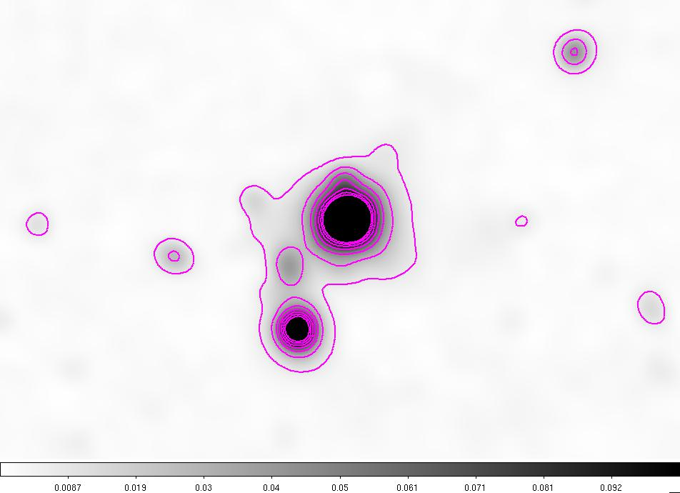
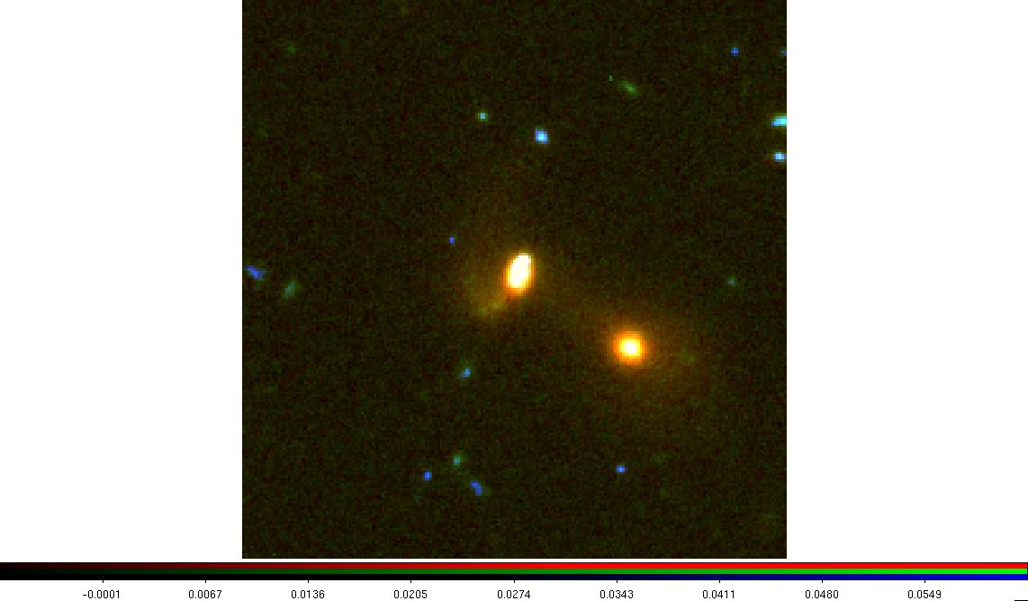
Task IV: Steps 1 -
Step 1.
Step 2.

Slide 12
Task V
4 steps

Slide 13
Task V: Steps 1 -
Step 1.
Step 2.

Slide 14
Task VI
3 steps

Slide 15
Task VI: Steps 1 -
Step 1.
Step 2.

Slide 16
Collaborators
Task I:
Task II:
Task III:
Task IV:
Task V:
Task VI:

Slide 17
Sources
[1] https://sep.readthedocs.io/en/v1.0.x/tutorial.html
[2] https://docs.python.org/2/library/copy.html
[3] https://www.edrawsoft.com/explain-algorithm-flowchart.html
[4]
[5]
[6]

