Slide 1
Tutorial V – Professional Plotting with Python
By Lauren Higgins

Slide 2
1.1 AXIS-specific plotting
Activity I

Slide 3
1.1 AXIS – specific plotting: Activity I
Activity I
The main conceptual difference I see is instead of using plt.*** this way of plotting uses axis.***. Each corresponding command, ie. plt.xticks vs. axis.set_ticks, tells python to create the same elements of a plot. The main difference I see is ”axis=plt.gca()”. This command gives the user access more control over specifics of the plot. Something I wasn’t able to do in my plot for the (u-r) vs stellar mass plot was, create the powers of 10 increments on my x-axis. I see here with the command I mentioned earlier, axis.set_ticks, will create the ticks I wanted in my previous plot.

Slide 4
Task I
4 steps
Activities II - IV

Slide 5



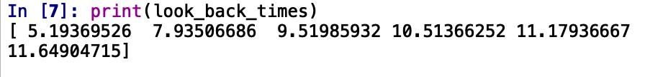
Task I: Steps 1 - 2, Activity II
Step 1.
I wrote the lines of code 1-4 into my python file.
Activity II.
I computed the look back time for z = 3, by changing the value of redshift to 3.0..
Step 2.
I wrote the lines of code 1-5 into my python file and printed the look back times.

Slide 6
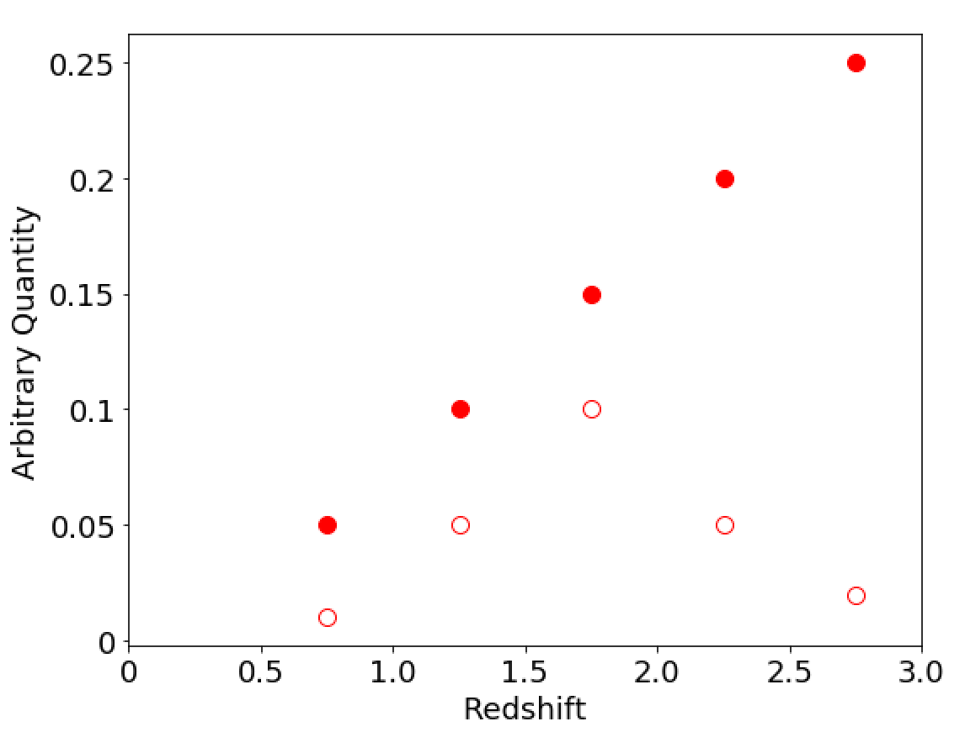
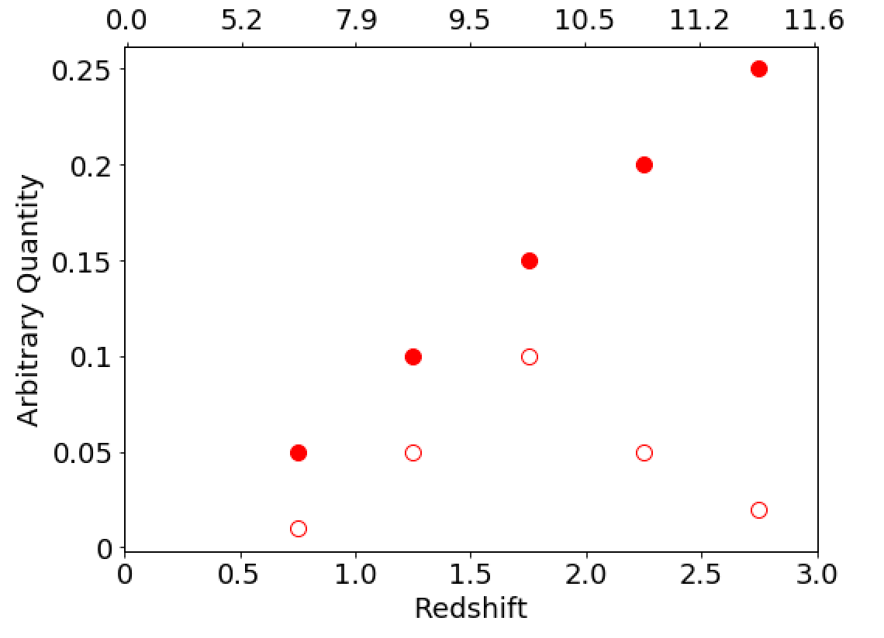
Task I: Steps 3 - 4, Activities III & IV
Step 3.
I wrote the lines of code 1-4 into my python file.
Activity III.
Added lines 1-2 in my code and plotted a replica of the left panel of Figure 2.
Activity IV
The keywords responsible for creating open markers are “markerfacecolor = ‘None’” and “markeredgecolor = ‘red’”.
Step 4.
I wrote the lines of code 1-5 into my python file and created the twin axis plot.

Slide 7
Task II
3 steps

Slide 8
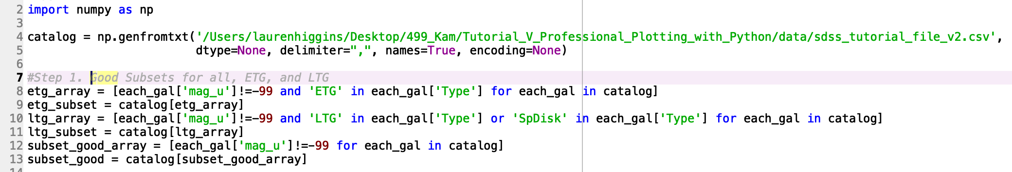
Task II: Steps 1 & 2
Step 1.
I loaded in the necessary file and created the ETG and LTG subsets from previous tutorials.
Step 2.
I imported the csv file I needed, created the subsets, wrote the code for the plot, and created the figure. (See python code file for code with the file name Tutorial_V_TaskII)

Slide 9
Task II: Step 3
Figure 1. The red dots are elliptical galaxies (ETGs) and the blue dots are spiral disk galaxies (LTGs). The left panel shows the log₁₀ of the stellar mass vs. the (u-r) color. Galaxies that have high (u-r) color are red and are concentrated between masses of ~10.4 to ~11 are the ETGs. Galaxies that are generally lower on the (u-r) color scale and are concentrated between 10 to ~10.9 are LTGs. The right panel shows the (r-z) color vs. (u-r) color. Galaxies low on both axis are blue in color and galaxies high on both axis are red in color. These are the LTG and ETG galaxies, respectively. Notice a wider spread in color and mass for the LTGs.

Slide 10
Task III
4 steps

Slide 11
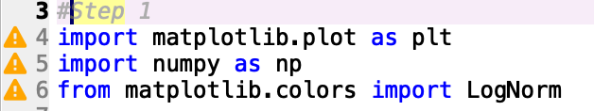
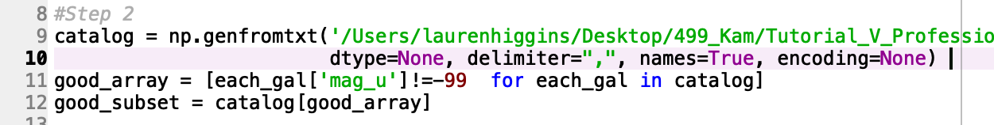
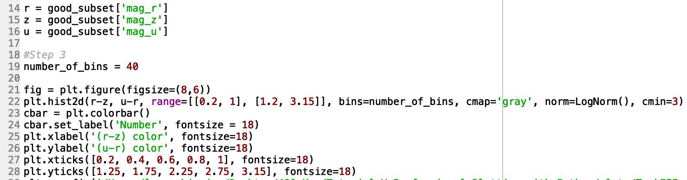
Task III: Steps 1 & 2
Step 1.
I imported the necessary packages.
Step 2.
I loaded the sdss dataset and created the subsets of good entries.
Step 3.
I wrote code for the 2-D histogram scatter and color bar plot.

Slide 12
Task III: Step 4
Figure 2. This is a plot of the (u-r) color vs. the (r-z) color for the entire sample of galaxies with a value for their u color. The plot has a color map corresponding to the number of galaxies within each color bin. The more galaxies within a bin the lighter the color.

Slide 13
Task IV
4 steps

Slide 14
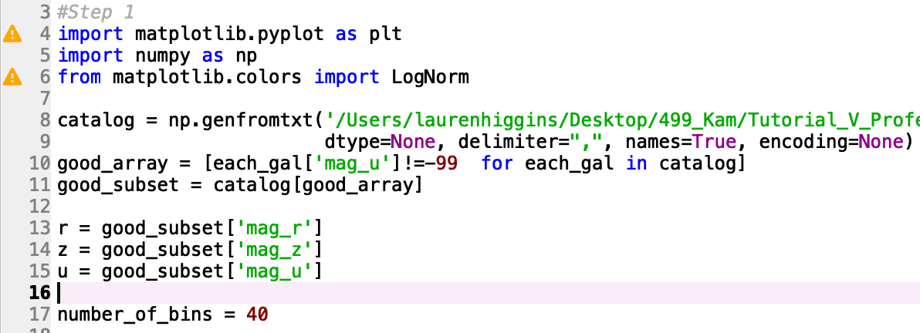
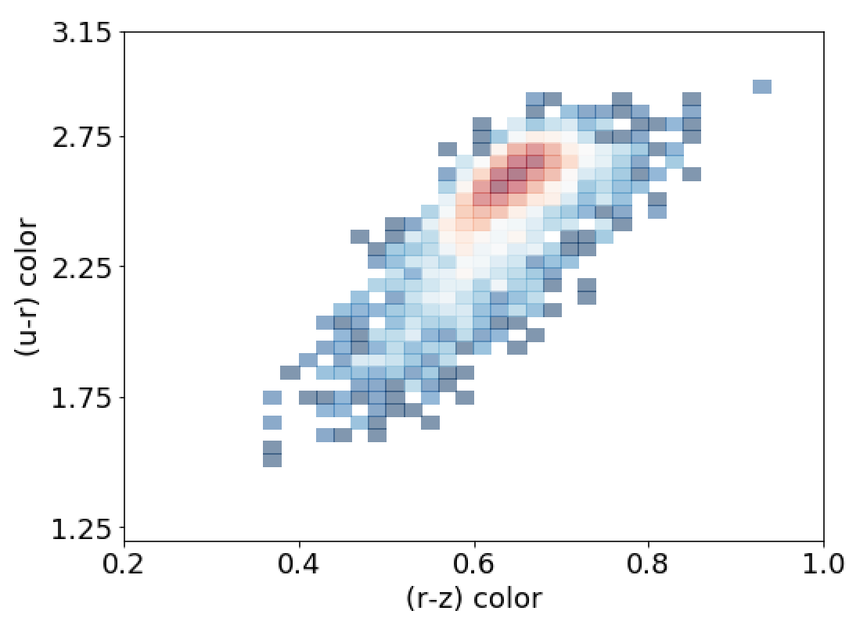
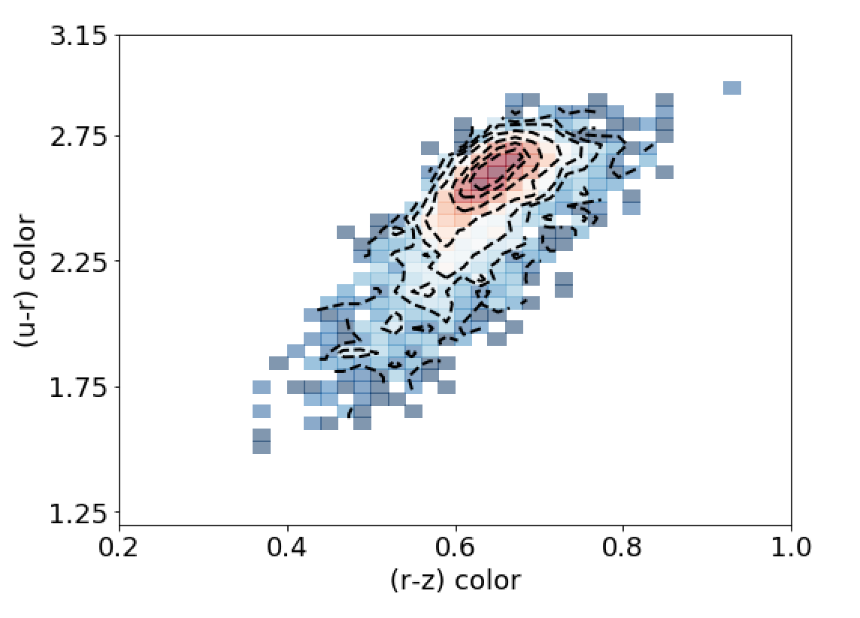
Task IV: Steps 1 - 3
Step 1.
I copied in the same set up as in Task III.
Step 2.
I plotted the 2D histogram using the listed code and the good subset I created for Step 1.
Step 3.
I plotted the contour lines on top of the 2D histogram plot.

Slide 15
Task IV: Step 4
Figure 3. This is a plot of the (u-r) color vs. the (r-z) color for the entire sample of galaxies with a value for their u color. The plot has a color map corresponding to the number of galaxies within each color bin. The more galaxies within a bin the redder the color. The black dashed lines are corresponding contour lines. These represent the amount of galaxies internal to each contour line. Here there are seven contour lines corresponding to ﻿5, 10, 15, 25, 50, 75, or 100 galaxies within a bin internal to that contour line. The bulk of galaxies lie between ~0.5 and ~0.75 on the (r-z) color axis.

Slide 16
Task V
3 steps

Slide 17
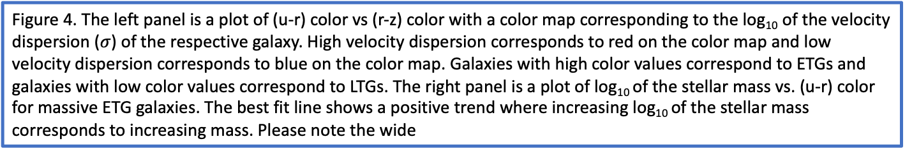
Task V: Step 1
Note: I used reference [1] for help with the double axes plot.
Figure 4. The left panel is a plot of (u-r) color vs (r-z) color with a color map corresponding to the log₁₀ of the velocity dispersion ($σ$) of the respective galaxy. High velocity dispersion corresponds to red on the color map and low velocity dispersion corresponds to blue on the color map. Galaxies with high color values correspond to ETGs and galaxies with low color values correspond to LTGs. The right panel is a plot of log₁₀ of the stellar mass vs. (u-r) color for massive ETG galaxies. The best fit line shows a positive trend where increasing log₁₀ of the stellar mass corresponds to increasing mass. Please note the wide

Slide 18
Task V: Step 2
Figure 5. This is a plot of the log₁₀ of the stellar mass vs (u-r) color, including a color map corresponding to the number of galaxies within a specific bin. The whiter the bin the more galaxies in that bin and the darker the bin the less galaxies within that respective bin. The bin sizes are set at 40.

Slide 19
Task V: Step 3
Figure 6. This is a plot of the log₁₀ of the stellar mass vs (u-r) color, including a color map corresponding to the number of galaxies within a specific bin and a contour map corresponding to the number of galaxies within each interior bin. The redder the bin the more galaxies in that bin and the bluer the bin the less galaxies within that respective bin. The bin sizes are set at 40 and the contour lines range from 5, 10, 15, 25, 50, 75, and 100 galaxies.

Slide 20
Task VI
Plot Analysis

Slide 21
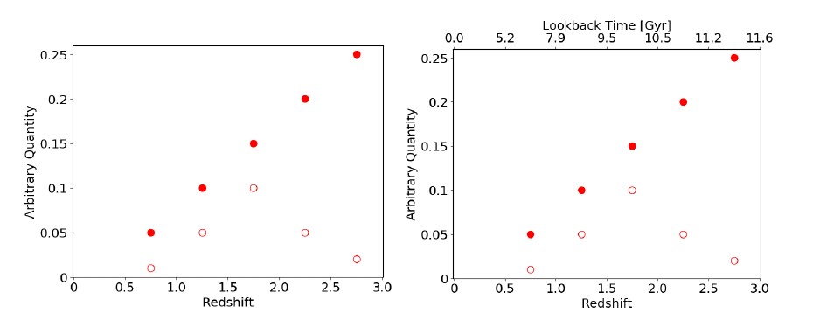
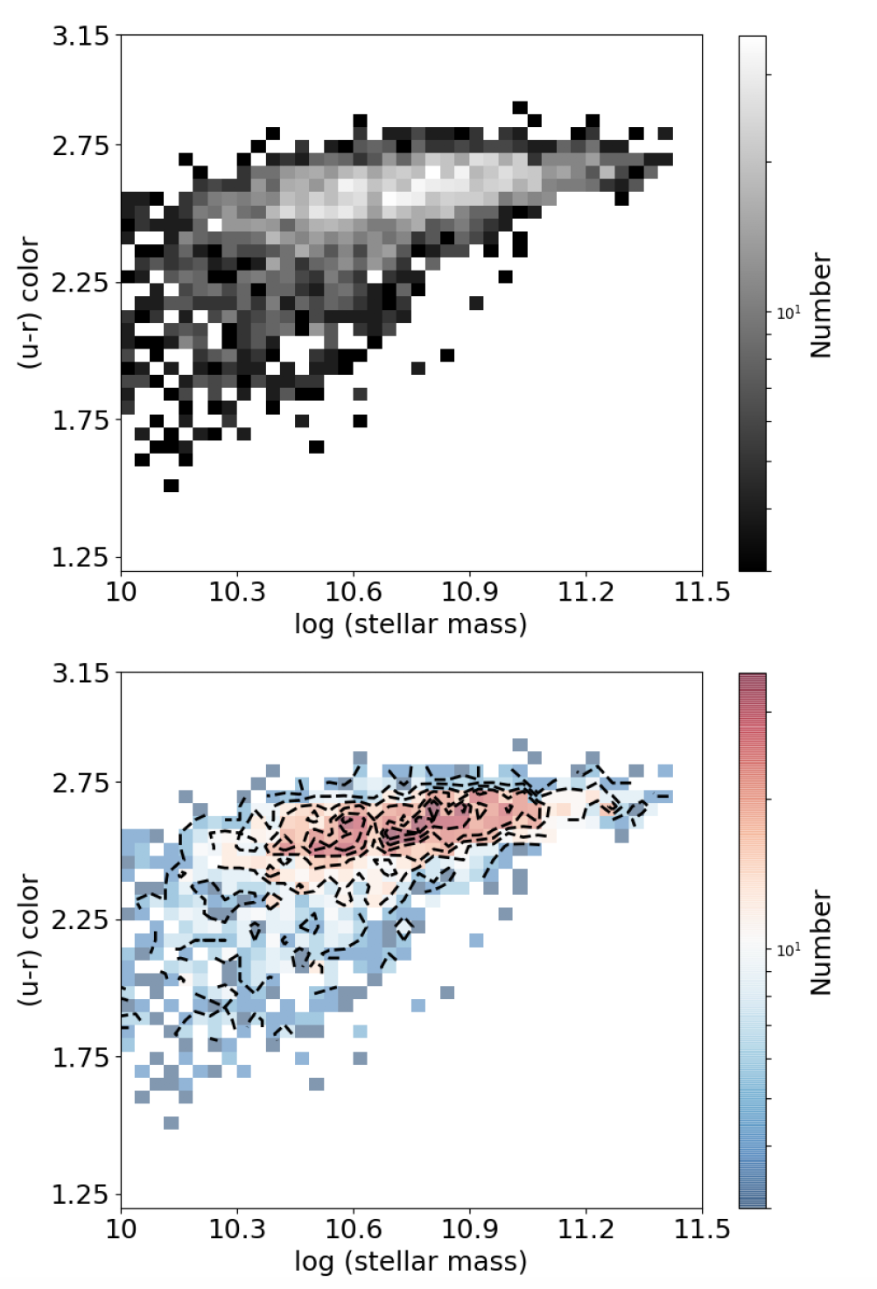
Task VI: Plots Analysis
I notice in Figure 2 that there is not a legend even with plenty of room in the upper left-hand corner. It is not obvious what the open and closed circles represent. There is also no units with the arbitrary quantity. There should probably be a [arbitrary] next to the axis label.
I notice in Figure 6 that the label “Number” is vague. Number of what? “Number of Galaxies” would be better. Also, there is not units with the “stellar mass”. Next to stellar mass should be [Msol]. Also, printing the bottom plot in black and white might lead to confusion. The contour lines might just blend in with the bin colors when printed in black and white. I would print the plot before using it in a paper.

Slide 22
Collaborators
1.1: none
Task I: Bry, Debbie, Grace
Task II: none
Task III: none
Task IV: none
Task V: Debbie
Task VI: Bry

Slide 23
Sources
[1] https://matplotlib.org/api/_as_gen/matplotlib.axes.Axes.scatter.html#matplotlib.axes.Axes.scatter

