Slide 1
Brain Functional Changes Following Mindfulness Training in Asthma
Estelle T Higginsª, Richard J Davidson^{a,b,c}, Melissa A Rosenkranz^{a,c}
ªUniversity of Wisconsin-Madison, Center for Healthy Minds, Madison, WI, USA
^{b}University of Wisconsin School of Medicine and Public Health, Department of Psychiatry, Madison, WI, USA
^{c}University of Wisconsin-Madison, Department of Psychology, Madison, WI, USA
Notes:
Introduce

Slide 2
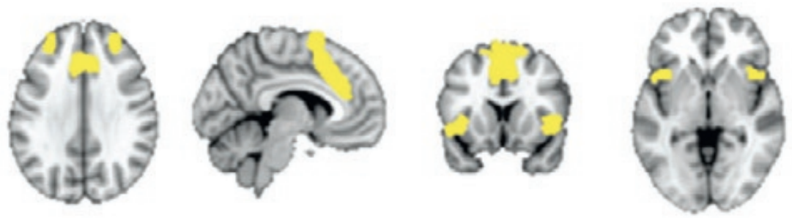
Background
Psychological distress & asthma
Neural networks: attention, emotion, salience
PFC, dACC, amygdala, insula
Mindfulness-Based Stress Reduction (MBSR)
Does activity in these neural regions underlie MBSR’s impact on disease-related outcomes in asthma?
(Menon, 2015; Brain Mapping: An Encyclopedic Reference)
Notes:
In asthma, psychological distress can negatively impact airway inflammation, asthma control, and treatment efficacy
Asthma-related inflammation has been associated with neural activity in networks involved in regulating attn, and processing and responding to emotionally salient cues
Interventions targeting emotion regulation, such as MBSR, can reduce stress-related inflammation, improve asthma control, and alter neural activity within these networks
Does activity in these neural networks underlie MBSR’s impact on disease-related outcomes in asthma?

Slide 3
Methods
Type 2 Inflammation: blood & sputum eosinophils, FeNO
Self-Report: asthma control (ACQ-6), mindfulness (FFMQ), distress (SCL90R), depression (BDI), anxiety (BAI)
Task-Based fMRI: Asthma Stroop
8wk Mindfulness-Based Stress Reduction (n=38)
Attention on breath, body, and mind
Nonjudgmental awareness
Weekly 2.5hr classes & home practice
T1
(baseline)
(n=72)
T2
(month 2)
(n = 67)
T3
(month 6)
(n = 65)
Wait-List Control
(n=34)
Notes:
We randomized 72 asthmatic adults to an 8wk mindfulness-based stress reduction course or wait-list control group,
and collected type 2 inflammation, self-report measures, and functional neuroimaging
at baseline, after the intervention, and at 6mo followup

Slide 4
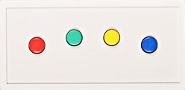
Task-Based fMRI: Asthma Stroop
wheeze
lonely
curtains
Notes:
For functional neuroimaging, participants in the scanner pressed a button to identify the color of asthma-relevant, negative, or neutral words

Slide 5
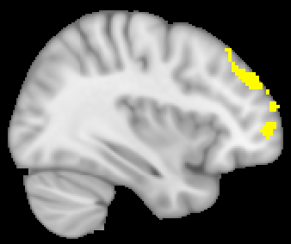
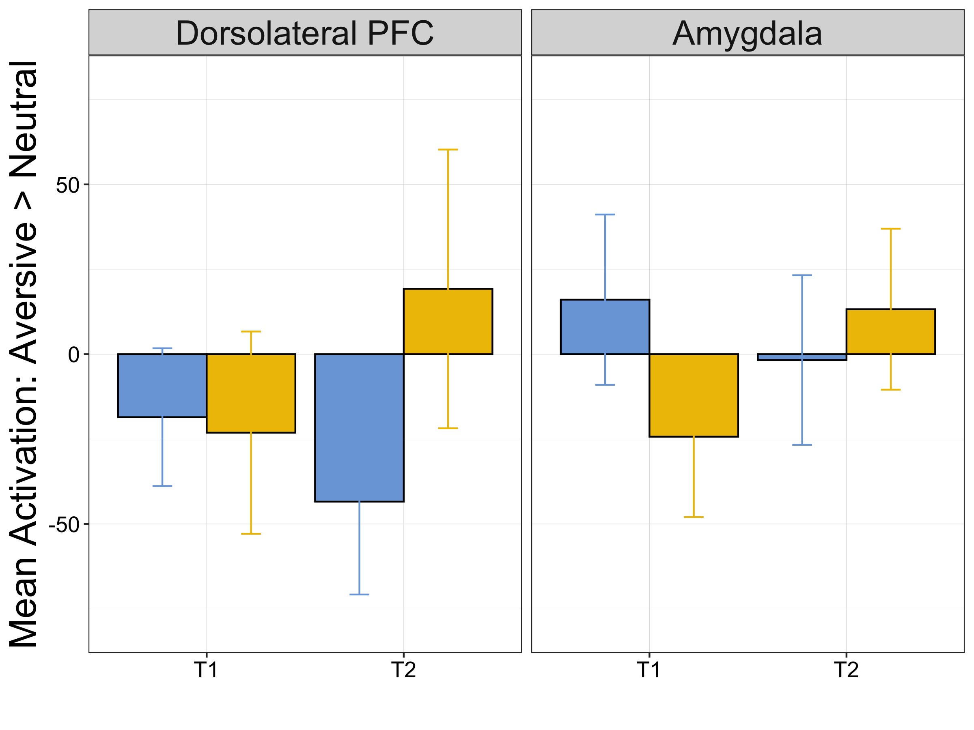
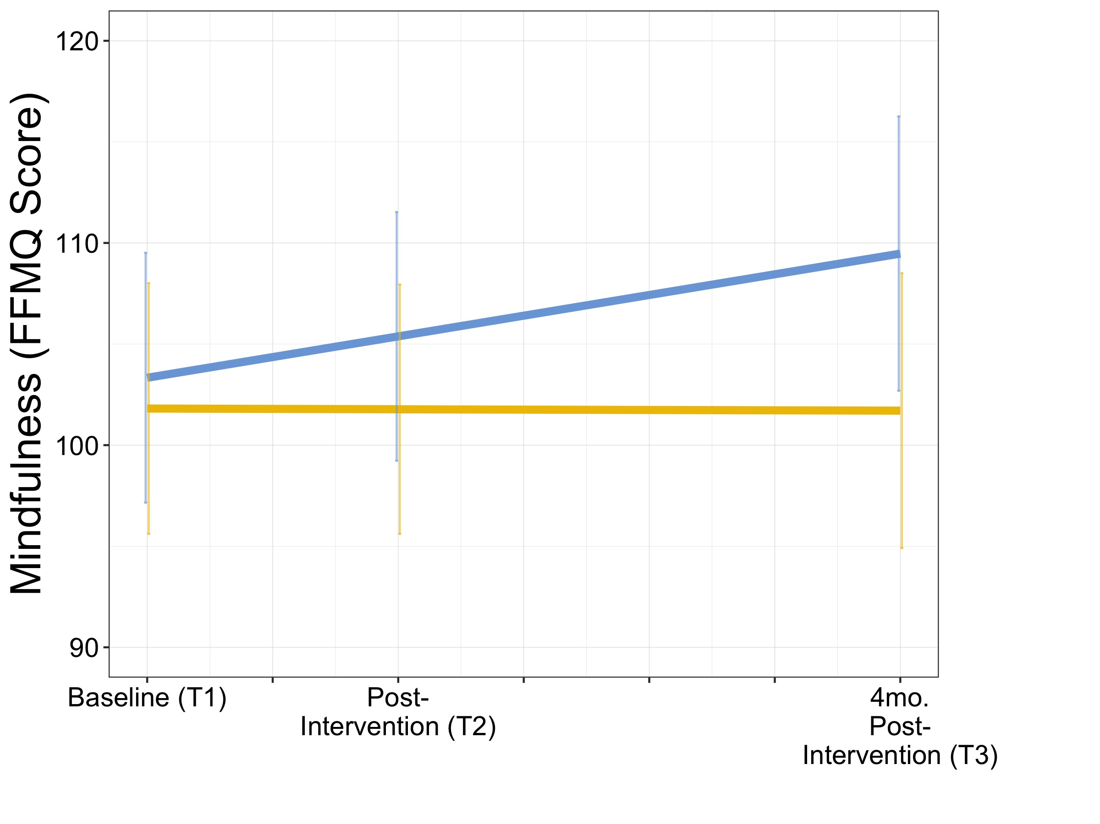
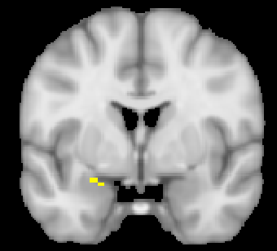

MBSR decreases dlPFC and AMYG response to aversive cues at T2, relative to wait-list controls, which correlates with increased mindfulness
*
*
B = -1.04, t(64) = -2.36, p < .05
Notes:
INTERPRETATION: dlPFC attn allocation, amyg reactivity -- may reflect a decrease in attn allocated to salient cues, and buffered/reduced reactivity to those cues; associated w increased mindfulness
Brains = regions where change in activation was greater for MBSR than WL, and where there is an association with mindfulness
dlPFC: significant decrease in MBSR group alone, group diff
Amyg: significant increase in WL group alone, group diff – buffering effect

Slide 6
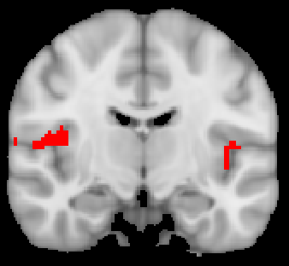
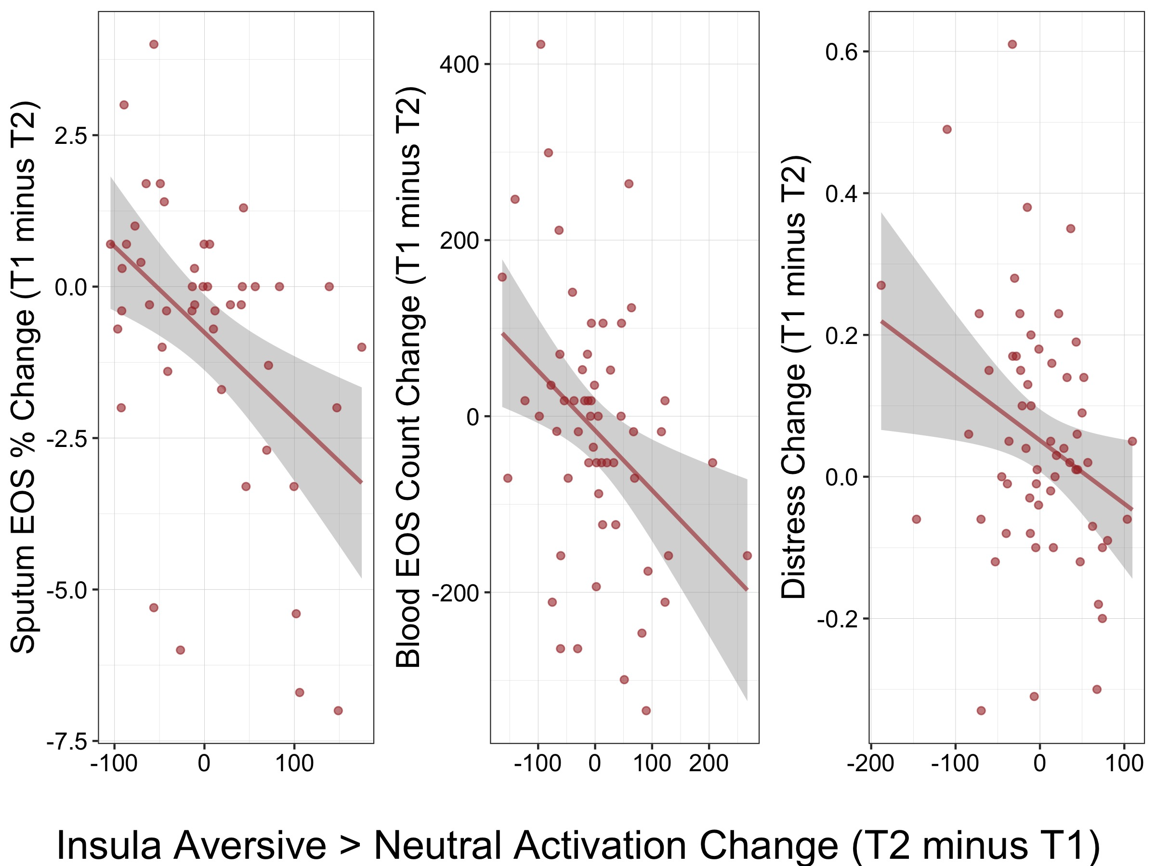
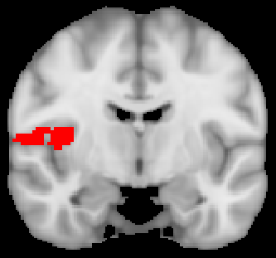
Across groups, decreased inflammation and distress ~ reduced insula response to aversive cues at T2
Improved symptoms
Sputum
%EOS
Blood
EOS
Distress
Reduced aversive > neutral insula activation over time
Notes:
Across groups, decreased inflammation and distress correlate with reduced insula response to aversive cues at T2
INTERPRETATION: decreased attn and emotional arousal to salient cues predicts improved asthma-related symptoms
emotion arousal, salience; associated with asthmatic inflammation in our previous studies
less intense (emo/inflam) response to triggers
In other words, the greater the decrease in neural response to aversive cues from over time, the bigger the improvement in symptoms
Brains = regions where decrease in activation was greater for those who had more symptom improvement
Distress = GSI

Slide 7
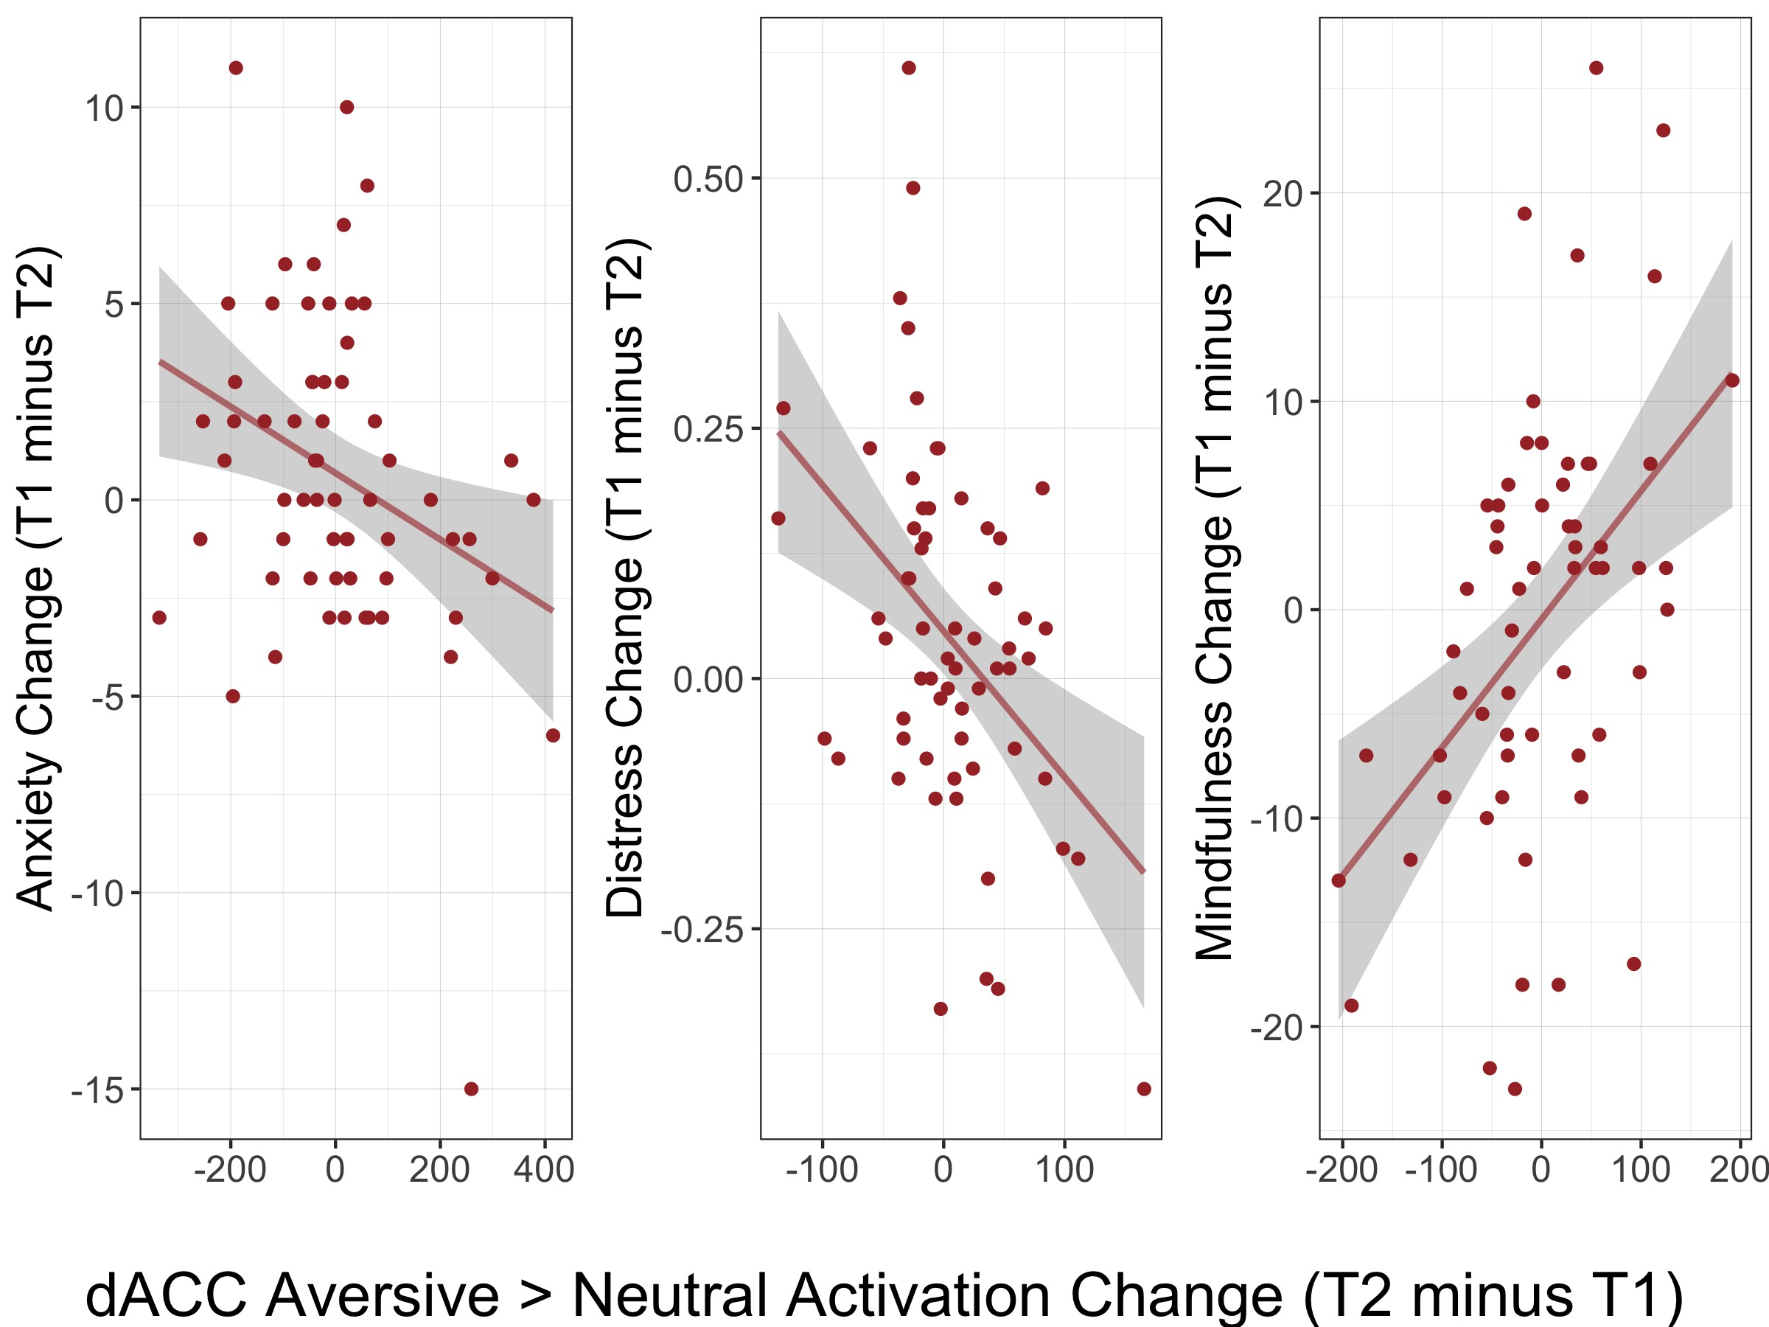
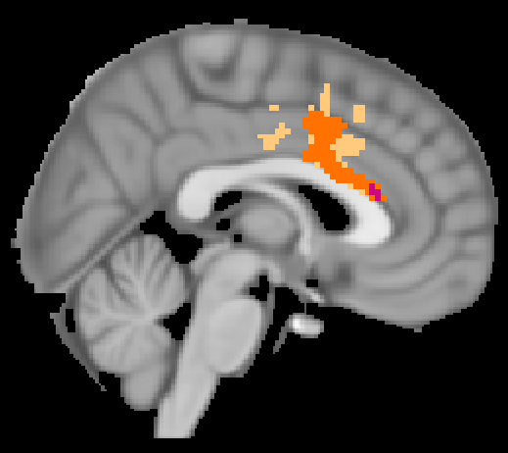
Across groups, increased mindfulness and decreased distress ~ reduced dACC response to aversive cues at T2
Improved symptoms
Distress
FFMQ
Anxiety
More mindful
Notes:
Across groups, increased mindfulness and decreased distress correlates with reduced dACC response to aversive cues at T2
INTERPRETATION: dACC also part of network involved in salience/emotion reactivity, may reflect decreased reactivity – less triggered by salient events, lower symptom
In other words, the greater the decrease in neural response to aversive cues from before to after the intervention, the bigger the improvement in mindfulness/symp
Brains = regions where decrease in activation was greater for those who showed more mindfulness and less distress

Slide 8
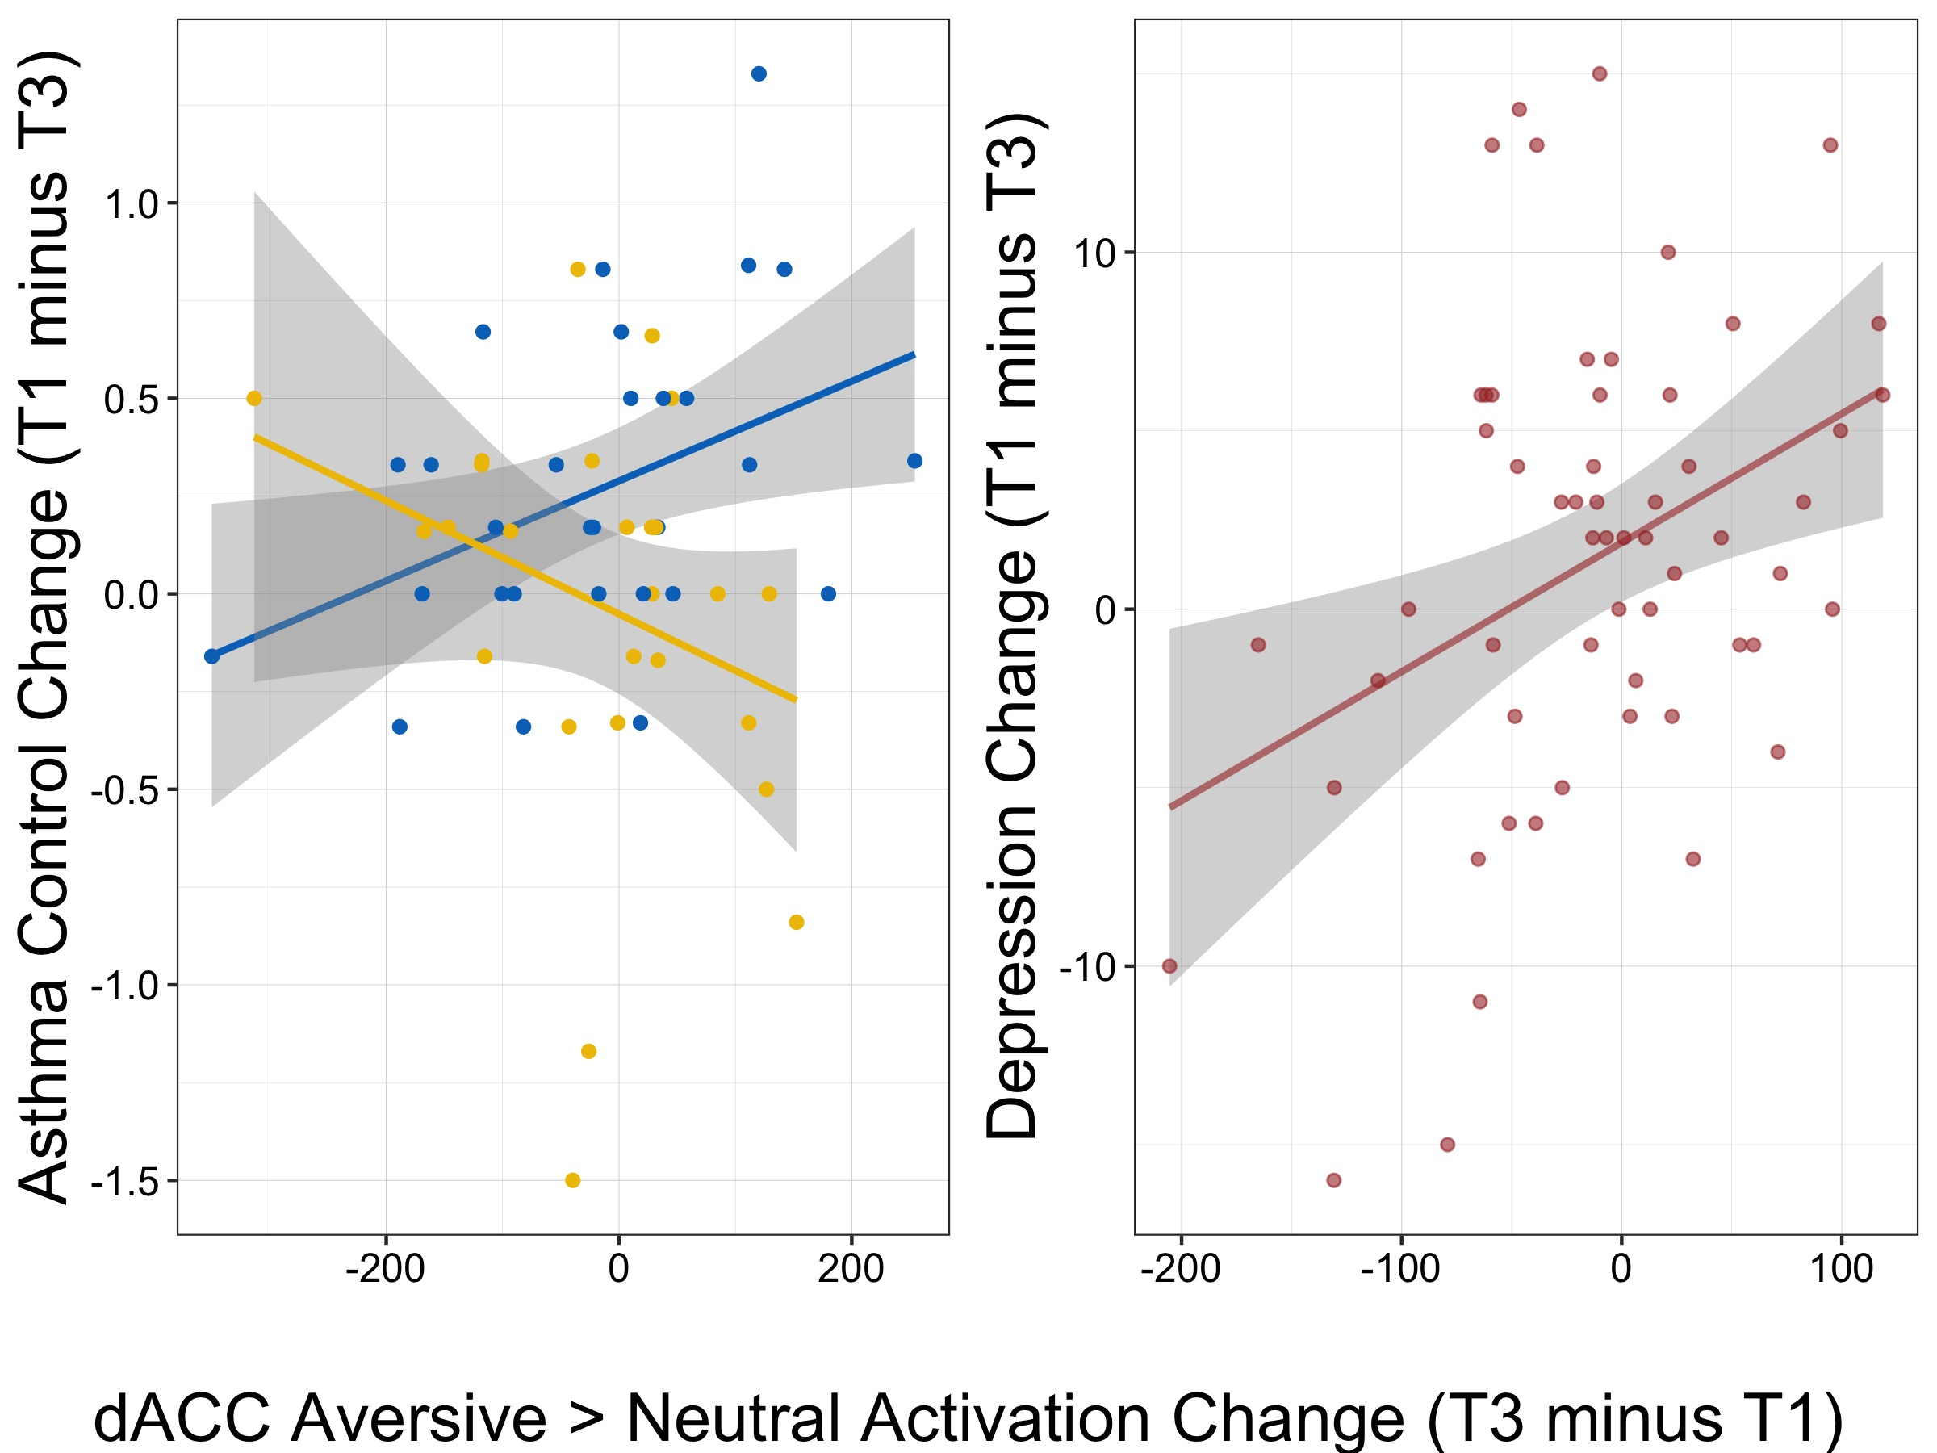
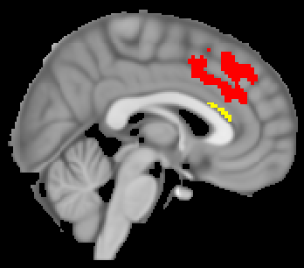
MBSR-related improved asthma control and overall decreased depression ~ increased dACC response to aversive cues at T3
Improved symptoms
Depression
ACQ6 x MBSR > WL
Notes:
In contrast to T2, at T3, MBSR-related improved asthma control and overall decreased depression correlates with increased dACC response to aversive cues
INTERPRETATION: role of dACC in these associations may shift over time, becoming more regulatory
dACC implicated in both emo reactivity and regulation
In other words, the greater the INCREASE in neural response to aversive cues from before to after the intervention, the bigger the improvement in symptoms
cluster in the brain where increasing activity from T1 to T3 (in response to aversive compared to neutral cues) was associated with MBSR-related improvements in asthma control /// was greater for those whose depression improved most

Slide 9
Conclusions
MBSR training alters neural processing of aversive cues
Decreased reactivity, enhanced attention/emotion regulation
Decreased neural salience reactivity is associated with positive disease outcomes
dACC’s role in mindfulness, emotion, and asthma may become more regulatory over time
Mind-body relationships in asthma treatment
Notes:
To recap and summarize, we found that:
MBSR training alters neural processing of aversive cues, which may reflect decreased reactivity to salient triggers and enhanced attn/emotion regulation, and predicts increased mindfulness and asthma control
Across groups, decreased neural reactivity to salient cues (in emotion-reactive circuits) is associated with positive disease outcomes (inflammation and distress)
dACC’s role in mindfulness, emotion, and asthma may become more regulatory over time
These results highlight the importance of targeting mind-body relationships in asthma treatment

Slide 10




Thank You
Melissa Rosenkranz, PhD
Richard Davidson, PhD
Bill Busse, PhD
… & many others!

