Slide 1
Seattle Crime Clustering
Jack Higgins

Slide 2
Who and Why?
I am from the Seattle area
To see which areas are prone to crime
Find commonalities between these areas
Low income? Near roads? Near water?

Slide 3
Data Set
Public data set published by the SPD
All crimes reported by the SPD from 2008-Present
[Offense Start DateTime, Crime Against, Offense, Precinct, Address, Longitude, Latitude]
1.05M rows
Used 2020 data which is 71,401 rows

Slide 4
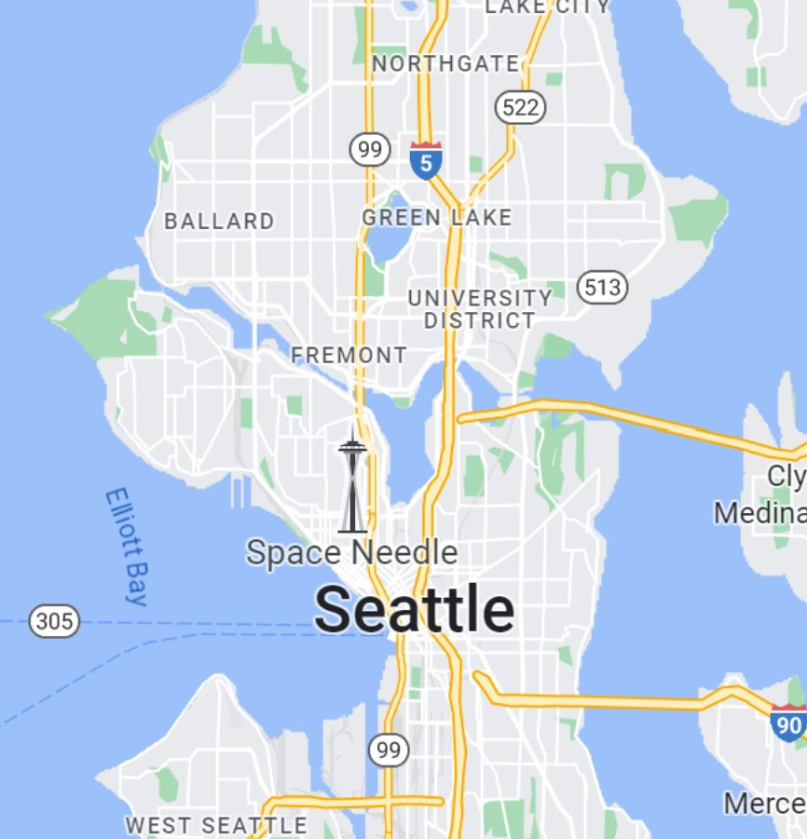
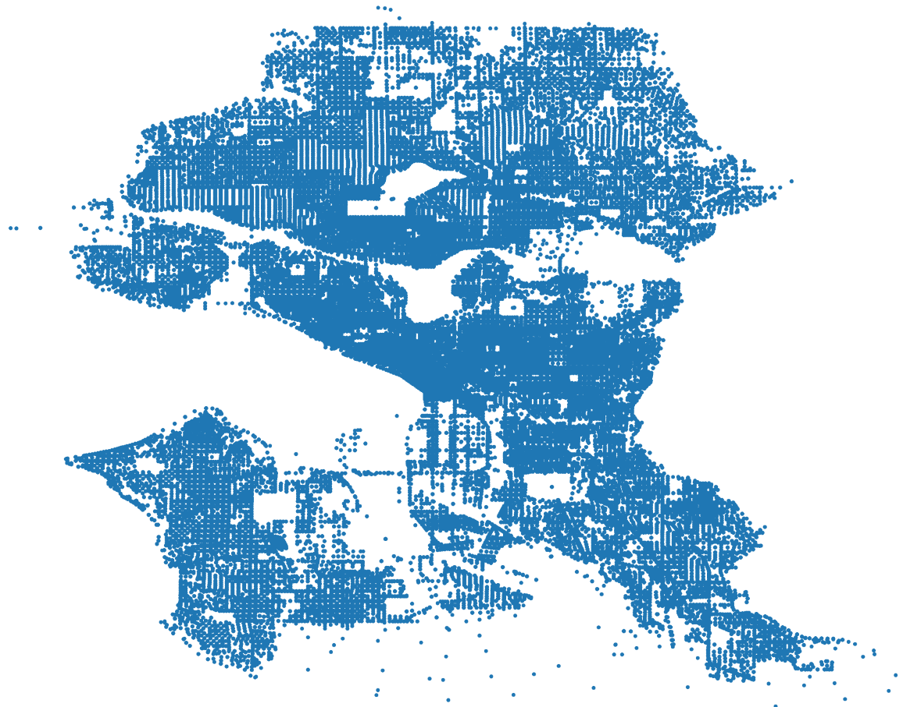
Sanity Check – Most Crimes are on Land

Slide 5
Clustering Method
Used a Euclidean distance metric
Gaussian Mixture Models
Elliptical shape and overlapping clusters
Determine probability that each data point belongs to a distribution
K-means
Spherical shaped clusters
Random selection of initial centroids
Tolerance of 0.1

Slide 6
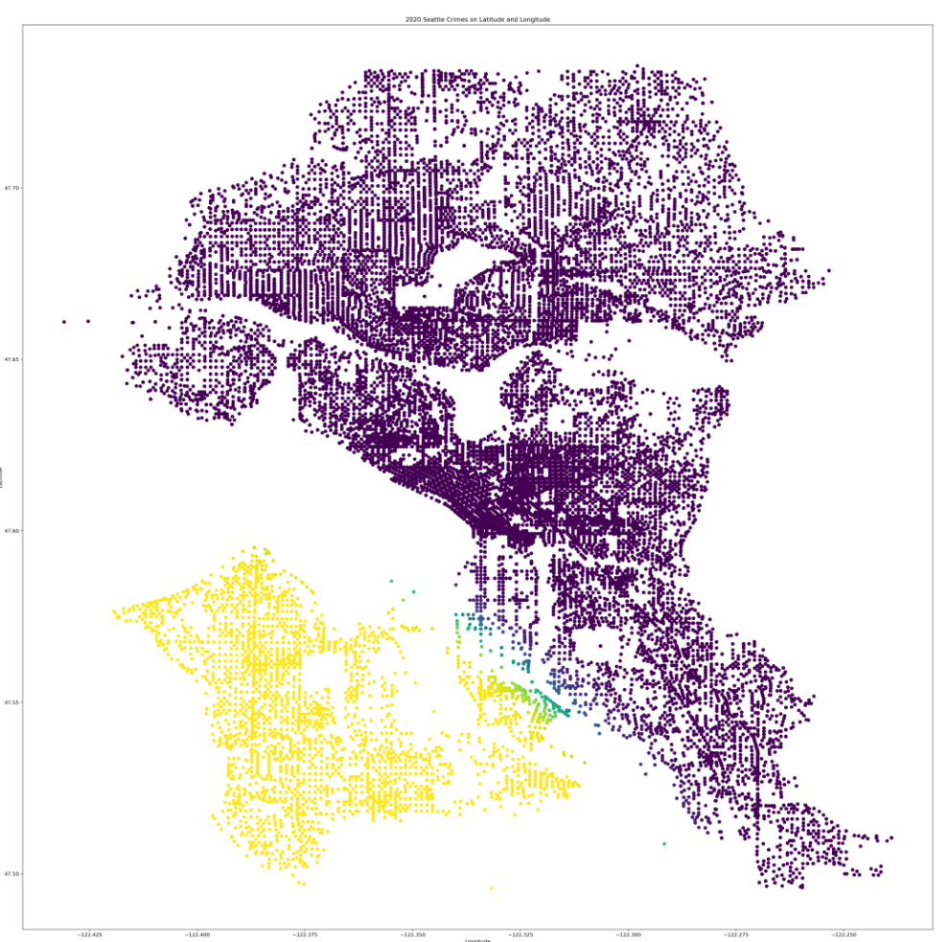
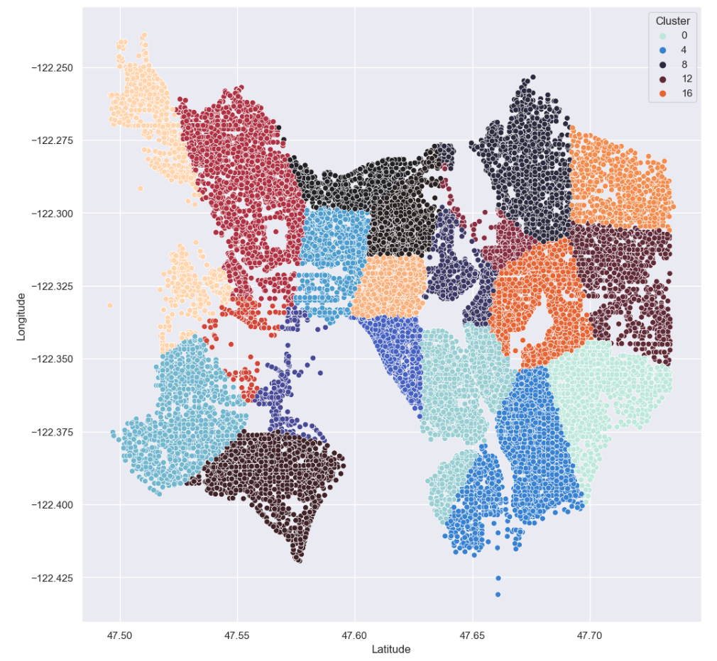
Models
GMM
K-Means

Slide 7
Next Steps
Testing different values of k
Elbow plot to find appropriate k value
Checking centroid locations and look for commonalities
Potentially shrinking the data set by only looking at violent crimes
Actual walking distance used through API

