Slide 1


Machine learning
In Cyber Security
Team Member
Anurag Pareek (89)
Animesh Parab (88)

Slide 2

Lesson overview
Photosynthesis is an energy production process undertaken by plants and green algae. It consists of various steps, during which energy coming through sunlight is converted into stored, chemical energy. It has special importance also for animals and humans, because a secondary product of the reaction is oxygen, necessary for the respiration of all living organisms.
Learning objectives
Keywords
Learn what materials and conditions are needed for photosynthesis.
Understand the process of transforming the input substances and sunlight into new products.
Learn about the plant structures that participate in this process.
Photosynthesis, Chloroplasts, Chlorophyll, Carotene, Xantophyll, Thylacoid, Plants, Algae, Carbon dioxide, Water, Sunlight, Energy, Oxygen, Glucose, Starch, Sugar
Standards
Common Core CCSS ELA-Literacy 11-12.RI.7
Integrate and evaluate multiple sources of information presented in different media or formats as well as in words in order to address a question or solve a problem.
11-12.W.7
Conduct short as well as more sustained research projects to answer a question (including a self-generated question) or solve a problem; narrow or broaden the inquiry when appropriate; synthesize multiple sources on the subject, demonstrating understanding of the subject under investigation.
11-12.SL.1
Initiate and participate effectively in a range of collaborative discussions (one-on-one, in groups, and teacher-led) with diverse partners on grades 11–12 topics, texts, and issues, building on others’ ideas and expressing their own clearly and persuasively.
11-12.SL.2
Integrate multiple sources of information presented in diverse formats and media (e.g., visually, quantitatively, orally) in order to make informed decisions and solve problems, evaluating the credibility and accuracy of each source and noting any discrepancies among the data.
11-12.SL.5
Make strategic use of digital media (e.g., textual, graphical, audio, visual, and interactive elements) in presentations to enhance understanding of findings, reasoning, and evidence and to add interest.
NGSS
HS-LS1-5
Use a model to illustrate how photosynthesis transforms light energy into stored chemical energy.

Slide 3
1. Introduction
5
min
What Is Machine Learning in Security?
Machine learning (ML) lets computers learn without being explicitly programmed. Put another way, machine learning teaches computers to do what people do: learn by experience. Machine learning is a domain within the broader field of artificial intelligence.
In security, machine learning continuously learns by analyzing data to find patterns so we can better detect malware in encrypted traffic, find insider threats, predict where “bad neighborhoods” are online to keep people safe when browsing, or protect data in the cloud by uncovering suspicious user behavior.

Slide 4
2. How ML Works
15
min
How does machine learning work in security?
The cyber threat landscape forces organizations to constantly track and correlate millions of external and internal data points across their infrastructure and users. It simply is not feasible to manage this volume of information with only a team of people.
This is where machine learning shines, because it can recognize patterns and predict threats in massive data sets, all at machine speed. By automating the analysis, cyber teams can rapidly detect threats and isolate situations that need deeper human analysis.
How does it work?
The details of machine learning can seem intimidating to non-data scientists, so let's look at some key terms.
Supervised learning calls on sets of training data, called “ground truth,” which are correct question-and-answer pairs. This training helps classifiers, the workhorses of machine learning analysis, to accurately categorize observations. It also helps algorithms, used to organize and orient classifiers, successfully analyze new data in the real world.
An everyday example is recognizing faces in online photos: Classifiers analyze the data patterns they are trained on--not the actual noses or eyes--in order to correctly tag a unique face amongst many millions of online photos.

Slide 5
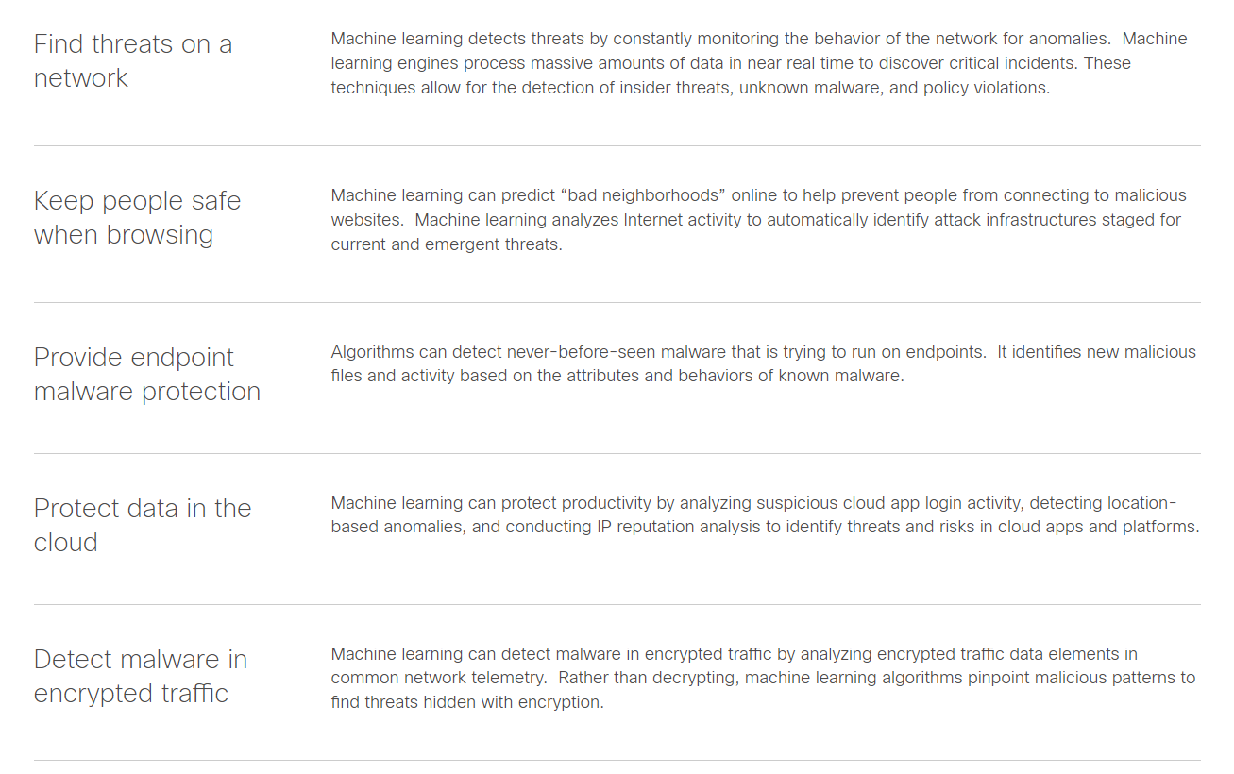
3. How machine learning helps security...
30
min

Slide 6
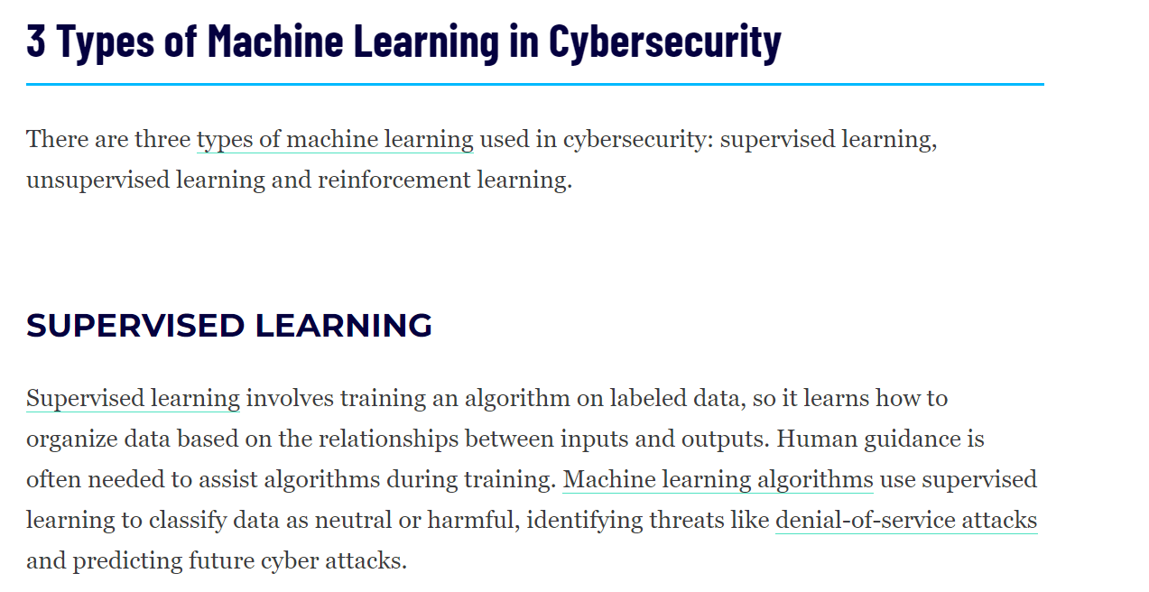
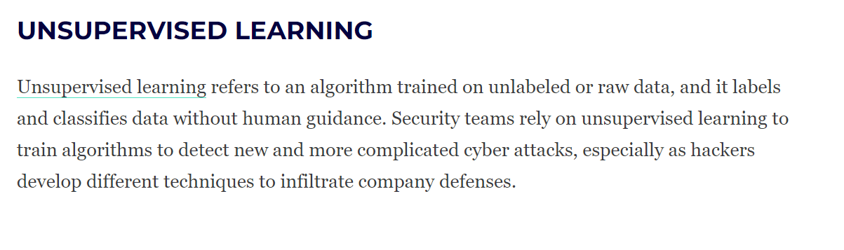
4. The power of green

Slide 7
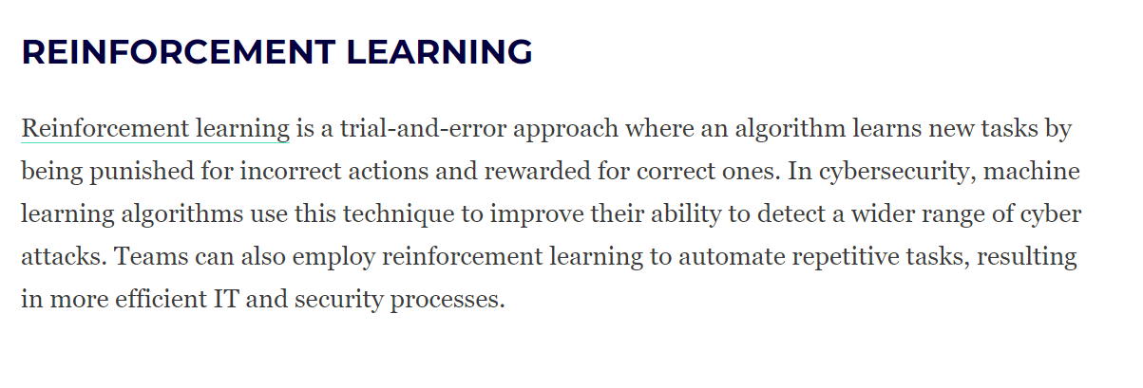
5. Experiment – photosynthesis under different conditions

Slide 8
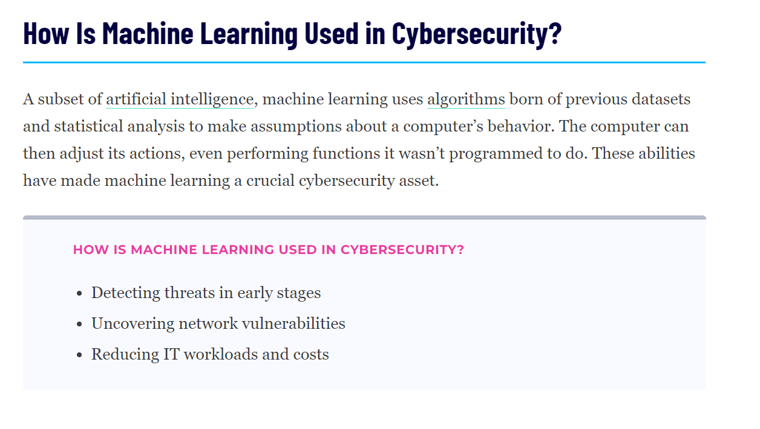

Slide 9
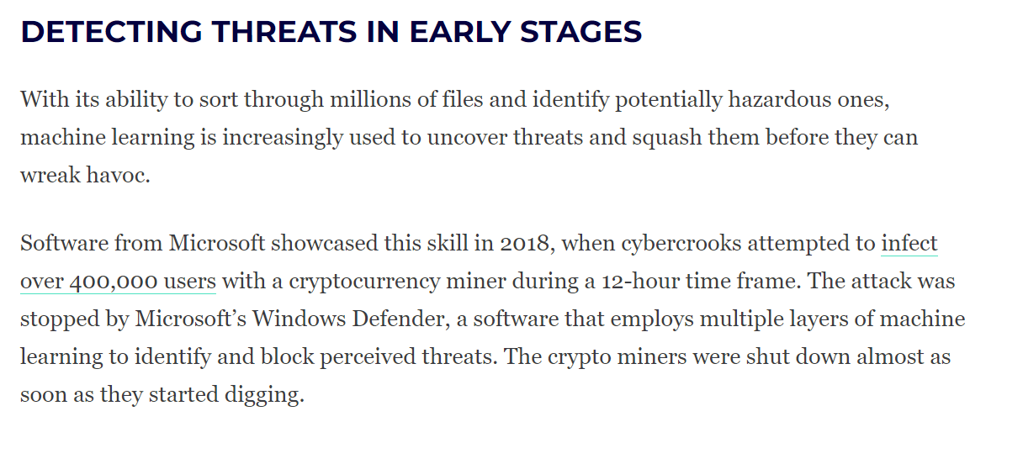

Slide 10


Slide 11
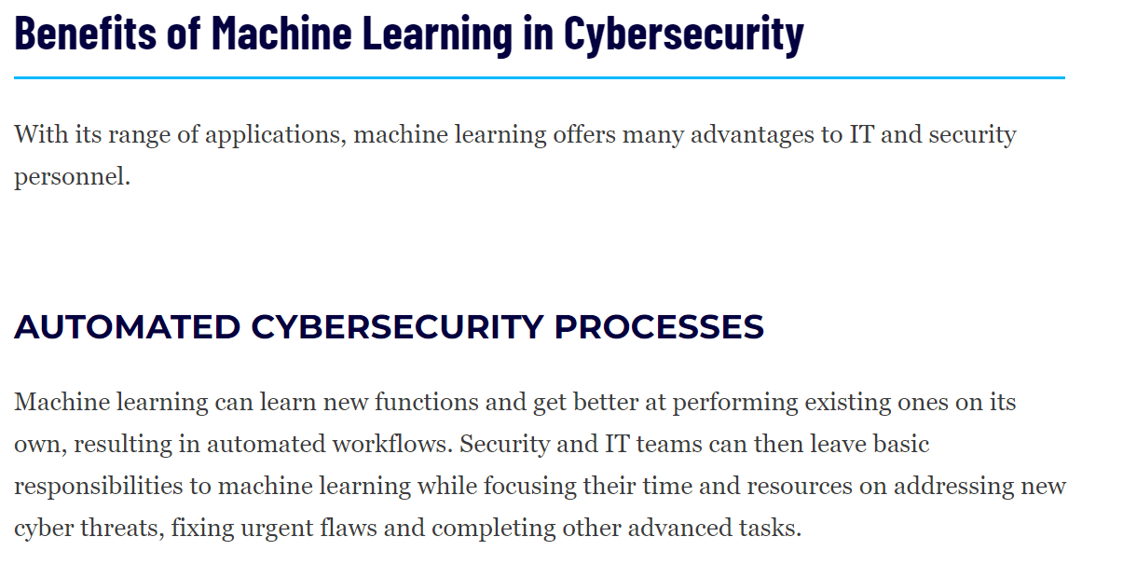

Slide 12
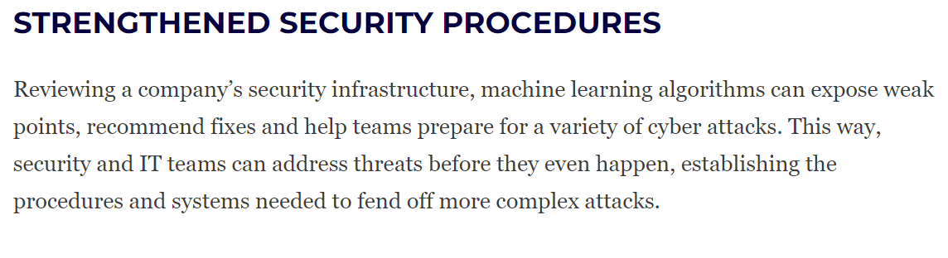

Slide 13
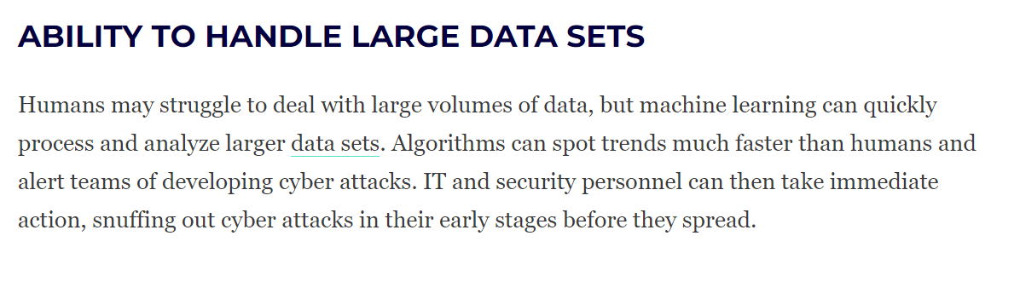

Slide 14
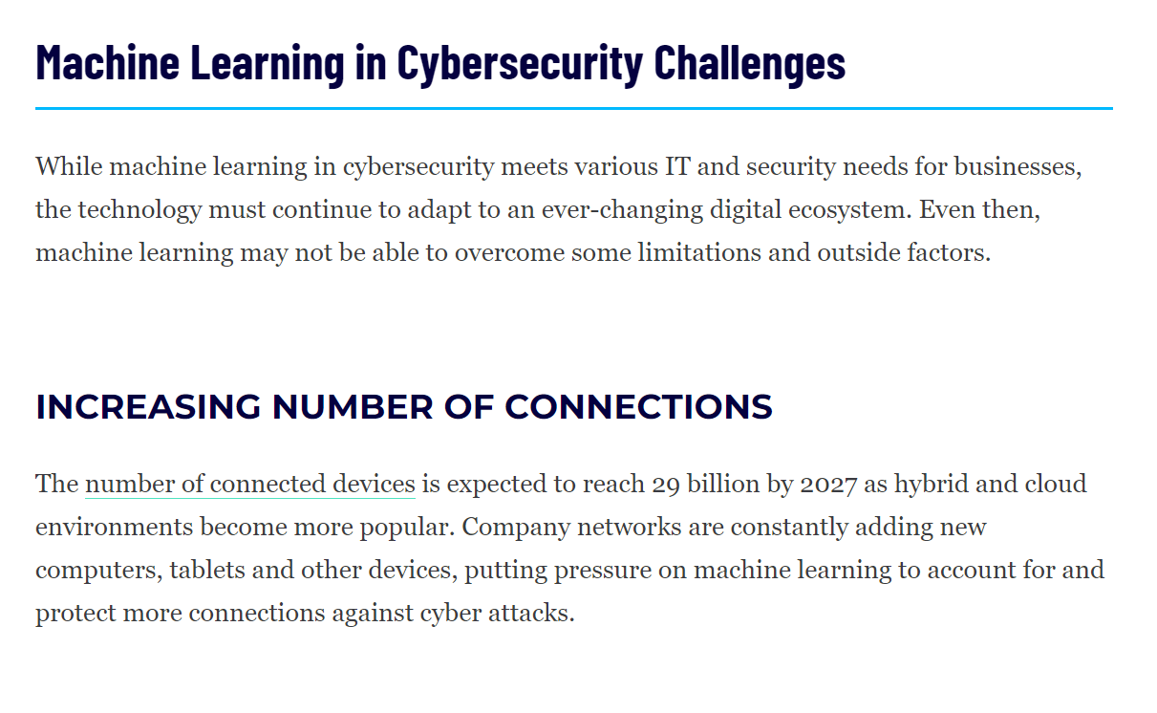

Slide 15
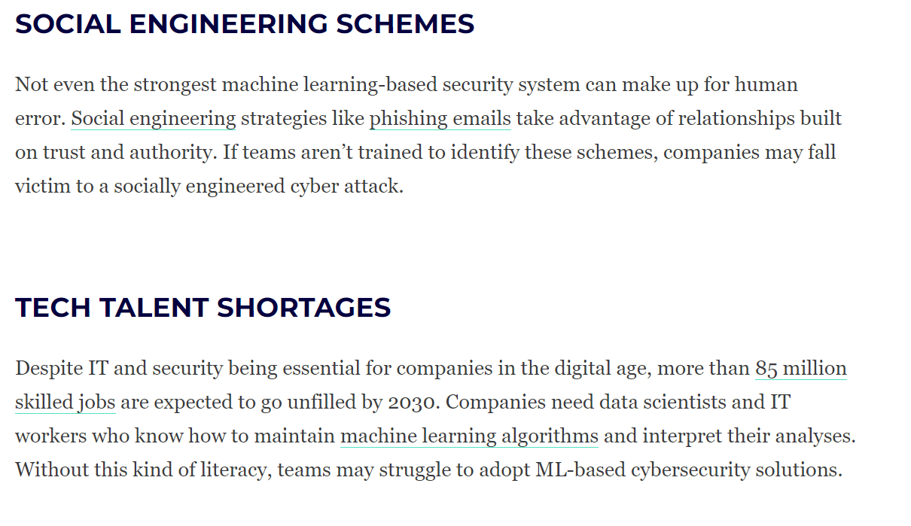
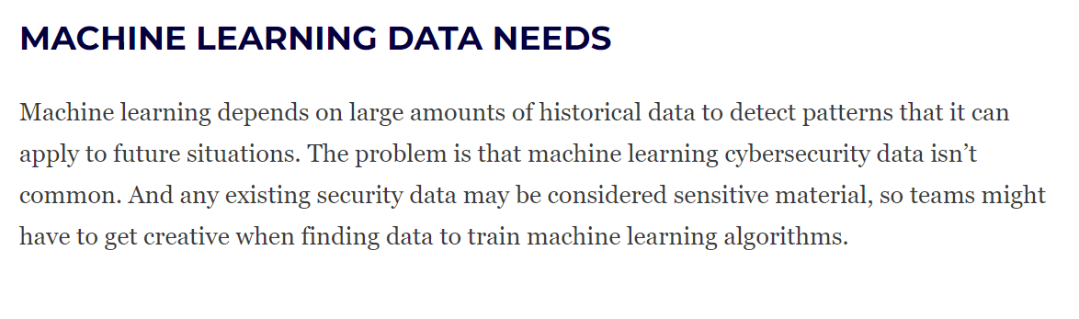

Slide 16

Thanks for using Lifeliqe's lesson plan!
Excite your students in learning science with 1,000+ more 3D models and lesson plans at online.lifeliqe.com

