Slide 1
3 ways to model a real object in FreeCAD
Aims of this talk:
Give beginners some ideas of how to go about making a model of a real object
Show that there is usually more than one way to model a given object
Give a basic introduction to FreeCAD

Slide 2
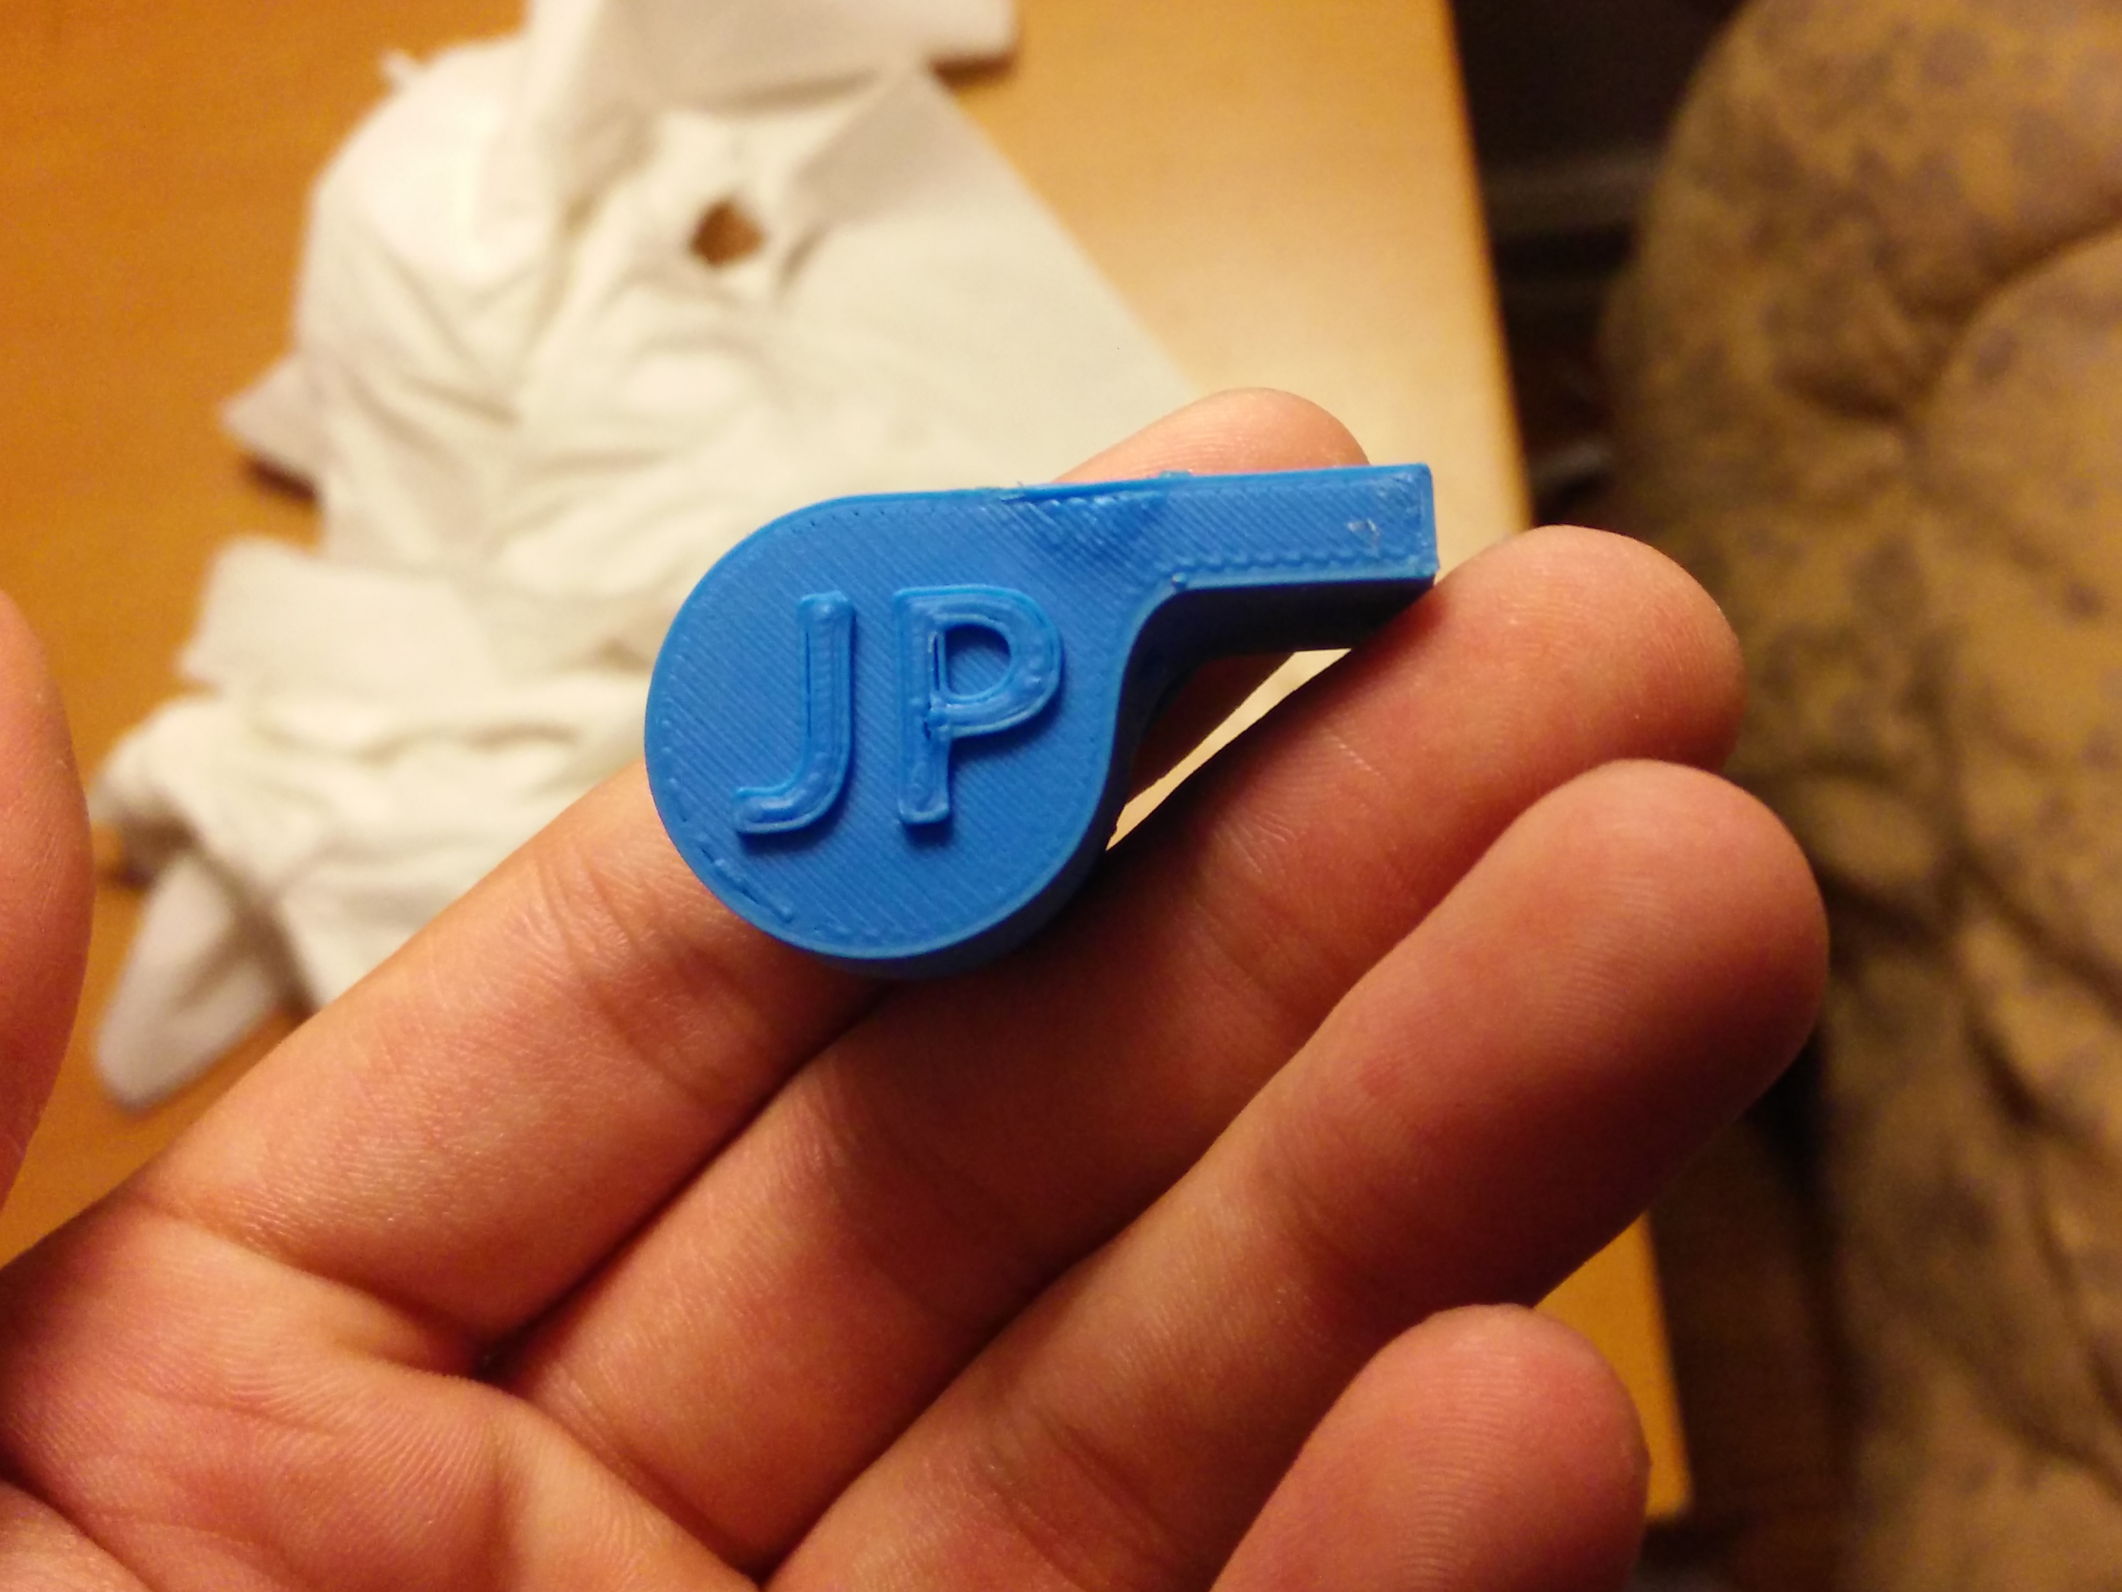
The Prusa Whistle

Slide 3
Getting Started
How to make a start with creating a model (1st strategy).
Think about how you can create the object by combining elementary shapes.
Some shapes you can use are Cubes, Spheres, and Cylinders.
You can fuse shapes together, use one to cut bits out of another, or create a new shape from the overlap between two others (Boolean operators).
Start by drawing a rough sketch with measurements.

Slide 4
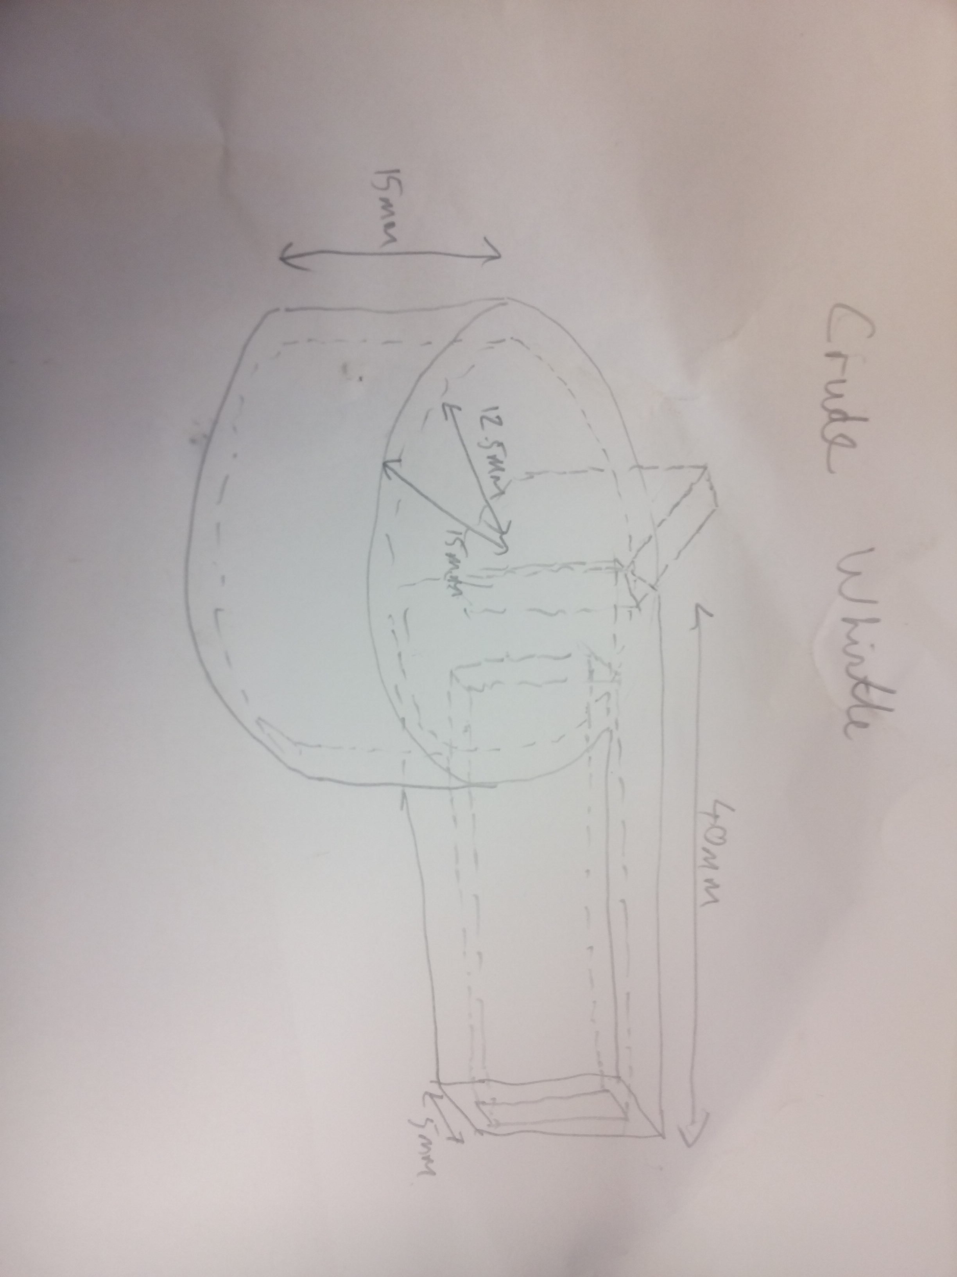
A crude model of a whistle

Slide 5
This is a pretty crude model
On the real whistle, the join between the body and the mouthpiece is rounded.
We had to make the walls of the body thicker to get the blade of the air hole in the right place.
It’s awkward moving all those objects round in 3D space.

Slide 6
A more accurate model
Another approach is based on ‘Extrusions’ (and also ‘Revolutions’) of simple 2D shapes.
You can think of the whistle as being made of:
2 flat end pieces
1 wall section with a complex cross section
Each of these can be created by extruding a cross-section shape, and then combined to make the model.
This allows for more complex shapes.

Slide 7
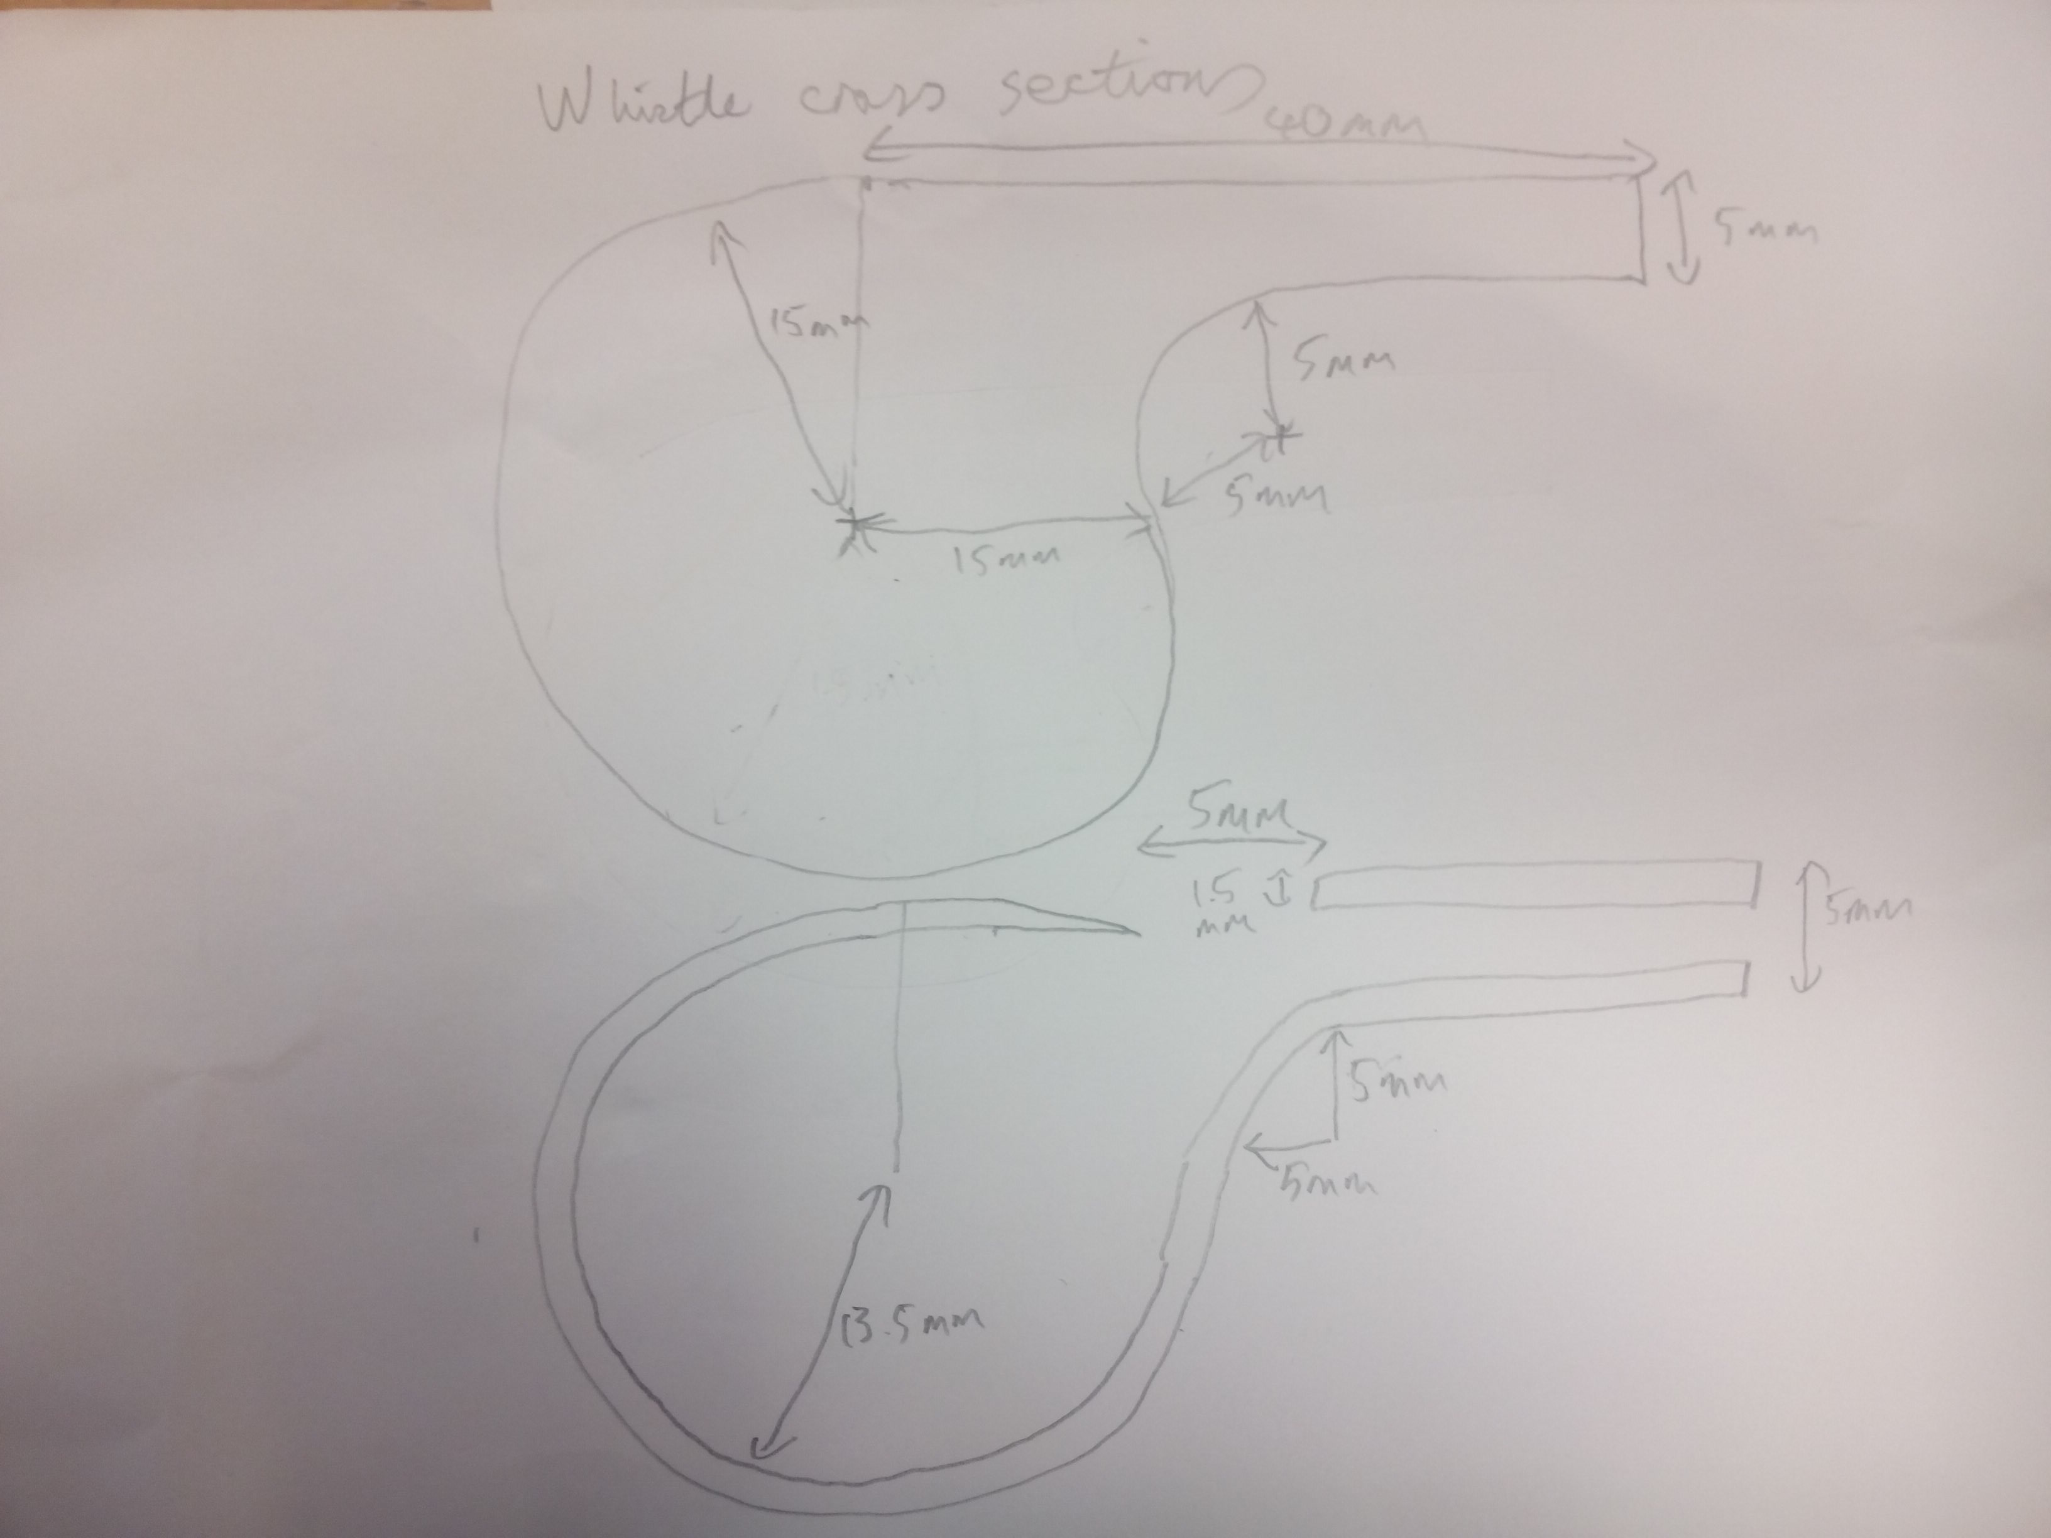
Cross-sections of the whistle

Slide 8
The FreeCAD Sketcher
You make 2D shapes in FreeCAD using the ‘Sketcher’
You put together elementary shapes like lines, circles, arcs, ellipses etc. to make your shape.
Then you add ‘constraints’ to set the dimensions and fix the pieces into position.
It’s all about removing ‘degrees of freedom’.
A ‘degree of freedom’ is one simple movement that a part of the shape can make.
Each constraint you add removes one or more degrees of freedom.
When there are no degrees of freedom, the shape is fixed.

Slide 9
There is more than one way to do it
The last model combines the two previous approaches.
It still uses the more sophisticated shapes you can draw in the sketcher.
However instead of adding shapes together, it goes back to the previous approach of making the outside first then cutting out the inside.
The effect is exactly the same, but the modelling is slightly simpler.

