Slide 1
SA…LUTE!
Final Project Process Report
Sogang Univ. Art&Technology
20191126 Lee Dongju

Slide 2
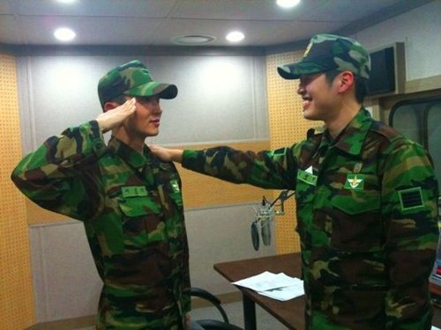
Idea & Concept
SALUTING
TO A
HIGHER
RANKING
SENIOR

Slide 3
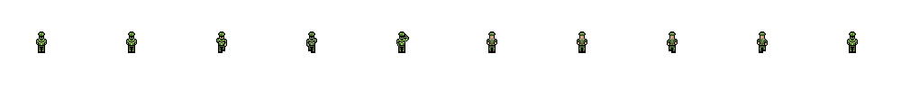
Process 1 – Graphics(Characters)
MOBS
PLAYER
Finished drawing the characters using pixel art

Slide 4
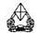
Process 2 – Graphics(Map)
SCORE: 613
RANK:
Layout Plan (In progress)
- Mobs faces south
- Player faces north
- Currently modifying the ’SHMUP!’ code to fit my game

Slide 5
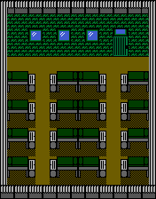



Process 2 – Graphics(Map)
Add Background
(At final Stage)
- Downloaded from Opengameart

Slide 6
Schedule
Finish Coding by Friday
Retouch the design by Sunday
Final Upload on Monday

