Slide 1

Getting Started with IBM Q Experience Part 1: Account Creation
Priya Angara, Ulrike Stege

Slide 2
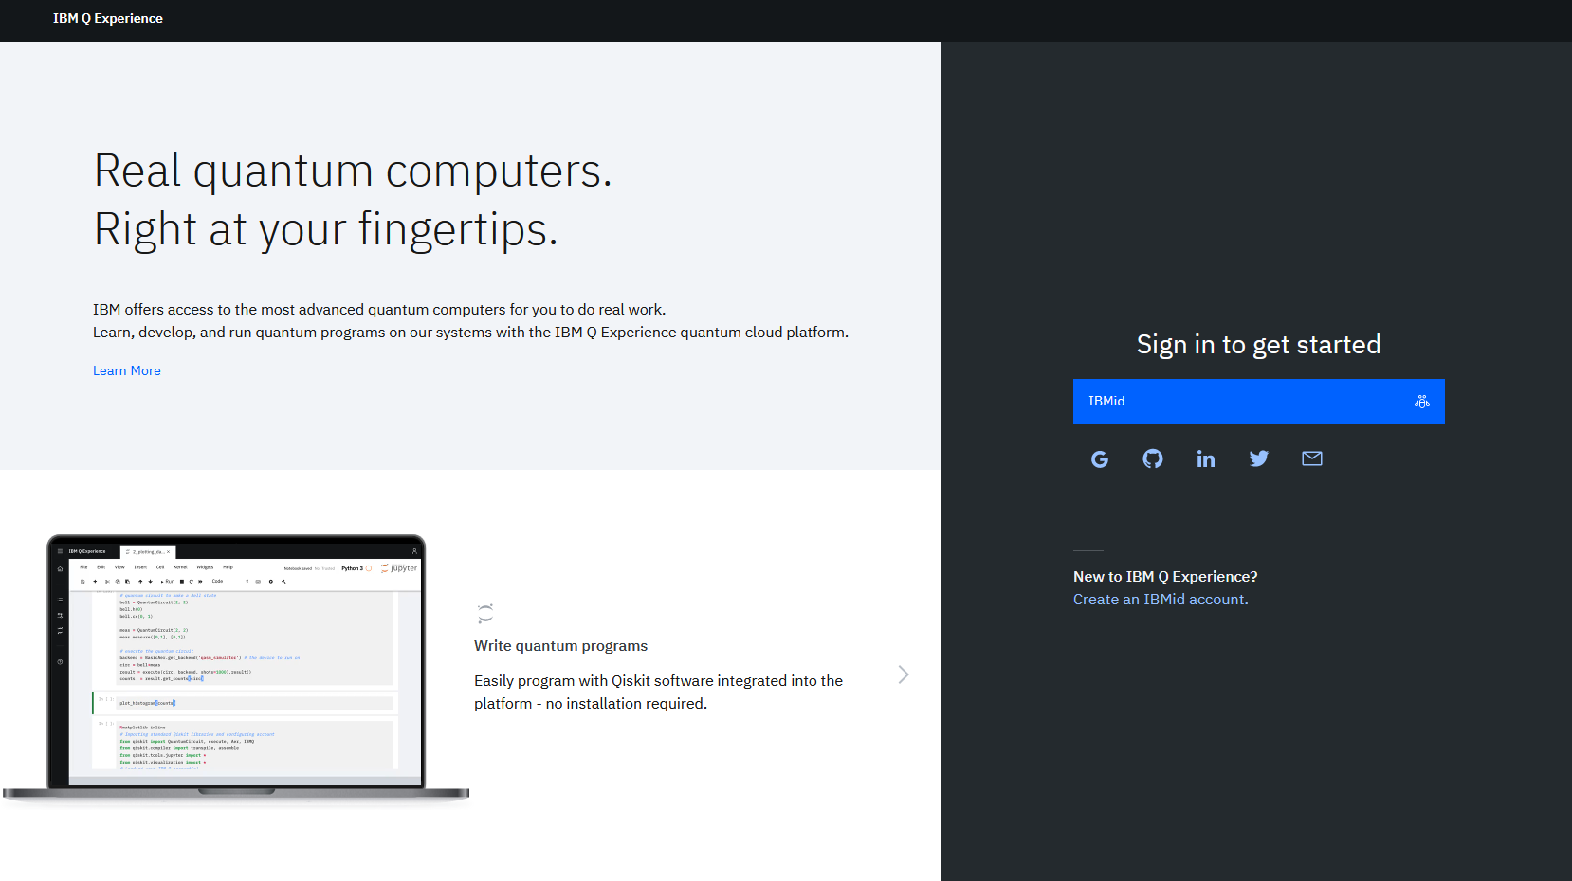
Step 1: Open https://quantum-computing.ibm.com/

Slide 3
Step 2: Click on “Create an IBMid account”

Slide 4
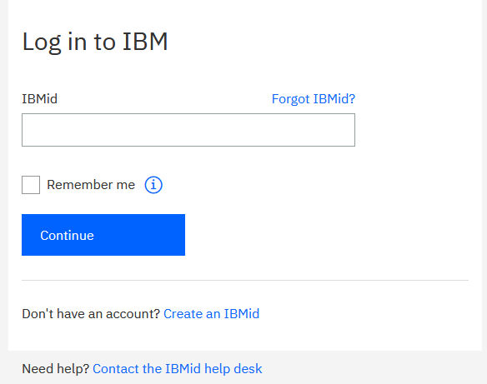
Step 3: Click on “Create an IBMid”

Slide 5
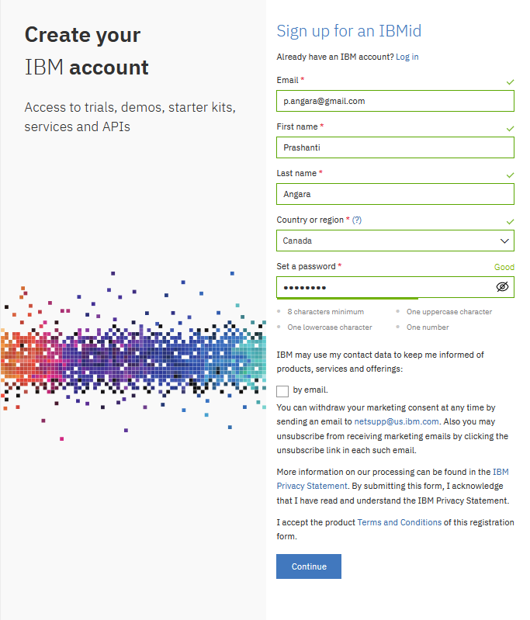
Step 4.1: Details
Fill in your email, name and set a password for your new account
Click on continue after agreeing to the terms, conditions and the privacy statement
Click on Continue.
Step 4.2: Check your email
You will get a 7-digit code that you will enter in the form after clicking on proceed
Account setup is done!

Slide 6
Step 5: Head back to the landing page, sign in

Slide 7
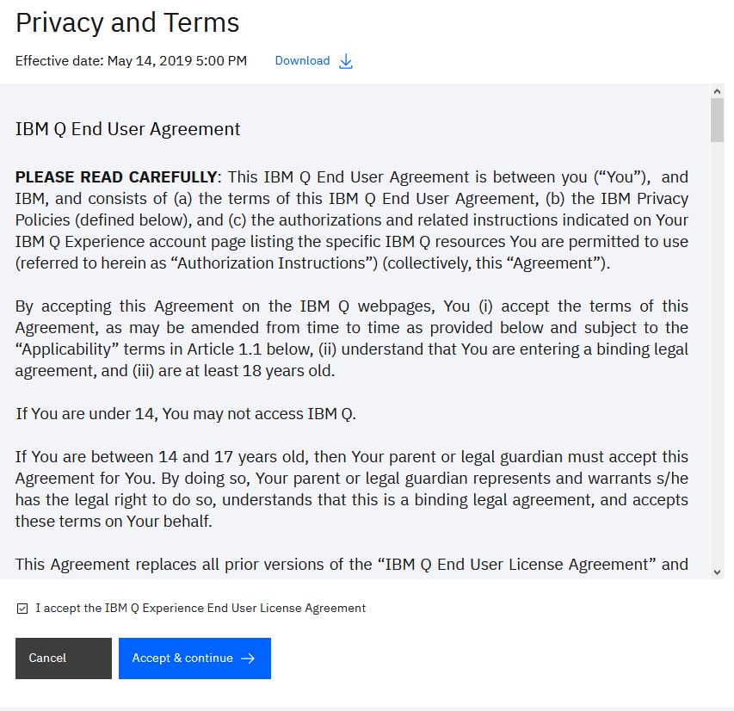
Step 6: Read the Privacy and Terms
Tick the checkbox if you agree to the terms, and then click on Accept and continue

Slide 8
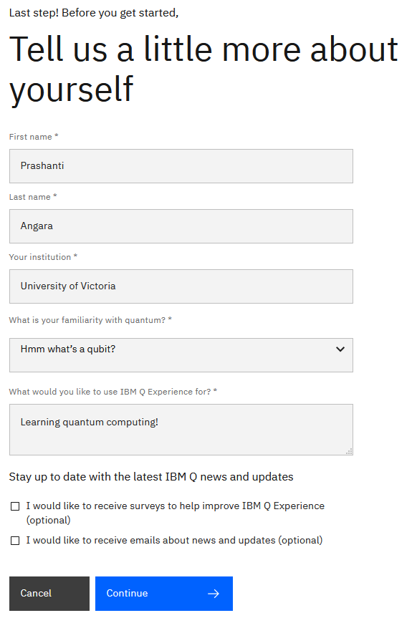
Step 7: Fill in an IBM survey (mandatory)

Slide 9
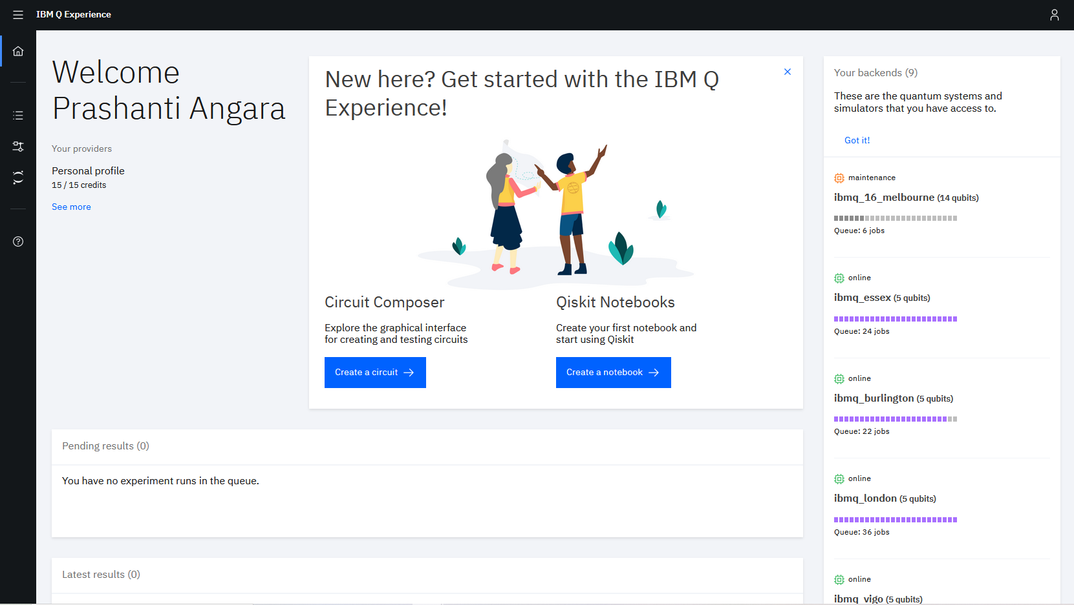
Done!

