Slide 1

Getting Started with IBM Q Experience & Jupyter Notebooks Explore the platform
Priya Angara, Ulrike Stege

Slide 2
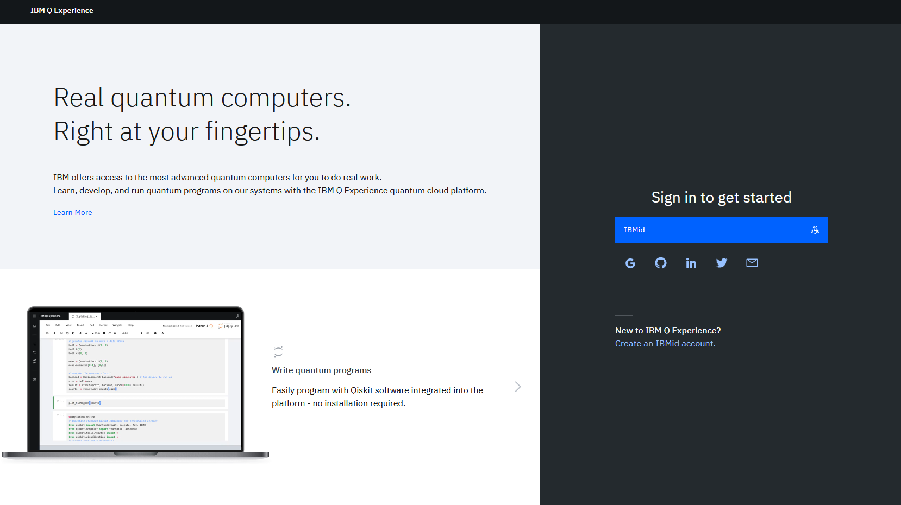
Sign in: https://quantum-computing.ibm.com/

Slide 3
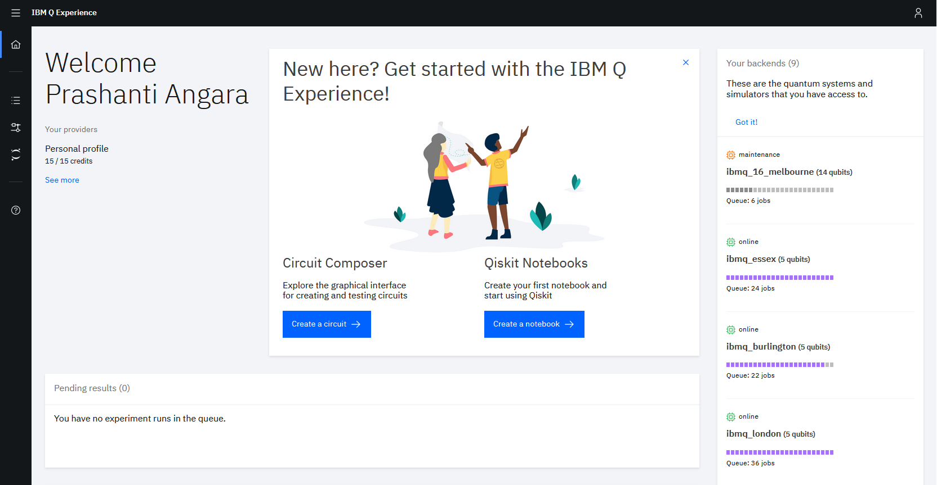
Components

Slide 4
Components: Circuit Composer
The circuit composer lets you design and run circuits using a graphical user interface (i.e. you can drag and drop gates to form a circuit)

Slide 5
Components: Qiskit notebooks
These are Jupyter notebooks. One can design and run experiments using code written in Python and Qiskit

Slide 6
Components: Backends
https://quantum-computing.ibm.com/support
Where do you run the experiments? These are actual quantum computers and simulators that you have access to

Slide 7
Click on Create a notebook
These are Jupyter notebooks. One can design and run experiments using code written in Python and Qiskit

Slide 8
Import instructions

Slide 9

Working with Python, Jupyter Notebooks and Qiskit
Let’s open the first jupyter notebook: 0_python_jupyter_ qiskit.ipynb

Slide 10
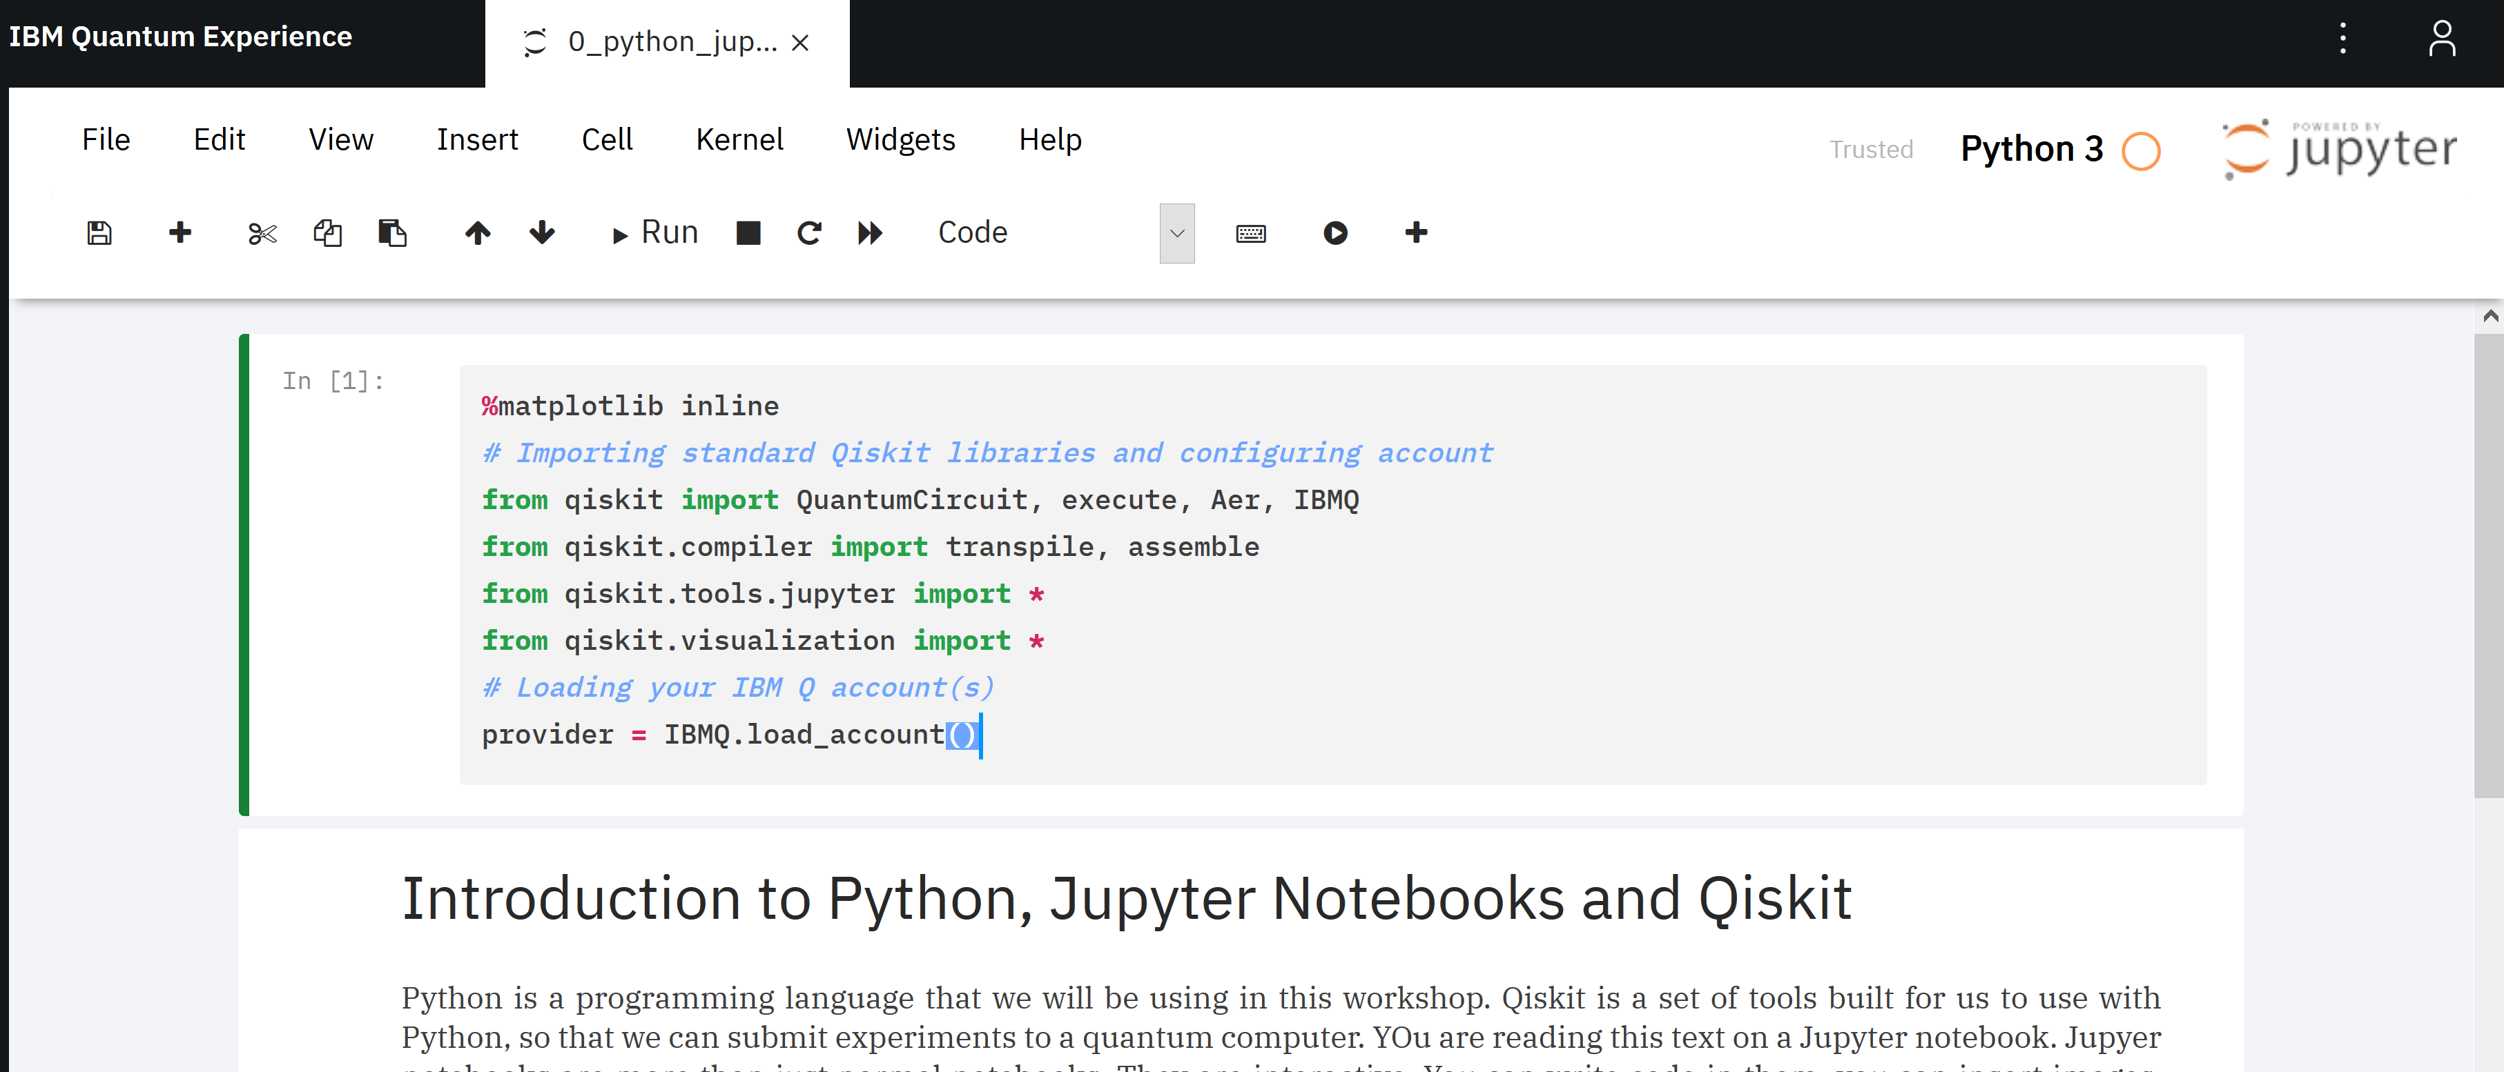
Jupyter Notebooks
This is the interface you’ll be working on.

Slide 11
Cells
Each of these boxes is called a cell
Cells are run one after another
This particular cell is a set of import statements – think of this as things that will help you with your quantum code

Slide 12
New Cell
Click on + to create a new cell.

Slide 13
Change Cell Type
You can change the cell type using this drop down
A cell can be:
A code cell (Code)
A text cell (Markdown)

Slide 14
Kernel
Think of a kernel as an environment. A fish needs to be in water, similarly, a quantum program needs to be in a quantum kernel

Slide 15
Run a cell
You can run a cell one at a time, stop a running cell, refresh or run all cells at once

Slide 16
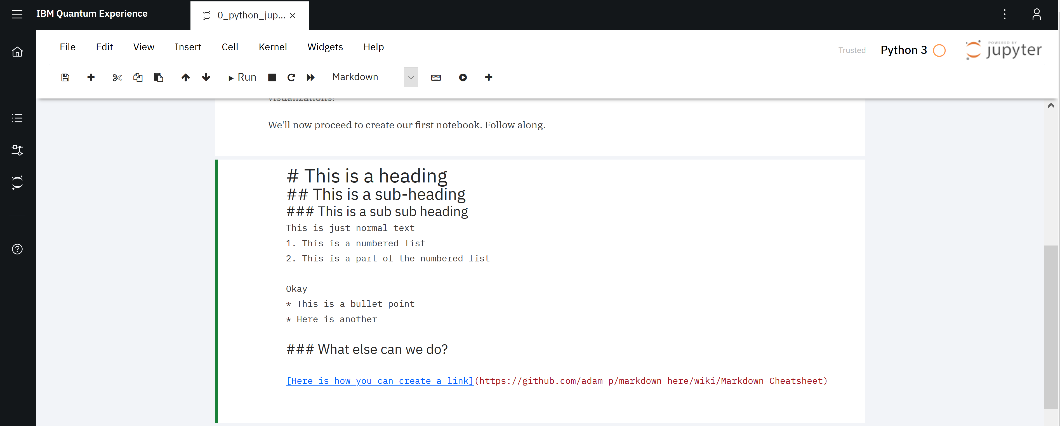
Markdown
Markdown is a fancy, but easy way to format this.

Slide 17
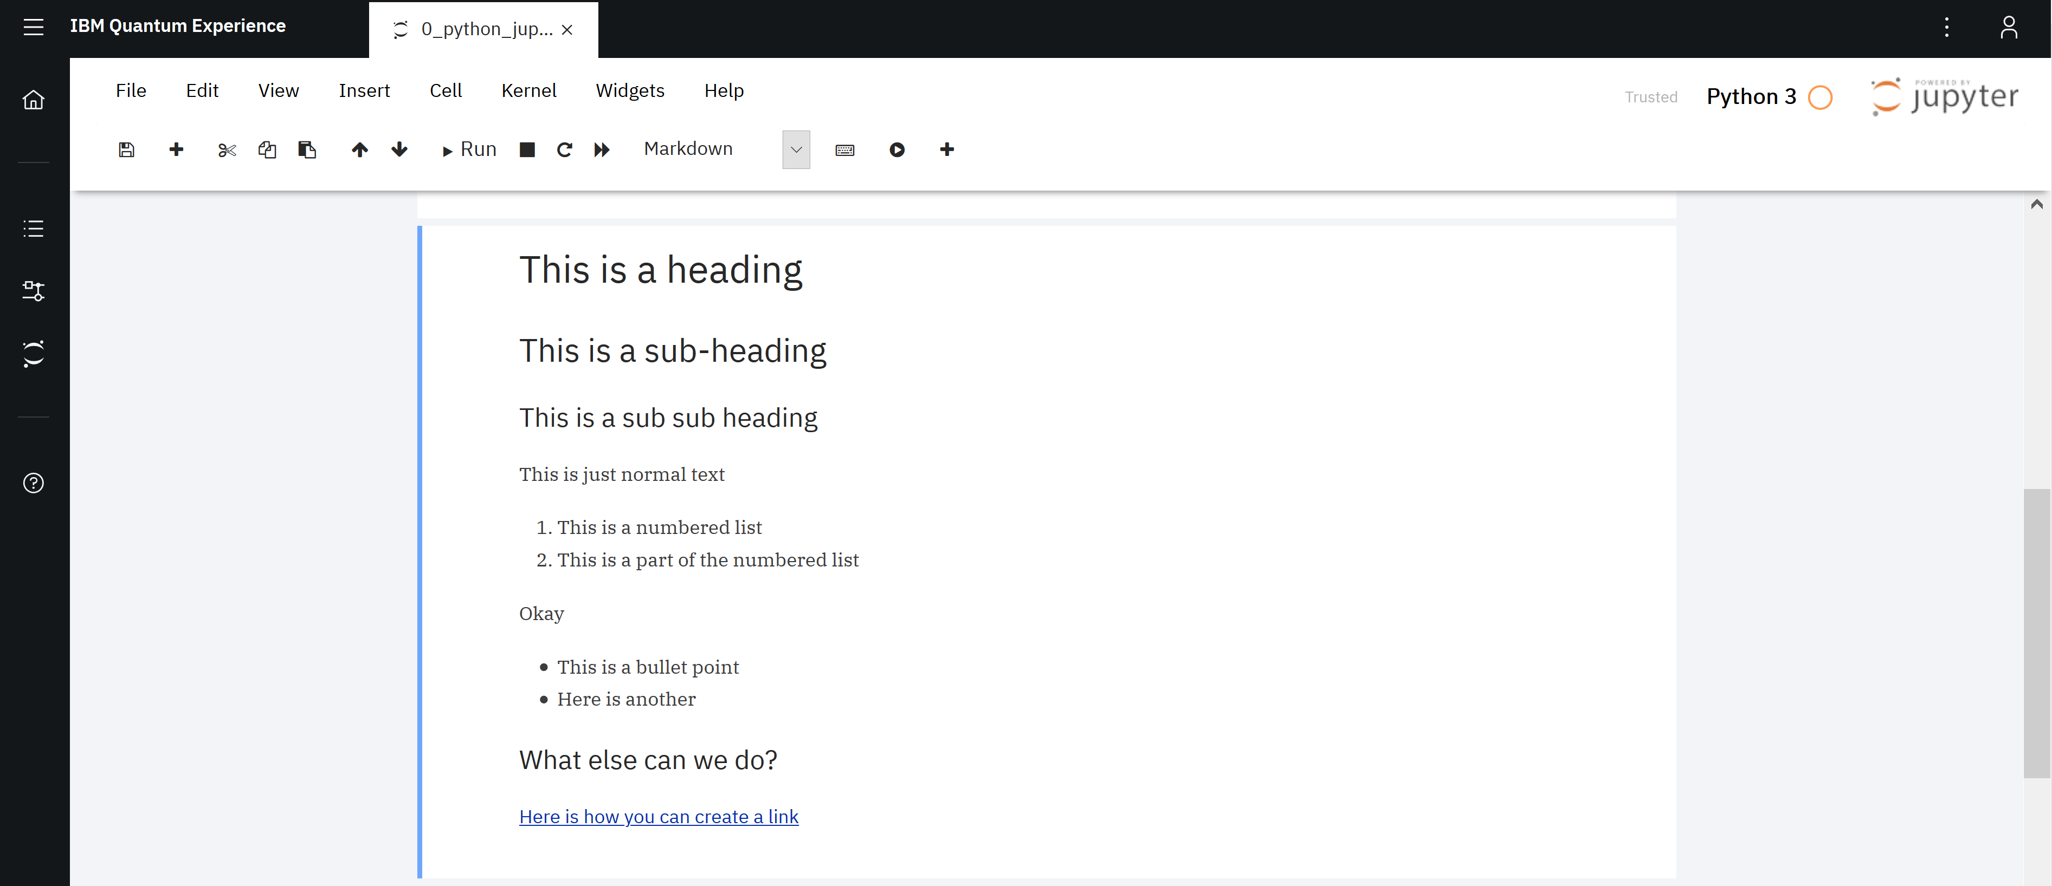
Markdown
When you run the cell, this is what we see. Looks nice?

Slide 19
Markdown

Slide 20
Resources
https://quantum-computing.ibm.com/support
https://qiskit.org/

