Slide 1
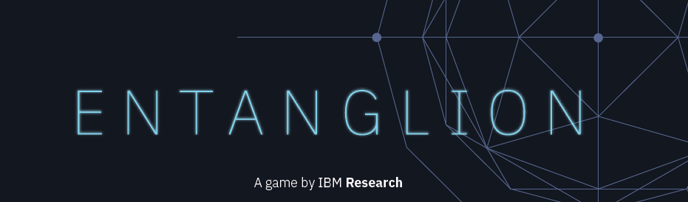
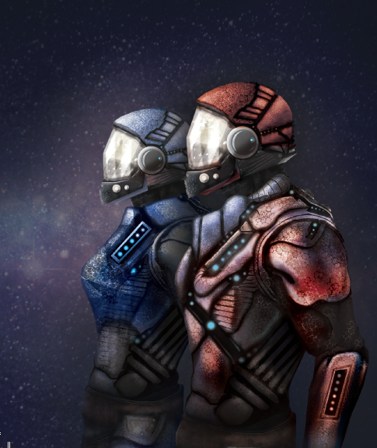
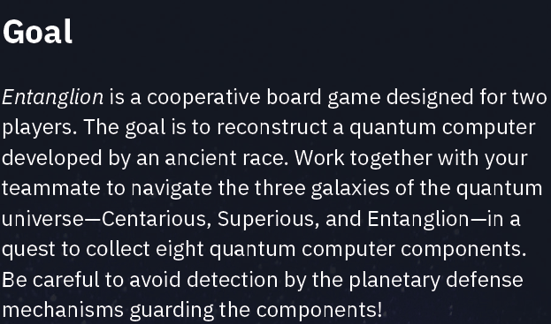

Slide 2
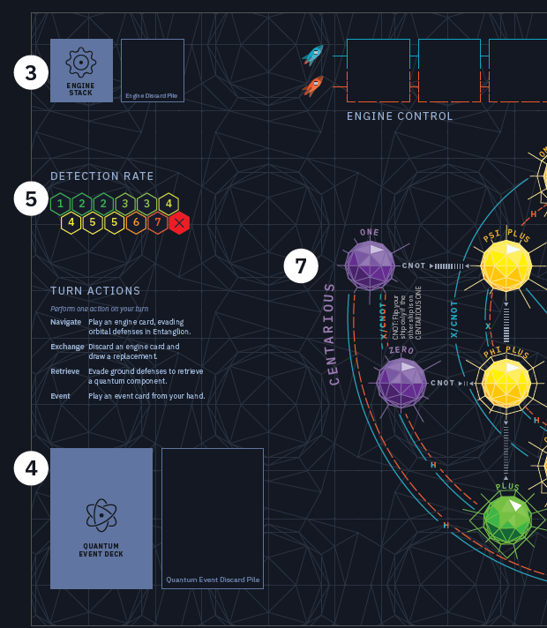
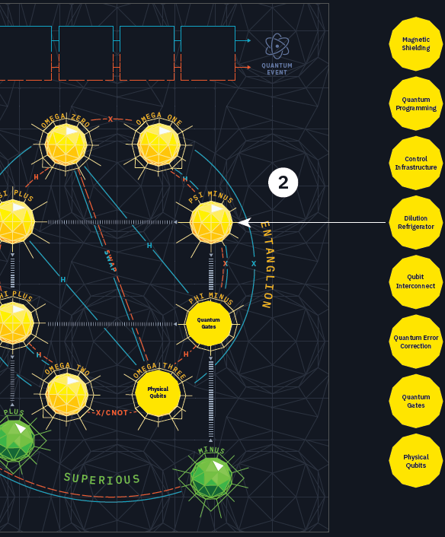
Game Setup
Lay out the game & spaceship boards
Place the quantum components
Shuffle the engine card stack
Prepare the quantum event deck
Set the initial detection rate
Determine the first player
Determine the initial ship locations
Draw engine cards

Slide 3
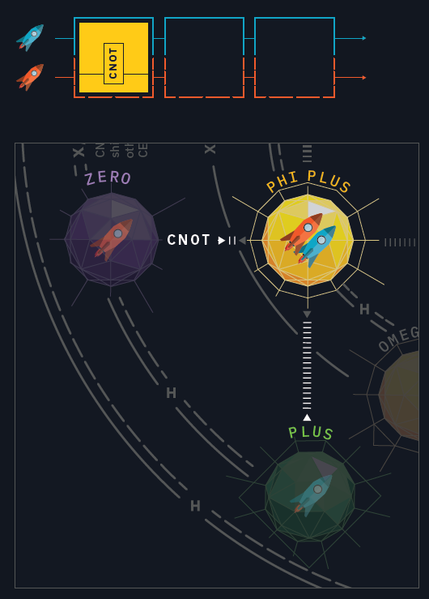
Engine Cards
Orbital defenses
Once all six engine control slots have been filled, perform a quantum event at the end of your turn.
Roll the Entanglion die.
If the outcome > detection rate then the orbital defenses have been evaded.
Else
Increase the detection rate by one.
Roll the Centarious die and move both ships to the planet indicated.
Draw a quantum event card and perform the action indicated.
Entering & exiting Entanglion
Ground defenses
one spaceship needs to be in Centarious, and the other spaceship needs to be in Superious.
Roll the Entanglion die.
If the outcome > current detection rate, collect the component and place it on your spaceship board.
Else increase the detection rate by one.

Slide 4
