Slide 1
BioViz Local
KEGG Pathway Analysis Report
Pathway ID: hsa04640
Generated: 2025/12/9 18:57:57
Generated by BioViz Local

Slide 2
Methodology
Gene expression data was mapped to KEGG Pathway [hsa04640]. Color coding represents Log2 Fold Change (Red=Up, Blue=Down). Data processing and visualization were performed by BioViz Local v0.1.

Slide 3
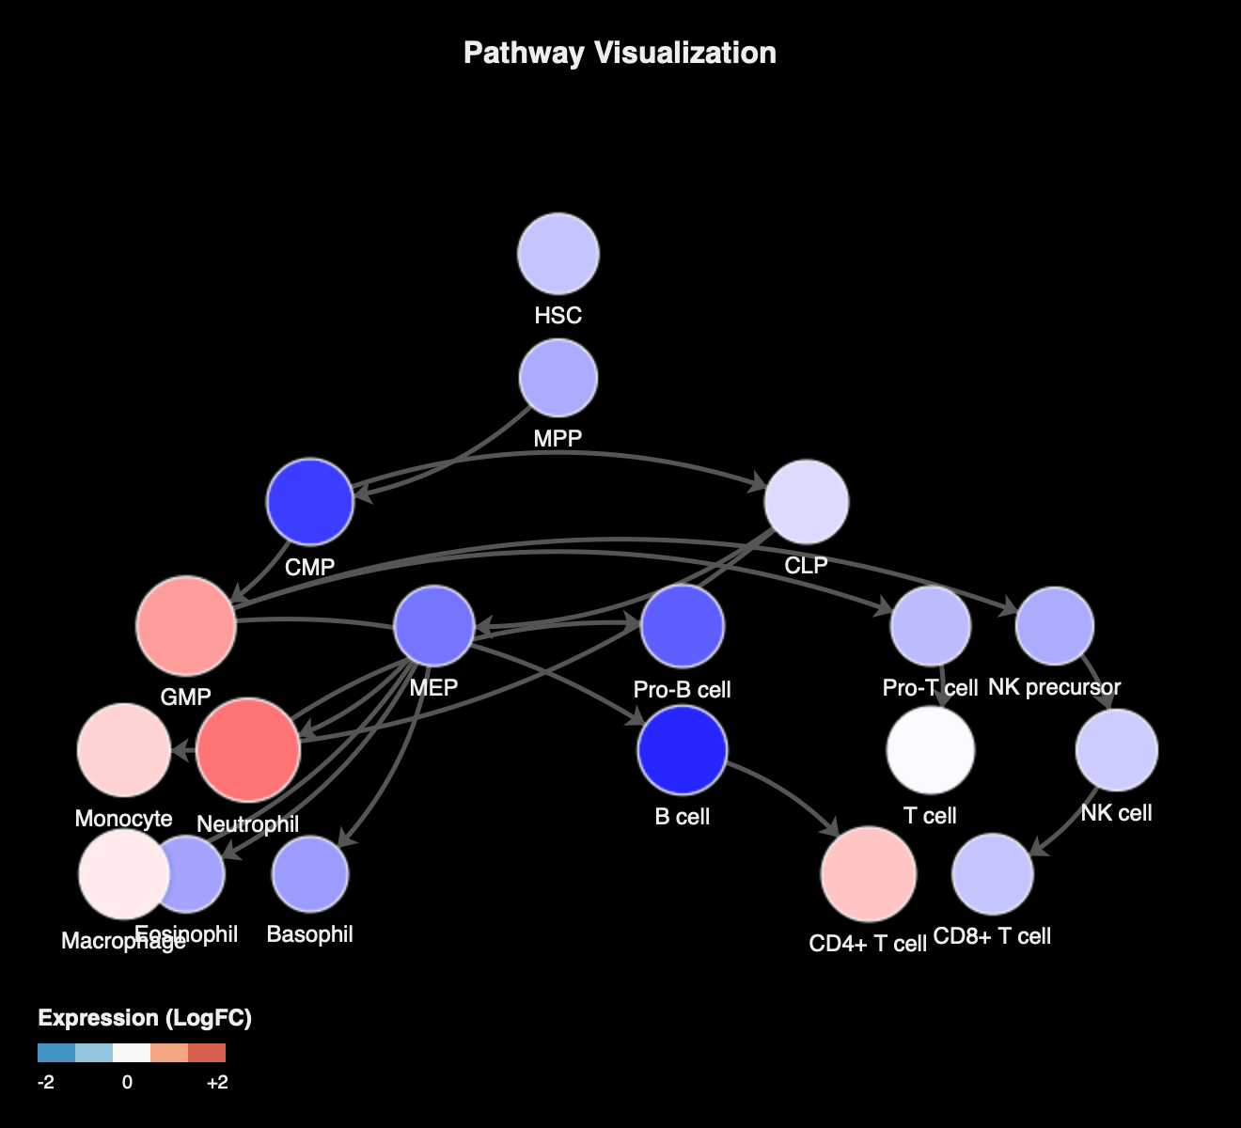
Pathway Map

Slide 4
Summary Statistics
Metric | Count | Percentage
Total Nodes | 19 | 100%
Upregulated | 14 | 73.7%
Downregulated | 4 | 21.1%

Slide 5
Key Findings
14 genes are upregulated.
4 genes are downregulated.
1 items show no significant change or were not detected.
Pathway Coverage: 100.0% of total pathway nodes.

Slide 6
Expression Details
Gene | Expression | Status
Neutrophil | 3.00 | High
GMP | 2.50 | High

Slide 7
CD4+ T cell | 2.00 | High
Monocyte | 1.80 | High
Macrophage | 1.50 | High
B cell | -1.50 | Low

Slide 8
CMP | -1.20 | Low
T cell | 1.20 | High
CLP | 0.80 | High
Pro-B cell | -0.80 | Low

Slide 9
NK cell | 0.60 | High
HSC | 0.50 | High
MEP | -0.50 | Low
CD8+ T cell | 0.50 | High

Slide 10
Pro-T cell | 0.40 | High
MPP | 0.20 | High
NK precursor | 0.20 | High
Eosinophil | 0.10 | High

Slide 11
Basophil | 0.00 | Low

Slide 12
References & Acknowledgements
1. Kanehisa, M. and Goto, S.; KEGG: Kyoto Encyclopedia of Genes and Genomes. Nucleic Acids Res. 28, 27-30 (2000).
2. BioViz Local: An advanced, secure, and beautiful pathway visualization tool.
GitHub Repository:
https://github.com/bioviz/local

