Slide 1
BioViz Local
KEGG Pathway Analysis Report
Pathway ID: hsa00010
Generated: 2025/12/10 19:35:48
Generated by BioViz Local

Slide 2
Methodology
Gene expression data was mapped to KEGG Pathway [hsa00010]. Color coding represents Log2 Fold Change (Red=Up, Blue=Down). Data processing and visualization were performed by BioViz Local v0.1.

Slide 3
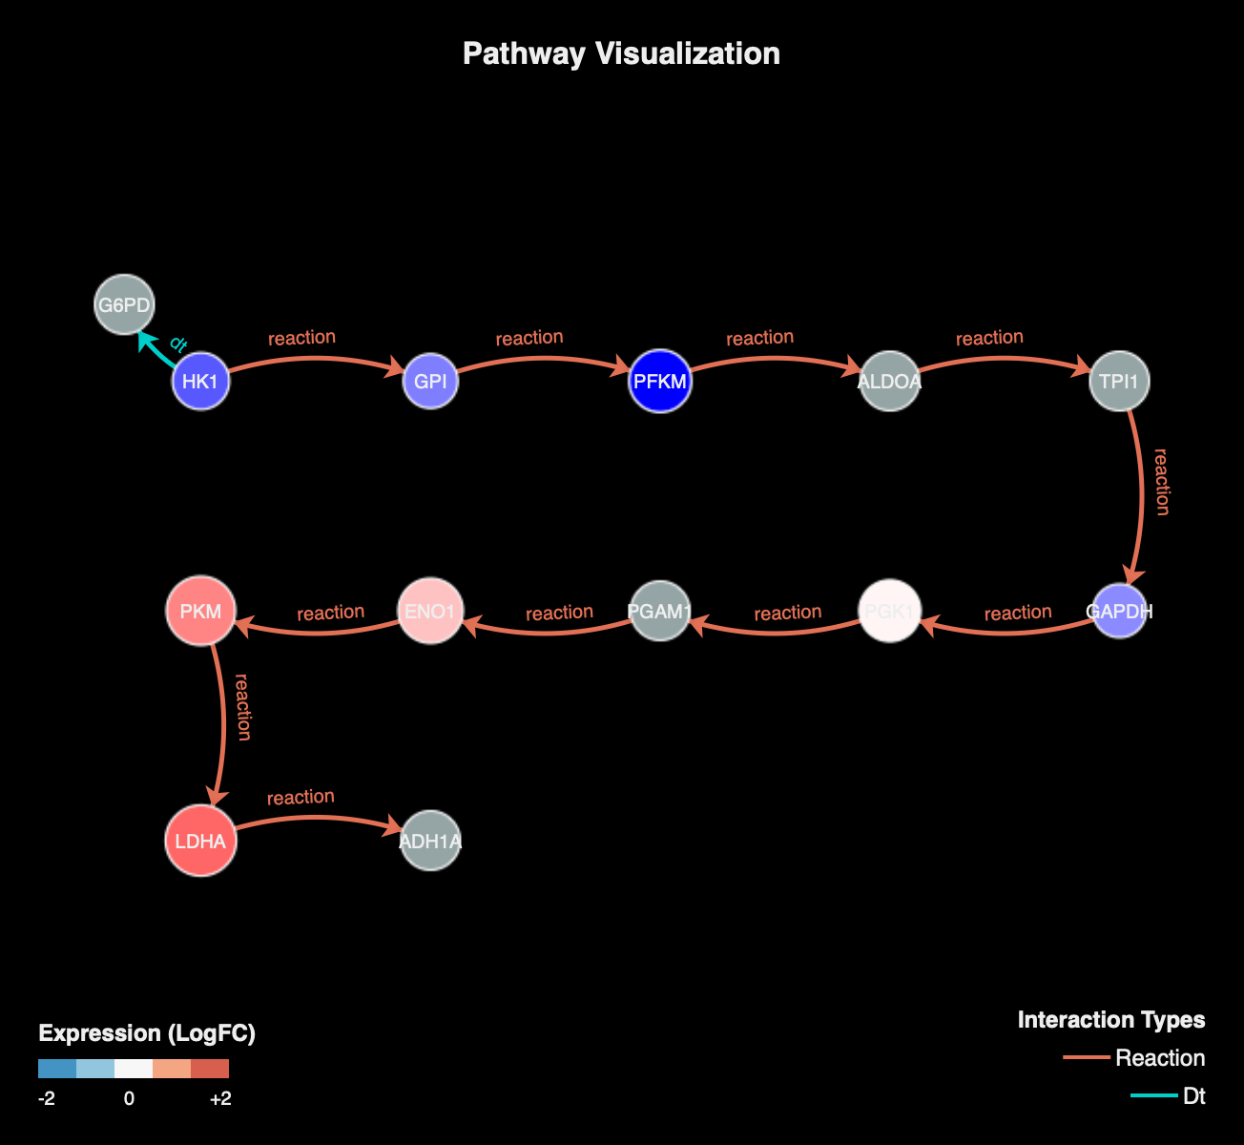
Pathway Map

Slide 4
Summary Statistics
Metric | Count | Percentage
Total Nodes | 13 | 100%
Upregulated | 4 | 30.8%
Downregulated | 4 | 30.8%

Slide 5
Key Findings
4 genes are upregulated.
4 genes are downregulated.
5 items show no significant change or were not detected.
Pathway Coverage: 61.5% of total pathway nodes.

Slide 6
Expression Details
Gene | Expression | Status
LDHA | 3.06 | High
PKM | 2.69 | High

Slide 7
ENO1 | 2.00 | High
PFKM | -1.62 | Low
PGK1 | 1.41 | High
HK1 | -0.59 | Low

Slide 8
GPI | -0.17 | Low
GAPDH | -0.02 | Low

Slide 9
References & Acknowledgements
1. Kanehisa, M. and Goto, S.; KEGG: Kyoto Encyclopedia of Genes and Genomes. Nucleic Acids Res. 28, 27-30 (2000).
2. BioViz Local: An advanced, secure, and beautiful pathway visualization tool.
GitHub Repository:
https://github.com/bioviz/local

