Slide 1
BioViz Local
KEGG Pathway Analysis Report
Pathway ID: hsa00010
Generated: 2025/12/18 08:36:07
Generated by BioViz Local
BioViz Local • bioviz@bioviz.com

Slide 2
Methodology
Gene expression data was mapped to KEGG Pathway [hsa00010]. Color coding represents Log2 Fold Change (Red=Up, Blue=Down). Data processing and visualization were performed by BioViz Local v0.1.
BioViz Local • bioviz@bioviz.com

Slide 3
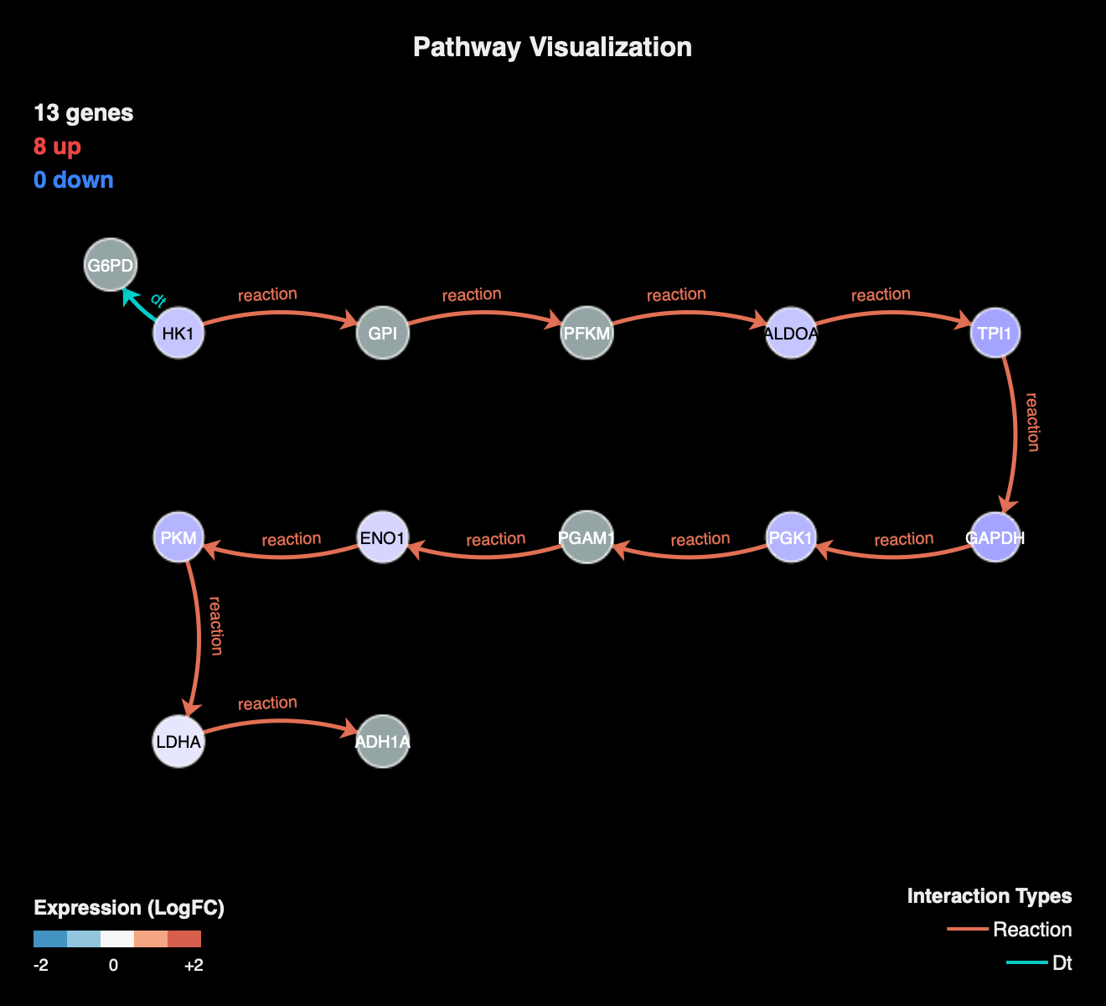
Pathway Map
BioViz Local • bioviz@bioviz.com

Slide 4
Summary Statistics
Metric | Count | Percentage
Total Nodes | 13 | 100%
Upregulated | 8 | 61.5%
Downregulated | 0 | 0.0%
BioViz Local • bioviz@bioviz.com

Slide 5
Key Findings
8 genes are upregulated.
0 genes are downregulated.
5 items show no significant change or were not detected.
Pathway Coverage: 61.5% of total pathway nodes.
BioViz Local • bioviz@bioviz.com

Slide 6
Expression Details
Gene | Expression | Status
LDHA | 0.80 | High
ENO1 | 0.70 | High
HK1 | 0.60 | High
ALDOA | 0.60 | High
PGK1 | 0.50 | High
PKM | 0.50 | High
TPI1 | 0.40 | High
GAPDH | 0.40 | High
BioViz Local • bioviz@bioviz.com

Slide 7
References & Acknowledgements
1. BioViz Local: An advanced, secure, and beautiful pathway visualization tool.
WeChat:
bioviz
BioViz Local • bioviz@bioviz.com

