Slide 1
SEQUENCE ALIGNMENT
By Julius Higiro

Slide 2
SEQUENCE ALIGNMENT
Domain: Biological Sciences.
What is it? Technique that is used to compare nucleotide sequences in DNA, RNA or amino acid sequences in proteins.
Purpose: Identification of patterns and similarities in aligned sequences in order to discover ancestral and evolutionary relationships, and to understand the structure and function of different molecules.

Slide 3
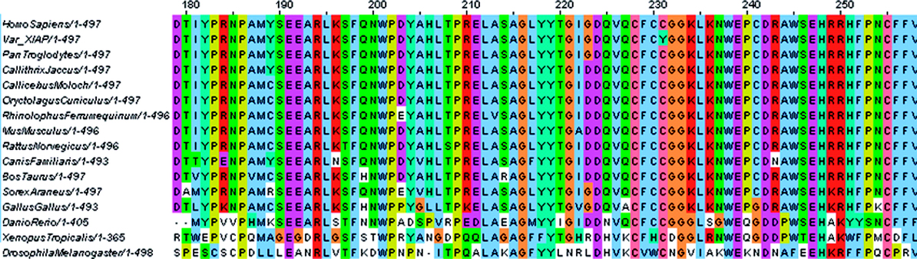
SEQUENCE ALIGNMENT (XIAP Protein)

Slide 4
SEQUENCE ALIGNMENT
Needleman-Wunsch algorithm: a dynamic programming algorithm that is used to generate the optimal sequence alignment for analysis when comparing two sequences of DNA or protein molecules.
The algorithm was designed by Christian Wunsch and Saul Needleman in 1970 in order to find the optimum alignment of two amino acid sequences and it is a very popular algorithm that is utilized in bioinformatics.

Slide 5
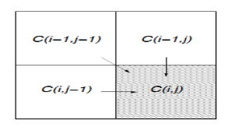

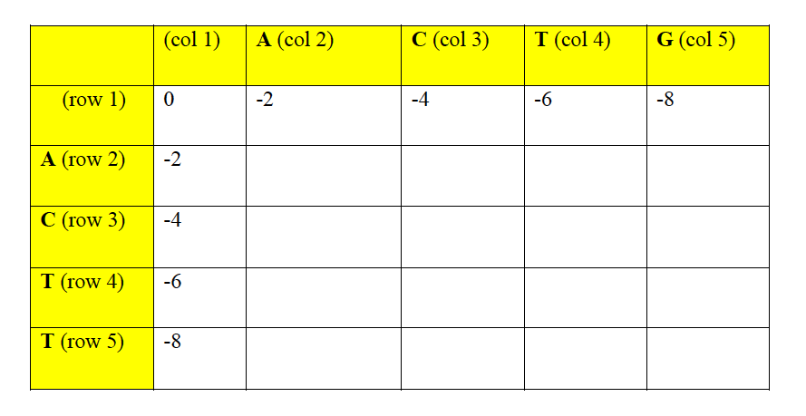
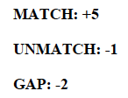
SEQUENCE ALIGNMENT
+ match / unmatch
+ gap score
+ gap score
Max Score
SCORE:

Slide 6
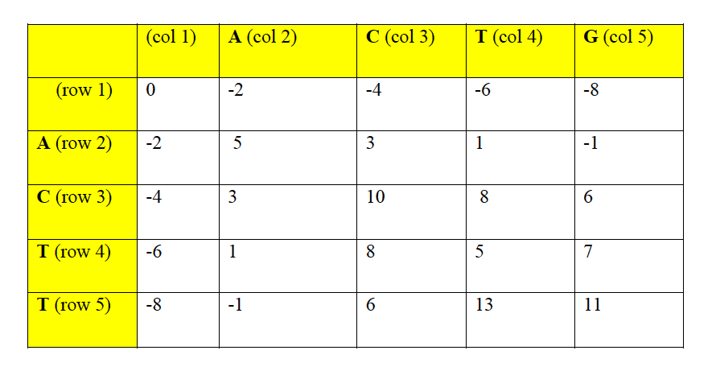
SEQUENCE ALIGNMENT
+ match / unmatch
+ gap score
+ gap score
Max Score

Slide 7

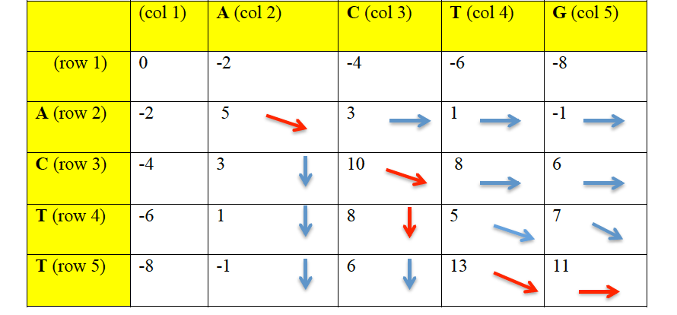
SEQUENCE ALIGNMENT

Slide 8
WHY ASP?
Needleman-Wunsch algorithm solves a combinatorial problem with goal of optimization and ASP is suitable for solving combinatorial search problems.
Multiple optimal alignment sequences can be generated when using the algorithm.

Slide 9
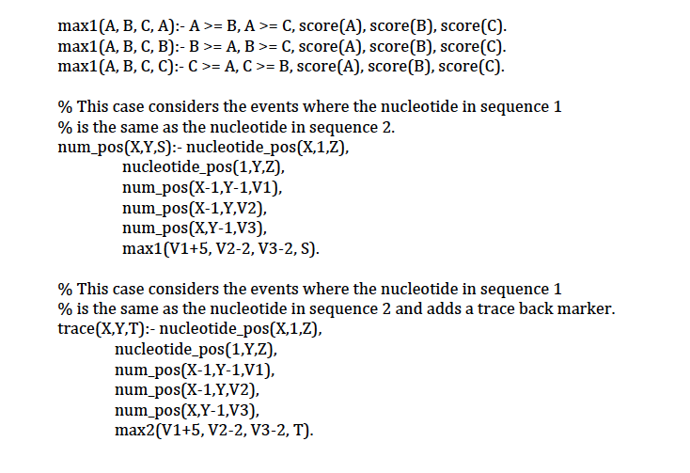
ASP ENCODING

Slide 10
CHALLENGES
Selecting a project.
Backtracking to identify the optimal alignment.

Slide 11
DEMO

