Slide 1
LAB 1번_류제범

Slide 2
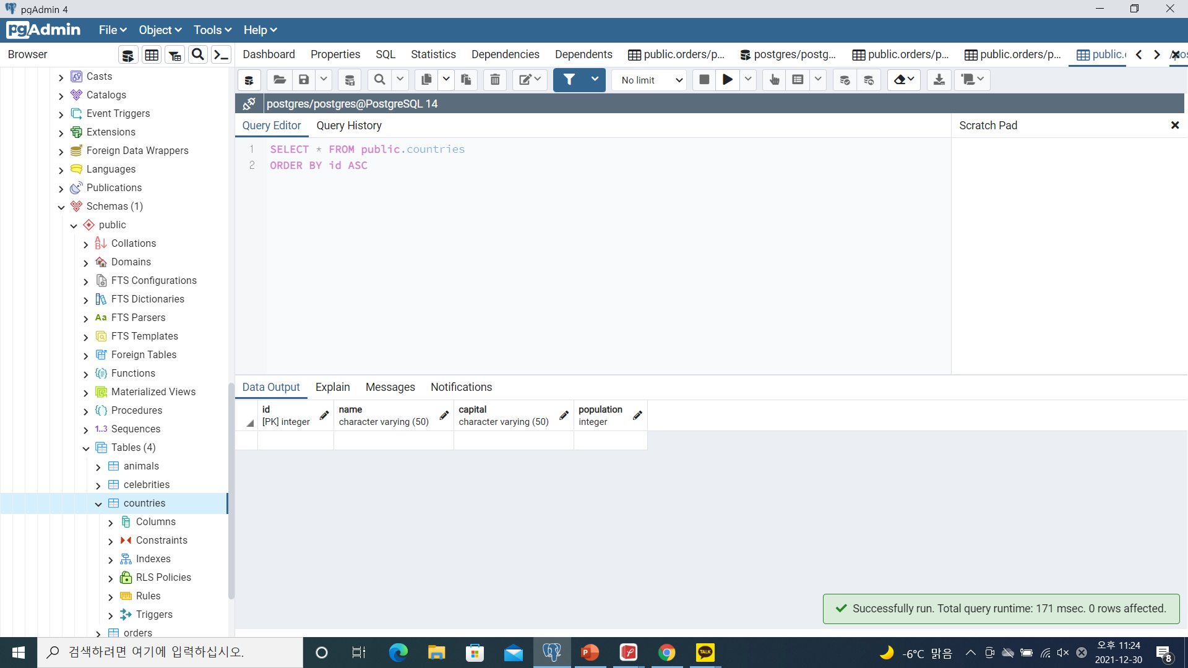
1번
CREATE TABLE IF NOT EXISTS countries
(
id serial PRIMARY KEY,
name VARCHAR (50) UNIQUE NOT NULL,
capital VARCHAR (50) NOT NULL,
population Integer
);

Slide 3
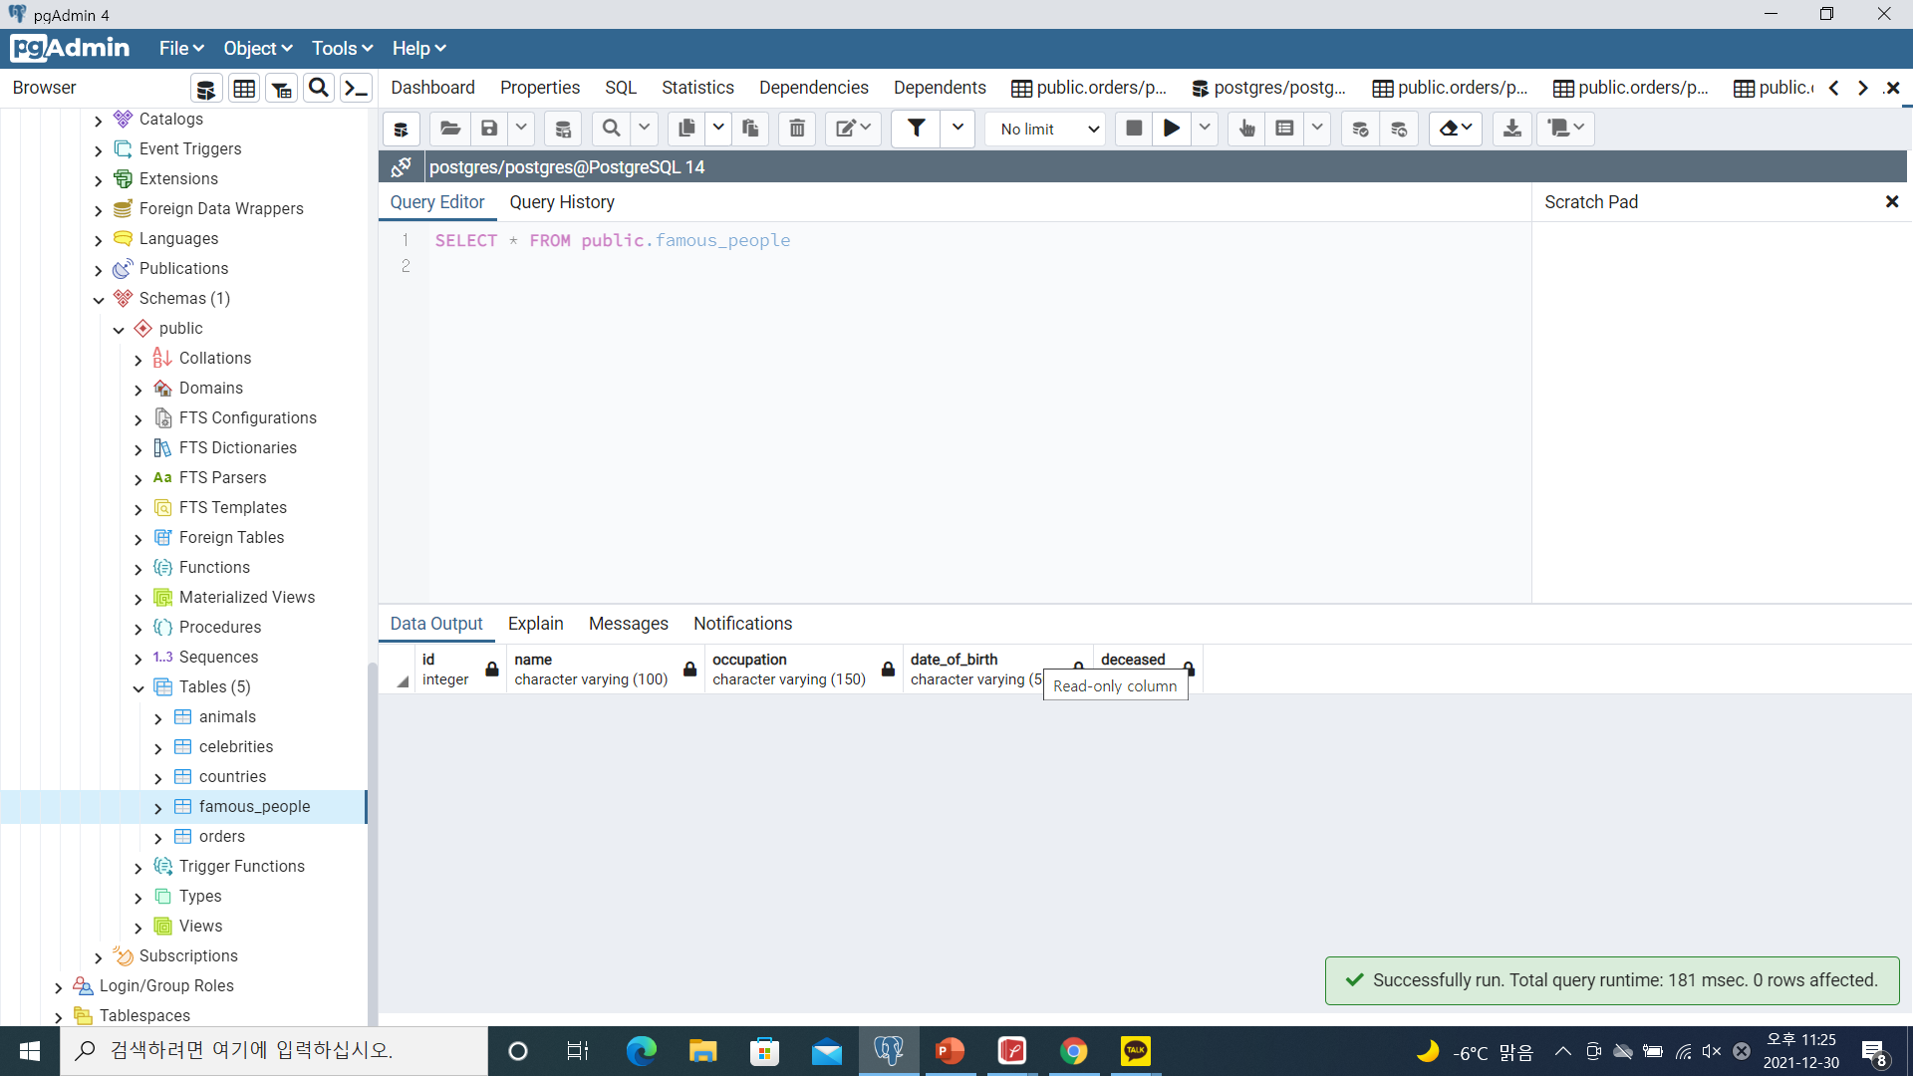
2번
CREATE TABLE IF NOT EXISTS famous_people
(
id serial,
name varchar(100) NOT NULL,
occupation varchar(150),
date_of_birth varchar(50),
deceased boolean default false
);

Slide 4
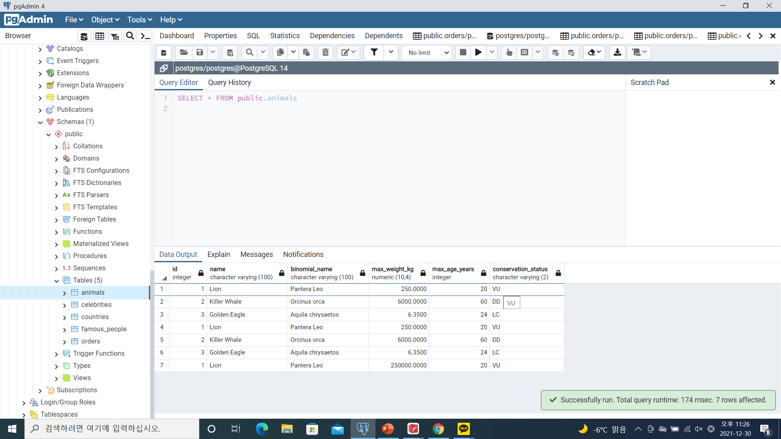
3번
CREATE TABLE IF NOT EXISTS animals
(
id serial,
name varchar(100) NOT NULL,
Binomial_Name varchar(100) NOT NULL,
Max_Weight_kg decimal(8,2),
Max_Age_years integer,
Conservation_Status varchar(2)
);
INSERT INTO animals VALUES (1, 'Lion', 'Pantera Leo', 250, 20, 'VU' );
INSERT INTO animals VALUES (2, 'Killer Whale', 'Orcinus orca', 6000, 60, 'DD' );
INSERT INTO animals VALUES (3, 'Golden Eagle', 'Aquila chrysaetos', 6.35, 24, 'LC' );

Slide 5
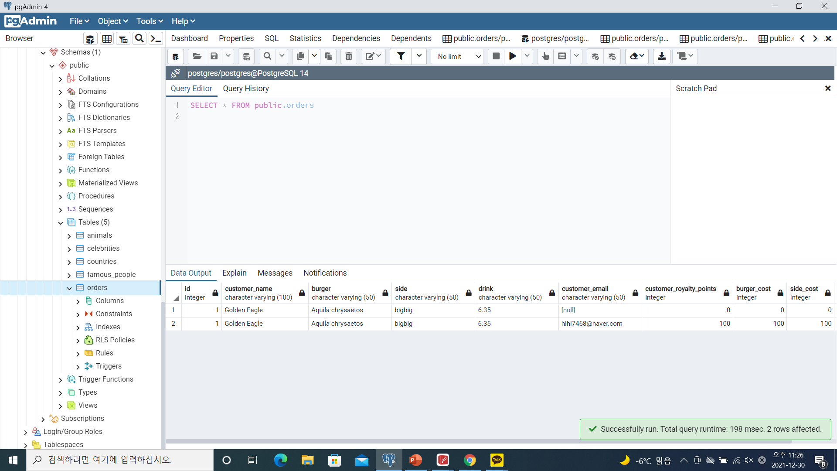
4번
CREATE TABLE IF NOT EXISTS orders
(
id serial,
customer_name varchar(100) NOT NULL,
burger varchar(50),
side varchar(50),
drink varchar(50),
order_total numeric(4,2) not null check(order_total <100)
);

Slide 6
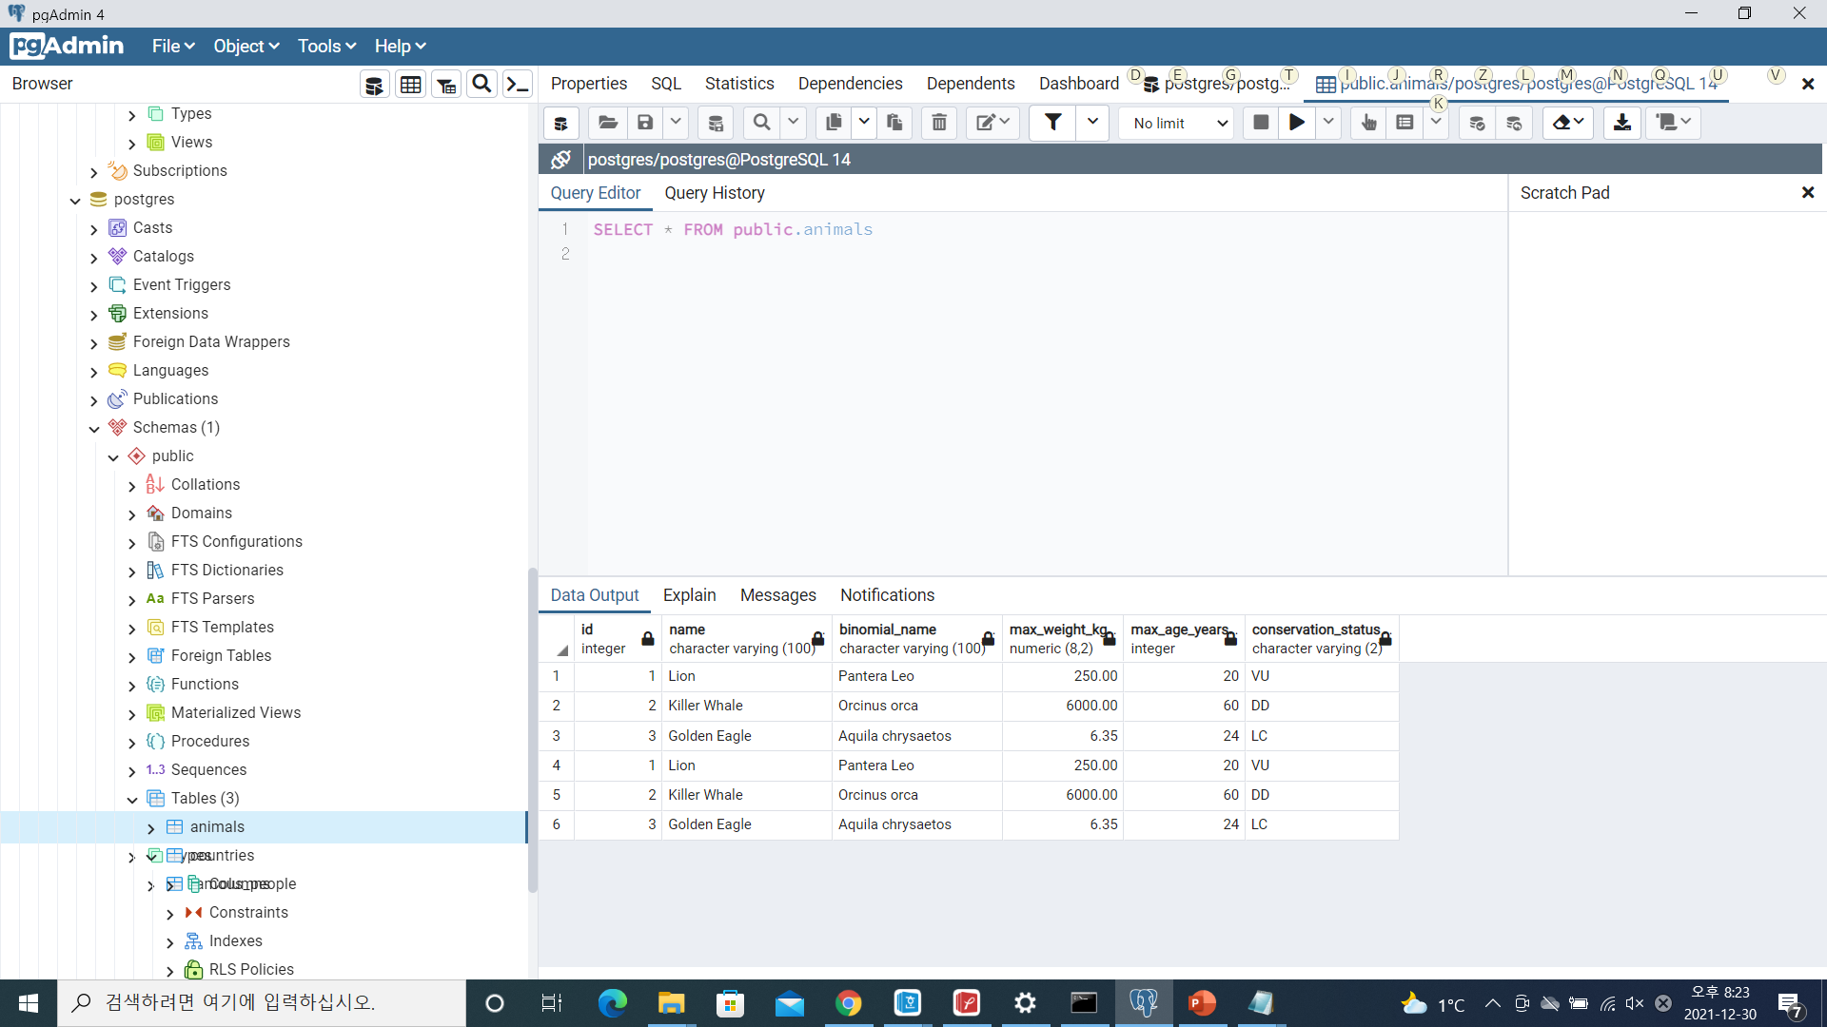
5번
ALTER TABLE famous_people RENAME TO celebrities;

Slide 7
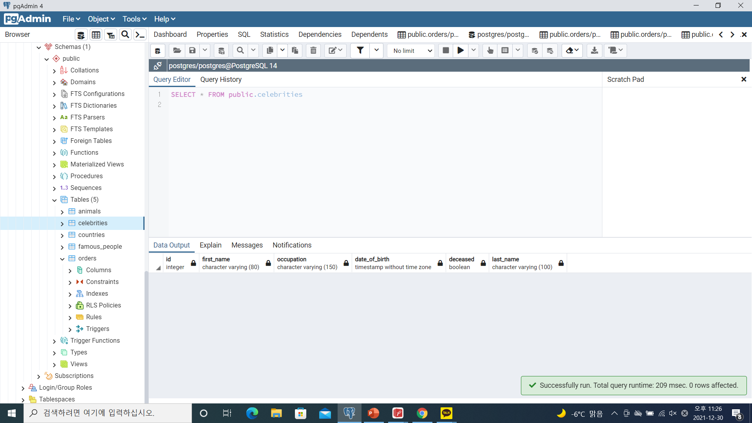
6번
ALTER TABLE celebrities RENAME COLUMN name TO first_name;
ALTER TABLE celebrities ALTER COLUMN first_name TYPE varchar(80);

Slide 8
7번
ALTER TABLE celebrities ADD COLUMN last_name varchar(100) NOT NULL;

Slide 9
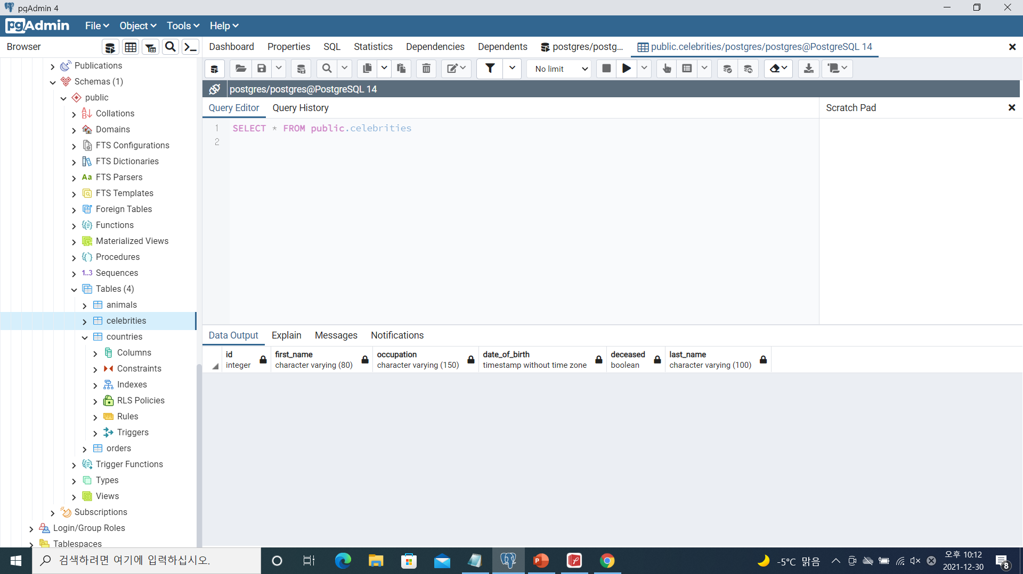
8번
ALTER TABLE celebrities ALTER COLUMN date_of_birth TYPE TIMESTAMP without time zone USING date_of_birth::TIMESTAMP without time zone;

Slide 10
9번
ALTER TABLE animals ALTER COLUMN max_weight_kg TYPE decimal using
Max_Weight_kg::decimal(10,4);

Slide 11
10번
ALTER TABLE animals ADD CONSTRAINT new_binomial_name UNIQUE(binomial_name);

Slide 12
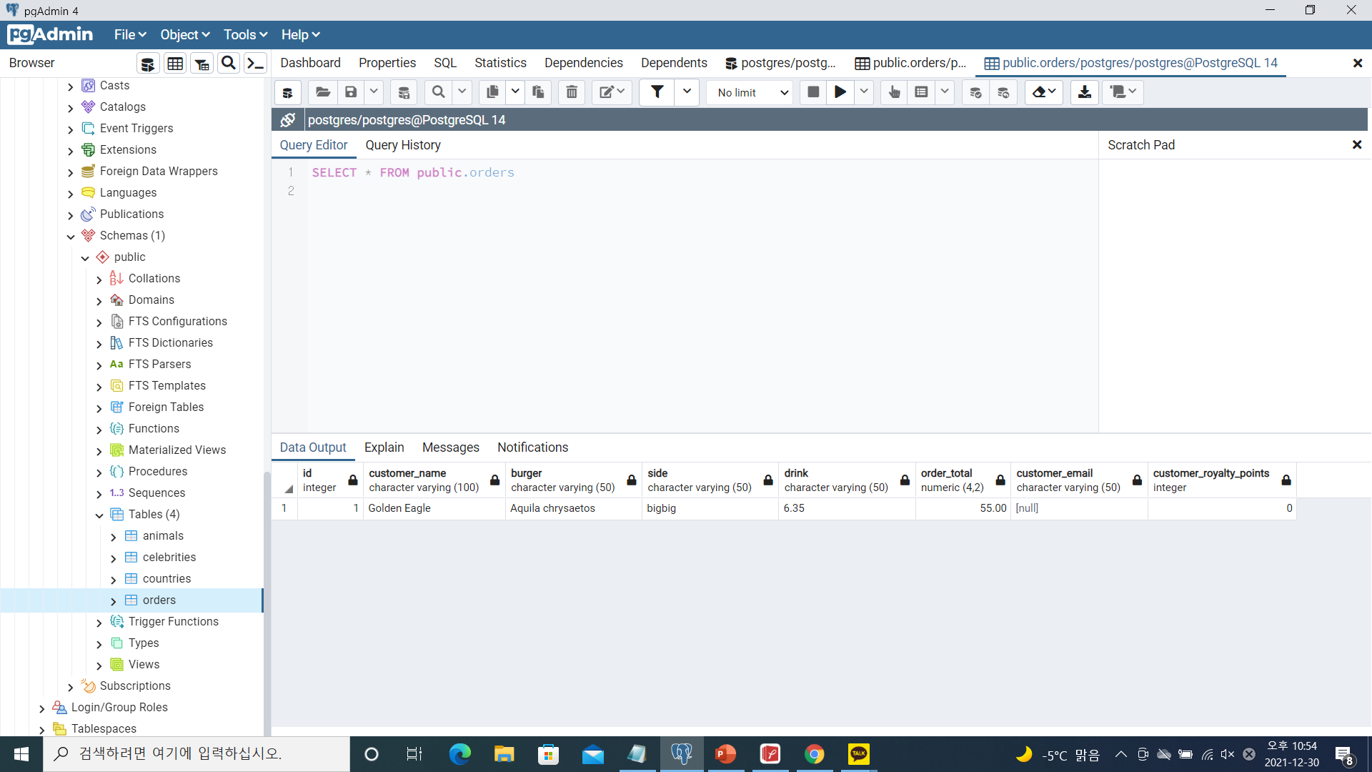
11번
ALTER TABLE orders ADD COLUMN customer_email varchar(50);
ALTER TABLE orders ADD COLUMN customer_royalty_points integer default 0;

Slide 13
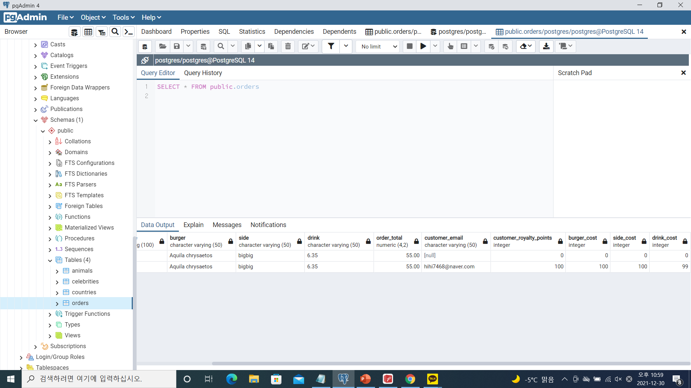
12번
ALTER TABLE orders ADD COLUMN burger_cost integer default 0;
ALTER TABLE orders ADD COLUMN side_cost integer default 0;
ALTER TABLE orders ADD COLUMN drink_cost integer default 0 check(drink_cost<100);

Slide 14

13번
ALTER TABLE orders DROP COLUMN order_total;

