Slide 1


DevOps

Slide 2
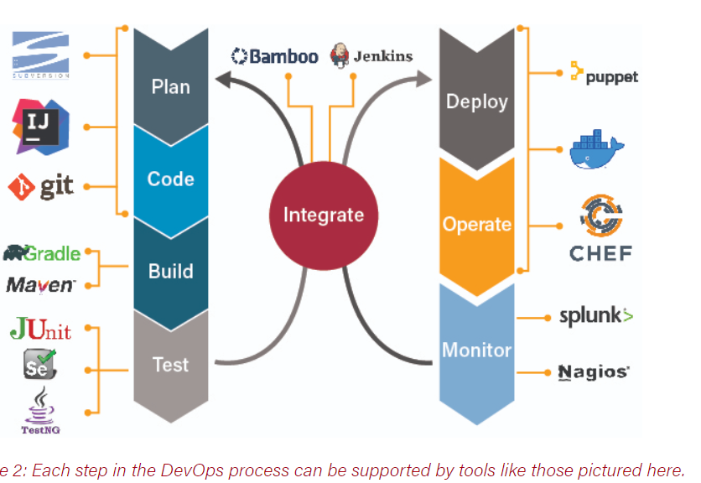

Slide 3
TOPICS
Introduction to source code management tools
What is Git
Installation of Git
Common commands in Git
Working with Remote Repositories
Branching and merging in Git

Slide 4


Slide 5
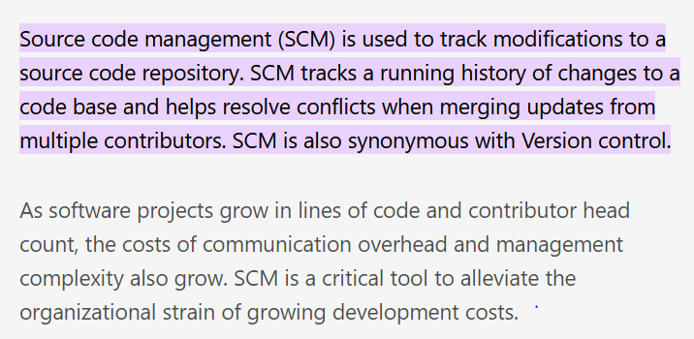

Slide 6
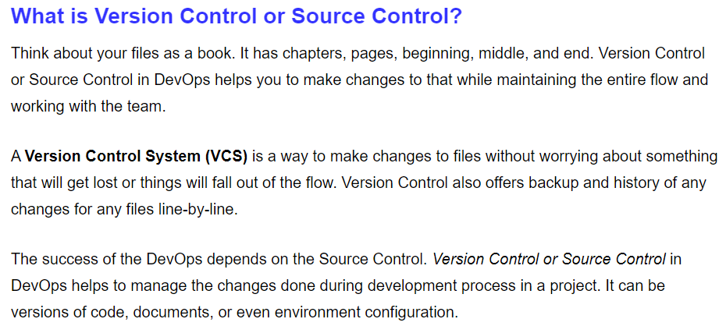

Slide 7
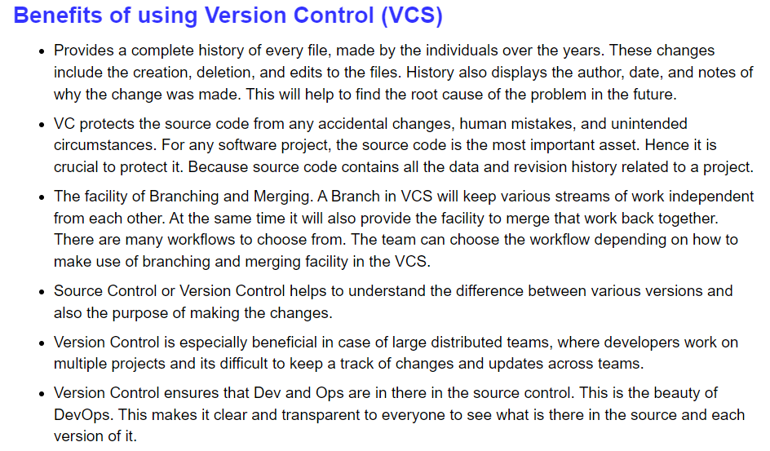

Slide 8
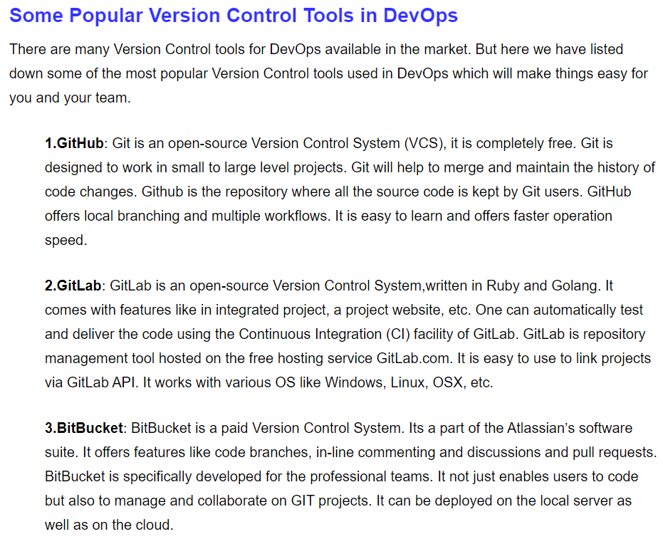

Slide 9
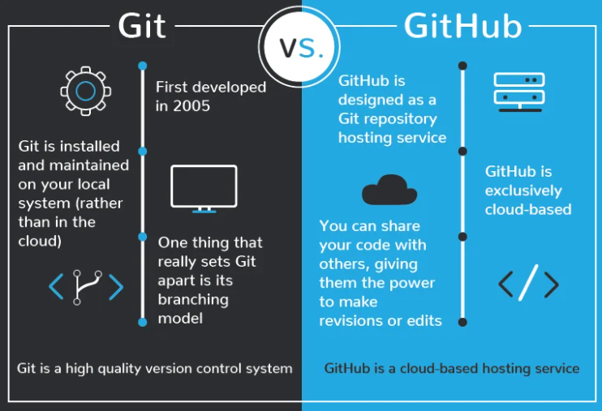

Slide 10
GIT DOWNLOAD

Slide 11
THANK YOU

