Slide 1

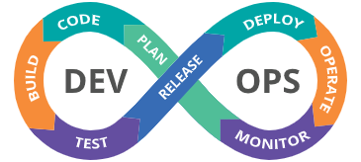
DevOps

Slide 2
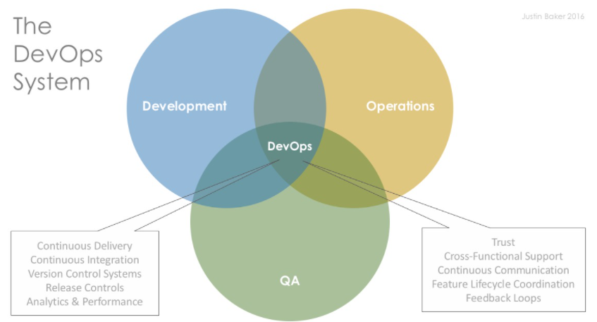

Slide 3
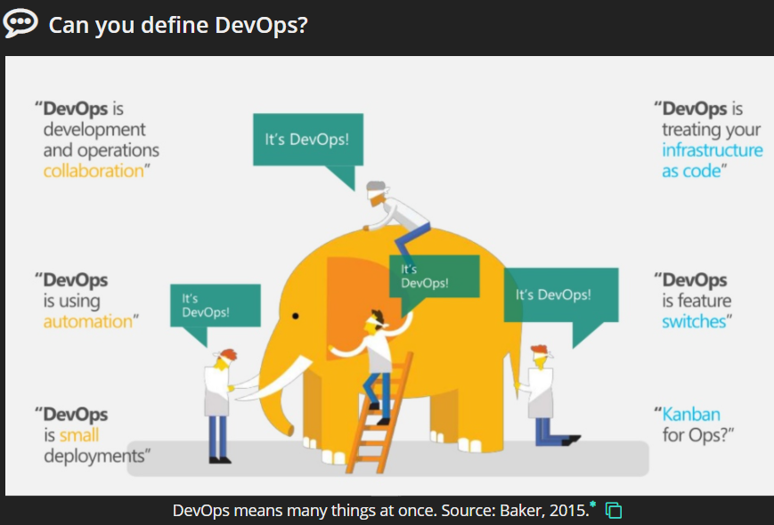

Slide 4
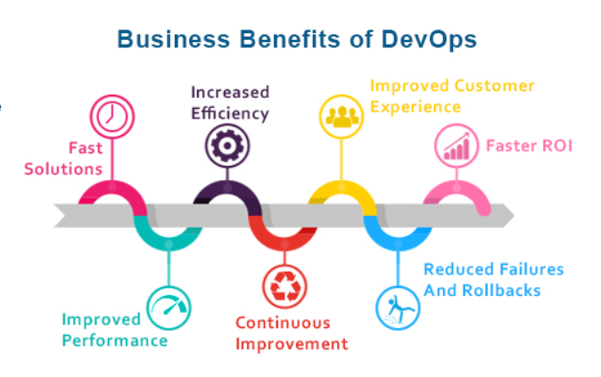

Slide 5
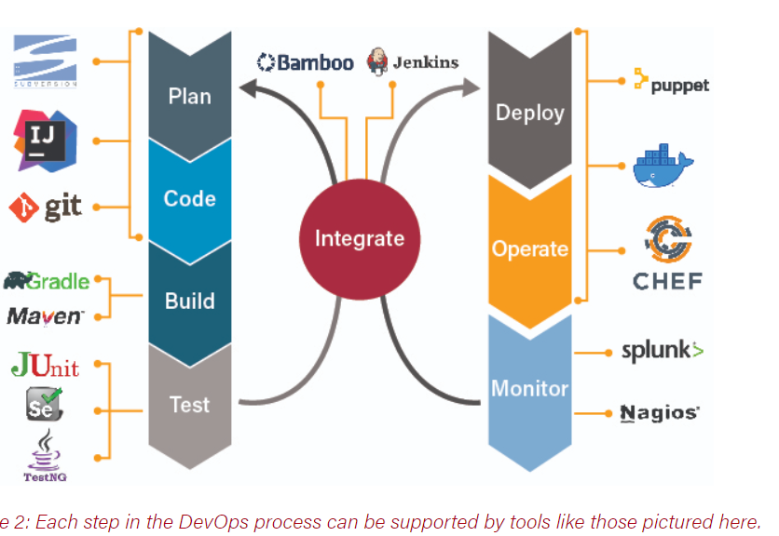

Slide 6
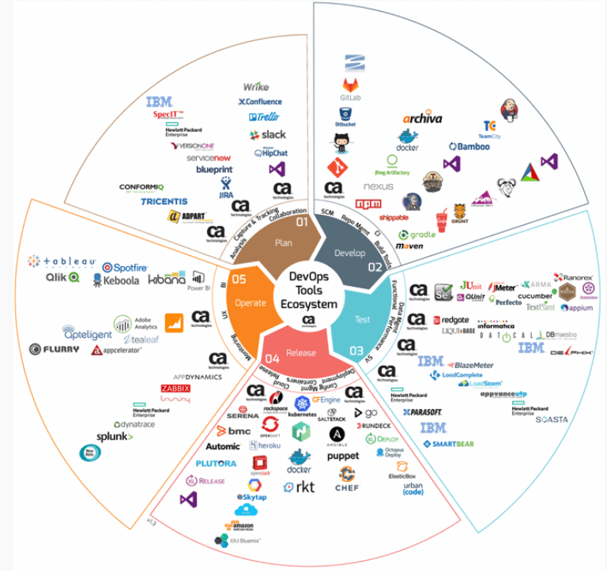

Slide 7
We will cover …
What is DevOps and it’s stages
Agile
Basic AWS Cloud with DevOps
Everything about Linux
GIT and GitHub
Chef with DevOps
Virtualization
Docker
Ansible
CI/CD Pipeline
Jenkins
Maven
Kubernetes
Terraform

Slide 8
THANK YOU

