Slide 1
VIBECODING LAB · ADVANCED TRACK
Build an AI coding
agent workflow
Inspect → plan → implement → debug → review → defend
Taskroom starter project
Notes:
Timing: 2 minutes
Open by setting the expectation: this is not a prompting contest. The output is working software plus evidence that the team understood and challenged what the AI produced.
[Sources]
- Internal workshop brief and local Taskroom codebase; no external sources.

Slide 2
TODAY’S STANDARD
Fast code is not the goal.
Controlled, explainable, tested code is.
You will be rewarded for finding subtle failure—not for shipping the flashiest feature.
02
Notes:
Timing: 2 minutes
Ask for a show of hands: who has accepted AI-generated code because the demo worked once? Use that tension to frame the lab around control and evidence.
[Sources]
- Internal workshop brief and local Taskroom codebase; no external sources.

Slide 3
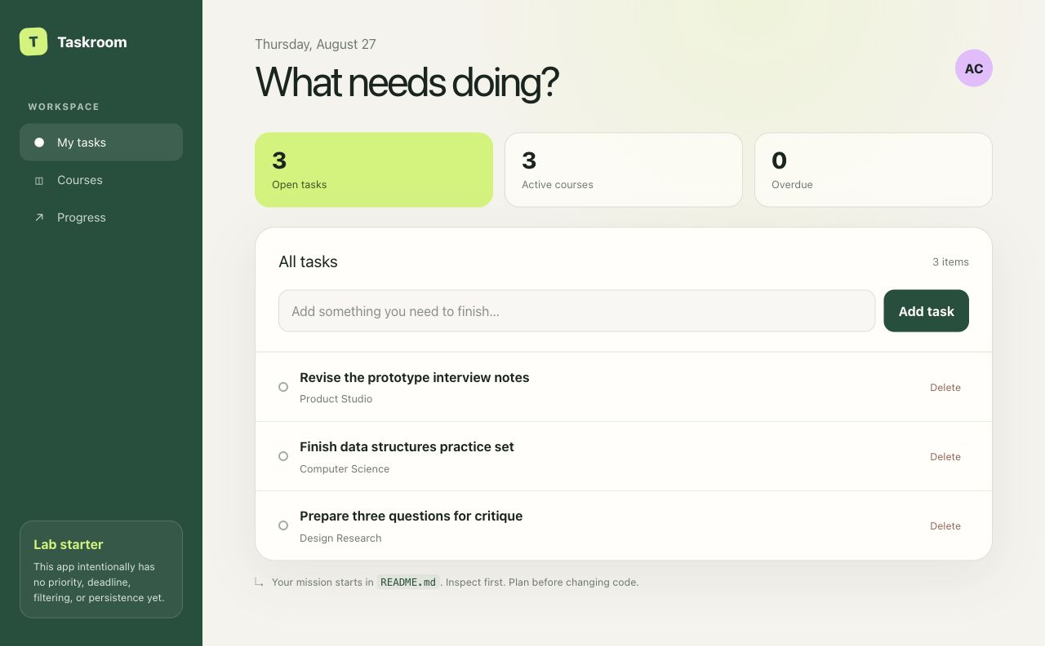
THE CODEBASE
Your starting point is intentionally incomplete
Already works
Create a task
Delete a task
Validate task titles
Missing on purpose
Priority · deadlines · filters
persistence · overdue states
03
Notes:
Timing: 3 minutes
Point participants to README.md, not to individual source files. Their first job is discovering the architecture. Confirm the baseline checks pass before teams begin.
[Sources]
- Internal workshop brief and local Taskroom codebase; no external sources.

Slide 4
TODAY’S RUN
The work moves through seven engineering gates
10 min
10 min
25 min
15 min
15 min
10 min
15 min
Inspect
Plan
Build
Debug
AI review
Human
Demo
Architecture map
Tests + assumptions
Level 1 feature
Injected failure
Fresh context
Find the miss
Defend choices
Plan before code. Review after tests. Human approval stays last.
04
Notes:
Timing: 2 minutes
Keep the clock visible. At minute 45, stop feature work and begin debugging even if some teams are incomplete. The constraint is part of the exercise.
[Sources]
- Internal workshop brief and local Taskroom codebase; no external sources.

Slide 5
GATE 1 · RECONNAISSANCE
Inspect the system before proposing changes
Ask your agent to explain
Your artifact
Runtime architecture
An architecture explanation with exact file references, risky areas, and explicit uncertainty.
State and data flow
Existing domain rules
Test strategy
No edits yet.
Smallest likely change surface
05
Notes:
Timing: 10 minutes
Do not accept a tour that only lists filenames. Ask teams to explain which component owns state and where domain validation lives. Require cited files.
[Sources]
- Internal workshop brief and local Taskroom codebase; no external sources.

Slide 6
GATE 2 · PLANNING
A useful plan names decisions—not just steps
01
02
03
Data
Behavior
Evidence
Priority type
Deadline representation
Defaults for old tasks
Filter semantics
Overdue definition
Empty and error states
Unit tests
Failure modes
Regression coverage
The plan must include what happens when storage is missing, corrupt, or slow.
06
Notes:
Timing: 10 minutes
Before allowing edits, check that each team has made a default-priority decision and identified a persistence failure mode. A list of files without tradeoffs is not a plan.
[Sources]
- Internal workshop brief and local Taskroom codebase; no external sources.

Slide 7
BUILD · FEATURE
Level 1: make task urgency visible and usable
Required behavior
The trap
Low / medium / high priority
A feature can look right and still be wrong at the boundaries.
Optional deadline
Filter by priority
Clear overdue state
Probe empty values, long titles, deadline equality, timezone assumptions, and deleting while filtered.
Tests for new domain behavior
07
Notes:
Timing: Part of 25-minute build
Encourage a thin vertical slice before styling. If teams disagree about overdue semantics, require them to document the chosen definition and test it.
[Sources]
- Internal workshop brief and local Taskroom codebase; no external sources.

Slide 8
BUILD · ARCHITECTURE
Level 2: persistence is a failure-mode exercise
Choose one
Refresh is
not enough.
Local storage
Fastest route. Handle parse errors and stale schema.
Local API
Define async loading, writes, and server failure.
Explain data ownership, migration, and degraded behavior.
Hosted database
Handle credentials, latency, and unavailable network.
08
Notes:
Timing: Part of 25-minute build
Level 2 is stretch work if time is short. Local storage is acceptable, but teams must still define corruption and migration behavior. Avoid letting hosted setup consume the whole lab.
[Sources]
- Internal workshop brief and local Taskroom codebase; no external sources.

Slide 9
BUILD · AGENTIC WORKFLOW
Level 3: separate roles so review has teeth
Human
Planner
Implement
Test / lint
Reviewer
Fix + approve
Fresh context
Give the reviewer requirements + diff + check output—not the implementer’s reasoning.
09
Notes:
Timing: 2 minutes
Teams may use any AI coding tool. The process requirement is role separation. A second tab with copied reasoning is weaker than a reviewer receiving only evidence.
[Sources]
- Internal workshop brief and local Taskroom codebase; no external sources.

Slide 10
THE NON-NEGOTIABLE RULE
Do not accept code you cannot defend.
01
Why is this file changing?
02
What does this function do?
03
What assumptions did the agent make?
04
How could this break?
05
Is there unnecessary complexity?
06
How would you test it?
10
Notes:
Timing: Use throughout
Keep this slide visible during implementation. Randomly ask a teammate—not only the person driving—to answer one question about a major change.
[Sources]
- Internal workshop brief and local Taskroom codebase; no external sources.

Slide 11
GATE 4 · DEBUGGING
Deleting one task can remove another
Reported sequence
Delete a starter task → add a new task → later delete the new task
1
Reproduce
2
Collect evidence
3
Explain root cause
4
Add regression test
Do not trust the wording.
Inspect identity and state.
Name the broken invariant.
Then fix the code.
11
Notes:
Timing: 15 minutes
Apply facilitator/duplicate-id-bug.patch before showing this slide. The injected generator uses tasks.length + 1. After deletion, IDs can be reused; duplicate IDs cause React key confusion and ID-based deletion removes both matching records. Reveal hints only as needed: inspect state after each operation; compare identity with list size; try delete → create → delete. Require a regression test before the fix.
[Sources]
- Internal workshop brief and local Taskroom codebase; no external sources.

Slide 12
GATE 5 · AI REVIEW
The second AI reviews evidence, not intent
Give the reviewer
Ask it to hunt
Requirements
Correctness gaps
Final diff
Date / timezone errors
Test + lint output
Accessibility regressions
Data loss and stale state
Known assumptions
Weak tests or needless abstraction
Every finding gets fixed—or rejected with a reason.
12
Notes:
Timing: 15 minutes
Require a fresh AI context. Teams should write dispositions in LAB_NOTES.md. A confident review with no cited lines is not enough.
[Sources]
- Internal workshop brief and local Taskroom codebase; no external sources.

Slide 13
GATES 6–7 · HUMAN REVIEW + DEMO
Close the AI tabs. Now find what both missed.
Demo in 3 moves
Human-only review
1
Show the feature
Read the diff. Exercise edge cases. Challenge defaults. Look for needless abstractions and behavior no test proves.
2
Recreate the failure
Record one issue both AIs missed.
3
Defend the final design
Tests passing is the floor—not the presentation.
13
Notes:
Timing: 10 minutes review + 10–15 minutes demos
For the human review, ask teams to ignore both AI sessions for ten minutes. For demos, cut setup narration quickly: feature, failure, engineering judgment.
[Sources]
- Internal workshop brief and local Taskroom codebase; no external sources.

Slide 14
FINAL LIGHTNING ROUND
What was the most convincing mistake your AI made?
Win on subtlety, specificity, and how you detected it—not presentation polish.
60 sec
Advanced vibecoding = control, evaluate, orchestrate.
14
Notes:
Timing: 5–10 minutes
Give each team 60 seconds. Reward the most subtle, convincing failure and the strongest detection method. Close by reinforcing the permanent split: beginners build with AI; advanced participants control, evaluate, and orchestrate AI.
[Sources]
- Internal workshop brief and local Taskroom codebase; no external sources.

