Slide 1
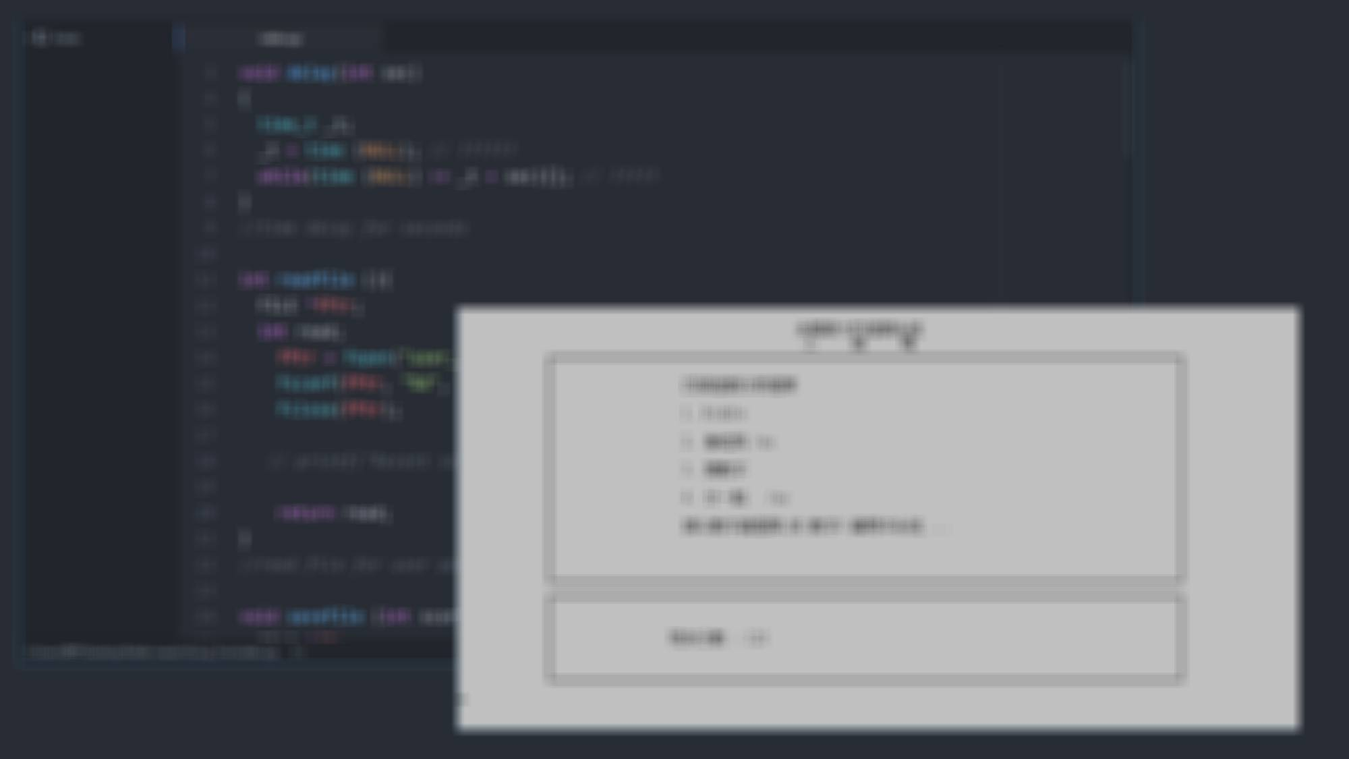
int Group5(){
int group = 5;
char *member[4] =
{張以勒 ,呂肇軒,
陳傲賢 ,韓定鈞};
}

Slide 2
Objective
This gaming system can let the users (mainly students)to relax under the busy life .
As we know that the school life gives us lots of pressure. Through this program, users can play what they want with their friends .

Slide 3
Special Functions
Readfile:
Read user profile(scores) from .txt
Savefile:
Save scores to .txt file

Slide 4
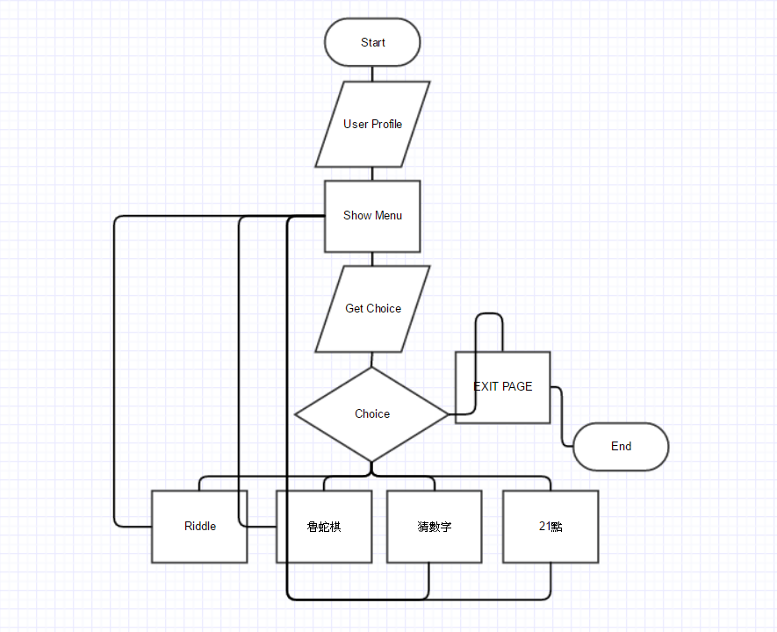
Flow Chart of the Gaming system

Slide 5
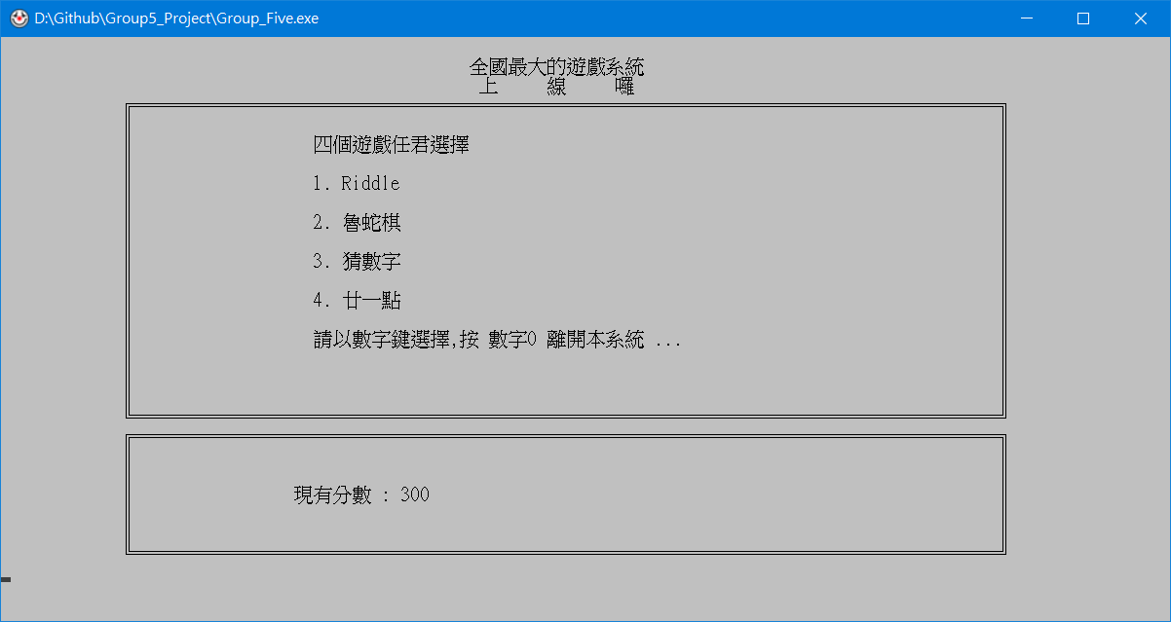
Screenshot of the menu

Slide 6
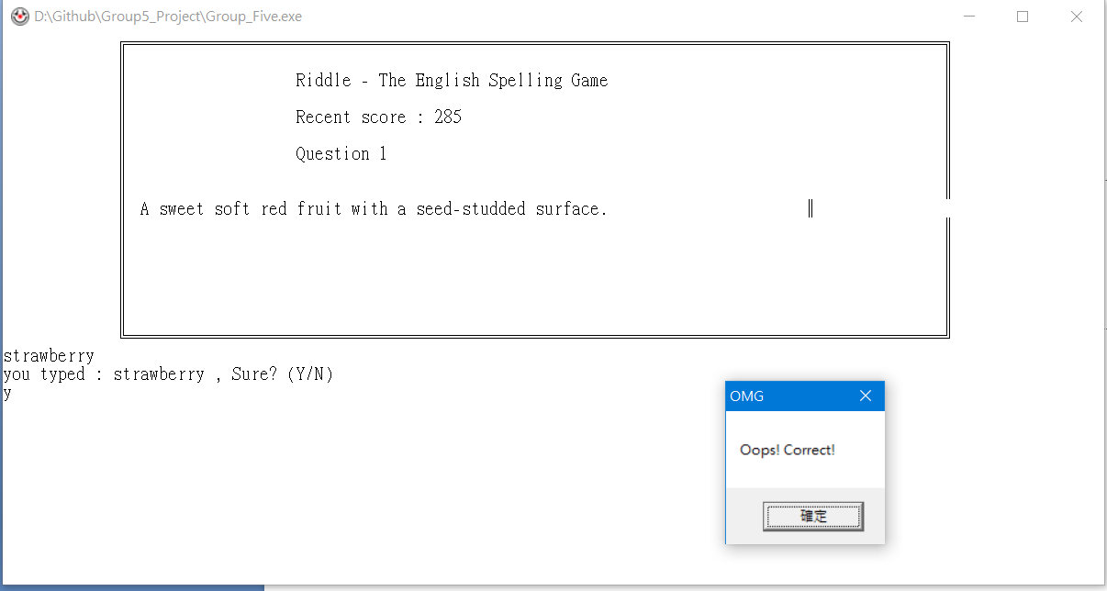
Game one –
Riddle, The English spelling game

Slide 7
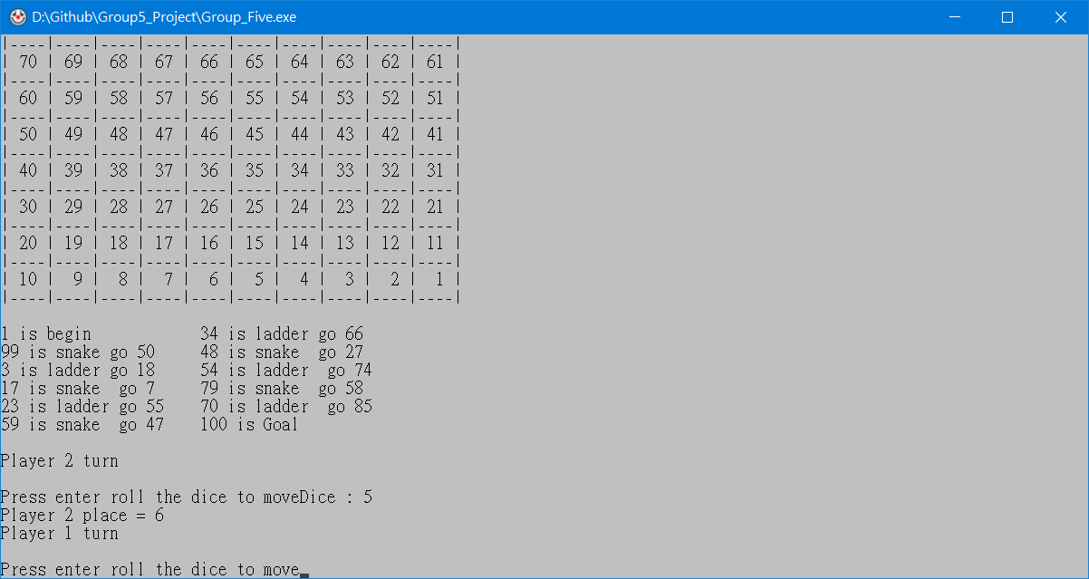
Game Two, “魯蛇棋”

Slide 8
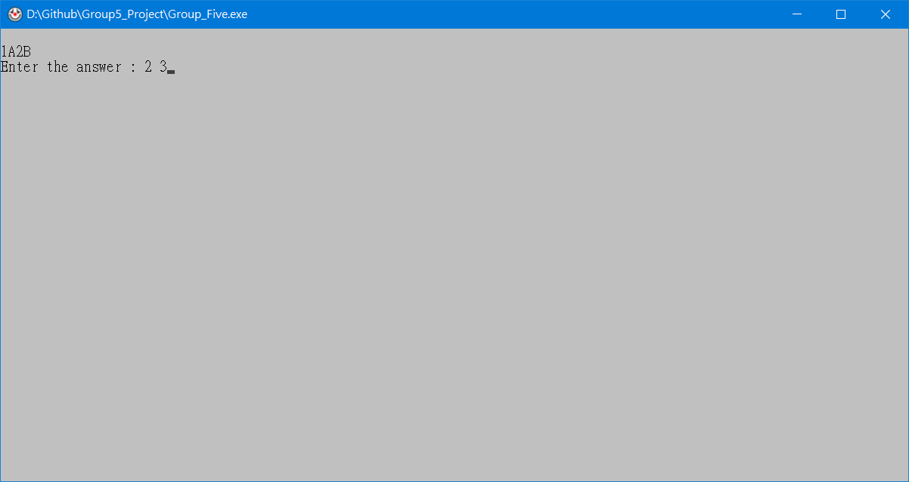
Game 3 – 猜數字

Slide 9
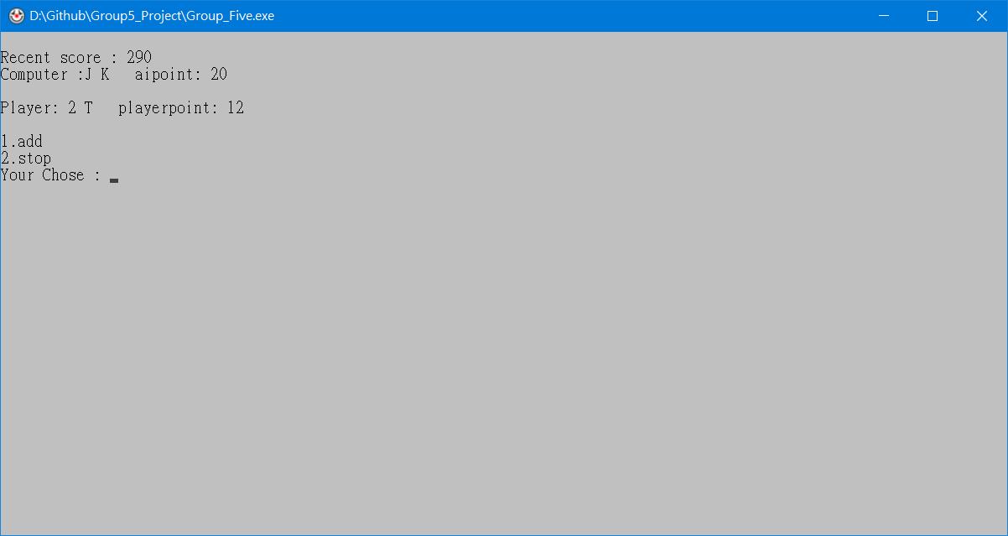
Game 4 – 21點(Black Jack)

Slide 10
完 !

