Slide 1
MILESTONES Ongoing
Milestone No. | Task
1 | Equipment & Raw Material Procurement
2 | Device Development
3 | User Interface
4 | Testing & Optimization
5 | Fabrication of Enclosure
6 | Design & Fabrication of PCB

Slide 2
Real-time Pressure Monitoring Device for Compliant Balloon Catheter
Sr. No. | Milestone | Status
1. | Design of Device | Completed
2. | Procurement of Raw Materials | In process
3. | Development of Design 1 | Pending
4. | Testing of Design 1 | Pending
5. | Development of Design 2 | Pending
6. | Testing of Design 2
7. | Comparative Analysis of both Designs | Pending
8. | Project Documentation | Pending

Slide 3
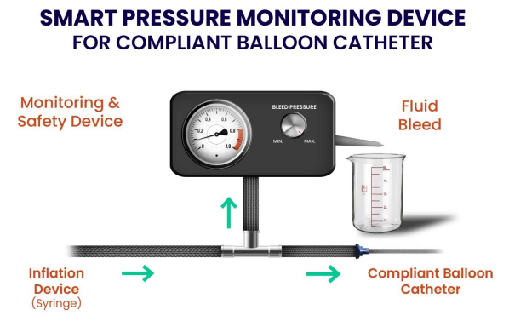
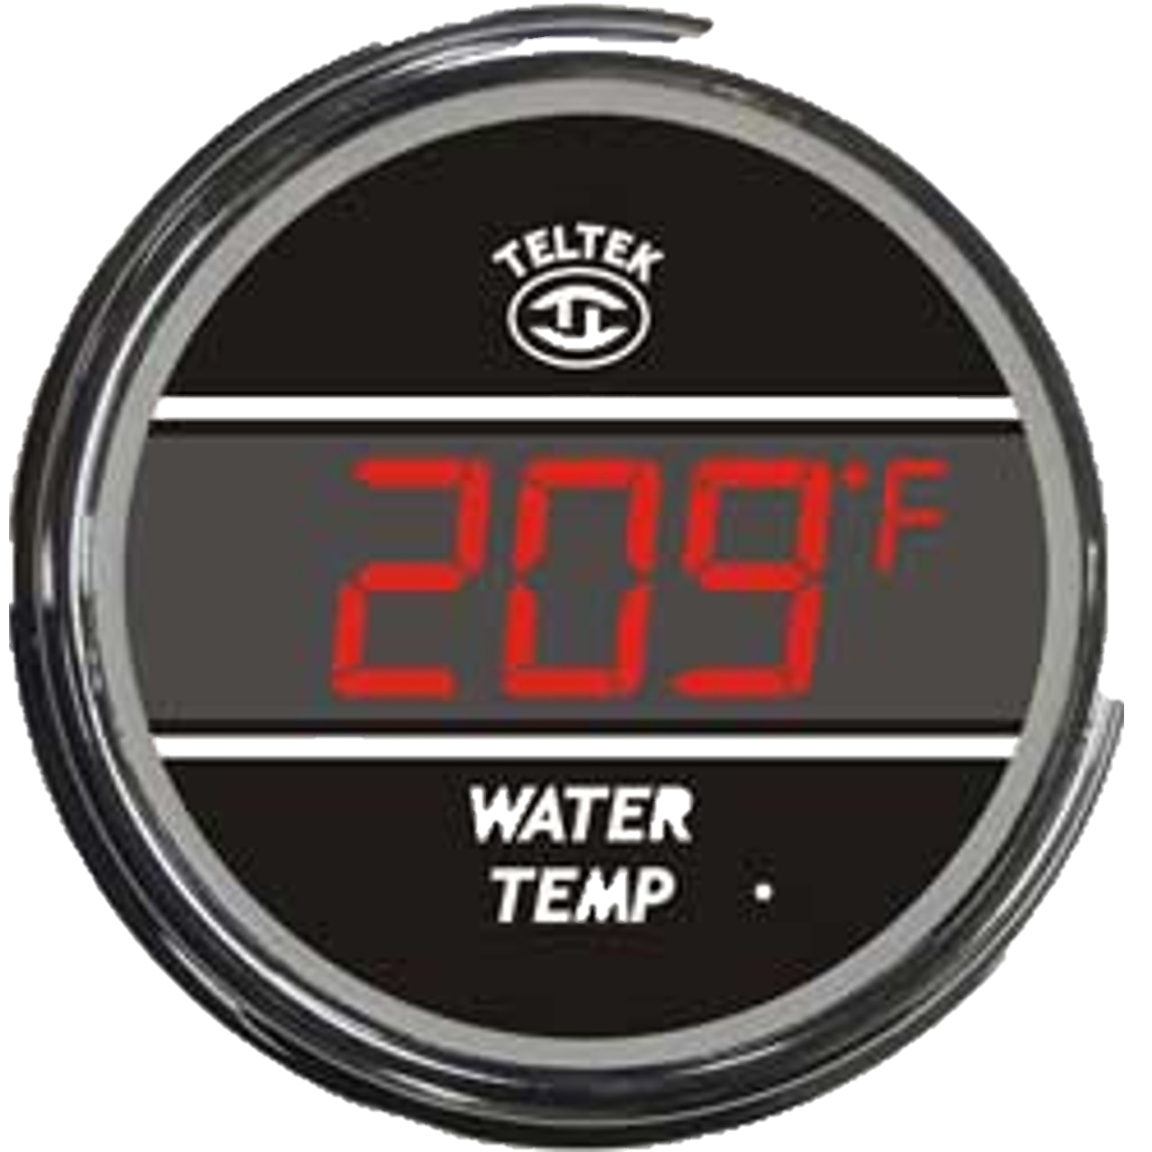
DEVICE DESIGN 1
Reusable Device
Disposable Circuit used for IBP
Electrical wire/signals
Disposable Pressure Relief Valve

Slide 4
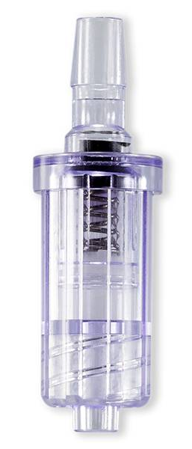
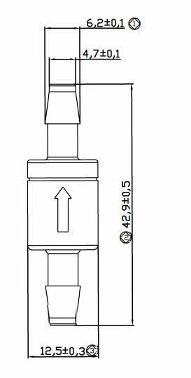
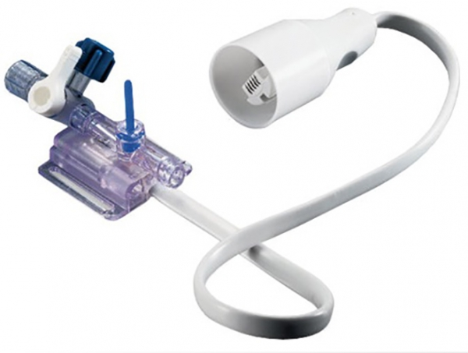
DEVICE DESIGN 1: CRITICAL COMPONENTS
Pressure Relief Valve 50-70kPa Pressure Relief Valve 70-120kPa
Disposable Blood Pressure Transducer

Slide 5
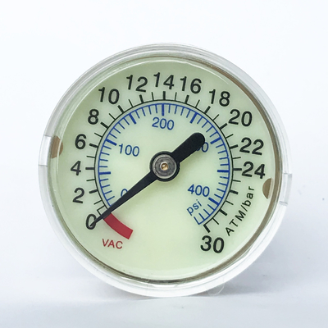
DEVICE DESIGN 2
Disposable Pressure Relief Valve

Slide 6
DEVICE DESIGN 2: CRITICAL COMPONENTS
Pressure Relief Valve 50-70kPa Pressure Relief Valve 70-120kPa
Disposable Pressure Gauge

